Slide 1
AMD AI DEVMASTER 2026 · TRACK 2
XiangLens
XL
Private, evidence-backed profile-image review
on AMD Radeon + ROCm
GOAL-RELATIVE · SOURCE-BACKED · USER-CONTROLLED
Notes:
[Sources]
- Internal product brief: docs/SUBMISSION_BRIEF.md
- Track 2 requirements: Radeon-Cloud-User Guide/2026 AMD AI DevMaster 黑客松赛事说明.md

Slide 2


A profile image is a tiny, high-stakes identity surface
The same image is repeatedly cropped, downsized, copied, and read across communities.
CANDIDATE B
visible QR risk
Can the subject survive a circular crop?
Does the file expose metadata, a badge, or a QR code?
Which candidate fits the user’s stated audience—and why?
CANDIDATE A
clean
XiangLens answers with local tools, a self-hosted VLM, cited context, and explicit user goals—not personality inference.
XIANGLENS · TRACK 2
02
Notes:
[Sources]
- Scenario and safety boundaries: docs/SUBMISSION_BRIEF.md
- Portrait fixture: https://commons.wikimedia.org/wiki/File:Wikimedia_Summit_2019_-_Portrait_Abbad_Diraneyya.jpg (Aida Kadrispahic for Wikimedia Deutschland e.V., CC BY-SA 4.0)
- Derived fixture labels and transforms: data/fixtures/labels.jsonl and data/fixtures/README.md

Slide 3
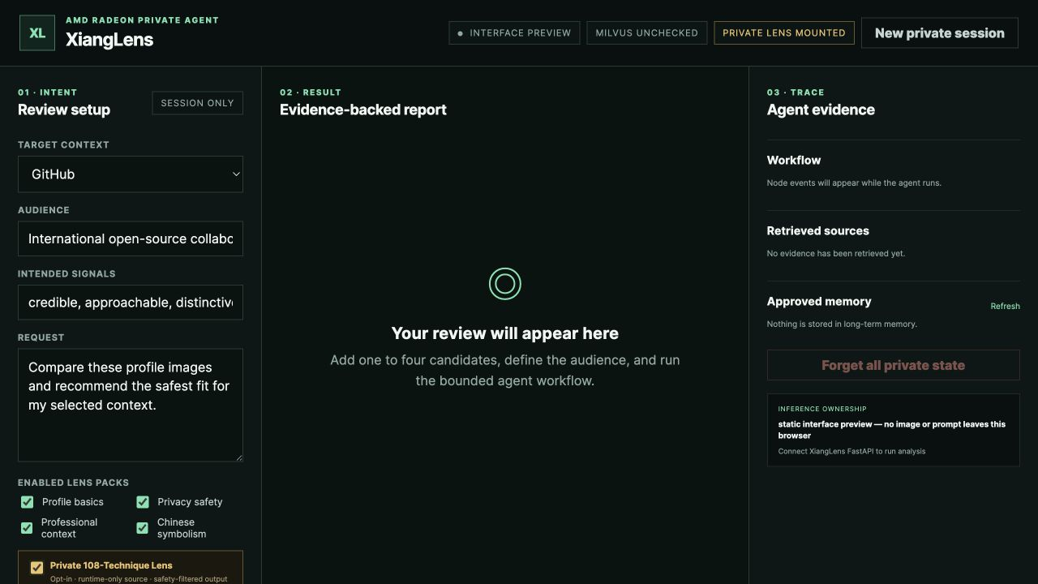
The interface makes the Agent workflow inspectable
01 · INTENT
The user declares context, audience, and desired signals.
02 · RESULT
The bounded workflow produces one evidence-backed report.
03 · TRACE + PRIVATE
Retrieval, private Tool, memory, deletion, and ownership stay visible.
ACTUAL NUXT INTERFACE · STATIC PREVIEW · NO MODEL OUTPUT SHOWN
XIANGLENS · TRACK 2
03
Notes:
[Sources]
- Actual XiangLens Nuxt interface captured from apps/web in local static-preview mode after the private Lens integration; no model output or private course text was fabricated.
- Interface implementation: apps/web/pages/index.vue and apps/web/assets/css/main.css

Slide 4
The Agent owns every decision around the model
PUBLIC EDGE
USER-CONTROLLED RADEON ENVIRONMENT
Static UI
FastAPI
LangGraph
llama-server
Radeon host
GitHub Pages
upload · SSE · auth
policy · plan · state
OpenAI-compatible /v1
ROCm · W7900
Local tools
Context engines
SQLite memory
EXIF · QR · crop · safe copy
Milvus Top-K · opt-in private Lens
threads · consent · deletion
FastAPI alone is exposed; model, Milvus, private Lens, SQLite, uploads, and permanent key stay private.
XIANGLENS · TRACK 2
04
Notes:
[Sources]
- Agent architecture: docs/SUBMISSION_BRIEF.md
- Runtime-only private mount and safety boundary: docs/PRIVATE_LENS_TOOL.md and src/xianglens/tools/private_lens.py

Slide 5
One workflow proves all five Track 2 capabilities
01
02
03
04
05
Plan
Tools
RAG
Memory
Permission
Visible fixed plan
and bounded routing
EXIF, QR, crop,
private Lens, safe copy
Milvus Lite Top-K
with visible sources
Cross-thread recall
after explicit approval
Policy gate, short token,
and Forget Me
Policy → recall → inspect → observe → private Lens → RAG → compare → consent → cited report
XIANGLENS · TRACK 2
05
Notes:
[Sources]
- Bounded workflow implementation: src/xianglens/agent/graph.py
- Private Lens API and typed output contract: src/xianglens/api/routes.py and src/xianglens/schemas.py

Slide 6
Core multimodal inference stays on the Radeon host
The public interface is intentionally thin. The private execution boundary contains every stateful and inference-critical component.
PRIVATE RADEON + ROCm SURFACE
PUBLIC SURFACE
Qwen3.6 35B-A3B Fable 5 Distill · Q6_K GGUF
GitHub Pages static UI
Short-lived Bearer session
FastAPI HTTPS endpoint
llama.cpp / llama-server on 127.0.0.1
LangGraph + deterministic image tools
Milvus Lite + opt-in private 108-technique Lens
SQLite + controlled uploads; permanent key stays server-side
Demo proof: rocm-smi + /v1/models + XiangLens system status
XIANGLENS · TRACK 2
06
Notes:
[Sources]
- Deployment boundary: docs/PRODUCTION_DEPLOYMENT.md
- Private tool configuration and service wiring: src/xianglens/config.py and src/xianglens/services.py

Slide 7
W7900 delivers 83.42 tok/s median with 100% valid JSON
Five warm multimodal runs returned identical structured output.
FIRST DELTA
87.09 ms median
FINAL CONTENT
9.96 s median
Q6_K · full GPU offload · Flash Attention · Q8_0 KV cache.
One warmup, 2,048-token reasoning budget, 384-token final budget.
END TO END
11.92 s median
TOKEN GENERATION
83.42 tok/s median
100% valid JSON.
Same output hash across 6 runs.
COLD REFERENCE
825.58 ms first delta · 12.69 s total · one separate run
XIANGLENS · TRACK 2
07
Notes:
[Sources]
- Optimized W7900 capture: benchmarks/results/llama_cpp_w7900_optimized.json and benchmarks/results/llama_cpp_w7900_optimized.md
- Cold reference: benchmarks/results/llama_cpp_w7900_cold.json and benchmarks/results/llama_cpp_w7900_cold.md
- Reproducible runner: scripts/benchmark_llama.py
- Production launch configuration: docs/PRODUCTION_DEPLOYMENT.md
- Interpretation: five warm measured runs after one warmup; the separate cold run is a state reference, not a controlled one-flag A/B baseline. Peak VRAM and GPU utilization are separate video evidence.

Slide 8
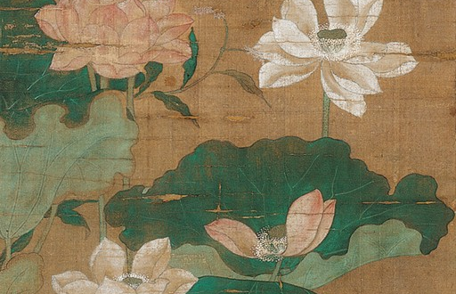
Consent and evidence keep every recommendation accountable
XiangLens reviews communication choices. It does not decide who a person is.
Policy gate
Blocks identity, personality, health, wealth, protected-attribute, and predictive inference.
Public + private context
Public claims stay cited; private course associations are opt-in, runtime-only, and safety-filtered.
Consent-first memory
The model drafts; only the user approves. One memory—or all private state—can be deleted.
OPEN CHINESE SYMBOLISM LENS PACK
Documented association ≠ universal meaning
XIANGLENS · TRACK 2
08
Notes:
[Sources]
- Safety policy: docs/SUBMISSION_BRIEF.md
- Runtime-only source, opt-in, output filtering, and rights scan: docs/PRIVATE_LENS_TOOL.md

Slide 9
THE JUDGE CAN VERIFY THE WHOLE STORY
Ready to verify,
end to end
120 deterministic image fixtures
32 inspectable public knowledge cards
1 opt-in private Lens Tool
One 4:30 live Radeon demo
Upload → inspect → observe → private Lens → retrieve → compare → consent → report
github.com/ld0574/Radeon-hackathon-2026-07
Reproduce: docs/REPRODUCE.md
PRIVATE · EVIDENCE-BACKED · USER-CONTROLLED
Notes:
[Sources]
- Test inventory: tests/ and data/fixtures/labels.jsonl
- Public RAG cards: data/knowledge/cards.jsonl
- Private Lens integration test: tests/test_private_lens.py
- Recording sequence: docs/DEMO_VIDEO_SCRIPT.md

