Slide 1
Accessing the Win32 API in PowerShell
Leo D’Arcy

Slide 2


Many thanks to our sponsors!

Slide 3




Leo D’Arcy
Principal Consultant @ PowerON Platforms
Lead developer of DPC
Part time pyrotechnician
Father to Rabbits
ld0614
@LeoDArcy1

Slide 4
What is the Win32 API?
Officially known as the Windows API
Written in C
Originally released in 1993 for Windows NT
Based on Win16 API released in 1985 for Windows 1.0
Core set of Application Programming Interfaces for Windows
How pretty much any language/library actually interfaces with windows behind the scenes (eventually)

Slide 5
Challenges with C#/PowerShell
Managed vs Unmanaged Memory Management
Unintuitive Syntax
Limited Documentation

Slide 6
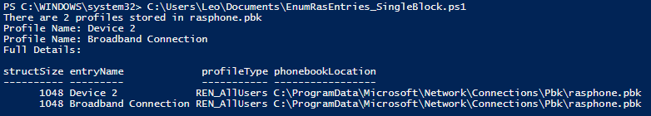

What’s end goal?
Notes:
RasEnumEntries
Returns a list of VPN Profiles configured on a System
Returns an array data structure containing
Profile Name
Saved Location
Profile Type
Non-trivial example of how to run Windows API calls from PowerShell
Requires constants
Memory Management
Custom Data structures
Enums
Example of typical Memory Management Tasks
Simple enough to fit into this talk ☺
How to read the documentation
How to find out when the documentation is lacking

Slide 7
P/Invoke is your friend
Define Some Constants
Define the Data Structure
Define the P/invoke Interface
Access the Interface

Slide 8
Official Documentation
Windows API index - Win32 apps | Microsoft Learn
pinvoke.net: RasEnumEntries (rasapi32)
RasEnumEntriesA function (ras.h) - Win32 apps | Microsoft Learn
[MS-DTYP]: Data Types | Microsoft Learn
Notes:
Pinvoke.net is a great resource, well worth checking out and adding additional information as you discover it, unfortunately not all APIs have been documented and some may have inaccuracies. Use as a leg up but don’t rely on it

Slide 9
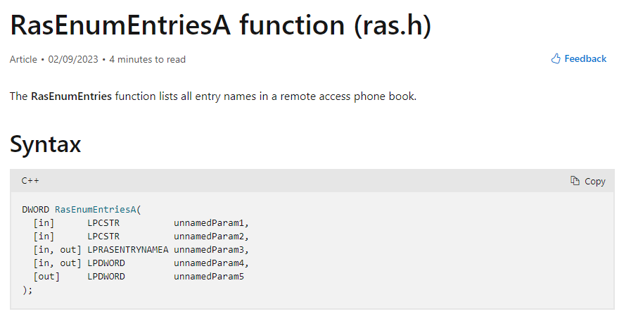
Let’s work through it

Slide 10
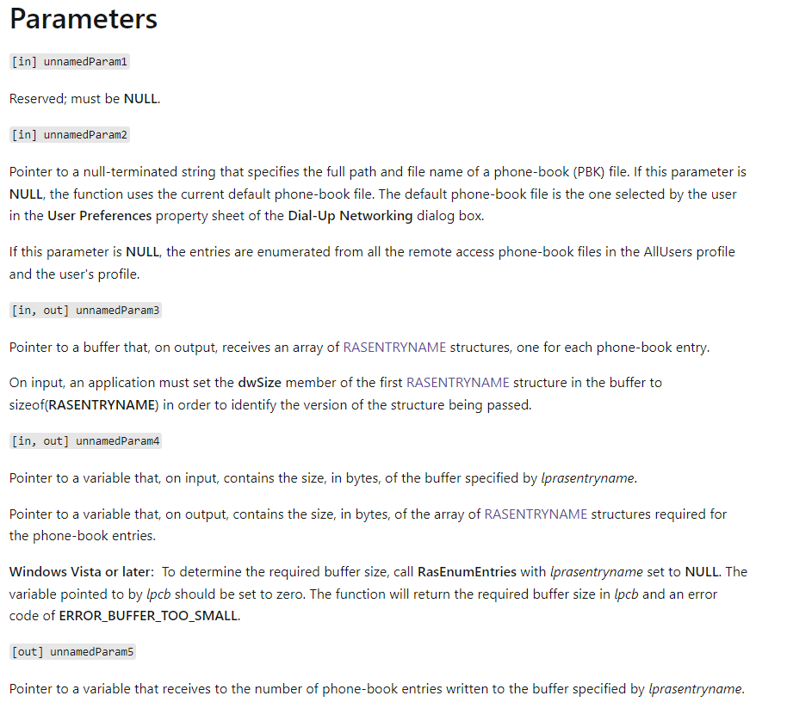
Let’s work through it

Slide 11
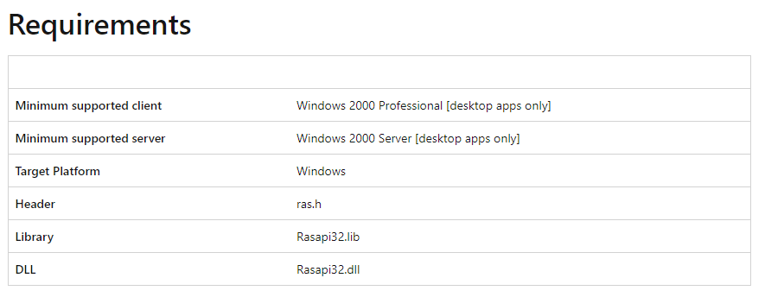
Let’s work through it
Notes:
Whats this WINVER thing?
What is Max Path?
What values to dwFlags actually use?

Slide 12
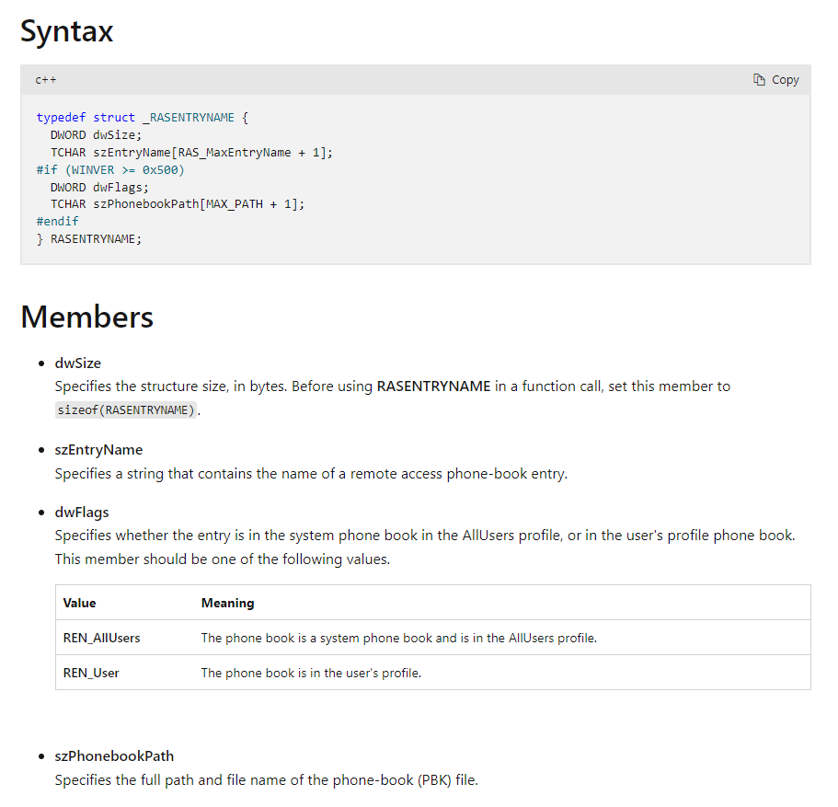
Let’s work through it
Notes:
Whats this WINVER thing?
What is Max Path?
What values to dwFlags actually use?

Slide 13
Windows SDK to the Rescue!
Ras.h is located in C:\Program Files (x86)\Windows Kits\10\Include\10.0.22000.0\um\Ras.h
Um = User Mode – Most Interesting
Shared = Shared between multiple runtimes
Winrt = Windows Runtime – Metro/UWP Apps
Cppwinrt = Windows Runtime for C++
Ucrt = Universal Microsoft C Runtime library – used for visual C++ Apps
Notes:
Built as part of the Windows Build process
Windows SDK - Windows app development | Microsoft Developer
Some Structures change depending on version
Some Enums get additional values

Slide 14
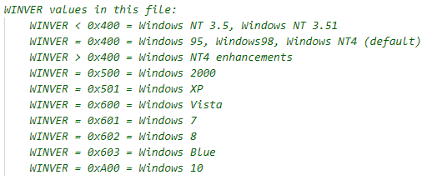
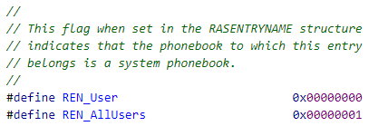
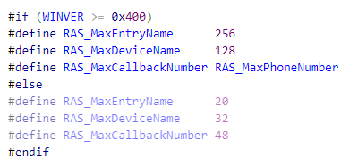
Windows SDK to the Rescue!
Notes:
Built as part of the Windows Build process
Windows SDK - Windows app development | Microsoft Developer
Some Structures change depending on version
Some Enums get additional values

Slide 15
Building the Script
Notes:
Built as part of the Windows Build process
Windows SDK - Windows app development | Microsoft Developer
Some Structures change depending on version
Some Enums get additional values

Slide 16
Loading Dependent Code
1 big C# Block
Hardcode Values
Dynamically Updated Code $()
-OutputAssembly / -ReferencedAssemblies

Slide 17
Gotcha’s
Once loaded with Add-Type only way to remove is the restart PowerShell window
$null is not the same as c# null IntPtr::Zero is more consistent
PowerShell Arrays of c# objects appear to be readonly
Windows REALLY doesn’t like writing to memory outside of the process
Notes:
Assemblies loaded into an AppDomain cannot be unloaded. Only the AppDomain can be unloaded, and powershell uses a single appdomain.
Out of range memory access will cause PowerShell to teminate

Slide 18

Have you considered C#?
C# PowerShell Module
PowerShell calling .exe
Write this script as an app

Slide 19
Useful Modules
PSReflect
Matt Graeber
https://github.com/mattifestation/PSReflect
PSReflect-Functions
Jared Atkinson
https://github.com/jaredcatkinson/PSReflect-Functions
Invoke-Win32
Lee Holmes
https://www.leeholmes.com/get-the-owner-of-a-process-in-powershell-pinvoke-and-refout-parameters/

Slide 20
Q&A
ld0614
@LeoDArcy1

