Slide 1



Distributed Text Services
LD4LT@LDK-2021, Zaragoza, Spain, Sep 4, 2021
Christian Chiarcos
Applied Computational Linguistics (ACoLi)
chiarcos@informatik.uni-frankfurt.de
Notes:
20 min incl. disc.

Slide 2
Canonical Text Services (CTS)
http://cite-architecture.org/cts/
protocol to identify and retrieve passages of text cited by canonical reference.
specification: network service for identifying texts and retrieving fragments of texts
using notions of "work" and "citation"
rather than “string” and “position”
Initially implemented for the Homer Multitext project

Slide 3
Canonical Text Services (CTS)
http://cite-architecture.org/cts/
scope
CTS URNs
protocol to resolve them
address (TEI) XML documents
return XML data
multi-document extension of the Text Encoding Initiative
applicable to other XML data

Slide 4
CTS URNs
http://cite-architecture.org/ctsurn/
urn:cts:[NAMESPACE]:[WORK]:[PASSAGE]
urn:cts:pbc:bible.parallel.eng
WORK has a hierarchical structure
TEXTGROUP.WORK.VERSION.EXEMPLAR
PASSAGE is optional

Slide 5
CTS URNs
http://cite-architecture.org/ctsurn/
urn:cts:[NAMESPACE]:[WORK]:[PASSAGE]
urn:cts:pbc:bible.parallel.eng
urn:cts:pbc:bible.parallel.eng:1.3.2
reference to a citable node, implicit encoding of a hierarchy
designed for TEI documents

Slide 6
CTS URNs
http://cite-architecture.org/ctsurn/
urn:cts:[NAMESPACE]:[WORK]:[PASSAGE]
urn:cts:pbc:bible.parallel.eng
urn:cts:pbc:bible.parallel.eng:1.3.2
urn:cts:pbc:bible.parallel.eng:1.2-1.5.6
dynamic URI: a span between two nodes

Slide 7
CTS URNs
http://cite-architecture.org/ctsurn/
urn:cts:[NAMESPACE]:[WORK]:[PASSAGE]
urn:cts:pbc:bible.parallel.eng
urn:cts:pbc:bible.parallel.eng:1.3.2
urn:cts:pbc:bible.parallel.eng:1.2-1.5.6
urn:cts:pbc:bible.parallel.eng:1.2@the[2]-1.5.6@five
@ => subsections (here, tokens)

Slide 8
CTS URNs
http://cite-architecture.org/ctsurn/
urn:cts:[NAMESPACE]:[WORK]:[PASSAGE]
urn:cts:pbc:bible.parallel.eng
urn:cts:pbc:bible.parallel.eng:1.3.2
urn:cts:pbc:bible.parallel.eng:1.2-1.5.6
urn:cts:pbc:bible.parallel.eng:1.2@the[2]-1.5.6@five
[...] => index

Slide 9
CTS URLs
http://cite-architecture.github.io/cts_spec/
URNs are valid URIs, but they don‘t resolve
wrapping into a URI, using a URN resolver
urn:cts:pbc:bible.parallel.eng:1.2@the[2]-1.5.6@five
http://cts.informatik.uni-leipzig.de/pbc/cts/?request=GetPassage&urn=urn:cts:pbc:bible.parallel.eng.kingjames:1.2@the[2]-1.5.6@five
as defined in CTS protocol

Slide 10
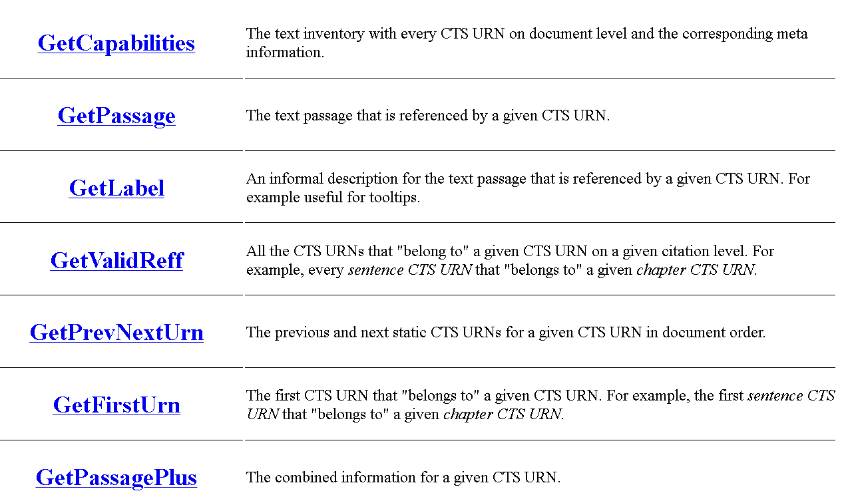
CTS Protocol
http://cite-architecture.github.io/cts_spec/
?request=
[other parameters depend on the specific function, e.g.,
?urn=<CTS-URN>]

Slide 11
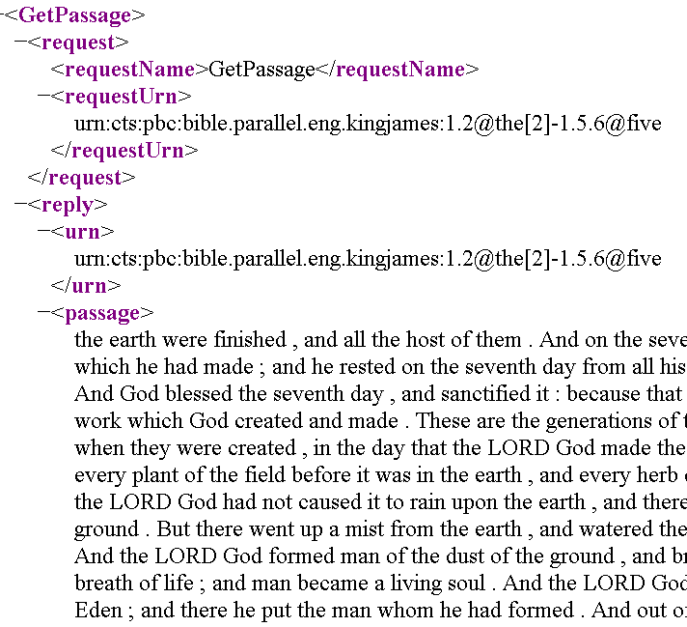
CTS URLs
http://cite-architecture.github.io/cts_spec/
http://cts.informatik.uni-leipzig.de/pbc/cts/?request=GetPassage&urn=urn:cts:pbc:bible.parallel.eng.kingjames:1.2@the[2]-1.5.6@five
examples from http://cts.informatik.uni-leipzig.de

Slide 12
Return values
CTS is designed to work with TEI documents
defines a special-purpose XML syntax for responses
CTS URLs can resolve, but they cannot resolve to RDF data
CTS Protocol requires CTS URNs
cannot support other (more widely used) citation systems

Slide 13
DTS – Distributed Text Service
https://distributed-text-services.github.io
REST API for collections of TEI documents
inspired, informed and influenced by CTS
but:
more generic, no prescriptions for identifier system, or structure of documents
real-world systems also support CTS URNs
https://dts.perseids.org/collections?id=urn:perseids:latinLit

Slide 14
DTS Operations
Navigate across texts, navigate within texts, retrieve textual content
e.g., retrieve
lists of collection members
metadata about individual collection items
lists of citeable passages within a text
lists of citeable passages within a text as groups of client-defined sizes
metadata about the citation structure of a document
single text passage at any level of the citation hierarchy
range of text passages with a clearly defined start and end passage
entire text

Slide 15
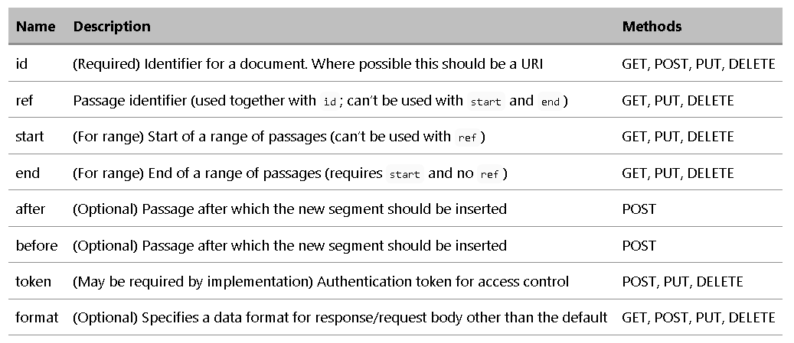
Retrieval („Document Endpoint“)

Slide 16
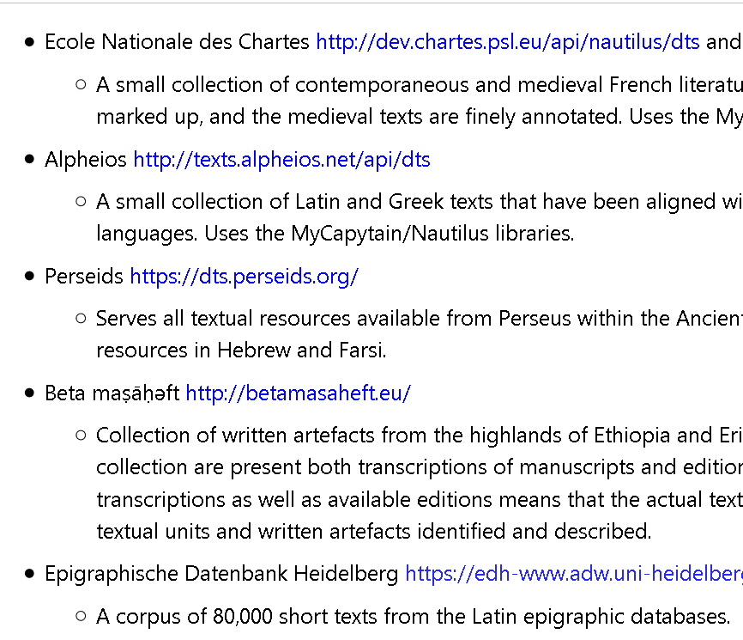
DTS + Linked Data
REST API
JSON-LD
enables full-fledged Linked Data
Sample end points:
https://distributed-text-services.github.io/specifications/

Slide 17
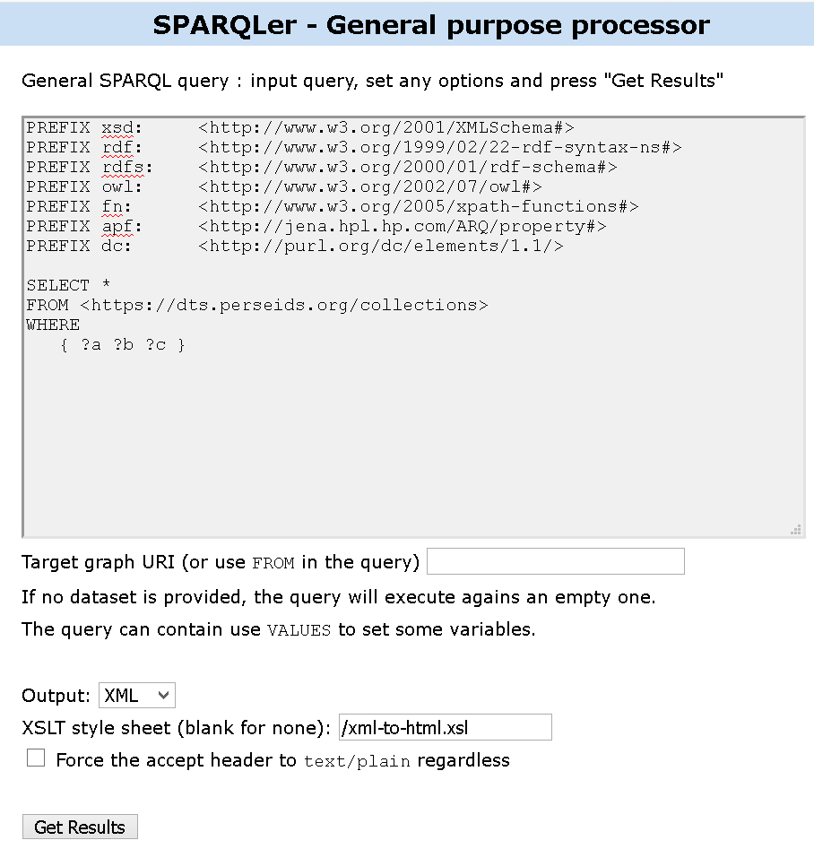
Accessing a DTS endpoint
https://dts.perseids.org/collections
accessed via sparql.org
web service around Apache Jena

Slide 18
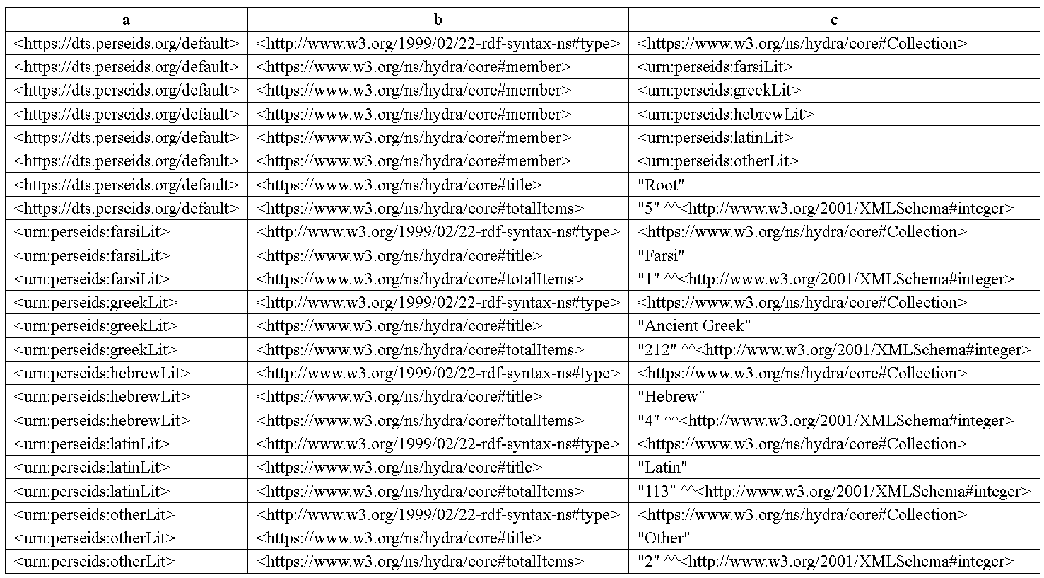
Accessing a DTS endpoint
https://dts.perseids.org/collections
accessed via sparql.org
web service around Apache Jena

Slide 19
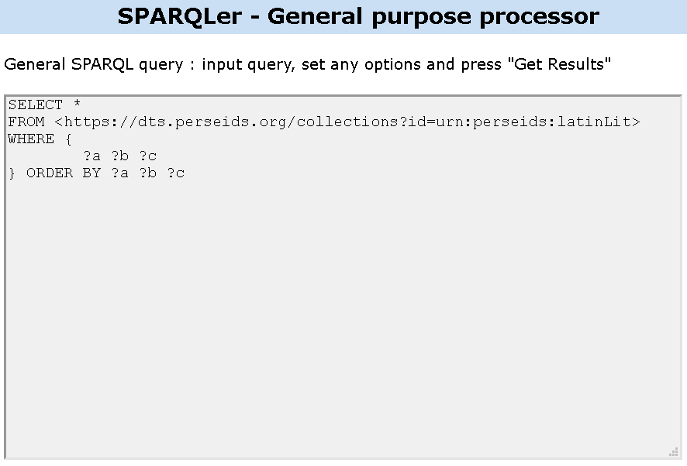
Accessing a DTS endpoint
https://dts.perseids.org/collections
accessed via sparql.org
FROM
GET request at DTS end point
results can be loaded into named graph

Slide 20
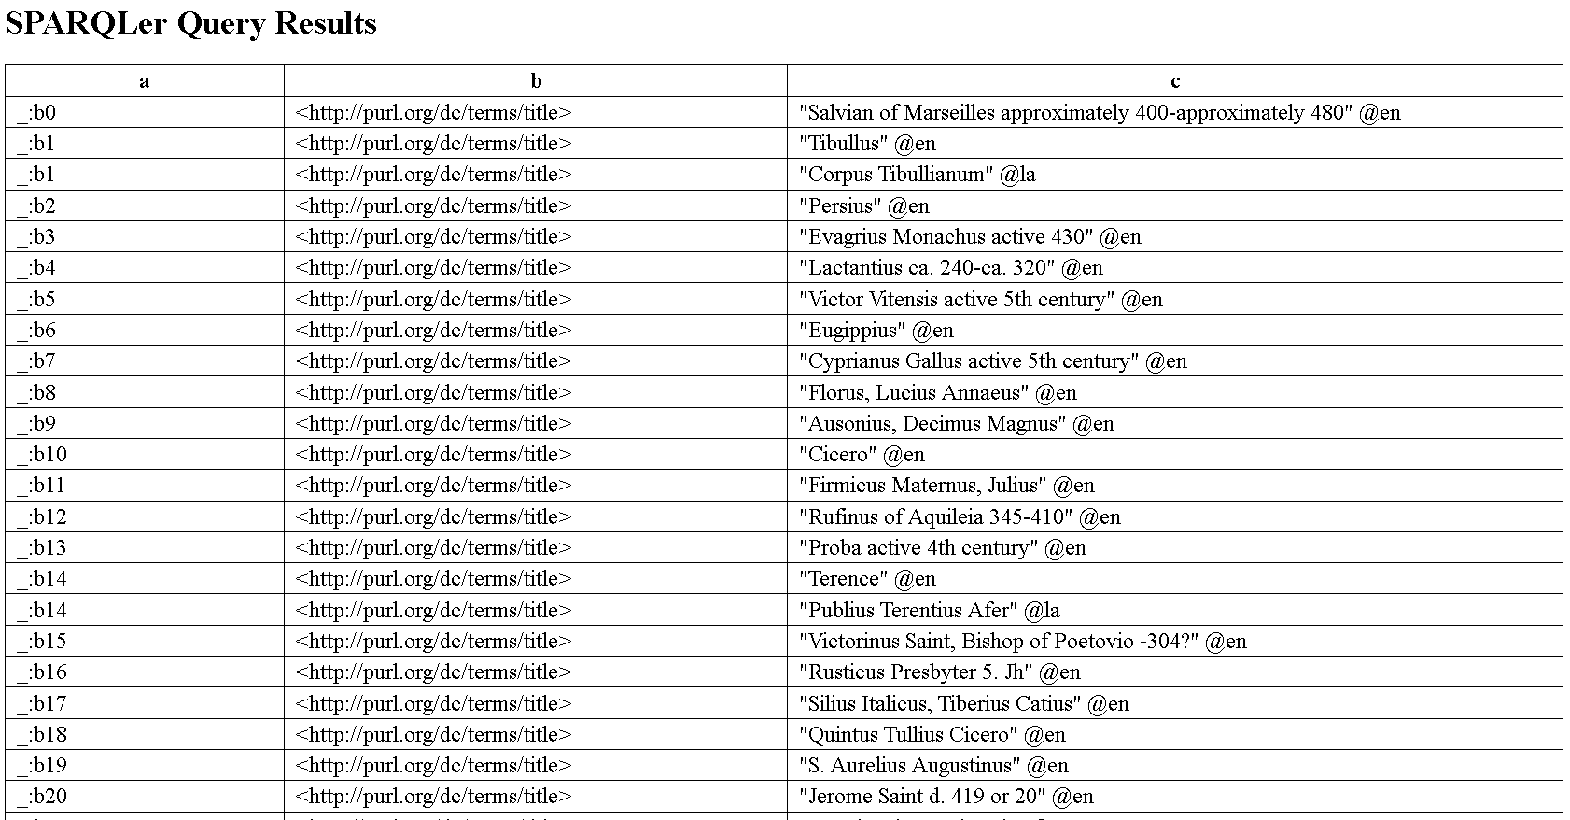
Accessing a DTS endpoint
https://dts.perseids.org/collections
accessed via sparql.org
FROM
GET request at DTS end point
results can be loaded into named graph

Slide 21
Summary
CTS URIs
yet another text addressing system
canonical, can abstract from/generalize over multiple string representations
DTS protocol
resolvable (CTS and other) URIs
JSON-LD responses, full RDF integration

