Slide 1
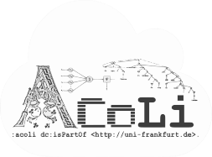
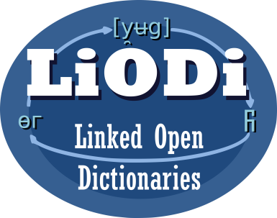

LD4LT Discussions on Linguistic Annotation (so far)
LD4LT@LDK-2021, Zaragoza, Spain, Sep 4, 2021
Christian Chiarcos
Applied Computational Linguistics (ACoLi)
chiarcos@informatik.uni-frankfurt.de
Notes:
20 min incl. disc.

Slide 2
RDF and Annotation: A brave new world?
Not quite (yet):
Concurrent, incompatible vocabularies
Web Annotation (mostly for bioinformatics and DH)
NLP Interchange Format (mostly for NLP web services)
Ligt (morphology, not supported otherwise)
POWLA (generic LAF data structures)
Prospects on information integration recognized already during the 2000s
Hampered by incompatibilities
Consolidation initiative
W3C Community Group „Linked Data for Language Technology“
+ supported by Nexus Linguarum, WG 1, T1.1

Slide 3
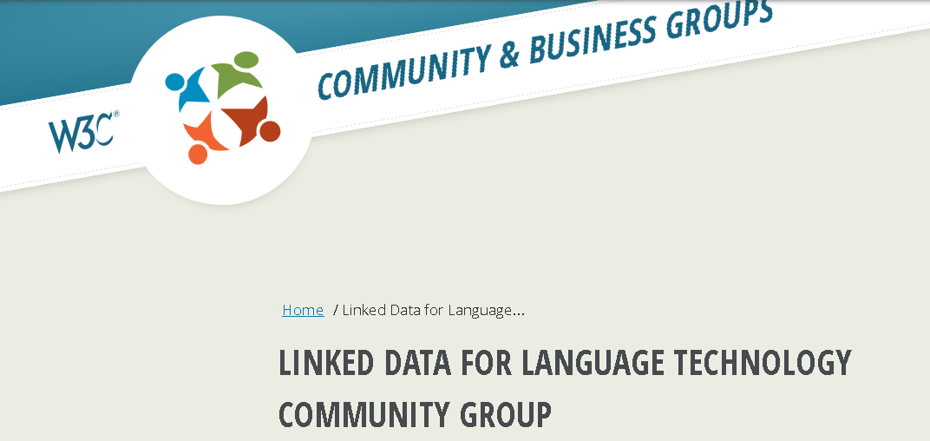
Linked Data for Language Technology
https://www.w3.org/community/ld4lt/
address use cases and requirements for Language Technology Applications that use Linked Data
interoperability
two active lines of discussion
language resource metadata (METASHARE OWL)
consolidate linguistic annotations on the web (Web Annotation + NIF + …)

Slide 4
LD4LT Harmonization Initiative
Establish one RDF vocabulary for annotations on the web
API specifications
Guidelines/specs for linguistic annotations on the web
publishing, processing, exchanging, accessing
Largely compatible/building on existing standards
detect and compensate gaps
compatible with or easily upgradable from existing implementations

Slide 5
Questions
What to annotate?
identify and address elements of the primary data
e.g., strings in a text
explicit selectors
RDF properties that describe how to retrieve fragments from a web resource
extensible, but verbose
fragment identifiers
e.g., offset-based URIs as used in NIF
compact, but not extensible and not very robust
both supported by Web Annotation
but there may be need for extensions

Slide 6
Questions
How to annotate?
identify linguistic data structures
e.g., morphemes, words, sentences, phrases, dependencies
no general RDF standard in existence
other RDF vocabularies include
NIF („simple“ NLP annotations)
CoNLL-RDF (NIF adaptation for tabular formats)
LAF/POWLA (generic format[s], but limited tool support)
Ligt (interlinear glosses, morphology)
tool-specific formats (LIF, NAF-RDF, etc.)

Slide 7
Questions
Processing and exchange?
Independent API specifications
Web Annotation
NIF
Guidelines and strategies
Recommended tools/APIs
to produce, consume, retrieve, search linguistic annotations ?
Develop generic tools or facilitate interoperability between existing tools
can/should we try to change established workflows

Slide 8
Related Activities: OntoLex-FrAC
https://www.w3.org/community/ontolex/wiki/Frequency,_Attestation_and_Corpus_Information
frequency, attestation, corpus information
W3C Community Group Ontology-Lexica
pointers from lexical resources into corpora
annotation with dictionary references
OntoLex

Slide 9
Related Activities: OntoLex-FrAC
https://www.w3.org/community/ontolex/wiki/Frequency,_Attestation_and_Corpus_Information
frequency, attestation, corpus information
provides anchor points
to refer to corpora/documents
frac:corpus / frac:Corpus
abstract concept, specifying the size of a resource
provenance information, mostly
source of dictionary examples, embeddings, etc.
Notes:
LD4LT isn‘t the only initiative to look at the linguistic annotation of corpora

Slide 10
Related Activities: OntoLex-FrAC
https://www.w3.org/community/ontolex/wiki/Frequency,_Attestation_and_Corpus_Information
frequency, attestation, corpus information
provides anchor points
to refer to corpora/documents
frac:corpus / frac:Corpus
to address an excerpt from a corpus
frac:attestation / frac:Attestation
illustrates a lexical entry, lexical form, word sense, lexical concept, or ontological concept
Notes:
LD4LT isn‘t the only initiative to look at the linguistic annotation of corpora

Slide 11
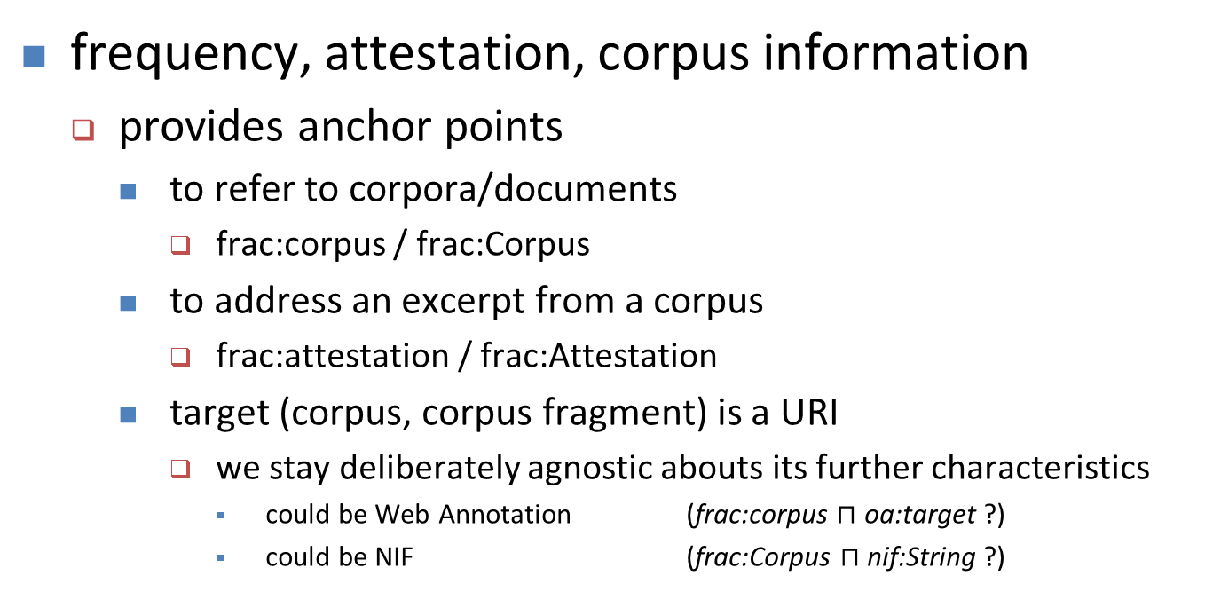
Related Activities: OntoLex-FrAC
https://www.w3.org/community/ontolex/wiki/Frequency,_Attestation_and_Corpus_Information
frequency, attestation, corpus information
provides anchor points
to refer to corpora/documents
frac:corpus / frac:Corpus
to address an excerpt from a corpus
frac:attestation / frac:Attestation
target (corpus, corpus fragment) is a URI
we stay deliberately agnostic abouts its further characteristics
could be Web Annotation (frac:corpus $⊓$ oa:target ?)
could be NIF (frac:Corpus $⊓$ nif:String ?)
Notes:
LD4LT isn‘t the only initiative to look at the linguistic annotation of corpora

Slide 12
Related Activities: OntoLex-FrAC
https://www.w3.org/community/ontolex/wiki/Frequency,_Attestation_and_Corpus_Information
frequency, attestation, corpus information
provides anchor points
to refer to corpora/documents
frac:corpus / frac:Corpus
to address an excerpt from a corpus
frac:attestation / frac:Attestation
target (corpus, corpus fragment) is a URI
we stay deliberately agnostic abouts its further characteristics
we would like to give a concrete recommendation
=> one of the motivations for the LD4LT harmonization effort
Notes:
LD4LT isn‘t the only initiative to look at the linguistic annotation of corpora

Slide 13
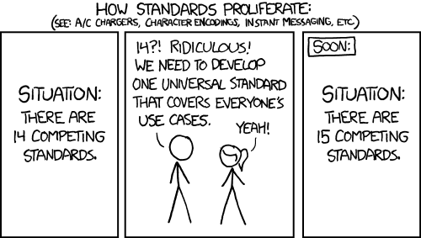
What do we want to do?

Slide 14
Approach so far
https://github.com/ld4lt/linguistic-annotation
Pilot survey: WA / NIF / both ?
2018-2019
H2020 project Pret-a-LLOD
Ready-to-use Multilingual Linked Language Data for Knowledge Services across Sectors (2019-2022)
Series of telcos
since 2019, somewhat irregular
aiming for a more regular rhythm
joint activity with Cost Action Nexus Linguarum (2019-2023)

Slide 15
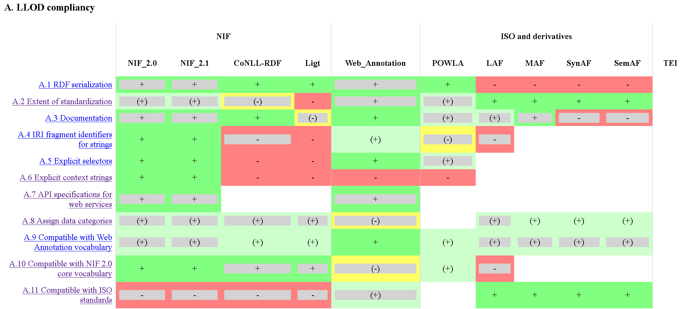
Approach so far
https://github.com/ld4lt/linguistic-annotation
Survey of requirements and features
https://github.com/ld4lt/linguistic-annotation/tree/master/survey

Slide 16
Approach so far
https://github.com/ld4lt/linguistic-annotation
Survey of requirements and features
https://github.com/ld4lt/linguistic-annotation/tree/master/survey
still incomplete
add statistics on features and formats
to be added: TEI, ISO
partially fed into a draft article
Khan et al. (ms), TITLE

Slide 17
Approach so far
https://github.com/ld4lt/linguistic-annotation
Survey of requirements and features
Now, decide how to develop common specifications
Extending an established vocabulary?
Which one?
„Web Annotation for Linguistic Annotation (WALT)“?
„NIF 2.0“ ?
„LAF-RDF“ ?

Slide 18
Approach so far
https://github.com/ld4lt/linguistic-annotation
Survey of requirements and features
Now, decide how to develop common specifications
Extending an established vocabulary?
Deeper discussion of sub-topics => separate calls
suggested for fragment identifiers

Slide 19
Approach so far
https://github.com/ld4lt/linguistic-annotation
Survey of requirements and features
Now, decide how to develop common specifications
Need help, feedback and additional use cases ;)
This can have a similar impact as OntoLex had on lexical resources
Since the publication of the vocabulary in 2016
If developed with an eye on usage, usability and compatibility

Slide 20
Materials
LD4LT mailing list & wiki
https://www.w3.org/community/ld4lt/
https://www.w3.org/community/ld4lt/wiki/Main_Page#Use_Cases
GitHub, incl. archive
https://github.com/ld4lt/linguistic-annotation

