Slide 1
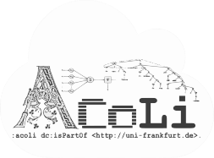
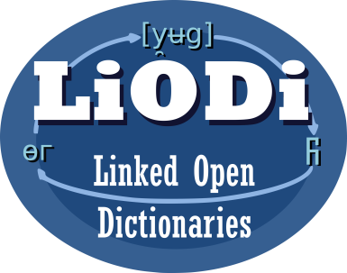

LD4LT Discussions on Linguistic Annotation (so far)
LD4LT@LDK-2021, Zaragoza, Spain, Sep 4, 2021
Christian Chiarcos
Applied Computational Linguistics (ACoLi)
chiarcos@informatik.uni-frankfurt.de
Notes:
20 min incl. disc.

Slide 2
RDF and Annotation: A brave new world?
Not quite (yet):
Concurrent, incompatible vocabularies
Web Annotation (mostly for bioinformatics and DH)
NLP Interchange Format (mostly for NLP web services)
Ligt (morphology, not supported otherwise)
POWLA (generic LAF data structures)
Prospects on information integration recognized already during the 2000s
Hampered by incompatibilities
Consolidation initiative
W3C Community Group „Linked Data for Language Technology“
+ supported by Nexus Linguarum, WG 1, T1.1

Slide 3
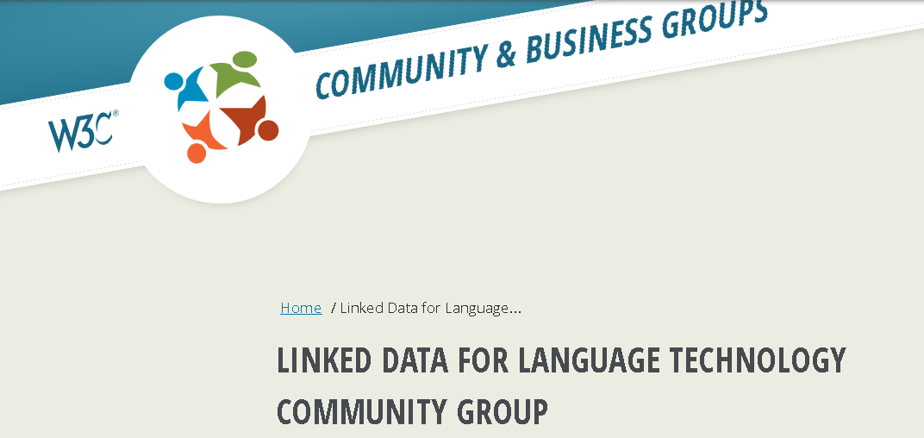
Linked Data for Language Technology
https://www.w3.org/community/ld4lt/
address use cases and requirements for Language Technology Applications that use Linked Data
interoperability
two active lines of discussion
language resource metadata (METASHARE OWL)
consolidate linguistic annotations on the web (Web Annotation + NIF + …)

Slide 4
LD4LT Harmonization Initiative
Establish one RDF vocabulary for annotations on the web
API specifications
Guidelines/specs for linguistic annotations on the web
publishing, processing, exchanging, accessing
Largely compatible/building on existing standards
detect and compensate gaps
compatible with or easily upgradable from existing implementations

Slide 5
Related Activities: OntoLex-FrAC
https://www.w3.org/community/ontolex/wiki/Frequency,_Attestation_and_Corpus_Information
frequency, attestation, corpus information
W3C Community Group Ontology-Lexica
pointers from lexical resources into corpora
annotation with dictionary references (OntoLex)
requires a vocabulary for annotating a corpus with lexical links, but does not provide it
Instead, it refers to external vocabularies such as NIF or Web Annotation
It would be better to provide a concrete recommendation

Slide 6
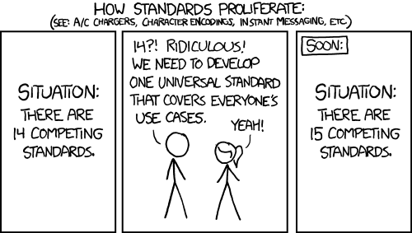
What do we want to do?

Slide 7
Approach so far
https://github.com/ld4lt/linguistic-annotation
Pilot survey: WA / NIF / both ?
2018-2019
H2020 project Pret-a-LLOD
Ready-to-use Multilingual Linked Language Data for Knowledge Services across Sectors (2019-2022)
Series of telcos
since 2019, somewhat irregular
aiming for a more regular rhythm
joint activity with Cost Action Nexus Linguarum (2019-2023)

Slide 8
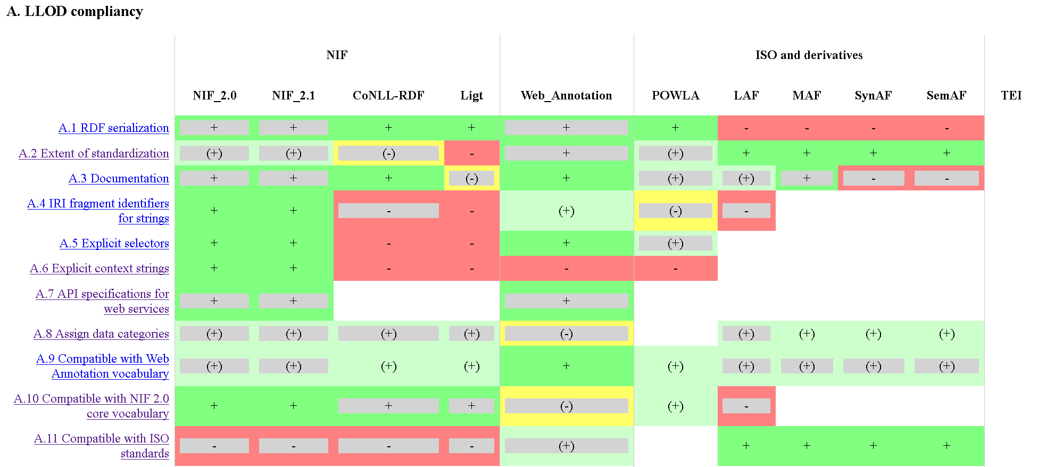
Approach so far
https://github.com/ld4lt/linguistic-annotation
Survey of requirements and features
https://github.com/ld4lt/linguistic-annotation/tree/master/survey

Slide 9
Approach so far
https://github.com/ld4lt/linguistic-annotation
Survey of requirements and features
https://github.com/ld4lt/linguistic-annotation/tree/master/survey
still incomplete
add statistics on features and formats
to be added: TEI, ISO
partially fed into a draft article
Khan et al. (ms), TITLE

Slide 10
Approach so far
https://github.com/ld4lt/linguistic-annotation
Survey of requirements and features
Now, decide how to develop common specifications
Extending an established vocabulary?
Which one?
„Web Annotation for Linguistic Annotation (WALT)“?
„NIF 2.0“ ?
„LAF-RDF“ ?

Slide 11
Approach so far
https://github.com/ld4lt/linguistic-annotation
Survey of requirements and features
Now, decide how to develop common specifications
Extending an established vocabulary?
Deeper discussion of sub-topics => separate calls
suggested for fragment identifiers

Slide 12
Approach so far
https://github.com/ld4lt/linguistic-annotation
Survey of requirements and features
Now, decide how to develop common specifications
Need help, feedback and additional use cases ;)
This can have a similar impact as OntoLex had on lexical resources
Since the publication of the vocabulary in 2016
If developed with an eye on usage, usability and compatibility

Slide 13
Materials
LD4LT mailing list & wiki
https://www.w3.org/community/ld4lt/
https://www.w3.org/community/ld4lt/wiki/Main_Page#Use_Cases
GitHub, incl. archive
https://github.com/ld4lt/linguistic-annotation

