Slide 1
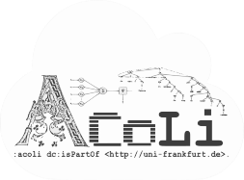
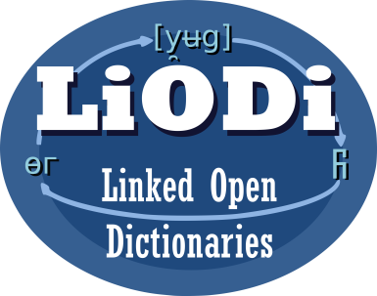

Harmonizing Linguistic Annotations (An LD4LT workshop)
LD4LT @ LDK, Zaragoza, Spain, Sep 4, 2021
Welcome & Overview
Notes:
20 min incl. disc.

Slide 2
Linked Data for Language Technology (LD4LT)
https://www.w3.org/community/ld4lt/
W3C Community Group
formed 2013
address use cases and requirements for Language Technology Applications that use Linked Data
interoperability
language technology
surveying needs and requirements (esp. 2013-2016)
language resource metadata (since 2015)
linguistic annotation (intensified since 2019)

Slide 3
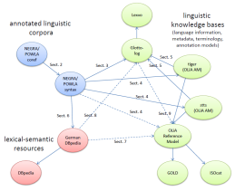
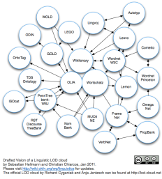
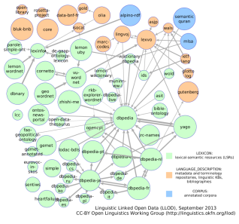
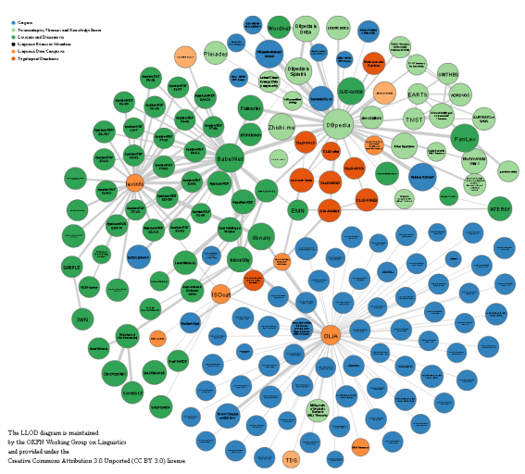
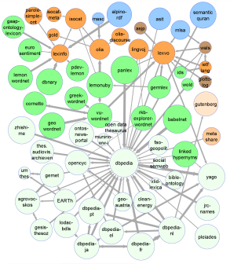
Linked Data and Language Technology
2010-2011:
vision
since 2010, an LOD sub-cloud of language resources has been emerging
Open Linguistics Working Group
http://linguistic-lod.org
2012:
workshop, book,
hackathon
2012-2013:
materialized
2014:
top-level
category
@ LOD
cloud
continuous growth

Slide 4
Linked Data and Language Technology
2010-2011:
vision
since 2016, it has particularly grown with respect to lexical resources
W3C CG Ontology-Lexica (OntoLex)
one vocabulary, many use cases
2012:
workshop, book,
hackathon
2012-2013:
materialized
2014:
top-level
category
@ LOD
cloud
continuous growth

Slide 5
Linked Data and Language Technology
2010-2011:
vision
linguistic annotation remains a problematic area
some resources (blue)
few successful user stories
concurrent standards
USP: interoperability?
not in the current situation
2012:
workshop, book,
hackathon
2012-2013:
materialized
2014:
top-level
category
@ LOD
cloud
continuous growth

Slide 6
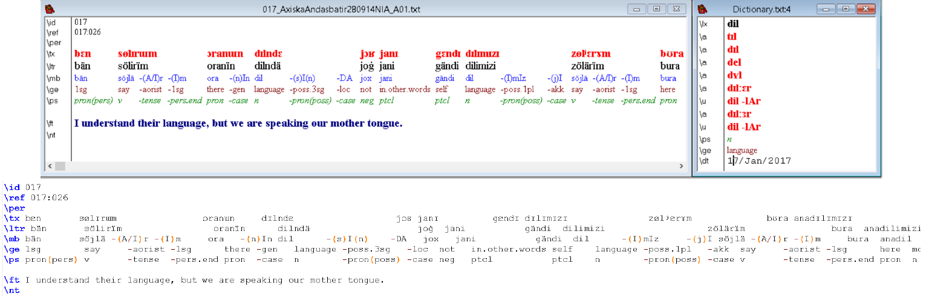
What is Linguistic Annotation, Actually?
Different communities of practice annotate very different things
Interlinear Glossed Text
(Toolbox)
https://software.sil.org/toolbox/

Slide 7
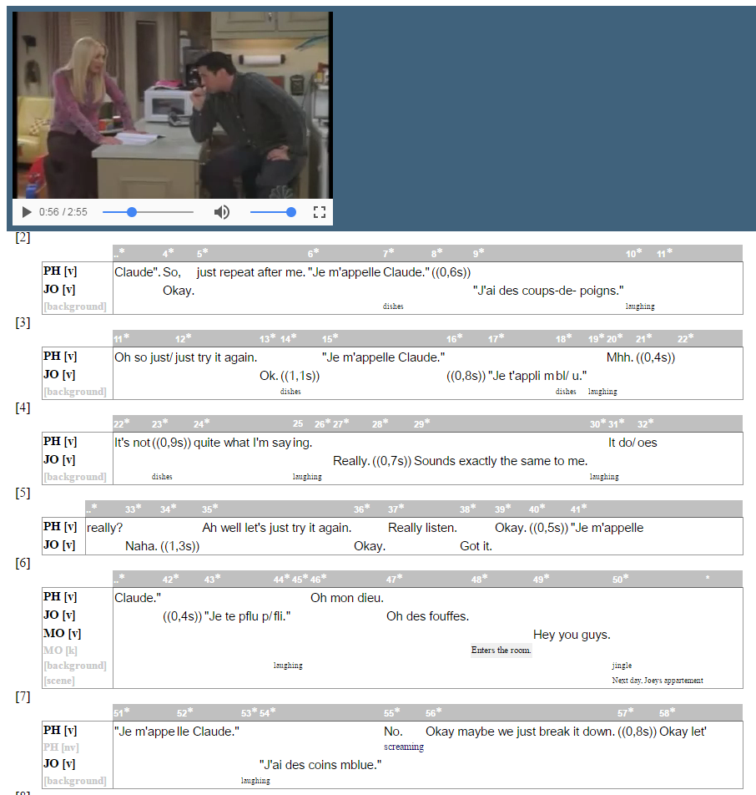
What is Linguistic Annotation, Actually?
Different communities of practice annotate very different things
Exmaralda
layered annotation over
multimodal content
(annotating dialogue,
guestures, etc.)
http://exmaralda.org

Slide 8
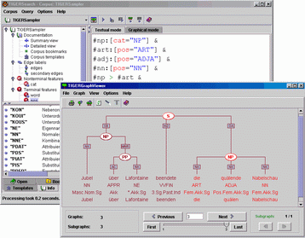
What is Linguistic Annotation, Actually?
Different communities of practice annotate very different things
Phrase
Structure
Syntax
(TIGERSearch/
Annotate)

Slide 9
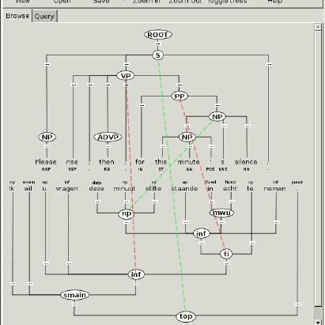
What is Linguistic Annotation, Actually?
Different communities of practice annotate very different things
TreeAligner
syntax annotation
for two aligned texts
https://www.ling.su.se/english/nlp/tools/stockholm-treealigner

Slide 10
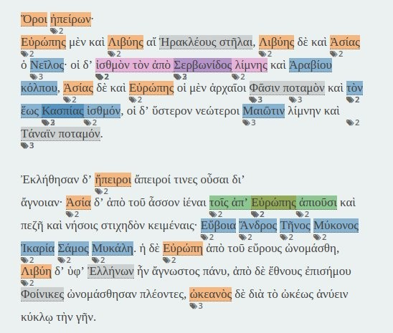
What is Linguistic Annotation, Actually?
Different communities of practice annotate very different things
Recogito
Georeference
(Entities)
http://commons.pelagios.org/2018/03/you-can-now-do-everything-in-recogito/

Slide 11
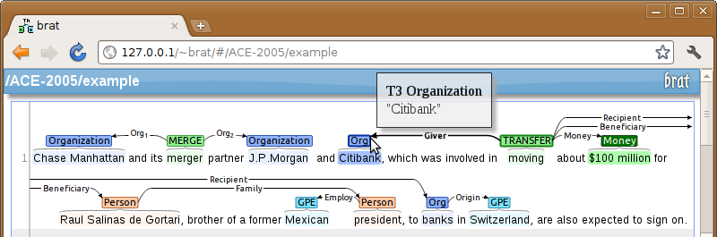
What is Linguistic Annotation, Actually?
Different communities of practice annotate very different things
Relations and Entities
(Brat)
https://brat.nlplab.org/manual.html

Slide 12
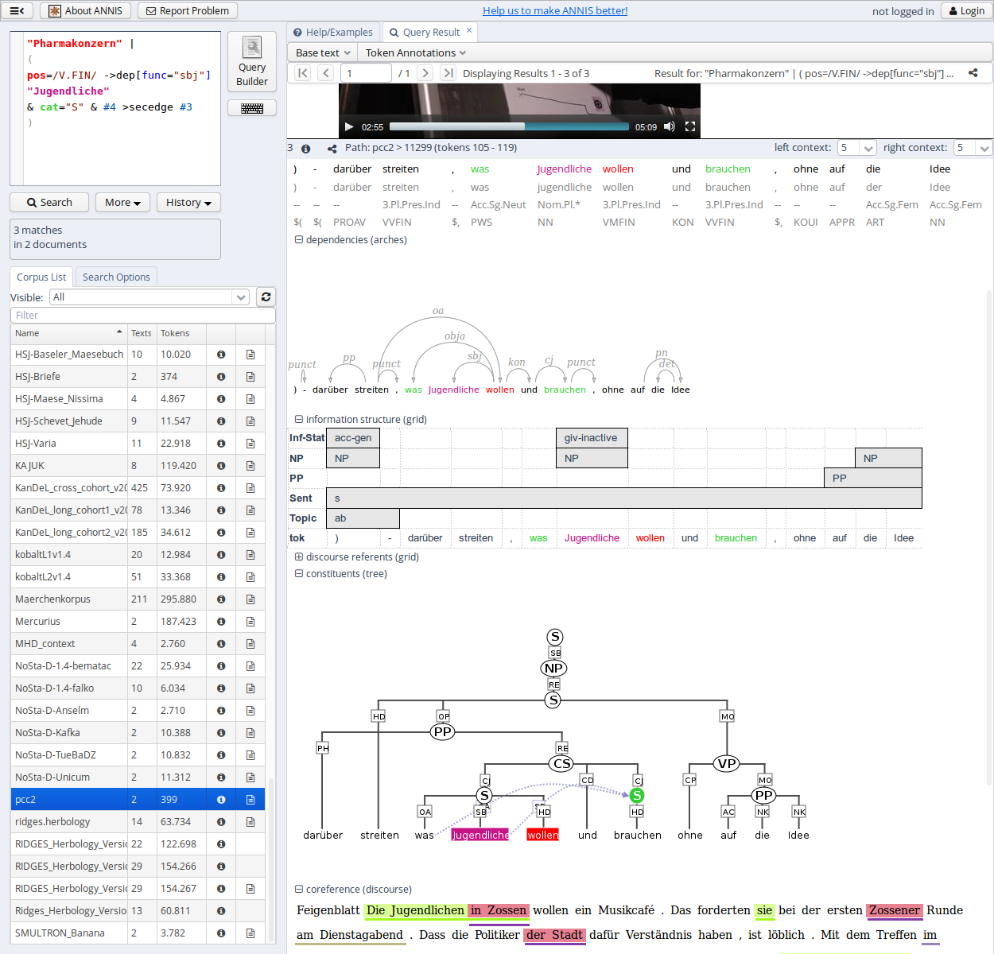
What is Linguistic Annotation, Actually?
Different communities of practice annotate very different things
All at once ?
Multi-Layer Annotation
https://corpus-tools.org/annis/

Slide 13
LD4LT Workshop @ LDK-2021
09:00 Welcome
09:10 - 10:30 Background: Linguistic Annotation on the Web
W3C Standard Web Annotation Christian Chiarcos
NLP Interchange Format Milan Dojchinovski
Text Encoding Initiative Fahad Khan
ISO TC37 standards Thierry Declerck
Text Fragids Joel Kalvesmaki
10:30 - 11:00 Break

Slide 14
LD4LT Workshop @ LDK-2021
11:00 - 11:40 Discussion
QA: What is missing? What is unclear? Where are problems?
Summary of LD4LT Discussions on Linguistic Annotation
11:40 - 12:30 Use Cases, Experiences, Extensions
Linking Latin Francesco Mambrini
Distributed Text Services Christian Chiarcos
Interlinear Glossed Text Maxim Ionov
Discourse Research Giedre Valunaite Oleskevicienė
Transforming Language Resources Christian Fäth
12:30-13:00 Brainstorming & Next Steps

Slide 15
LD4LT Workshop @ LDK-2021
primary goals
provide and collect background information
present and discuss use cases and requirement
initiate and plan future discussions
we record background presentations
for future reference
if you don‘t want to be recorded, please switch off camera and join the discussion via chat
Notes:
TODO: check with presenters to make sure they agree to record background presentations

Slide 16
LD4LT Workshop @ LDK-2021
held in conjunction with
3rd Conference on Language, Data and Knowledge (LDK-2021)
Face-to-face meeting of the W3C CG Ontology-Lexica
organized in cooperation between
W3C CG LD4LT
Cost Action Nexus Linguarum, T1.1

Slide 17
LD4LT Workshop @ LDK-2021
09:00 Welcome
09:10 - 10:30 Background: Linguistic Annotation on the Web
W3C Standard Web Annotation Christian Chiarcos
NLP Interchange Format Milan Dojchinovski
Text Encoding Initiative Fahad Khan
ISO TC37 standards Thierry Declerck
Text Fragids Joel Kalvesmaki
10:30 - 11:00 Break

