Slide 1

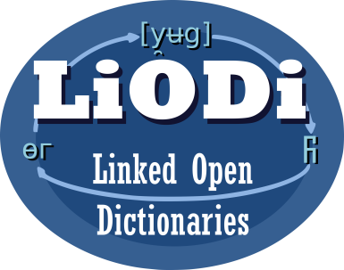

Web Annotation (W3C Standard)
LD4LT@LDK-2021, Zaragoza, Spain, Sep 4, 2021
Christian Chiarcos
Applied Computational Linguistics (ACoLi)
chiarcos@informatik.uni-frankfurt.de
Notes:
20 min incl. disc.

Slide 2
Web Annotation / Open Annotation
W3C Open Annotation Community Group
https://www.w3.org/community/openannotation/
2012-2014
mostly driven by bioinformatics, but generic formalism for annotating web content
Web Annotation (W3C recommendations, Feb 2017)
Data Model: https://www.w3.org/TR/annotation-model
general description
Vocabulary: https://www.w3.org/TR/annotation-vocab
ontology
Protocol: https://www.w3.org/TR/annotation-protocol
retrieving and manipulating annotations
serialization: must JSON-LD, should Turtle, may provide other RDF serializations

Slide 3
Web Annotation: Annotation
https://www.w3.org/TR/annotation-vocab/
rdf:type
hasTarget
motivatedBy
Motivation
Annotation
hasBody
dc:created
dc:creator
xsd:dateTime
recommended
required
TextualBody

Slide 4
Web Annotation: Annotation
https://www.w3.org/TR/annotation-vocab/
rdf:type
hasTarget
motivatedBy
Motivation
Annotation
hasBody
dc:created
dc:creator
rdf:type
xsd:dateTime
assessing
bookmarking
recommended
classifying
required
commenting
describing
editing
...
TextualBody

Slide 5
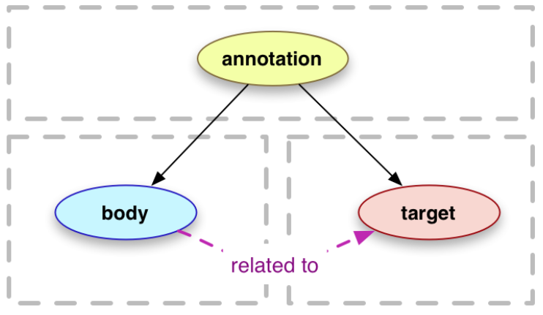
Web Annotation: Target and Body
https://www.w3.org/TR/annotation-model/
body
element containing the annotation
object property: oa:hasBody (any RDF object)
datatype property: oa:bodyValue (strings)
target
element being annotated
any RDF object, including
oa:Selector (more in a second)

Slide 6
oa:Selector – e.g. possible targets
Selector
FragmentSelector
XPathSelector
TextQuoteSelector
CssSelector
TextPositionSelector
SvgSelector
DataPositionSelector
RangeSelector
or: just any URI ;)
e.g., a String URI (RFC5147)
http://example.com/text.txt#char=100,105

Slide 7
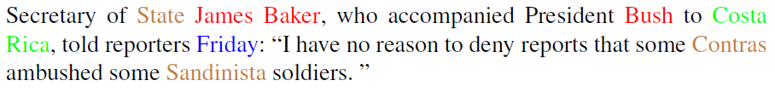
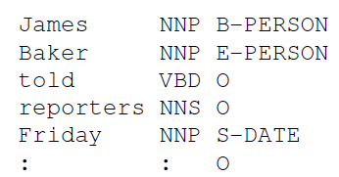
Named Entity Annotations (ENAMEX)
OntoNotes corpus, wsj-0655
https://catalog.ldc.upenn.edu/LDC2013T19

Slide 8
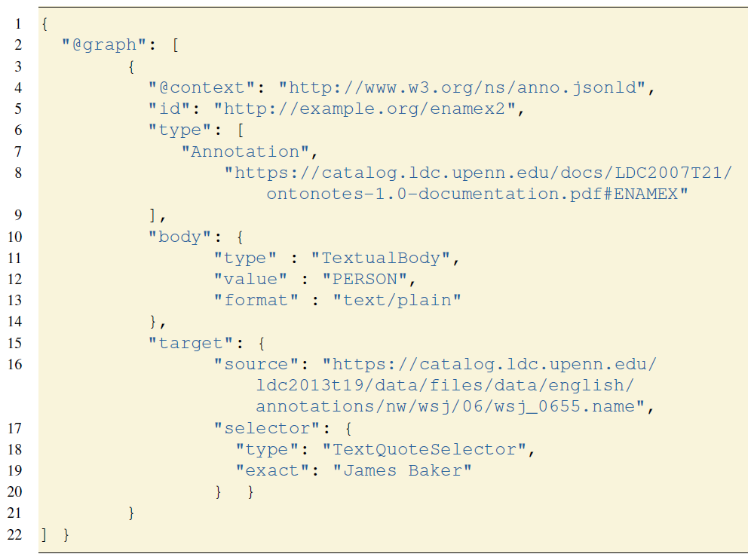
Named Entity Annotations (JSON-LD)

Slide 9
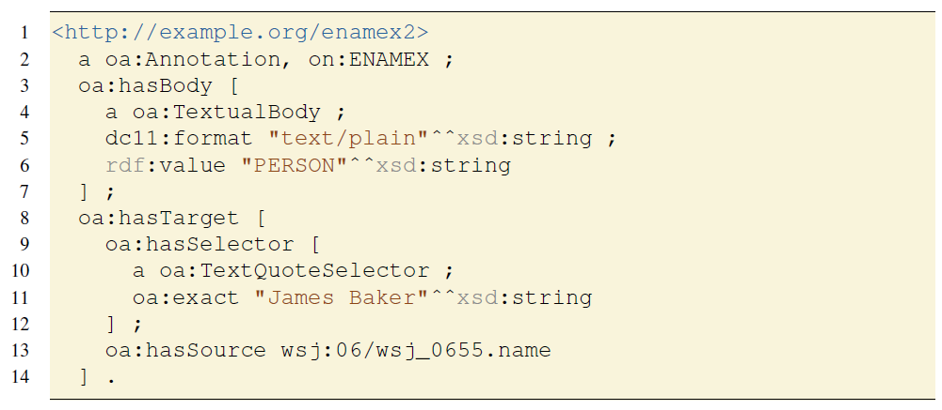
Named Entity Annotations (Turtle)

Slide 10
Named Entity Annotations
on:ENAMEX
TextualBody
rdf:type
rdf:type
http://example.org/emanex2
hasBody
hasTarget
dc11:format
“text/plain“
rdf:value
“PERSON“
hasSource
TextQuote
Selector
hasSelector
wsj:06/wsj_0655.name
exact
“James Baker“

Slide 11
Web Annotation: Overview
relatively good uptake
esp. in bioinformatics
reification
annotation as n:m relation between bodies & targets
with metadata
powerful
annotate all instances of a string at once using a oa:TextQuoteSelector
very verbose
„X is a person according to on:ENAMEX annotations“ takes 11 triples

Slide 12
Named Entity Annotations (Turtle)
notational shorthand: oa:bodyValue for string-value bodies
3-7 oa:bodyValue “PERSON“^^xsd:string ;
=> 4 triples replaced by 1

Slide 13
Web Annotation: Overview
relatively good uptake
esp. in bioinformatics
reification
annotation as n:m relation between bodies & targets
with metadata
powerful
annotate all instances of a string at once using a oa:TextQuoteSelector
rather verbose
„X is a person according to on:ENAMEX annotations“ takes 11 7 triples

Slide 14
Web Annotation: Overview
relatively good uptake
esp. in bioinformatics
reification
annotation as n:m relation between bodies & targets
with metadata
powerful
annotate all instances of a string at once using a oa:TextQuoteSelector
rather verbose
no linguistic data structures

Slide 15

Tooling: Recogito
https://recogito.pelagios.org
Recogito is a tool designed for the annotation of maps and texts with geographical entities
Developed by the Pelagios network
a long-running initiative that links information online through common references to places
Digital Humanities, e.g., historical maps, excavation reports, literature
Based on Web Annotation
can be applied to numerous source formats
limited to labelling and linking tasks

Slide 16
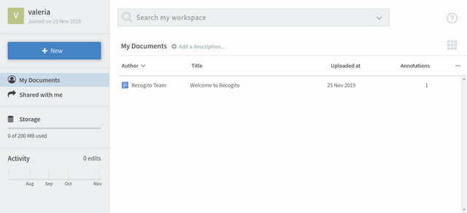
Recogito
fully graphical
underlying technology hidden from the user
1. upload a document
all screenshots from https://recogito.pelagios.org/help/tutorial

Slide 17
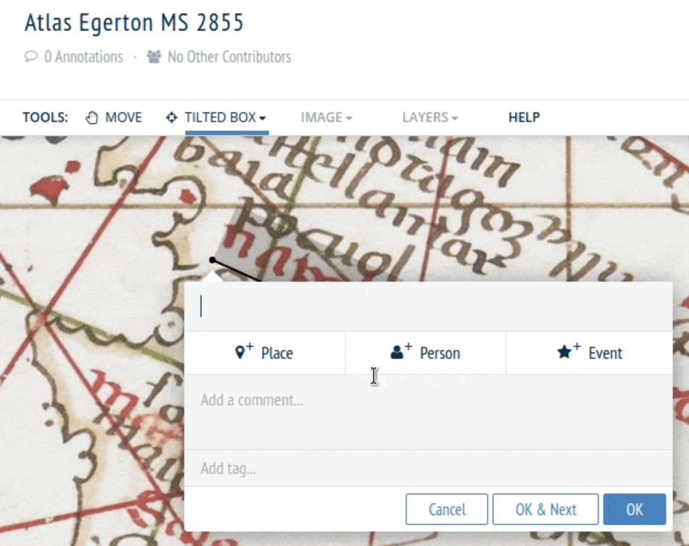
Recogito
fully graphical
select image fragments
with the mouse
1. upload a document
2. annotate your document
e.g., image
underlying ontology
of entity types
all screenshots from https://recogito.pelagios.org/help/tutorial

Slide 18
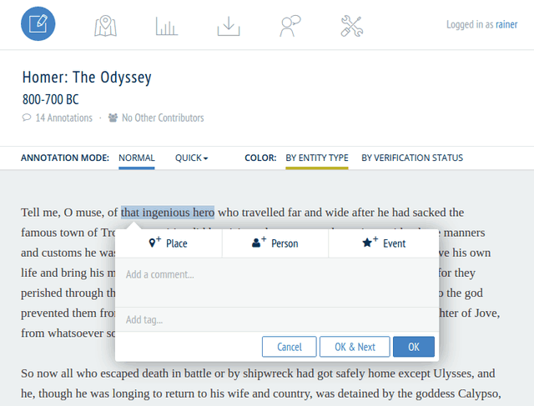
Recogito
fully graphical
select text fragments
with the mouse
1. upload a document
2. annotate your document
e.g., image or text
underlying ontology
of entity types
all screenshots from https://recogito.pelagios.org/help/tutorial

Slide 19
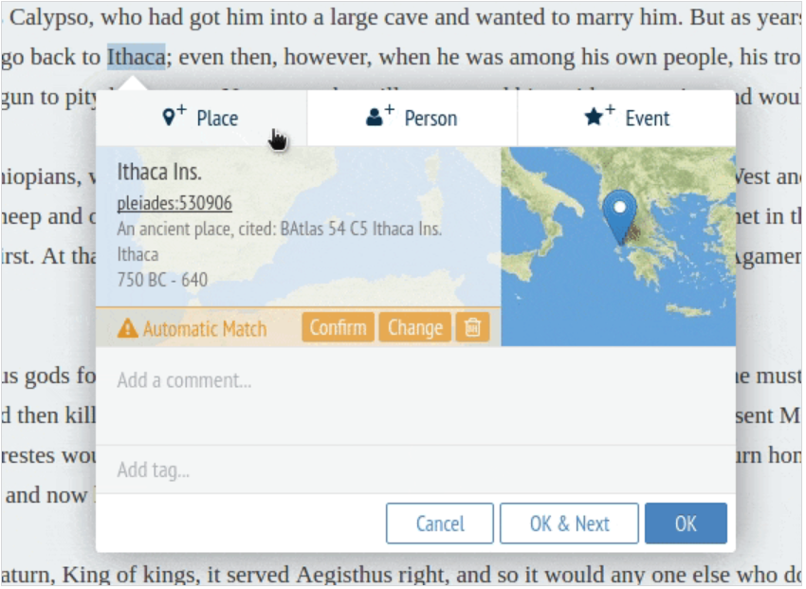
Recogito
fully graphical
1. upload a document
2. annotate your document
3. link with Gazeteers
annotation integrates
special-purpose views
for Geoinformation
all screenshots from https://recogito.pelagios.org/help/tutorial

Slide 20
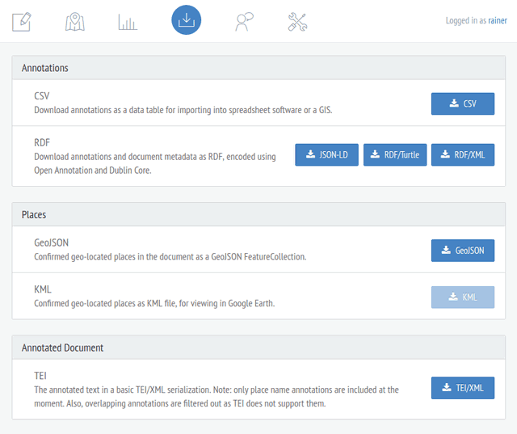
Recogito
fully graphical
1. upload a document
2. annotate your document
3. link with Gazeteers
4. export and share
illustrates the potential to develop applications for end users
... the tool itself is for a very restricted use case

Slide 21
Web Annotation
Strengths
very generic
multi-modal
extensible
full-fledged W3C standard
relatively widely used
esp., bioinformatics, DH
Weaknesses
labelling & linking, only
no linguistic data structures
phrases?
relations?
very verbose
counter-intuitive terminology

