Slide 1
Peer-to-Peer search and recommendations of scientific literature
Leonardo D'Alonzo
Supervisor
Chiar.mo prof. Ing Paolo Ciaccia
TUDelft Supervisors
Dr. Ir. Johan Pouwelse
Dr. David Hales
Dr. Tamás Vinkó

Slide 2
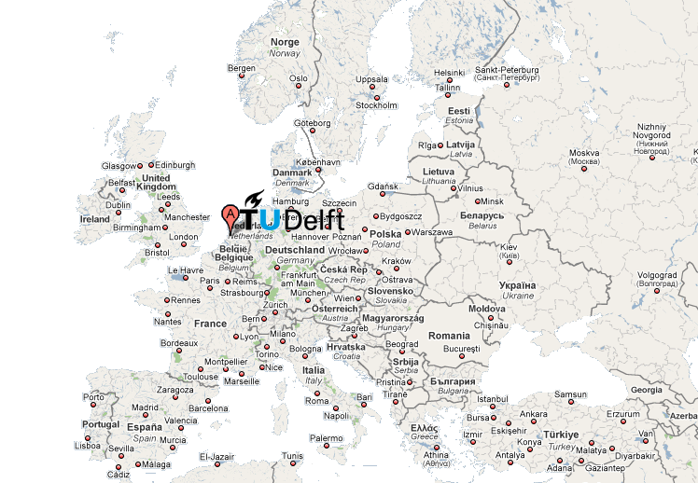
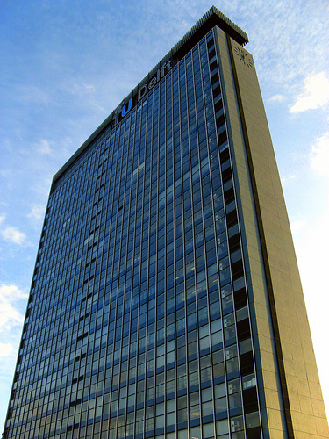
Acknowledgments
Introduction
System architecture
Learning information needs
Topology management
Search and recommendation
Conclusion
Parallel and Distributed
System Group
Faculty Electrical Engineering,
Mathematics and
Computer Science
Peer-to-Peer search and recommendation of scientific literature
Leonardo D'Alonzo

Slide 3
Overview
Introduction
System architecture
Learning information needs
Topology management
Search and recommendation
Conclusion
Motivation for a fully-decentralized approach to content location
Approach to proposed solution
    Underlying idea: exploiting network topology to ease content location
A fully-decentralized search and recommender system
    Aggregation of users with similar information needs
    Search and recommendation service built on top of a social network
Demo
Peer-to-Peer search and recommendation of scientific literature
Leonardo D'Alonzo

Slide 4








Motivation
Introduction
System architecture
Learning information needs
Topology management
Search and recommendation
Conclusion
Most of p2p file sharing systems rely on centralized information retrieval service
    Global knowledge of available contents
    High cost (scalability, dependability, maintenance)
    Prone to data exploitation
publish
query
publish
response
Peer-to-Peer search and recommendation of scientific literature
Leonardo D'Alonzo

Slide 5
Objective of this thesis
Introduction
System architecture
Learning information needs
Topology management
Search and recommendation
Conclusion
Goal
Crafting the foundations of a fully-decentralized search and recommender system for text-based documents
Settings
    Highly-populated, highly-dynamic p2p networks
    Contents are provided by peers
    Each node has a partial view of the network
        Overlay network
    Keyword-based access to information retrieval
Key concern
    Global knowledge of available contents requires high costs
Peer-to-Peer search and recommendation of scientific literature
Leonardo D'Alonzo

Slide 6
Organizing network topology around data
Introduction
System architecture
Learning information needs
Topology management
Search and recommendation
Conclusion
Semantic proximity of information should be mapped into an overlay network topology in order to ease content location
Underlying idea
Agents of a population self-organize into a connection topology which reflects similarities between users information needs.
Each user is supported by an agent which learns his information needs
Key concerns
    How to capture user information needs?
      They are dynamically changing
    How to manage network topology in a decentralized fashion?
      Low-intrusion principle
      Fast adaption to dynamics
Peer-to-Peer search and recommendation of scientific literature
Leonardo D'Alonzo

Slide 7
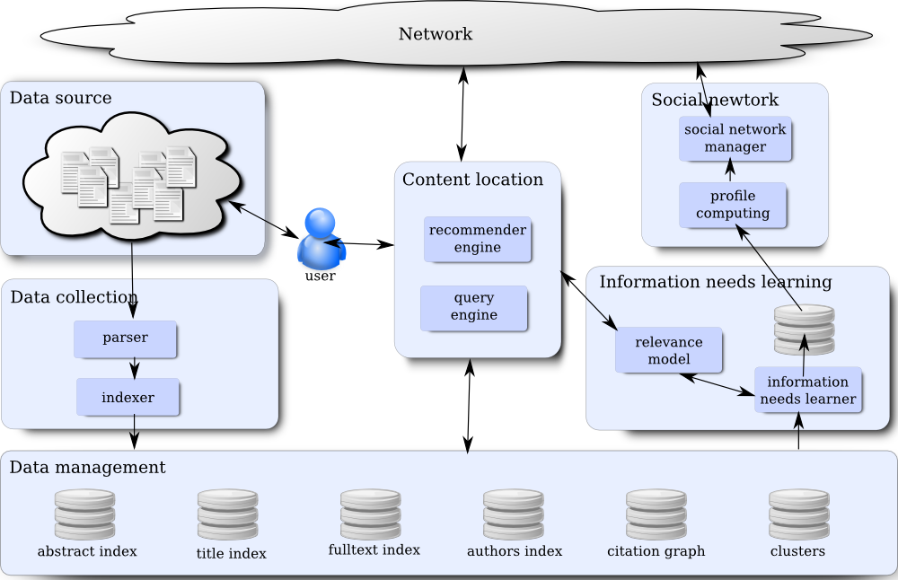
Agent architecture
Introduction
System architecture
Learning information needs
Topology management
Search and recommendation
Conclusion
Peer-to-Peer search and recommendation of scientific literature
Leonardo D'Alonzo

Slide 8

Collecting data
Introduction
System architecture
Learning information needs
Topology management
Search and recommendation
Conclusion
Research papers which have been read by user are locally collected
  The agent builds a local database
Which data model should be used?
  a fine-grained model allows better definition of the relevance model
  difficult of extracting structured information from visual layout documents
      machine learning algorithm as state-of-the-art
proof-of-concepts:
We designed a system which extracts title, abstract, fulltext, citations from pdf scholarly papers
  hybrid approach: rule based parser + machine learning algorithm
    fast prototyping
    difficult to adapt to new data
Peer-to-Peer search and recommendation of scientific literature
Leonardo D'Alonzo

Slide 9

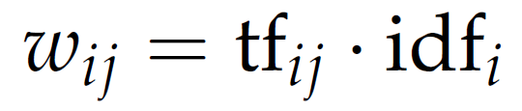
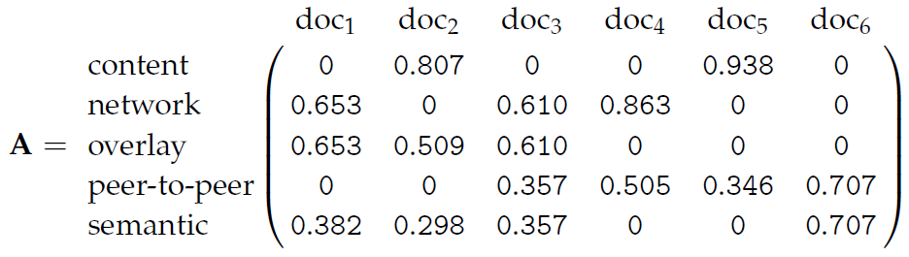
Vector Space Model
Introduction
System architecture
Learning information needs
Topology management
Search and recommendation
Conclusion
An algebraic model for representing text
A vocabulary of t words is treated as the basis of a vector space
Combination of words (i.e. text) is turned into a vector
Semantics of text can be estimated by relying on statistical model of language
Tf-Idf weighting scheme
  Term frequency
      local weight which depends on number of occurrences
  Inverse document frequency
      global weight: discriminative power within a collection
Peer-to-Peer search and recommendation of scientific literature
Leonardo D'Alonzo

Slide 10
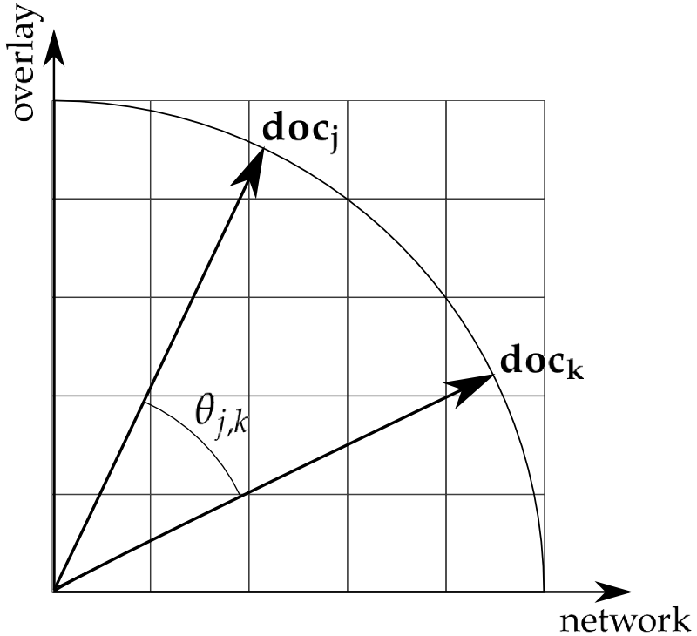
Computing similarities
Introduction
System architecture
Learning information needs
Topology management
Search and recommendation
Conclusion
Similarity between documents
Computed as Euclidean distance between corresponding normalized vectors
    Cosine similarity
Criticism
    Document semantics relies on a lexicon based model
        Inability to deal with natural language ambiguity
        Latent Semantic Indexing offers a better model of document semantics by performing linear algebraic operations on the Vector Space Model
Peer-to-Peer search and recommendation of scientific literature
Leonardo D'Alonzo

Slide 11
Learning user information needs
Introduction
System architecture
Learning information needs
Topology management
Search and recommendation
Conclusion
How to learn user information needs?
The agent should learn user information needs by relying on a model which takes into account a number of objective measurements of user interaction with the system:
    Semantics of documents which have been read
    Time spent while reading documents
    Tracking of issued queries
    …
Model should be shaped by relying on a machine learning approach
proof-of-concepts:
We rely just on user's collected documents
    User information needs are estimated with the centroid of document vectors computed according to vector space model
Peer-to-Peer search and recommendation of scientific literature
Leonardo D'Alonzo

Slide 12
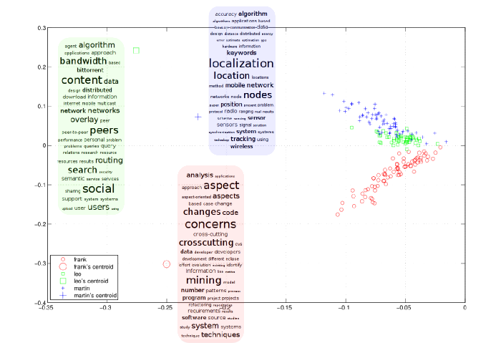
Locality of interests principle
Introduction
System architecture
Learning information needs
Topology management
Search and recommendation
Conclusion
Peer-to-Peer search and recommendation of scientific literature
Leonardo D'Alonzo

Slide 13
Topology construction problem
Introduction
System architecture
Learning information needs
Topology management
Search and recommendation
Conclusion
Each agent has:
    a profile
    a ranking function which defines an order over nodes profile
    a partial view of size c of the network
Topology management as a membership service middleware
The goal is to build the views of each node such that each view contains the first c elements according to the order defined by the ranking function
How to manage topology in highly-dynamic, highly-populated network with the minimum intrusion and without the need of a global view?
Gossip protocol: probabilistic multicast scheme
  Model to spread information among a large number of processes with dynamic collection topology
  Robust and scalable even in presence of high rate failures
Peer-to-Peer search and recommendation of scientific literature
Leonardo D'Alonzo

Slide 14
Aggregating users with similar interests
Introduction
System architecture
Learning information needs
Topology management
Search and recommendation
Conclusion
User profile
In order to keep light the protocol we rely upon an approximation of user documents centroid
    we retain just the most 30-weighted terms according to td-idf
Ranking function
Users information needs similarity is computed by cosine similarity between corresponding approximated documents centroids
    Documents centroids must refer to the same basis
        Terms are spread together with their weights
Social network of researchers
  Agents aggregates users with similar information needs
  Friendships emerge around data
Peer-to-Peer search and recommendation of scientific literature
Leonardo D'Alonzo

Slide 15







Searching on top of a social network
Introduction
System architecture
Learning information needs
Topology management
Search and recommendation
Conclusion
Network topology facilitates content location
Querying the system
User queries are routed by exploiting the network topology
  Relevant information is expected to be located in the user neighborhood
      We limit the search radius to the first connection level
  Effectiveness of the model resides in the ability of estimating user information needs and in his locality of interests
query
Peer-to-Peer search and recommendation of scientific literature
Leonardo D'Alonzo

Slide 16
Recommendation as collaborative filtering
Introduction
System architecture
Learning information needs
Topology management
Search and recommendation
Conclusion
Collaborative filtering
Agents adapt available information to each user information needs
Recommendation model
User's neighborhood recommends their contents which are most similar to user information needs
  We rely on a linear combination of cosine similarity and link analysis
I recommend
you...
my profile
is...
I recommend
you...
I recommend
you...
I recommend
you...
Peer-to-Peer search and recommendation of scientific literature
Leonardo D'Alonzo

Slide 17
Conclusions
Introduction
System architecture
Learning information needs
Topology management
Search and recommendation
Conclusion
Centralized information retrieval systems requires sizeable capital investments and are prone to data exploitation
Contribution
We designed a proof-of-concept prototype of a fully-decentralized search and recommender system for scientific literature
  Search and recommendation as a service developed on top of a proactively managed social network
      Aggregation of users with similar interests
  user interests are automatically learned by tracking his reading habits
Future work should improve:
  relevance model
  user information needs estimation
  agent profile and ranking function in order to achieve desirable clustering of information
Peer-to-Peer search and recommendation of scientific literature
Leonardo D'Alonzo

Slide 18
Demo and Question time
Introduction
System architecture
Learning information needs
Topology management
Search and recommendation
Conclusion
Peer-to-Peer search and recommendation of scientific literature
Leonardo D'Alonzo

Slide 19
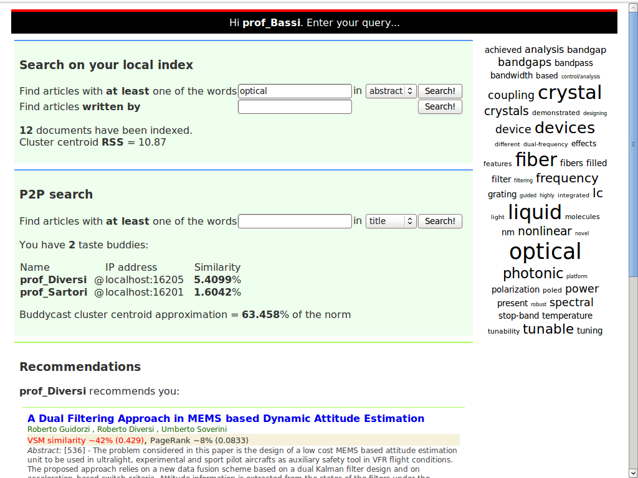
Introduction
System architecture
Learning information needs
Topology management
Search and recommendation
Conclusion
Peer-to-Peer search and recommendation of scientific literature
Leonardo D'Alonzo

Slide 20
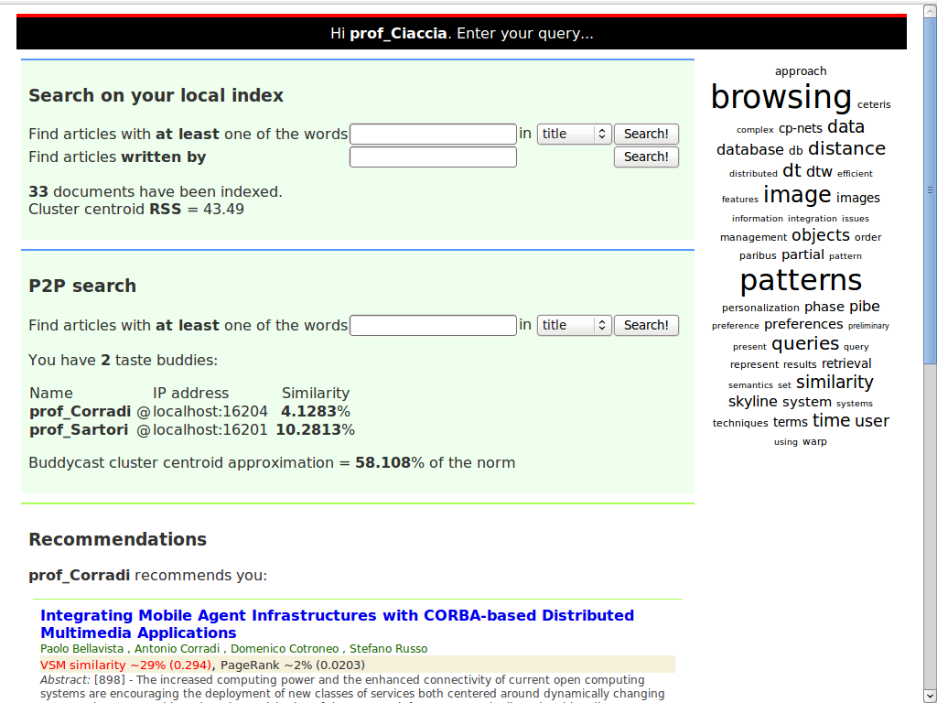
Introduction
System architecture
Learning information needs
Topology management
Search and recommendation
Conclusion
Peer-to-Peer search and recommendation of scientific literature
Leonardo D'Alonzo

Slide 21
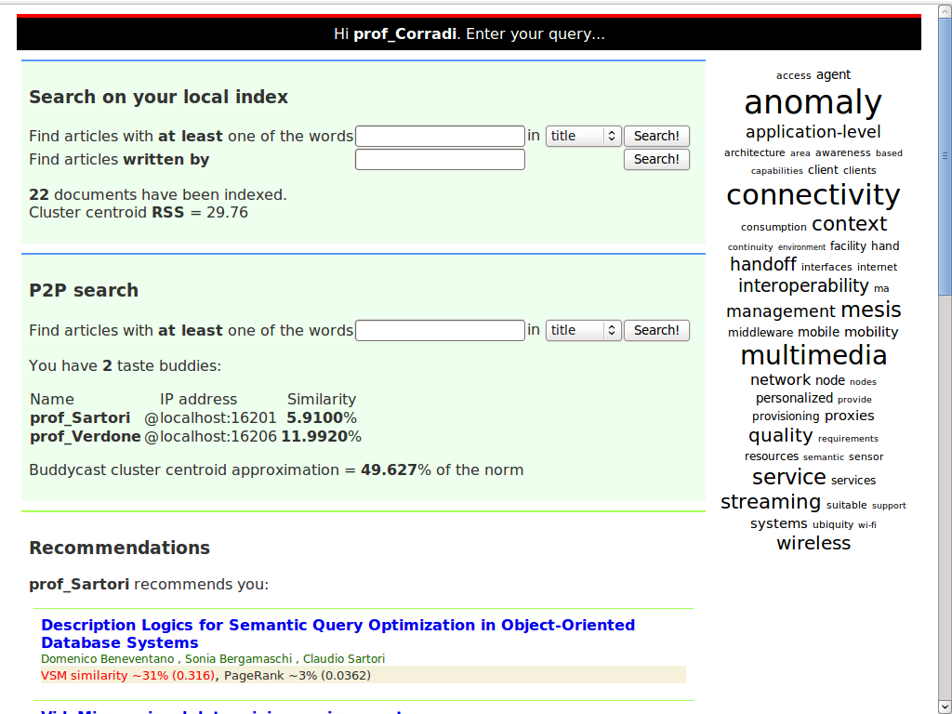
Introduction
System architecture
Learning information needs
Topology management
Search and recommendation
Conclusion
Peer-to-Peer search and recommendation of scientific literature
Leonardo D'Alonzo

Slide 22
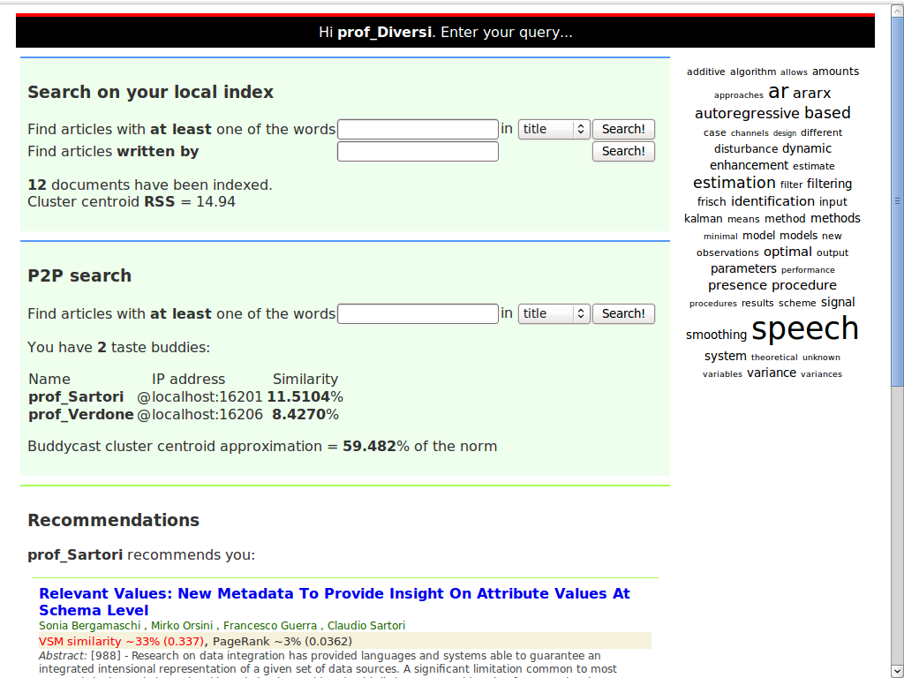
Introduction
System architecture
Learning information needs
Topology management
Search and recommendation
Conclusion
Peer-to-Peer search and recommendation of scientific literature
Leonardo D'Alonzo

Slide 23
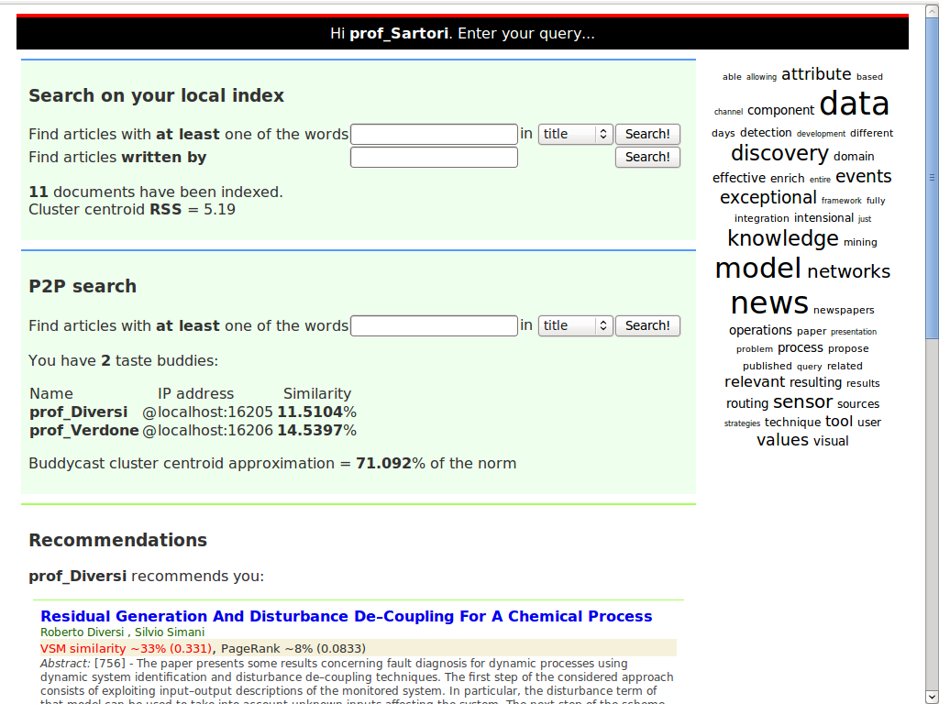
Introduction
System architecture
Learning information needs
Topology management
Search and recommendation
Conclusion
Peer-to-Peer search and recommendation of scientific literature
Leonardo D'Alonzo

Slide 24
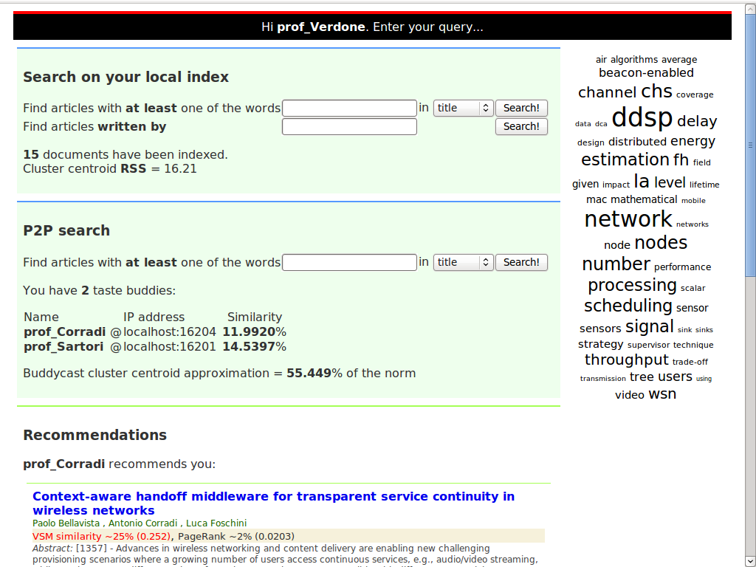
Introduction
System architecture
Learning information needs
Topology management
Search and recommendation
Conclusion
Peer-to-Peer search and recommendation of scientific literature
Leonardo D'Alonzo

Slide 25
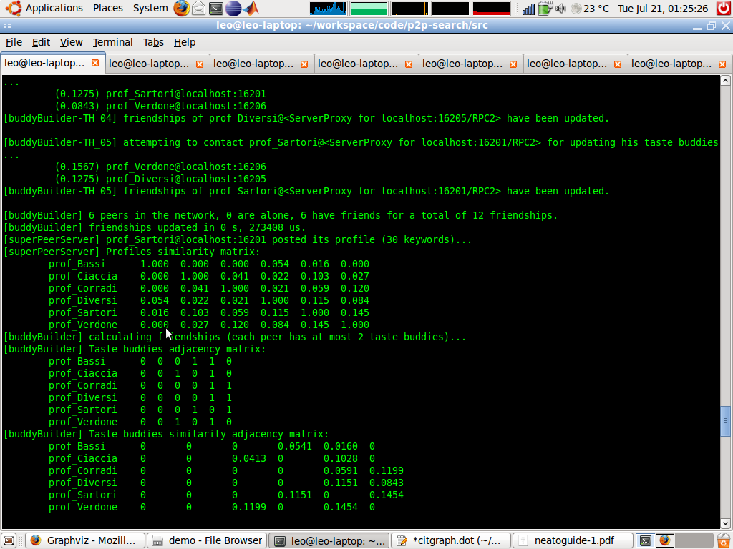
Introduction
System architecture
Learning information needs
Topology management
Search and recommendation
Conclusion
Peer-to-Peer search and recommendation of scientific literature
Leonardo D'Alonzo

