Slide 1
HOW AI CODING AGENTS
REALLY READ CODE
Inside the Runtime: Inspection, Memory, and Control
Leandro Damasio | AI Agents Montreal | February 23, 2026
Runtime > Prompt

Slide 2

About Me
Leandro Damasio
AI Systems Engineer | São Paulo, Brazil
🏦 Enforce (BTG Pactual Group)
AI platforms for financial & legal domains — governance is structural, not optional
⚙️ Agentic runtimes, vector search, context governance, LLM in production
🤖 Also building Robson — open-source AI trading agent
(you will see it in the demo)
🔗 linkedin.com/in/ldamasio

Slide 3

Memory Governance — Caught in the Wild
screenshot from claude.ai
This is memory governance in action.
If a simple web chat needs this...
what about a coding agent that runs for one hour and reads hundreds of files?

Slide 4
Brain vs Body
Brain (LLM) | Body (Runtime)
Intelligence | Eyes: Inspection
Reasoning | Memory: Governance
Decisions | Hands: Tool execution (MCP)
 | Limits: Control + Policy engine
 | Perception filter: Tool governance
The model reasons. The runtime acts.

Slide 5
The Thesis
The magic is not in the prompt.
It is in the runtime.
A tutorial teaches:
call API → execute tool → loop
That is a demo.
Missing: governance, policy engine, execution identity, cost control, tool governance.
Runtime
>
Prompt
This talk is what comes after the agent from scratch tutorial.

Slide 6
The Chain
TOOL GOVERNANCE
The runtime decides which tools are visible
INSPECTION
The agent explores files and builds context
COMPACTION
The runtime shrinks context to fit limits
PERSISTENCE
Knowledge moves from session to repository
RECALL
The agent loads persisted knowledge back
ACTION
The agent acts on recalled knowledge
CONTROL
The runtime enforces policy on the action
The quality of this chain determines the quality of the agent.

Slide 7
What Agents Really Do
"Most agents don't read code.
They grep it."
What people assume
What actually happens
The real shift
The agent reads code, understands it, reasons about it.
The agent searches strings, matches patterns, opens files.
Real reading starts when search becomes navigation — where a function is defined, who calls it, what type it returns.
That is the "REALLY" in the title.

Slide 8
The Reading Stack — 4 Layers
L4
External Capability
Protocol-injected via MCP — type checkers, formatters, static analyzers
L3
Semantic Intelligence
LSP: goToDefinition, findReferences · Tree-sitter AST · Turbopuffer (Cursor) · Claude Code LSP (Dec 2025)
L2
Wrapped Tools (Runtime-managed)
Claude Code: Read, Glob, Grep, LS · Codex CLI: read_file · Gemini CLI: ReadFileTool
Three companies → same design = same solution, found independently
L1
OS-Native Commands
grep · cat · ls · git diff · npm test · pytest ← behavioral reading
Kernel syscalls: open, read, stat
Most reading happens at L1 + L2. The runtime governs the OS — it does not replace it.

Slide 9
The Governance Tension — Issue #21696
Claude Code system prompt (3 independent sources):
"You MUST avoid using search commands like find and grep. Use Read and LS instead."
But: Claude Code frequently ignores this and uses cat, ls, find via Bash anyway.
GitHub Issue #21696 · anthropics/claude-code · Jan 2026 · Closed as 'duplicate' = known recurring problem
Runtime governance is necessary — but not enough.
Model compliance is not guaranteed.

Slide 10
Four Ways to Read Code
Textual
Structural
Semantic
Behavioral
How: String matching
Ex:
grep, cat, find
Layer:
L1-L2
Most agents live here
How: Syntax parsing
Ex:
AST, LSP, Tree-sitter
Layer:
L3
Navigate code like a graph
How: Similarity matching
Ex:
Embeddings, vector search
Layer:
Cross
Based on meaning, not exact match
How: Observing execution
Ex:
npm test, pytest, stacktraces
Layer:
L1 out
Read code by watching it run
No agent today fully integrates all four. That is the frontier.

Slide 11
Four Design Patterns — How Code Reaches the Model
CLI-Wrapper [PULL] — Claude Code · Codex CLI · Gemini CLI
A
LLM calls named tools. Tool wraps OS command + governance.
IDE-Hybrid [HYBRID] — Cursor (only hybrid)
B
@codebase = PUSH (editor indexes+embeds+injects)
Agent Mode = PULL (read_file, grep_search)
codebase_search = bridge
Library-Direct [PRE-COMPUTED] — Aider
C
Host reads via Tree-sitter. LLM receives context — never calls tools.
Agent Host [DELEGATED] — Zed
D
Editor provides surface. External agents bring their own tools.
The design choice shapes what the model can perceive.

Slide 12
Caching Architecture
CLAUDE CODE
CURSOR
AIDER
COLD START
WARM START
COLD START
Prompt cache (API-level, in-session)
No memory between sessions
Embedding cache · Merkle tree sync
Turbopuffer · .cursor/rules/
≤3 min behind
Repo map (Tree-sitter)
Regenerated every session
Caching determines what the agent already knows before you type.

Slide 13
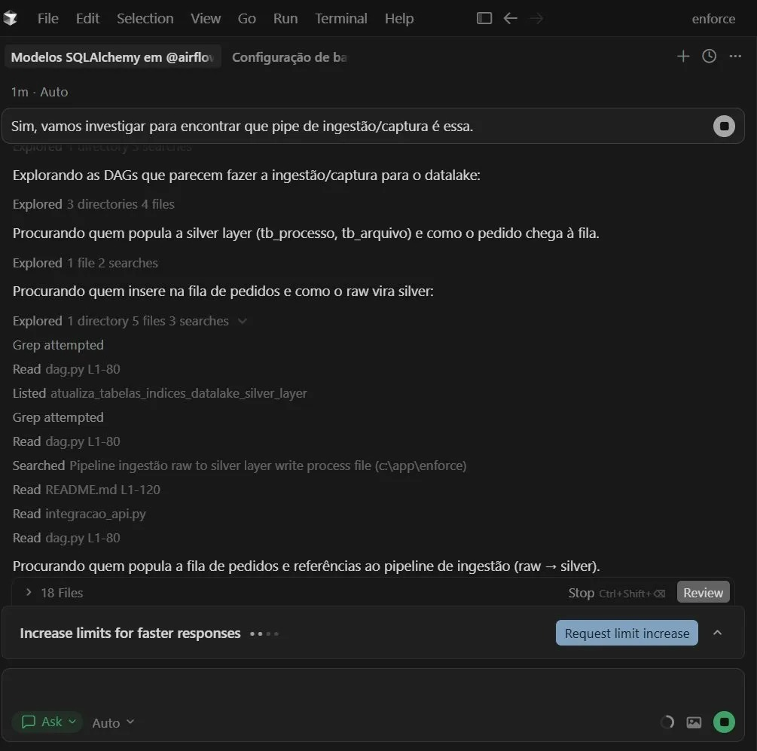
Inspection — Observed in Cursor
INSPECTION
Explored 3 directories · 4 files
Grep attempted · Read dag.py L1-80
Searched Pipeline ingestão raw to silver
18 Files total
Each step grows the explored set.
Each step costs tokens.

Slide 14
Memory Layers
L0
HIDDEN CONTEXT
Tool definitions invisible until requested · Deferral moves tools here
L1
EXECUTION BUFFER
What the model sees right now · Compaction shrinks this
L2
WORKING MEMORY
Session-local: context window + caches · Ephemeral
L3
ARCHIVE
Git repo · docs/ · rules/ · Survives sessions
COMPACTION Layer 1 shrinks
PERSISTENCE Layer 2 → Layer 3
RECALL Layer 3 → Layer 1
DEFERRAL Layer 1 → Layer 0

Slide 15
The Memory Cycle — Observed in Cursor
1
CREATE
Plan generated — stored outside the project
(observed: C:\Users\leandro.damasio\.cursor\plans\)
2
PERSIST
cp → docs/ARCHITECTURE.md + git add (Layer 3 — repo)
3
RECALL
"Read ARCHITECTURE.md" (Layer 3 → Layer 1)
4
ACT
Apply patches: +4 -2, +3 -3
5
CONTROL
Review gate — developer approves 21 files
Create → Persist → Recall → Act → Control. The full chain in action.

Slide 16
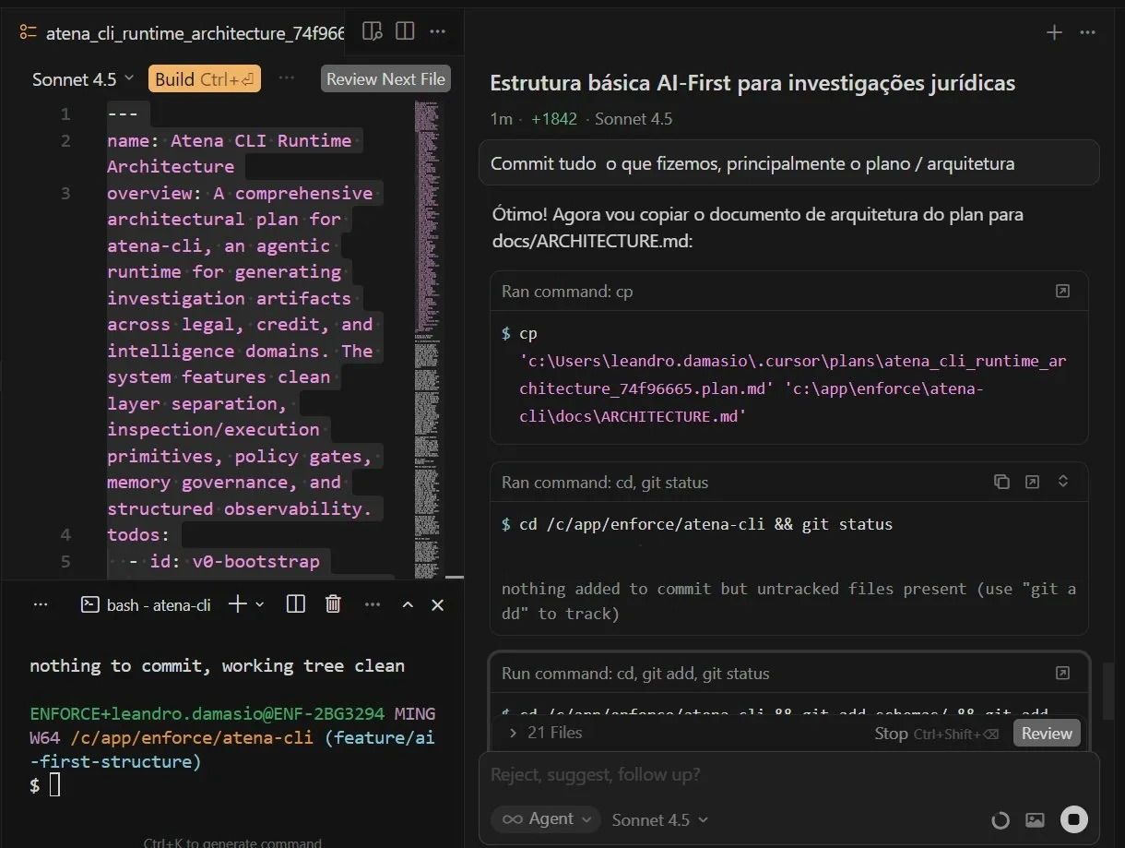
Persistence — Observed in Cursor
PERSISTENCE: Layer 2 → Layer 3
OBSERVED: Plan existed outside the repository (C:\Users\leandro.damasio\.cursor\plans\) · Agent moved it in via cp + git add · 21 files
UNKNOWN: Whether Cursor always stores plans at that path — or whether the agent created the folder itself.

Slide 17
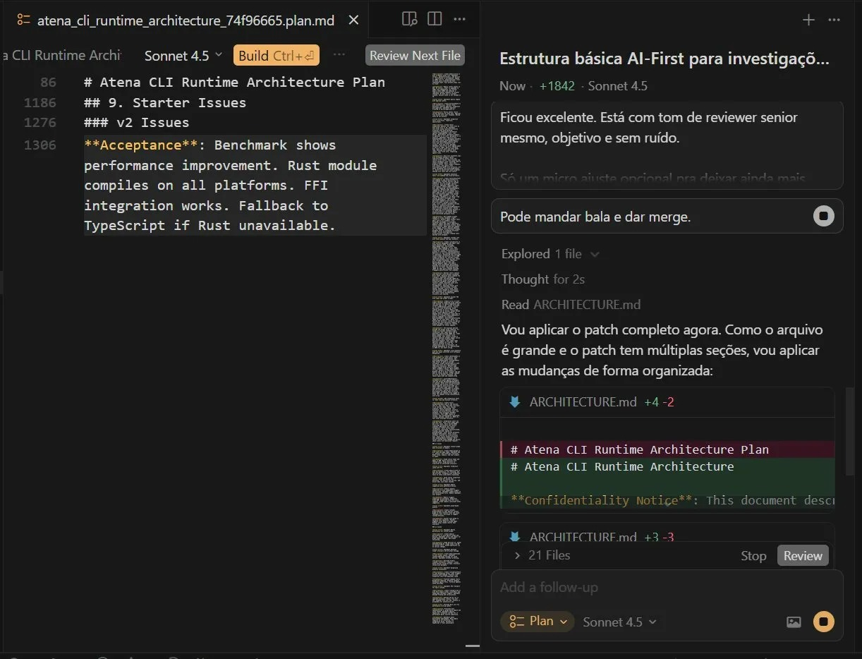
Recall + Action + Control — Observed in Cursor
RECALL → ACTION → CONTROL
Explored 1 file · Thought for 2s
Read ARCHITECTURE.md
← RECALL: L3 → L1
ARCHITECTURE.md +4 -2
ARCHITECTURE.md +3 -3
← ACTION
> 21 Files [Stop] [Review]
← CONTROL
The plan — stored outside the repository — drove the edits. That is the chain.

Slide 18
Three Compaction Mechanisms
Runtime compaction
When: During session
Claude Code at 98% context
Filtering before loading
When: Before loading
Aider: Tree-sitter → PageRank → 1K token budget
Deferral
When: Before session starts
Tool Search: defer_loading above 10K tokens
Cursor A/B test: 46.9% token reduction in multi-MCP scenarios.
What must survive compaction must be persisted.

Slide 19
What We Know and What We Don't
We saw it directly
OBSERVED
Cursor 46.9%, Claude Code compaction message
Reasonable guess
INFERRED
Claude Code server-side compaction
Cannot verify
UNKNOWN
Internal policy, closed code
Observe, don't assume.

Slide 20
Execution Path Over Output
Agent A
Agent B
Inspected: 5 files
Inspected: 50 files
Output: PASS
Output: PASS
Output eval: EQUAL
Output eval: EQUAL
Output eval: equal. Path eval: very different.
RLVR (R-L-V-R): evaluates the full execution path — not just the output.
Execution path over output. Process over product.

Slide 21
Context Pollution — The Pre-Inspection Problem
MCP Server | Tools | Token Cost
GitHub | 91 | ~46,000
Playwright | 21 | ~9,700
AWS Cost Explorer | 7 | ~9,100
Developer A: 66,000 tokens consumed before typing anything.
Developer B: 82,000 tokens — 41% of the 200K context window.
The agent starts with less than 60% of its context available for actual work.
More tools ≠ more capable. Ungoverned tools = context pollution.

Slide 22
Tool Search — Runtime Governance of Tool Visibility
Anthropic | January 2026
1
Runtime checks: tool definitions > 10K tokens?
2
If yes: tools marked defer_loading: true → Layer 0 (hidden)
3
Model receives a search tool instead of all definitions
4
Model searches by keyword → 3-5 tools loaded (~3K tokens)
Result: 85% reduction in tool token overhead.
The runtime governs what the model can even perceive.

Slide 23
Tool Search — The Empirical Proof
Model | Without Tool Search | With Tool Search | Delta
Opus 4 | 49% | 74% | +25pp
Opus 4.5 | 79.5% | 88.1% | +8.6pp
Same model. Same prompt. Same task.
Different runtime. Different behavior.
This is empirical evidence for Runtime > Prompt.
Source: Anthropic MCP evaluation suite. Vendor benchmarks, not independently verified.

Slide 24
The Runtime Map — Nine Agents, Two Axes
Governance Unknown*
8GB RAM, no visible compaction · Tool Search = visible tool governance
Medium
Claude Code
Runtime-Managed
46.9% reduction (A/B test) · 4x caching
High / Med
Cursor, Gemini CLI
Provider-Managed
API-level caching
Medium
Codex CLI, Trae, OpenCode
State-Bounded
FSM / ACP threads / bounded retrieval
Varies
Robson, Zed, Antigravity
No ranking. Categories, not tiers. Evidence evolves.

Slide 25
Cost — What You're Actually Paying For
Real cost =
tokens
retries
fixes
compaction overhead
wasted context
If 41% of your context window is tool definitions, you pay for tokens the agent never uses.
Tool Search reduces that by 85%. Not just accuracy — money.
Agents with good memory governance tend to be more cost efficient.
Based on observed patterns — not a proven causal claim.

Slide 26
Production — What Breaks + What Fixes It
Problem | Solution | Chain Position
No replay, no debug | Execution identity (run_id) | OBSERVABILITY
Model does forbidden actions | Policy engine (path/cmd restrictions) | CONTROL
God files (3000+ lines) | Split into modules | INSPECTION
No README → no orientation | Add AGENTS.md | INSPECTION
Too many MCP tools | Scope servers; use Tool Search | CONTROL
Can't reproduce | Version everything | ALL
Without execution identity, you have demos. With it, you have infrastructure.
Without guardrails, you have a demo. With guardrails, you have a product.

Slide 27
🖥️ Live Terminal — The Chain in Action
Command | Chain Node | Reading Mode
rg "TODO" . | Structural — Layer 2 | Textual — Layer 1
fd -e py . | FILE DISCOVERY | Textual — Layer 1
bat file.py --line-range 40:80 | READING | INSPECTION → L1
git log --oneline + git diff | PERSISTENCE / RECALL | INSPECTION
tokei . | REPO MAP | TOOL GOVERNANCE
pytest | rg "FAILED" | BEHAVIORAL | Mode 4 — the frontier
The model did none of this. The runtime did all of it.
⚠️ SWITCH TO TERMINAL NOW — Alt+Tab → PowerShell

Slide 28
Demo — Robson: Open-Source FSM
PLANNING
SEARCHING
READING
ANALYZING
→
→
→
Each state limits what the agent can do. Governance is structural.
run_id: "robson-demo-001"
├── state_changes: PLANNING → SEARCHING → READING → ANALYZING
├── files_inspected: 12
├── tokens_used: 8,400
└── outcome: analysis_complete
github.com/rbx-systems/robson

Slide 29
The Complete Picture
┌──────────────────────────────────────────────────────┐
│ │
▼ │
TOOL GOVERNANCE (defer/search) │
→ INSPECTION → COMPACTION → PERSISTENCE → RECALL │
→ TOOL INTENT (model) → EXECUTION (runtime via MCP) │
→ CONTROL (POLICY ENGINE) → EVALUATION │
→ EXECUTION IDENTITY → VERSIONING → EVALS ───────────────┘
The chain starts before the model sees anything.

Slide 30
What's Emerging
MCP Tool Search
ALREADY SHIPPING
Graph-first code inspection
EARLY STAGE
Execution identity as standard
DIRECTION
Dynamic context governance
DIRECTION
The chain is becoming the industry standard.

Slide 31
What You Can Do Monday Morning
Add AGENTS.md to your repo
30 min
INSPECTION
Store architecture decisions in docs/
30 min
PERSISTENCE
Add run_id to your agent scripts
1 hour
EXECUTION IDENTITY
Scope MCP servers to project needs
1 hour
CONTROL
Small changes. Big impact on the chain.

Slide 32
How AI Coding Agents REALLY Read Code
They govern what enters context before work starts
They inspect to build understanding
They compact to fit limits
They persist to survive sessions
They recall to act on past knowledge
The runtime governs every step. Runtime > Prompt.

Slide 33
References
Allen, F.E.
Control Flow Analysis — ACM SIGPLAN
1970
Russell & Norvig
AIMA — Rational agents: perceive + act
1995
Katz, J.
Cursor Blog — Dynamic Context Discovery
Jan 2026
Lindenberg, A.
Evals: Foundation of Reliable AI Agents — LinkedIn
Feb 2026
Anthropic Eng.
MCP Tool Search — dynamic tool discovery
Jan 2026
Anthropic Eng.
Claude Code LSP v2.0.74
Dec 2025
Aider / Gauthier
Tree-sitter repo map — open-source
Oct 2023
GitHub #21696
anthropics/claude-code — wrapper disobedience
Jan 2026
Cursor blog
46.9% token reduction — A/B test (HIGH confidence)
2026
Anthropic eval
Opus 4: 49%→74% accuracy (MEDIUM — vendor)
2026

Slide 34
Thank you, Montreal.
Leandro Damasio
AI Systems Engineer | São Paulo, Brazil
🔗 linkedin.com/in/ldamasio
Runtime > Prompt.
The model reasons. The runtime acts.
Same model. Different runtime. Different behavior.
The chain is the architecture.
Be aware of scams.

