Slide 1
STACK DSA
Home Health Care Agencies -
Patient Care Quality Rating
Author: Lois Dankwa
Date: June 18, 2020
Capstone Project –
Data Science & Analytics Bootcamp with Stack Education

Slide 2
Project Goal
To be a successful Home Health Care Agency (HHA), providing quality care to clients whilst promoting independence and ensuring highest standard to quality of life is paramount.
The goal is to try to identify measures of care reviewed by Medicare that directly result in higher quality rating by predicting the overall Patient Care Quality Rating for an Agency.

Slide 3
Background
Hypothesis:
Fewer clients visit to the hospital (Admit.Hosp) would result in a higher Patient Care Quality Rating (Care.Stars)
This was only partially the case
Results:
Other measurements, like improved walking (Move.Care) and getting in and out if bed (Bed.Move) had greater positive correlation to Care.Stars

Slide 4
Data
Data | Provided by
11,170 observations 71 variables 55 states represented | HealthData.gov Publisher : Centers for Medicare & Medicaid Services (CMS) Release Date: 2020-04-30
Data Dictionary
Column names: "How.often.home.health.patients.had.to.be.admitted.to.the.hospital" "How.often.patients.got.better.at.walking.or.moving.around” "No..of.episodes.to.calc.how.much.Medicare.spends.per.episode.of.care.at.agency..compared.to.spending.at.all.agencies..national.”

Slide 5
Data wrangling
Original dataset:
Columns
renamed all columns
column to be predicted: "Quality.of.Patient.Care.Star.Rating” – Care.Stars
Missing values
replaced with substituted values – only 4057 complete rows
New datasets:
Dataset | Contents | Data
AgencyDetails.csv | Location, certified date, services offered | 11,170 observations 15 variables
CareDetails.csv | Care assistance performed | 11,170 observations 20 variables

Slide 6
Feature Exploration
Dataset : "CareDetails.csv”
Questions asked to arrive at conclusion:
What is the distribution of the target variable, Care.Stars across all states?
How many agencies are in each state?- to remove any bias
Is there any correlation between the total number of Agencies in a state and their median Care.Stars?
Does having less Hospital Admissions corresponds to better higher quality care?
Any correlation to Care.Stars and amongst the features?
Could Care.Stars be predicted with the features that are highly correlated to it?

Slide 7
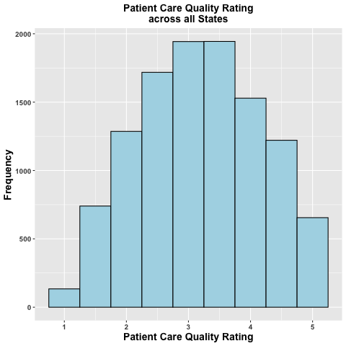
Feature Exploration
1. Distribution of the target variable, Care.Stars across all states.
ranges from 1 to 5
follows a Normal Distribution

Slide 8
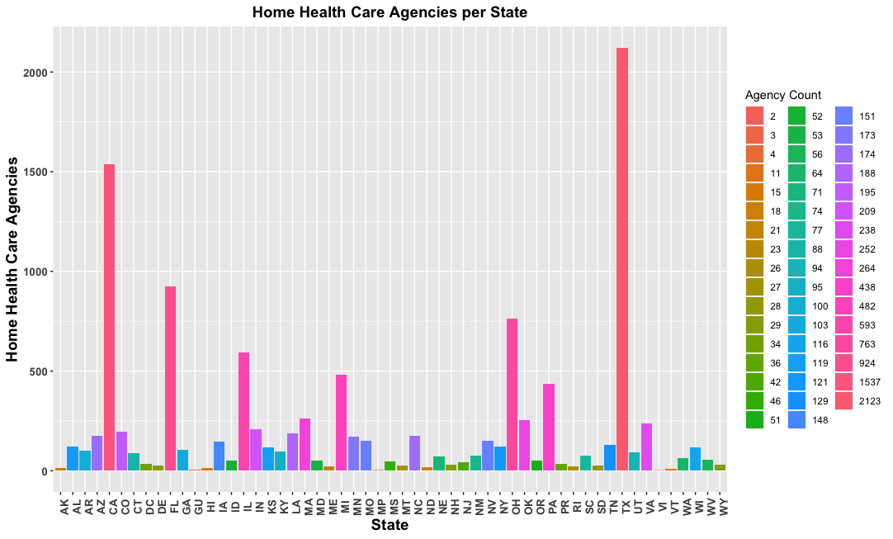
Feature Exploration
2. How many agencies are in each state? – to remove any bias
TX - 2123 maximum
VI – 2 minimum

Slide 9
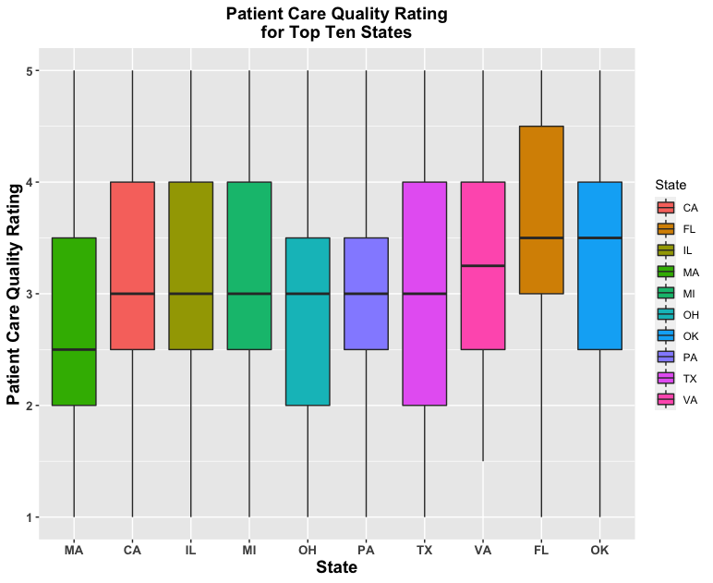
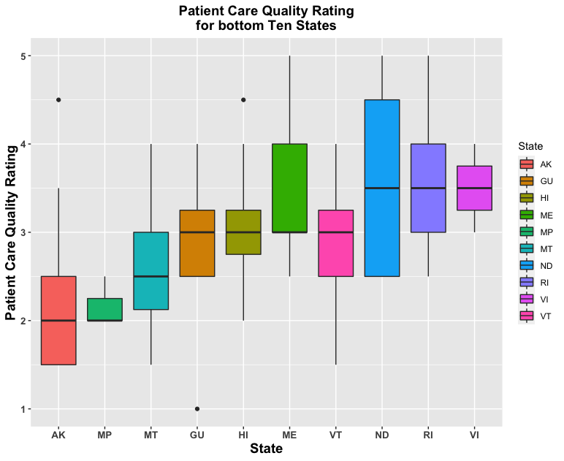
Feature Exploration
3. Is there any correlation between the total number of Agencies in a state and their median Care.Stars?

Slide 10
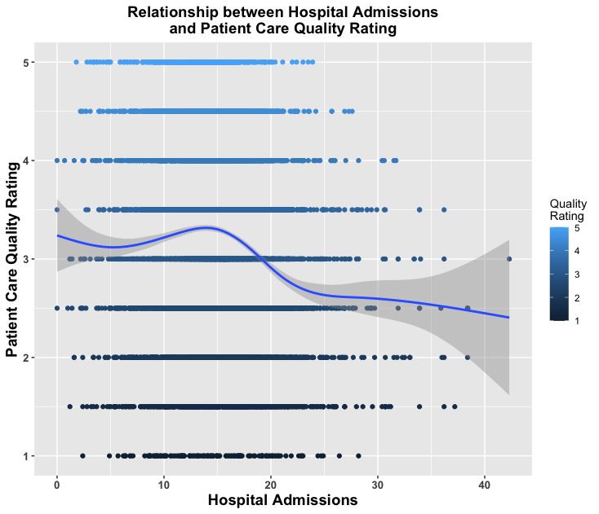
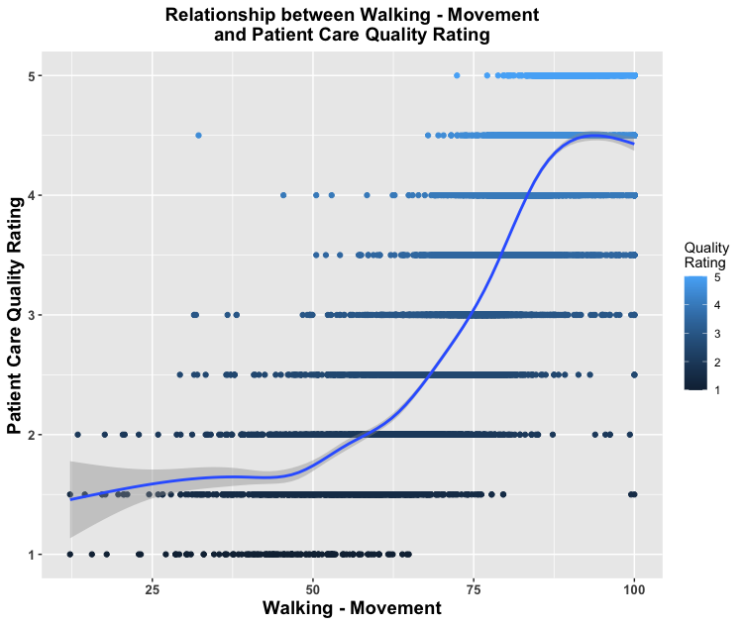
Feature Exploration
4. Does having less Hospital Admissions corresponds to higher quality care?

Slide 11
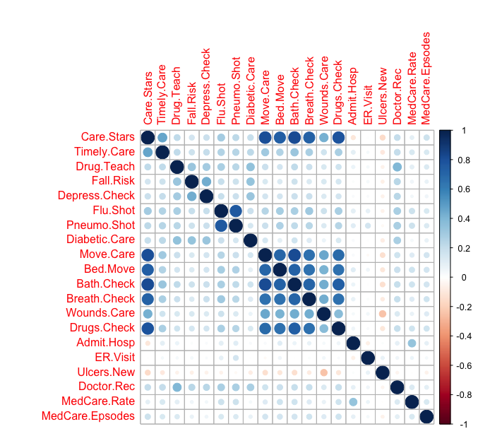
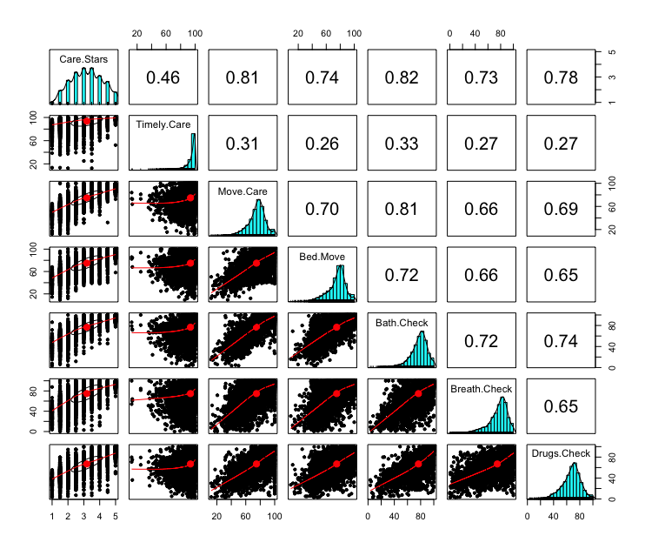
Feature Exploration
5. Any correlation to Care.Stars and amongst the features?
Correlation Matrix for all features
Pairwise Correlation for top features

Slide 12
Prediction
6. Could Care.Stars be predicted with the features that are highly correlated to it?
R packages used:
“ggplot2”, “caret”, “dplyr”, “rpart”, “randomForest”, “e1071”
Data split into 80/20 for train and test sets respectively
Three classification models were run with improved accuracy each time using confusion matrix for estimating accuracy
Classification Model Type | Accuracy
Tree Model | 46.1%
RandomForest Model | 63.41%
Support Vector Machines (SVM) Model | 65.56%

Slide 13
Conclusion
No more a ”wait-and-see” approach to how a Home Health Care Agency performs.
Based on the above analysis, HHAs could determine what Patient Care Quality Rating they would receive from Medicare and it is blind to location
HHAs could then put in place measures they are certain would improve the quality of life of their patients
In the future services provided by the HHAs would be taken into consideration when modeling to further increase the accuracy of prediction and thereby provide better insight to the HHAs as to the best combinations of services and care to offer their patients.

Slide 14
THANK YOU!

Slide 15
Appendix
https://healthdata.gov/dataset/home-health-care-national-data
https://www.geeksforgeeks.org/classifying-data-using-support-vector-machinessvms-in-r/
https://www.youtube.com/watch?v=An7nPLJ0fsg
https://www.rdocumentation.org/packages/mice/versions/3.9.0/topics/mice
http://www.sthda.com/english/wiki/visualize-correlation-matrix-using-correlogram
http://www.rebeccabarter.com/blog/2017-11-17-caret_tutorial/

