Slide 1
Contingency Management System
Leslie Ducray
Supervisor: Richard Lawlor

Slide 2
Project
A web application employing the principles of Contingency Management to aid staff of a drug treatment center.

Slide 3
Background
Contingency Management is a psycho-social treatment approach which focuses on the consequences of a person’s actions by rewarding or depriving them of incentives, based on their behaviour.
Personal correspondence
  Dr. Nancy Petry (low-cost contingency management treatment approach)
  Staff of a Dublin drug treatment center which employ a paper based approach.

Slide 4
Methodology
Aspects of the Agile Scrum Design Methodology applicable to a single developer development team.
System is divided into individual sprints/independent modules.
Plan and Design
Develop
Test and Review

Slide 5
Technologies
Operating System(s):Developed on Windows 7, compatible with any OS supporting a 'modern' web browser.
Programming Language(s): Java, JSP, JavaScript, JQuery, HTML5,CSS3 and Drools
Database(s): MySQL
Drools Rule Engine

Slide 6
Technical Architecture
3-tier architecture using J2EE core design patterns.

Slide 7
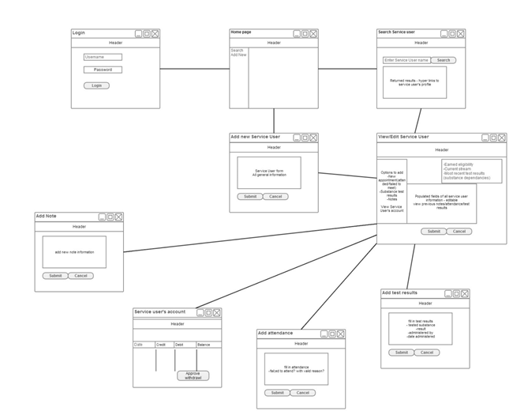
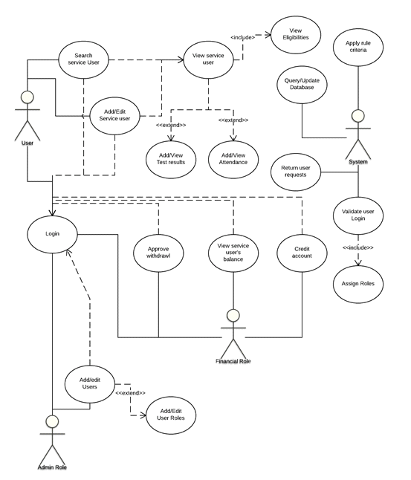
Front End
Front end rendered through client's web browser

Slide 8
Middle Tier
JavaBeans, Application Facades, Data Access Objects
JDBC MySQL Connector
Deployment Descriptor/Application Context

Slide 9
Back End
Client Information
  Identifying and demographic information
  Attendance/ substance test results/ Notes
  Transactions and account History

Slide 10
Risk Management and Mitigation
Integrating rule engine into the Java application.
Completing the full system
  Correct and reliable calculation and application of rules.
  Intended functionality and features.
  Presentable and intuitive user interface.
Horizontal Prototype (as displayed -Front End)
Vertical Prototype

Slide 11
Evaluation Criteria
Thorough full system testing based on per-defined test cases and user expectancies.
Evaluation will be based on the improved efficiency and productivity of real users of the Contingency Management approach
  Has their work load been reduced/ less laborious?
  Is the correct criteria applied?
  Correct results?
  Enhanced user experience?

Slide 12
Future Work
December – January
  Complete Front End – Middle Tier functionality through individual sprints.
  Document progress.
February – March
  Design and implement rule based system and integrate into Java application.
  Improve and enhance front end user interface.
  Test and Evaluate.
  Final report.

Slide 13
Thank you!
???
Questions
???

