Slide 1
LOOKING FOR A HOTEL

Slide 2
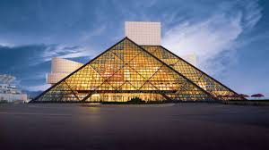
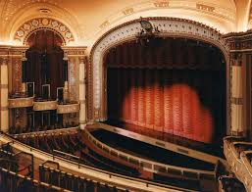
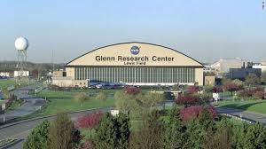
Cleveland is a cosmopolitan city, which offers residents and tourists a lot of artistic and cultural institutions.
It is very important to have a varied hotel offer that provides both national and international tourists a complete and totally enjoyable visit

Slide 3
DATA ACQUISITION AND CLEANING
Neighborhood Latitude Longitude
32 Woodland Hills, Cleveland 41.481389 -81.611389
31 Warehouse District, Cleveland 41.497500 -81.701667
30 University Circle 41.508611 -81.605278
29 Union-Mills Park 41.454889 -81.614389
28 Tremont, Cleveland 41.473611 -81.688611
.
.
.
4 Buckeye-Shaker 41.483889 -81.590556
3 Brooklyn Centre 41.453446 -81.699402
2 Broadway-Slavic Village 41.458056 -81.644722
1 Bellaire-Puritas, Cleveland 41.433682 -81.800140
0 Asiatown, Cleveland 41.508833 -81.680417
The data was take from Kaggle, named as Cleveland Neighborhoods
This is compous by 32 neighborhoods
The longitude and latitude is included
St. Clair-Suprerior and Nottingham, Ohio, are the unique ones without location information

Slide 4
The city offer many activities and places to visit, in the table it show the most common ones
vecis | 1st Most Common Venue | 2nd Most Common Venue | 3rd Most Common Venue | 4th Most Common Venue | 5th Most Common Venue | 6th Most Common Venue | 7th Most Common Venue | 8th Most Common Venue | 9th Most Common Venue | 10th Most Common Venue
0 | Asiatown, Cleveland | Rental Car Location | Credit Union | Gay Bar | Sandwich Place | Night Market | Nightclub | Chinese Restaurant | Recording Studio | Coffee Shop | Print Shop
1 | Bellaire-Puritas, Cleveland | Hotel | Pizza Place | Diner | New American Restaurant | Chinese Restaurant | Rental Car Location | Gas Station | Bar | Bank | Grocery Store
2 | Broadway-Slavic Village | Pizza Place | Restaurant | Pharmacy | Fast Food Restaurant | Ice Cream Shop | Polish Restaurant | Grocery Store | Eastern European Restaurant | Sandwich Place | Food & Drink Shop
3 | Brooklyn Centre | Pizza Place | Diner | Chinese Restaurant | Rental Service | Gas Station | Bar | Fast Food Restaurant | Mobile Phone Shop | Intersection | Art Gallery
4 | Buckeye-Shaker | American Restaurant | Light Rail Station | Hungarian Restaurant | Diner | Sandwich Place | Breakfast Spot | Burger Joint | Clothing Store | Plaza | Coffee Shop
There is a wide variety of restaurants, bars, shops and services in general, which is important and valuable for tourists who want to spend a few days in this city.

Slide 5
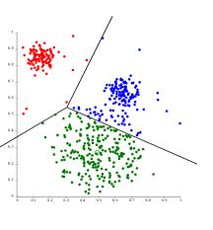
METHODOLOGY
K-means is an unsupervised classification (clustering) algorithm that groups objects into k groups based on their characteristics.
This method was chosen to analyze the categories of activities or services existing in the city.
For this, 5 clusters are searched.
Each cluster will consist of those categories that are more similar to each other.
Once these groups are defined, it will be analyzed in which of them it would be the most suitable for the construction of a hotel.
The above will take into account in which of the clusters is the largest number of tourist sites.

Slide 6
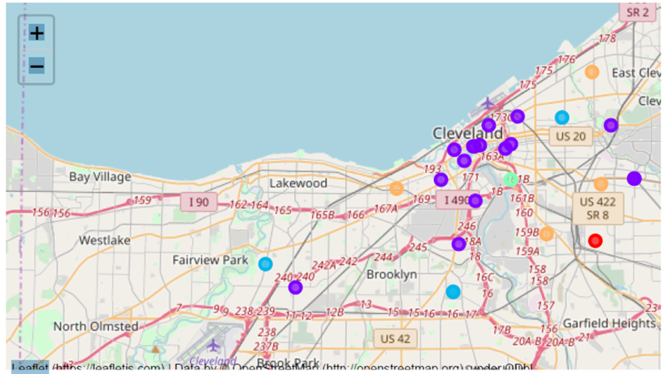
Finalmente esta es la distribución de los cinco clusters.

Slide 7
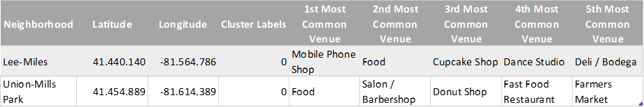
Analysis for cluster
Cluster 0
Cluster 0, identified in red, are localities located mainly in the city, away from the coastal zone, and in general in residential areas with some small commercial sites such as drugstore, pizzerias, barber shops, typical of residential places.

Slide 8
Cluster 1
Cluster 1; It is the one that was composed of the largest number of neighborhoods and therefore also has the largest number of categories offered such as restaurants, shopping centers, galleries, bars, among others.

Slide 9
Cluster 2
Cluster 2; It is the cluster that is most dispersed within the city, with some commercial points and some fast food restaurants, others.

Slide 10
Cluster 3
Cluster 3 has as its main category The Light Rail Sation, and a few small businesses such as a jewelry store and a donut shop.

Slide 11
Cluster 4
Cluster 4 is mainly composed of restaurants and fast food stores such as pizzerias and sandwiches

Slide 12
Conclusions and discussion
Once the different clusters created have been analyzed, it can be noted that there are indeed some places that do not offer comfort or proximity to most of the sites of interest for visitors looking for accommodation. As is the case with cluster 3, which only has the train station nearby. Cluster 0 and 4 are apparently made up of residential areas that have a few commercial businesses and some places to eat. Even cluster 2 presents this similar behavior, in addition to being watered throughout the city, While cluster 1, is concentrated in popular places and with a large influx of shops and restaurants.

