Slide 1
D&J
1551003 – Lê Duy Bách
1551023 – Hồ Sỹ Nguyên
1551025 – Liêng Thế Phy
1551039 – Trần Thoại Thông
1551040 – Bùi Nguyễn Đức Toàn

Slide 2

PROBLEM STATEMENTS
The problem of
Insufficient motivation for exercising among the youth

Slide 3

PROBLEM STATEMENTS
Affects
The life quality of the next generation

Slide 4
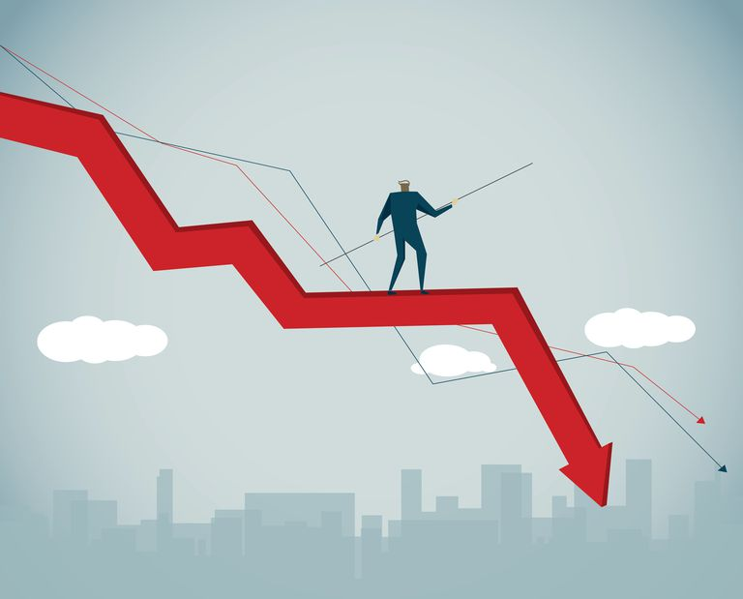
PROBLEM STATEMENTS
The impact of which is
Degrading the country’s economics

Slide 5


PROBLEM STATEMENTS
A successful solution would be
To create a mind-blowing combination of cute, fun and productivity to stimulate teenagers’ interest in physical conditioning.

Slide 6
PRODUCT POSITION STATEMENT
For
Anyone aged between 5 and 25.
Who
Loves to have fun while shredding down pounds
of fat.
Dog Lovers.
The D&J
is a Health & Fitness application, blended with entertainment.
That
Features adorable companion to help you along the way to improve your physical condition.

Slide 7
PRODUCT POSITION STATEMENT
Unlike
Any Fitbit product or Samsung Health, Runtastic application, even petting game like Talking Tom Cat, Pet Society, etc.
Our product
Encourages slight changes to make big different, providing nudges in form of missions, adoration as well as unique experience for family bonding, friends reunion, and city discoveries.

Slide 8


Slide 9

USER SUMMARY
Name | Description | Responsibilities | Stakeholder
Teenager | Part of main user group | Enjoy health benefit and entertainment value from the product. Evaluate on features, contents, usability and quality. | The development team
Parents | Secondary user group | Enjoy family time with their children who also use the product. Enjoy health benefit. | The development team
People from all age group | People that can walk | Enjoy health benefit and connectivity feature. | The development team

Slide 10


Alternative and Competition
Some popular applications include Runtastic, Samsung Health and a series of Fitbit product. They seem not to interest children or people at the lazier side of society.
Games like Talking Tom Cat, or Pet Society do not promote real life physical activity.
To our perception, the above competitors have not delivered the complete solution.

Slide 11

TEAM STRUCTURE
Team lead
Business Analyst
Designer
Implementer
Tester
Tran Thoai Thong
Ho Sy Nguyen
Tran Thoai Thong
Ho Sy Nguyen
Bui Nguyen Duc Toan
Lieng The Phy
Le Duy Bach
Lieng The Phy
Bui Nguyen Duc Toan
Le Duy Bach
Tran Thoai Thong
Lieng The Phy

Slide 12
RESPONSIBILITIES
Tran Thoai Thong, Designer, Tester, Implementer
Designer and Unity code developing, testing
Ho Sy Nguyen, Designer, Implementer
UI designer and Unity code developing
Le Duy Bach, Implementer, Tester
Unity developing and testing
Bui Nguyen Duc Toan, Implementer, Business Analyst
Unity developing and helping in content and features creating
Lieng The Phy, Implementer, Tester, Business Analyst
Unity developing, content and features creating, testing

Slide 13
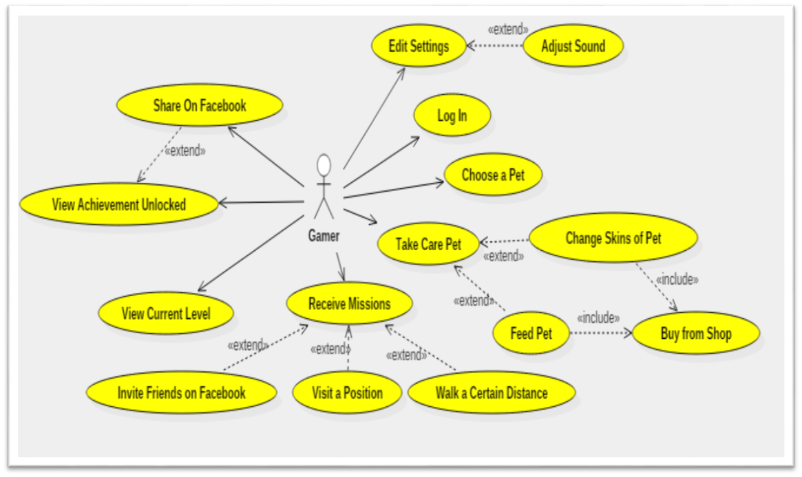

Slide 14
Non-functional Requirements
Performance Requirements
The game must smoothly illustrate the animation of pet at 30fps or more.
The system must be able to load all the data from below 1-2 seconds.
The delaying time when measuring distance or counting steps must below 2 seconds.

Slide 15












Software Components
Game Controller
Database Reader
Input Manager
Mission Manager
Achievement Manager
UI Representation

Slide 16




Game Controller
Direct user input
Direct user input
Feed data to UI

Slide 17




Game Controller
Direct user input
Direct user input
Feed data to UI

Slide 18

Game Controller
Direct user input
Direct user input
Feed data to UI

Slide 19







Database Reader
Save / Load Game

Slide 20







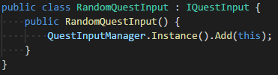
Input Manager
Encapsulate input
devices
Broadcast data

Slide 21





Mission & Achievement
Check progress
Reward

Slide 22



Mission
52 minutes before new Mission
Should give new?
On it…
Yes? Factory, help!

Slide 23




UI Representation
Request corresponding information and display on screen

Slide 24


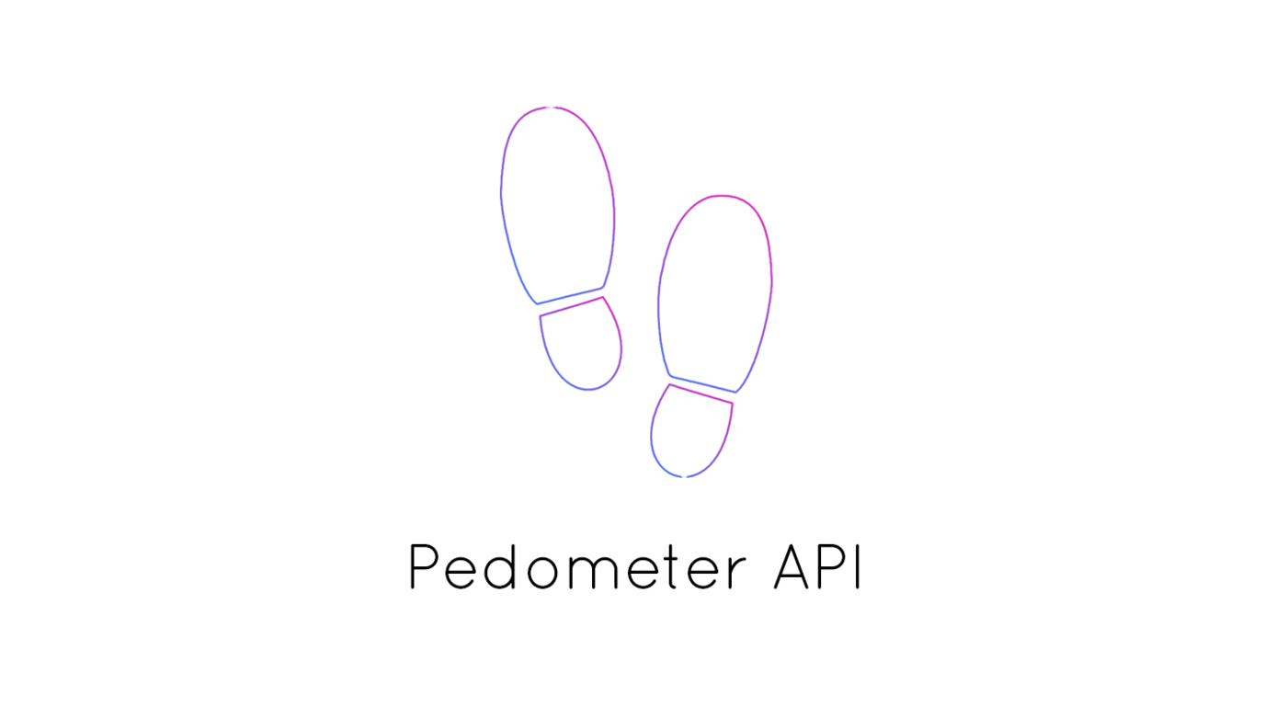

Technologies Uses
Unity 2017.3.0f3
Blender 2.79
FacebookSDK 4.29.0
Pedometer API 1.0

Slide 25
Test Environments
Hardware Requirements
This game is an android game so an android device is a must.
Other hardware requirements like memory or storage still need to further investigate.

Slide 26
Test Environments
Software in the Test Environment
The following base software elements are required in the test environment.
Software Name | Purpose | Version | Type and Other Notes
Marshmallow | Running game | 6.0 | Operating System
Nougat | Running game | 7.0,7.1 | Operating System
SQLite | Store data |  | Database
FacebookSDK | Sharing | 4.29 | Social Network

Slide 27
Test Environments
Productivity and Support Tools
The following tools will be employed to support the test process.
Tool Category or Type | Tool Brand Name | Vendor or In-house | Version
Automation Testing | Unity UI Automation Test
Defect Tracking | MS Excel 2016 | MS | 2016

Slide 28
Test Plan
Use cases, functional requirement, and non-functional requirement are identified as targets for testing the items listing below:
Database Testing
Verify that current level of pet and affection points can be displayed.
Verify that missions and achievement status should be maintained and displayed precisely.
The number of bought items in shop is conserved.

Slide 29
Test Plan
Functional Testing
Verify that skins of pets can be changed and displayed precisely.
Verify that after three days if users do not play, the affection points will decrease.
Volume of the BGM should be generated properly as the users modified.
Verify that after completing a mission users can receive rewards.
Verify that step counter can detect steps with approximately 2-3 steps difference.
Verify the transactions of users in shop when buying items.

Slide 30
Test Plan
Performance
Verify the animation of pet at 30fps or more.
Verify the response time of interface when displaying pet and load all the data from below 2 seconds.
Verify delaying time when measuring distance or counting steps must below 2 seconds.

Slide 31
Test Plan
Human Resources
Role | Minimum Resources | Specific Responsibilities or Comments
Test Manager | 1 | Provides management oversight. Responsibilities include: agree mission identify motivators acquire appropriate resources present management reporting
Tester | 3 | Implements and executes the tests. Responsibilities include: implement tests and test suites execute test suites log results analyze and recover from test failures document incidents

Slide 32
Test Results
Function | Test | Pass | Fail
Function 01: Load Data and Create a List Of Object in Scroll View | 12 | 8 | 4
Function 02: Switch Between Lists | 2 | 2 | 0
Function 03: Click Item and Load Buy View | 2 | 2 | 0
Function 04: Load Item Information in Buy View | 10 | 7 | 3
Function 05: Quantity View and Buy Button | 20 | 12 | 8
Function 06: Facebook Sharing | 3 | 2 | 1
Function 07: Progress Tracking | 2 | 2 | 0
Total | 51 | 35 | 16

Slide 33
Test Results

Slide 34
Test Results

Slide 35
DEMO

Slide 36
REFERENCES
https://github.com/taphos/unity-uitest
https://github.com/olokobayusuf/Pedometer-API

