Slide 1
Elsevier Health Sciences
Smart Content Drives Smart Applications
The Future Of Using Knowledge In Healthcare
LDBC 2012 Workshop
November 19, 2012
Alan Yagoda
VP, Business Technology
a.yagoda@elsevier.com
@alanyagoda

Slide 2
About Elsevier
Elsevier is the largest Science, Technical and Medical Publisher in the world. In the area of Health Sciences, Elsevier publishes leading brands including The Lancet, Braunwald’s Heart Disease, Gray’s Anatomy, and the Netter Atlases among others. In addition, Elsevier produces leading online clinical support tools and products including:
Clinical Key
MD Consult
Procedures Consult
Mosby’s Nursing Consult
CPMRC Nursing Care Plans
Gold Standard Drug Database
MEDai Analytics for Managed Care Plans

Slide 3
The Challenge: Getting doctors the right information to make the best decisions and provide the best clinical care
Trusted:
Authoritative medical and surgical content from Elsevier.
Comprehensive:
Integrated Medline and 3rd party content.
Speed To Answer:
Fast discoverability of the most relevant answers and more intuitive searching.

Slide 4
Introducing
Smart Content

Slide 5
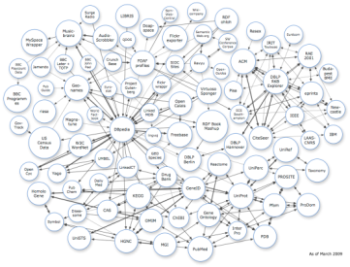

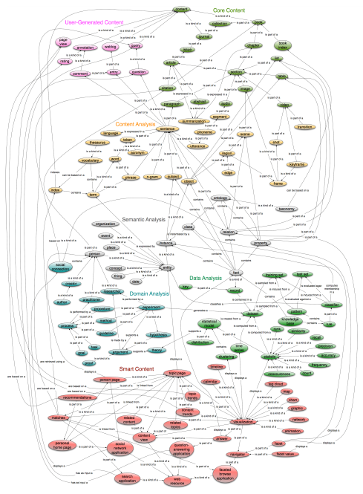
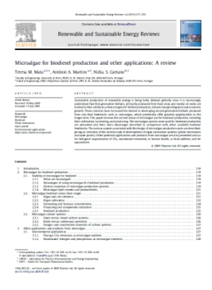

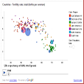
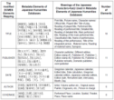


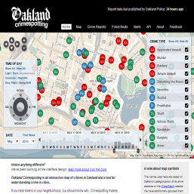
Smart Content At Elsevier
Smart Content Applications
Better discovery through semantic search & navigation
Faceted search & browse
Ontology-driven navigation
Task-specific results
Personalized/localized results
Link to evidenced-based content
Linked data from partners and the Web
Elsevier Content
Text
Entities, concepts and relationships
Better understanding through analysis and visualization
Question & Answer
Actionable Content & Alerts
Tag clouds
Heatmaps
Animations
Partner Content
Tables
Images
New knowledge through aggregation and synthesis
Topic pages
Social network maps
Geolocation maps
Data integration and mashups
Text mining
Inference and Reasoning
Elsevier
knowledge organization systems
5

Slide 6
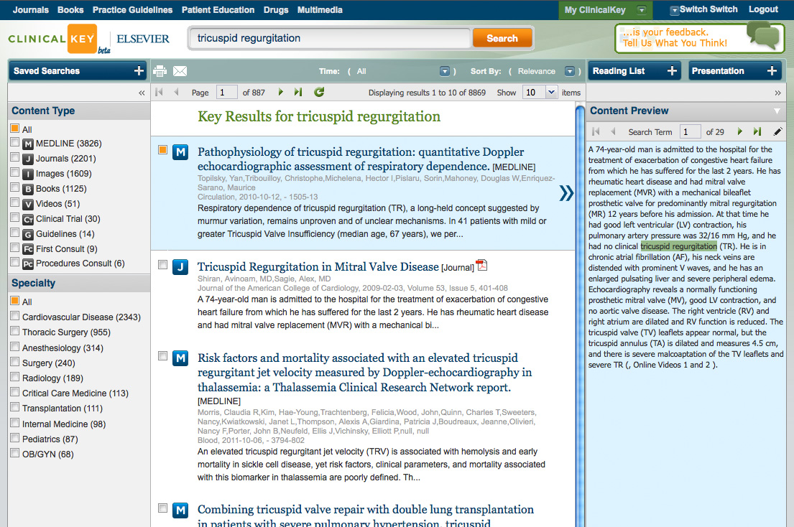
Speed to Answer: Most relevant preview

Slide 7
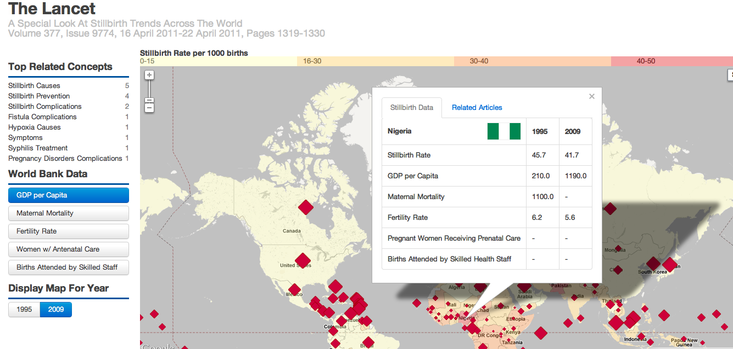
Trend Analysis Of Special Health Topics (Mashups)

Slide 8
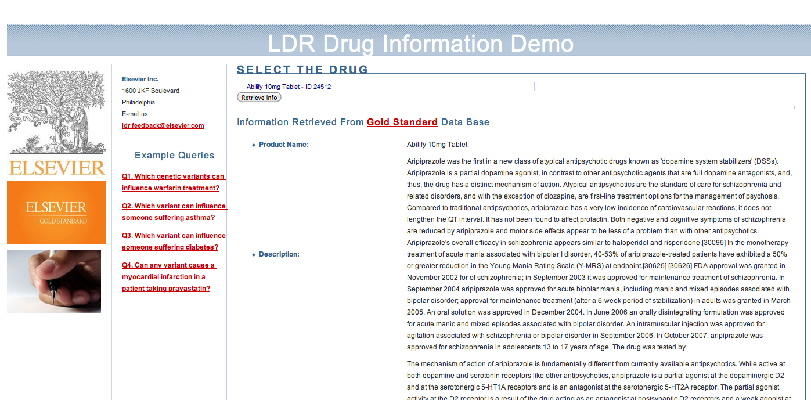
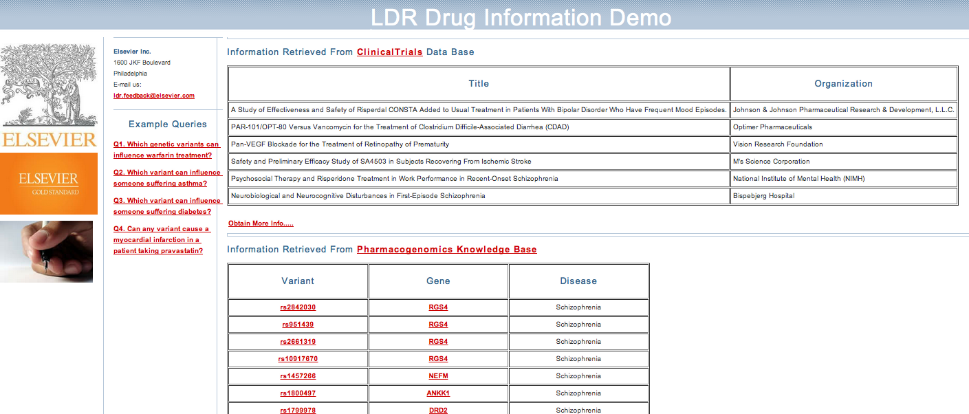
Comprehensive Drug Reference
Moving world-class content online to Point of Care.
Extracted knowledge is linked for further enrichment.
Information is condensed, immediate and actionable.

Slide 9
Working Scenario
Linked Data Repository

Slide 10


Linked Data Repository (LDR): Warehouse for Smart Content Enhancements
Delirium treatment: An unmet challenge
Service platform that provides a rich semantic layer that enables search and discovery of metadata.
Transforms content into knowledge data to allow exploration of extracted knowledge, content analysis, and visualization.
Enhances extracted knowledge of Elsevier assets by interlinking data with related sources of medical and scientific content and data.
Service layer API for high-volume read-write for use by end-user products.
Provide service layer APIs for ease of integration and SPARQL endpoint for advanced query services.
Title
Rivastigmine, a cholinesterase inhibitor, has been used to treat delirium in elderly patients with stroke. 1 A biologically plausible premise—that impaired cholinergic transmission might either cause or worsen delirium—led to a randomised, placebo-controlled, double-blind trial by Maarten van Eijk and colleagues 2 in The Lancet in which they added rivastigmine or placebo to usual treatment of patients in intensive care. The trial was halted at 104 patients by the drug safety and monitoring board (DSMB) because of increased mortality (12/54 in the rivastigmine group, 4/50 in the placebo group; p=0·07) and a worse outcome. The rivastigmine group …
Disease
Drug
Clinical finding
Elsevier
med:diseases Delirium
med:drugs Rivastigmine
owl:same as
ATC: N06DA03
Drug: Rivastigmine
owl: same as
Trial: NCT00623103
Serious Adverse events: Atrial fibrillation
LinkedCT
foaf:page
Trial: NCT00623103
Intervention: Rivastigmine
Condition: Delirium
10
Notes:
Here I would highlight that the owl:sameAs links refer to drug:rivastigmine. I changed the color font to red in the example you posed to highlight the relationship mad:drugs:Reigastigmine[Elsevier] -> owl:sameAs Durg:Rivastigmine [DrugBank] -> Intervention:Rivastigmine [LinkedCT]
Some people can argue that owl:sameAs predicates are a very strong assertion and entail inferred
s that are not always desired. If that’s the case you can say that we also use skos:exactMatch or skos:closeMatch that do not entail such a strong assertion, nor the inference but that the example was just for illustrating the use case

Slide 11
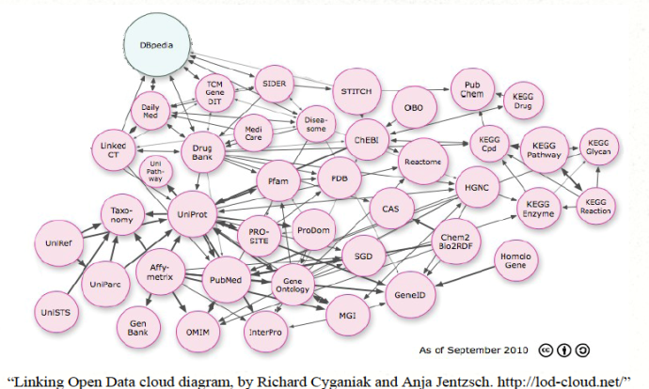
LDR Semantic Infrastructure
Linked Data Loader
Linked Data &
3rd Party Data
AWS Cloud Management
Data Space Services
Vocab & Annotation RDF Satellites
Annotation Satellites
Asset Satellites
Vocab Satellites
3rd Party Data
Linked Data
Smart Content Indexing Pipeline
EMMeT Semantic Network
Linked Data Pipeline Services (Hadoop)
Vocabulary SKOS
Generation
Discovery Services (Semantic Knowledgebase)
JSON Transform
N-Quads Extract
Reasoning
Interlinking
RDF Loader
Ontology Svcs
Analytics
…
Tagging and Indexing Services (Concepts, Chapters, Articles, Guidelines,etc)
RDF Generation
Elsevier Content
3rd Party Content
Instit.
Content
Amazon S3
MongoDB
NoSQL
SOLR/SIREn
Virtuoso Triplestore
Product-specific Smart Content Search Index
Access & Entitlements
Atom Feed
Admin & Monitoring
Analytics
Discovery Svc API (REST)
Ontology Service
SPARQL
Alerts

Slide 12
Loading Profile To RDF Store
BULK LOADS: ~40hrs
40M nQuad files
40M graphs
4.5B triples
DAILY FEED: 90 secs
25K nQuad files
25K graphs
2.8M triples
2013 Growth Forecast: 2x-3x

Slide 13
Query Use Cases
Simple
Taxonomy driven search and navigation(tree views)
Find the concept diabetes and all it’s children
For a subject hierarchy, find the topic Bio Chemistry and all connected topics
Search and filter across content assets
Find journal articles on diabetes published after Jan 1, 2010.
Counts/Aggregations/Co-occurrence
Counting occurrences of a term across a corpus
Complex
Trend discovery
Identify trends from latest research relevant to stillbirth rates in the Middle East.
Q&A with search across interlinked data sets
What genomic variants can cause a myocardial infarction in patients taking Pravastatin?
Class Inference
Fine new associations between genomes and diseases or chemical compounds and diseases

Slide 14
Technology Challenges

Slide 15
Key Challenges
SCALABILITY
Cluster replicates full data set to each node.
Copy data across cloud regions.
No ability to shard.
UPDATE PERFORMANCE
Low performance on large updates.
Exposure to inconsistencies due to lack of ACID.
REASONING
Run-time reasoning has large performance implications.
ANALYTICS
Do not get a lot of insight into contents of triple store with metrics and association profiles between entities, classes and properties.

Slide 16
Benchmark Objectives

Slide 17
Benchmarks
Load profiles
triples/sec on small, medium, large loads
Single vs Parallel loads
Graph replication
Query performance
queries/sec using mix of queries
Queries during loading
Concurrent users
Operational
Resource utilization (RAM, CPU, I/O)
Storage efficiency
Cluster configurations (horizontal and vertical scaling)

Slide 18
Thank you.
Alan Yagoda
a.yagoda@elsevier.com
@alanyagoda

