Slide 1




Next Generation Sequencing and
By

Slide 2


The world wide sequencing capacity exceeds 14Ptb
=
4 years
Bioinformatics is The Largest cost of NGS
Sequencing you get a disordered huge amount of words, you need
Assembly
And now you have an assembled long string… But NO meaning….. You need
Annotation
Now you have where are the genes and which is their function!!!

Slide 3



Complete Solution:
Business Model:
Project Design
Sequencing
Assembly
Annotation
Consulting
Cloud based custom solutions
Research
Cloud Computing
Open Source
Bacterial Genomics

Slide 4
Who are we ?
Eduardo Pareja. CEO
Raquel Tobes CSO
And 14 other people:
Bioinformaticians
Software engineers
Mathematicians
Biochemists

Slide 5



Where are we ?
Madrid (Spain)
Boston MA (USA)
Granada (Spain)

Slide 6
A pioneer graph based database for the integration of biological Big Data

Slide 7
Why we developed Bio4j ?
Because we needed to query complex databases together that were apart and we wanted to “navigate” biological graphs.
One special problem for us was the fact that the Genome databases are mainly in the NCBI (USA) and the Protein databases are in the EBI (Europe).

Slide 8
What is Bio4j ?
Bio4j is a bioinformatics graph based DB including most data available in :
Uniprot KB (SwissProt + Trembl)
Gene Ontology (GO)
UniRef (50,90,100)
NCBI Taxonomy
RefSeq
Enzyme DB

Slide 9
What is Bio4j ?
Everything in Bio4j is open source !
released under AGPLv3

Slide 10
What’s Bio4j?
Bio4j uses Neo4j technology, a "high-performance graph engine with all the features of a mature and robust database".
Thanks to both being based on Neo4j DB and the API provided, Bio4j is also very scalable, allowing anyone to easily incorporate his own data making the best out of it.

Slide 11






Highly interconnected overlapping knowledge
spread throughout different DBs

Slide 12
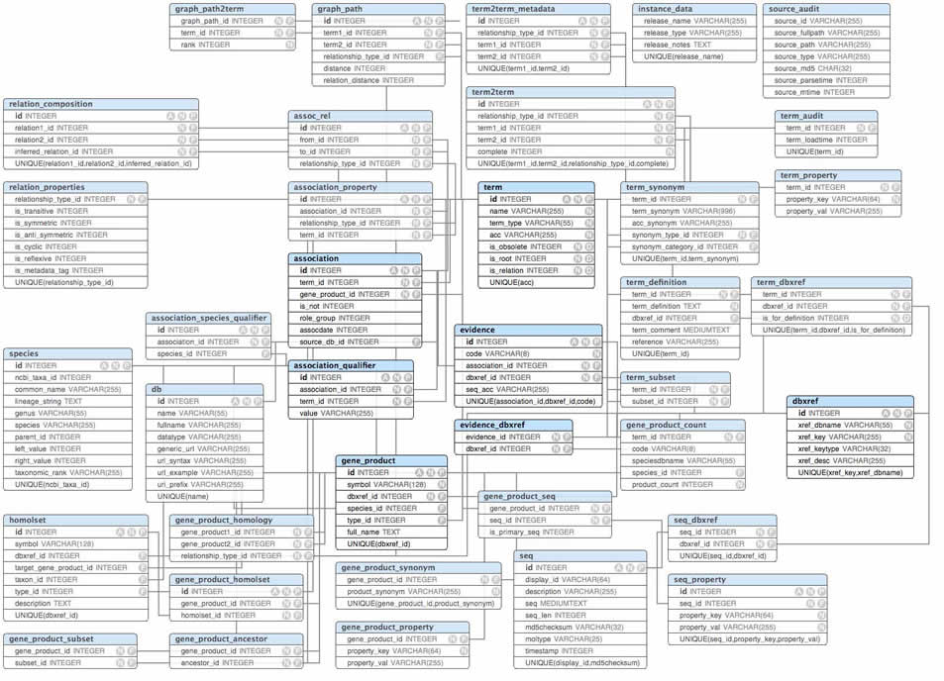

Slide 13
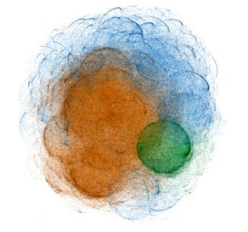
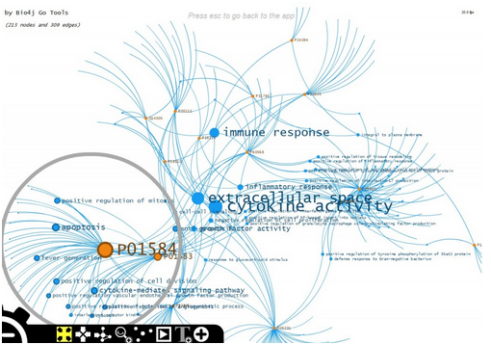
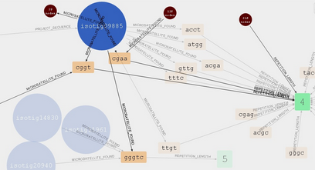
Life in general and biology in particular are probably not 100% like a graph…
but one thing’s sure, they are not a set of tables!

Slide 14
It provides a completely new and powerful framework for protein related information querying and management.
Since it relies on a graph engine, data is stored in a way that semantically represents its own structure

Slide 15
Bio4j in numbers
The current version (0.8) includes:
Relationships: 717.484.649
Nodes: 92.667.745
Relationship types: 144
Node types: 42

Slide 16
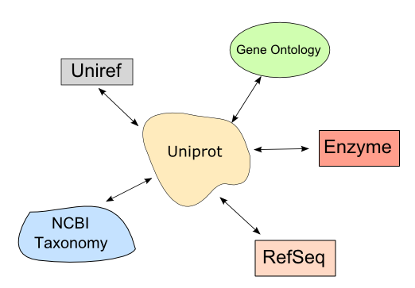
Let’s dig a bit about Bio4j structure…
Data sources and their relationships:

Slide 17
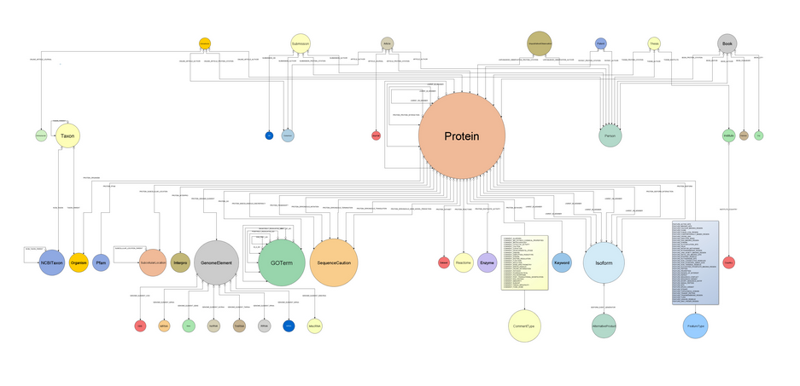
Bio4j domain model

Slide 18
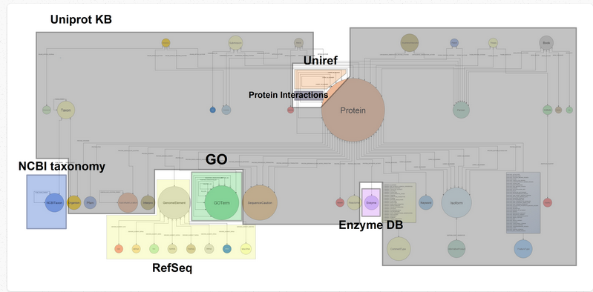
Bio4j modules
Bio4j includes different data sources but you may not always be interested in having all of them.
That’s why the importing process is modular and customizable, allowing you to import just the data you are interested in.

Slide 19
How are things modeled?
Couldn’t be simpler!
Entities
Associations / Relationships
Nodes
Edges

Slide 20
Some examples of nodes would be:
GO term
Protein
Genome Element
and relationships:
Protein
PROTEIN_GO_ANNOTATION
GO term

Slide 21
Retrieving protein info (Bio4j Java API)
//--creating manager and node retriever----
Bio4jManager manager = new Bio4jManager(“/mybio4jdb”);
NodeRetriever nR= new NodeRetriever(manager);
ProteinNode protein = nR.getProteinNodeByAccession(“P12345”);
Getting more related info...
List<InterproNode> interpros = protein.getInterpro();
OrganismNode organism = protein.getOrganism();
List<GoTermNode> goAnnotations = protein.getGOAnnotations();
List<ArticleNode> articles = protein.getArticleCitations();
for (ArticleNode article : articles) {
System.out.println(article.getPubmedId());
}
//Don’t forget to close the manager
manager.shutDown();

Slide 22
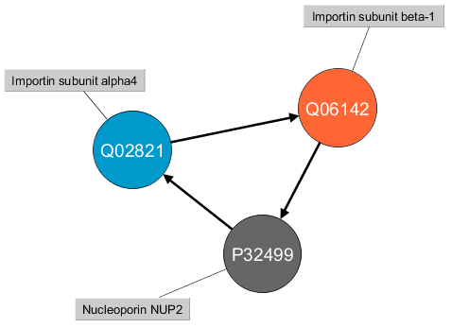
Mining Bio4j data
Finding topological patterns in
Protein-Protein Interaction networks

Slide 23
Bio4j + Cloud
We use AWS (Amazon Web Services) everywhere we can around Bio4j, giving us the following benefits:
Interoperability and data distribution
Releases are available as public EBS Snapshots, giving AWS users the opportunity of creating and attaching to their instances Bio4j DB 100% ready volumes in just a few seconds.
CloudFormation templates:
- Basic Bio4j DB Instance
- Bio4j REST Server Instance
Backup and Storage using S3 (Simple Storage Service)
We use S3 both for backup (indirectly through the EBS snapshots) and storage (directly storing RefSeq sequences as independent S3 files)

Slide 24
Community
Bio4j has a fast growing internet presence:
- Twitter: check @bio4j for updates
- Blog: go to http://blog.bio4j.com
- Mail-list: ask any question you may have in our list.
- LinkedIn: check the Bio4j group
Github issues: don’t be shy! open a new issue if you think
something’s going wrong.

Slide 25
Some points
To our knowledge, relationships are not internally indexed by their names, and nodes with a large number of incoming/outgoing relationships can drastically affect the performance of traversals.
Such is the case when you have just a couple of relationships of the type you're interested in plus let's say a million or so of others. In that case, retrieving these two relationships can be a real overkill in terms of performance

Slide 26
Some points
We would like to have node types. Due to the absence of node types we must do more complex things and have a lot of indexes.

Slide 27
Future
Design a strategy to facilitate the update when experimental data has been added previously.
Visualizations.

Slide 28
and... Who’s behind all this?
- Pablo Pareja Tobes: Main developer
- Eduardo Pareja Tobes: Technology and architecture main advisor
- Raquel Tobes: Bioinformatics main advisor
- Marina Manrique: Bioinformatics support
- Eduardo Pareja: Strategy and Scientific advisor

Slide 29


t
Thank You for your attention!
@eduardopareja
http://www.linkedin.com/in/eduardopareja
epareja@era7.com

