Slide 1
RJ Lee Group, Themis, and the Semantic Web November 2012
Dave Neuer
Senior Software Engineer
dneuer@rjlg.com
Notes:
1

Slide 2
Agenda
RJ Lee Group Overview
THEMIS
Issues

Slide 3

About RJ Lee Group
“We use our scientific expertise, instrumentation and technology together with a collaborative spirit to stimulate inquiry and solve complex problems.”
- Dr. Richard Lee, CEO

Slide 4
RJ Lee Group background
Formed from the fundamental research arm of U.S. Steel (USS) & Energy Technology Consultants (ETC)
Energy Technology Consultants (1980-1985)
Dr. Richard J. Lee, Head of Fundamental Research at USS, joins ETC in 1985 and company renamed RJ LeeGroup, Inc. (RJLG) in 1986
Started as 12 person company
2012, ~300 Employees
>100 associates through Outsource Laboratory Management contract for DOE-Hanford Facility in Washington (Waste Sampling & Characterization Facility, WSCF)
Scientists, Technicians, Developers, and Executive Staff: ~140

Slide 5
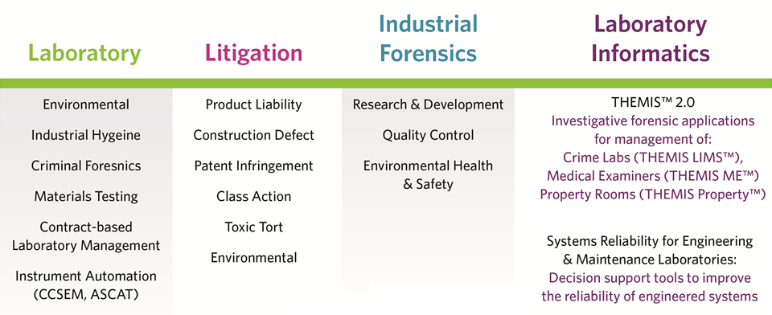
Service Areas

Slide 6
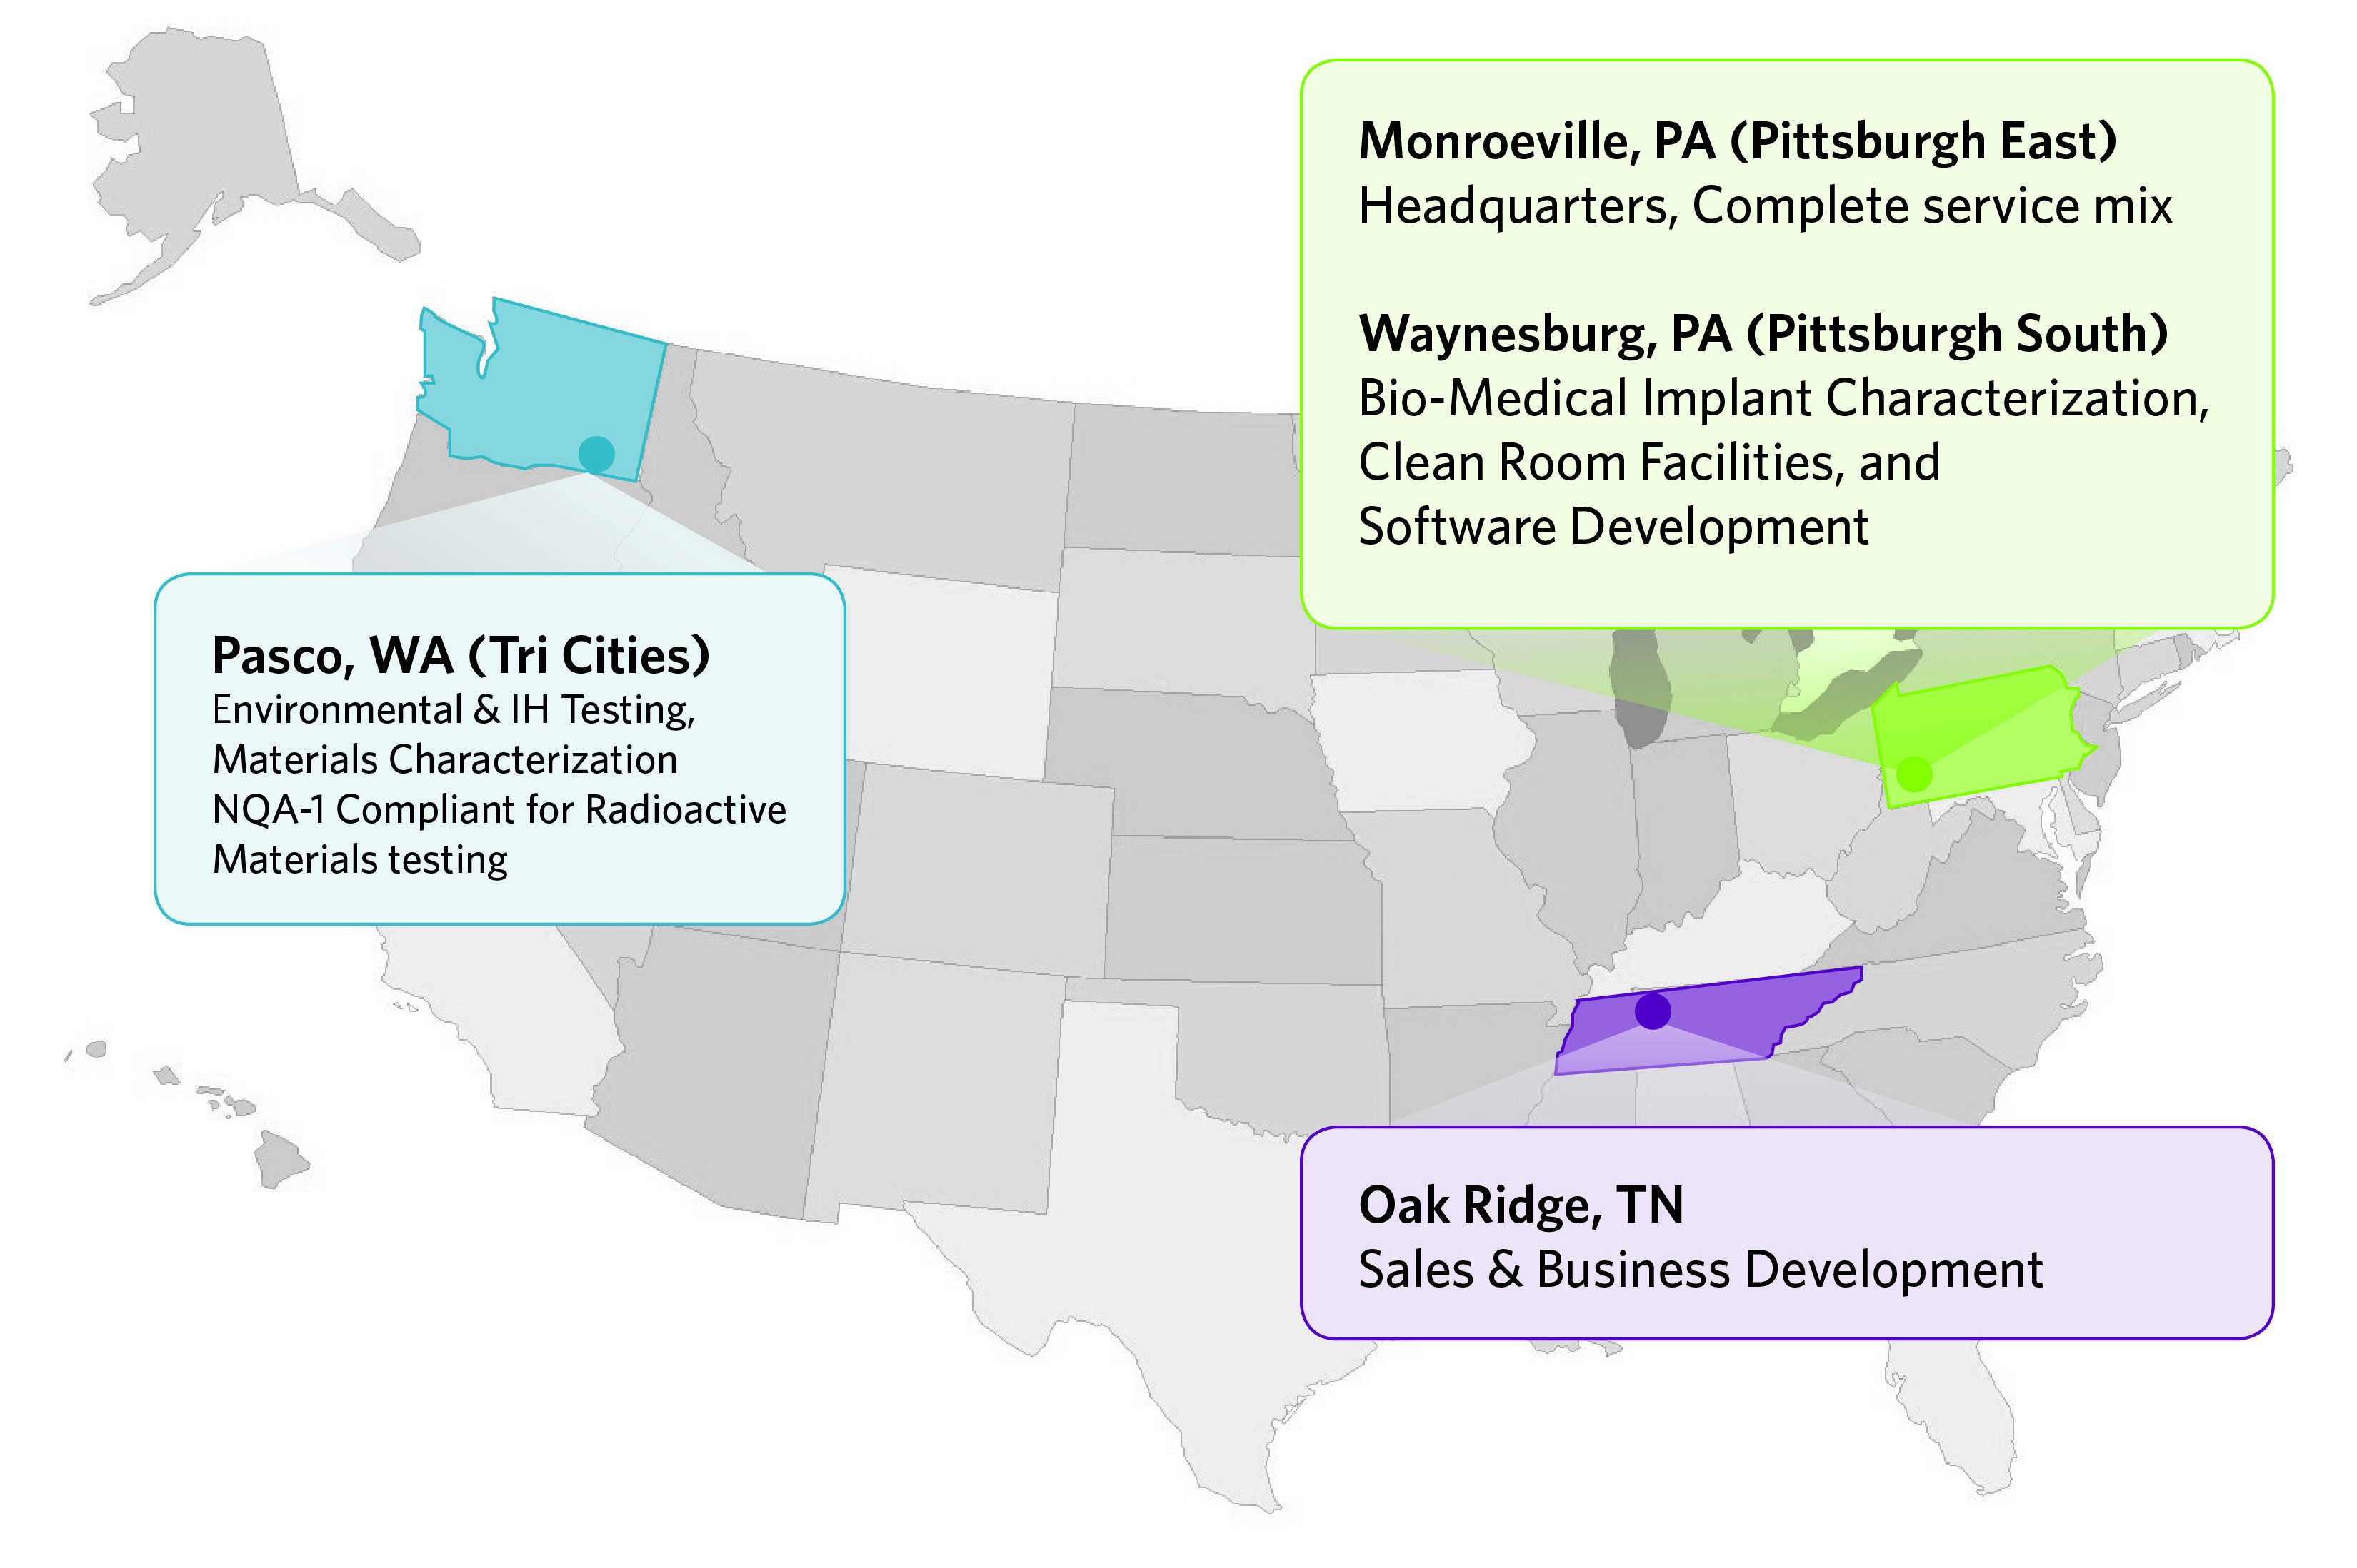
RJ Lee Group Locations

Slide 7
RJLG and the Semantic Web
Began with some DoD projects related to asset management
“Swift Discovery:” Sematic search for finding assets using natural-language-like searches
SKOS, Lemon and SAWSDL
User enters terms, terms become concepts, concepts become arguments to semantically-annotated services, services provide the results
Thinking about managing diverse types of data in our own lab inspired us to create a platform which layered semantics over relational and binary data

Slide 8
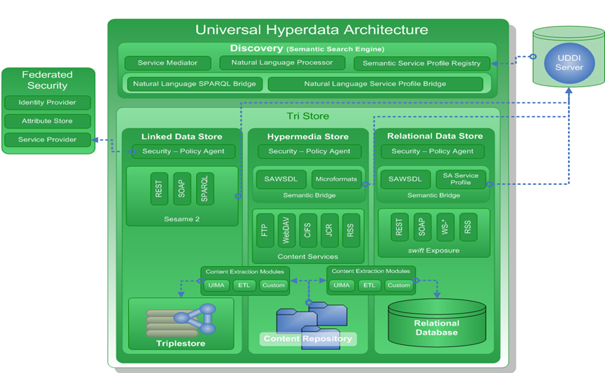
LabSpaces

Slide 9
Key Benefits
Workflow – Enforce business processes and make application data paths more predictable.
Content Management – Allow users to manage relevant content and the secure publication and sharing of this content under workflow.
User Dashboard – Provides a customizable, unified location that connects users to their laboratory casework.
Semantic Bridge – Unifies the data across the different back-ends, and enables searching across the entire expanse of data regardless of type.

Slide 10


Slide 11
Themis 1.0
Deployed at forensic labs across the country
Developed with close collaboration with domain experts in police and forensic lab operations over many years
“Legacy” technology
No enforced workflow
Changes in the structure of the data are challenging

Slide 12
Themis modules
Forensic Biology | Lab Evidence Control
Mobile CSI & MEI | Medical Examiner
Property and Evidence (PD) | Forensic Chemistry
Forensic Identification | Comparative Analysis
Digital Forensics | Resource Management
Invoicing | Law Office Data Collection

Slide 13
Themis 2.0
Applying the lessons learned in our DoD work and in our own lab to streamline access to scientific information
Built on the LabSpaces platform
Web-based platform, can be installed or accessed as a service
Designed to be mobile-friendly for use in the field

Slide 14
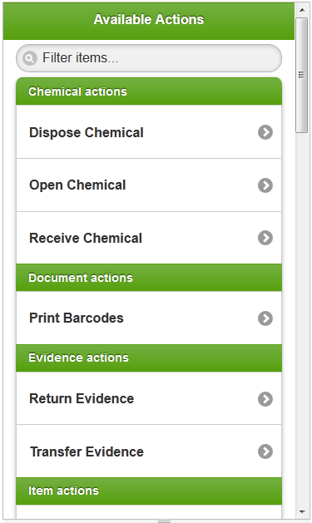
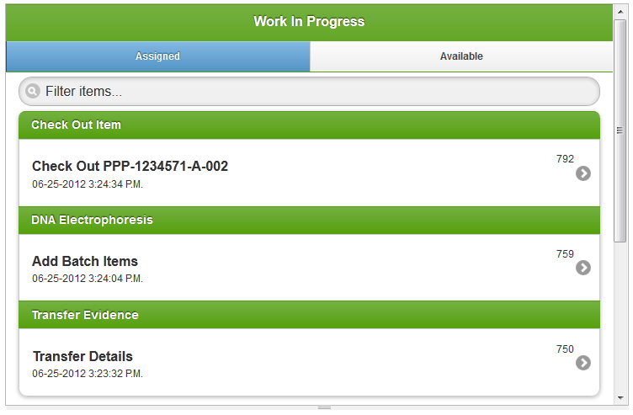
Process Management & Task Authorization

Slide 15
Process Management & Task Authorization
Actions are semantically annotated business process definitions (BPMN 2.0)
Mashup of data from workflow services and the triplestore
Each action pertains to an OWL class

Slide 16
Process Management & Task Authorization
Tasks pertain primarily to one individual of the class corresponding to an action
All data which is not workflow state or binary files is in the triplestore

Slide 17
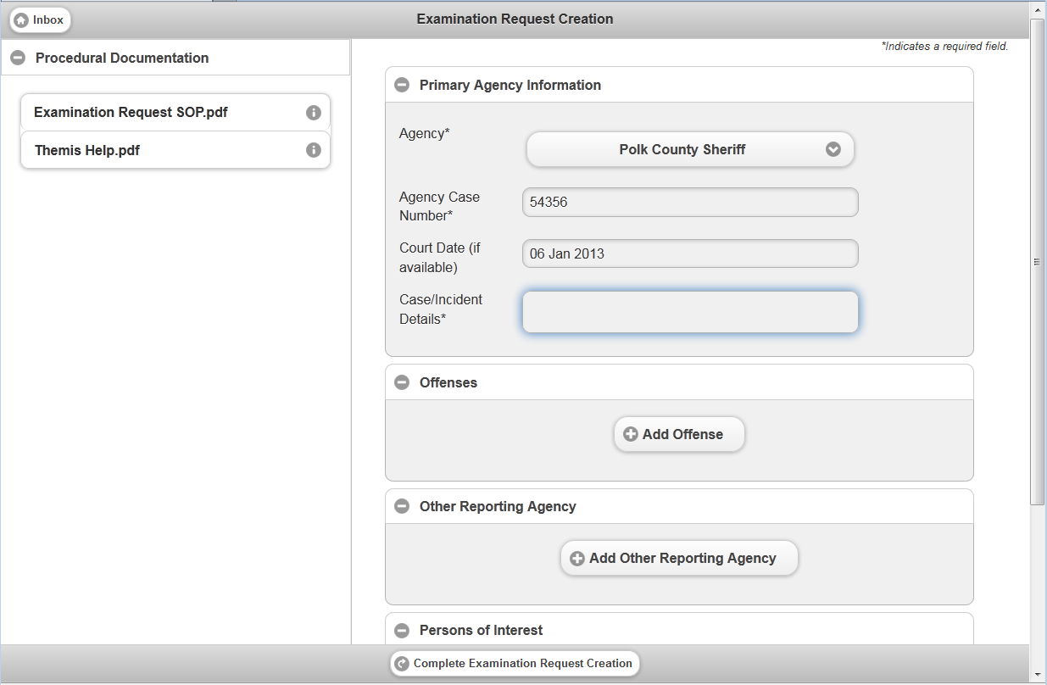
User Task Pages

Slide 18
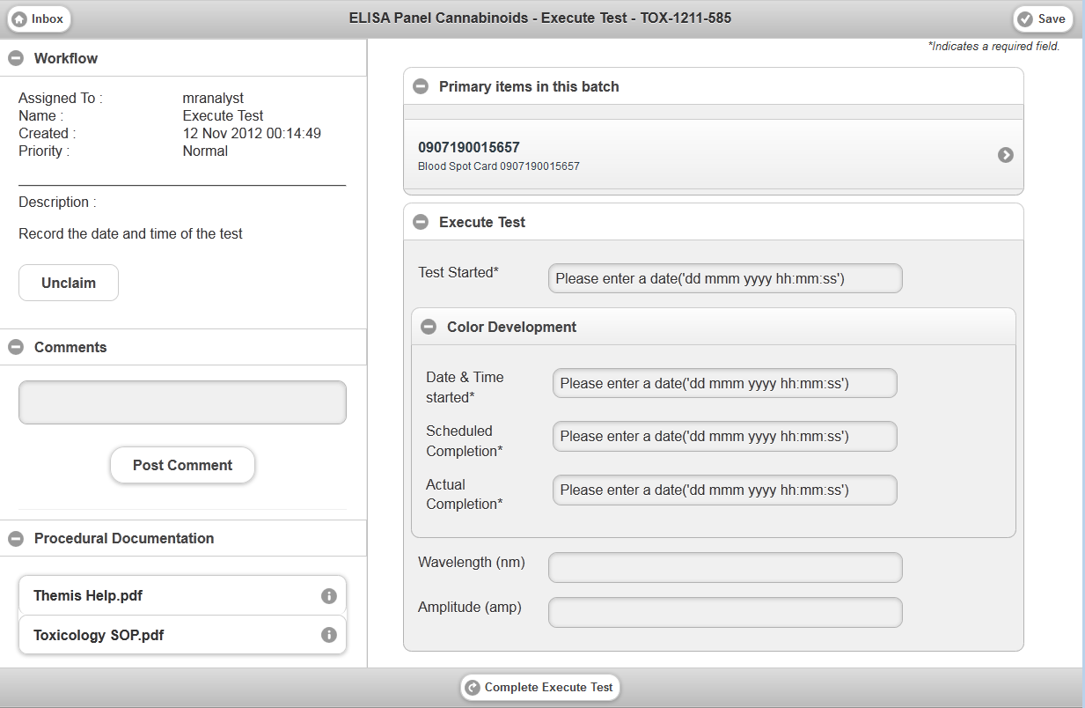
User Task Pages (continued)

Slide 19
THEMIS Product Development Plan Future Innovations
We want to make the triplestore itself a competitive advantage for Themis
Predictive and Investigative Reporting Solution
Use techniques such as semantic searching, data mining, predictive analytics
Identify key patterns in crime with available crime data
EG statistical analysis of Alleles to determine characteristics of origin or automated comparative analysis.
Geographical matching w/ contextual priming to tease important addresses or individuals from a mountain of location data
Will rely much more heavily on inference

Slide 20
Suspects, semantically
themis:Alibi a owl:Class .
themis:VerifiedAlibi owl:equivalentClass
[ a owl:Restriction;
owl:onProperty themis:confirmedBy;
owl:minCardinality 1 ].
themis:UnverifiedAlibi owl:intersectionOf (
[ a owl:Class;
owl:complementOf themis:VerifiedAlibi ]
themis:Alibi).
themis:Suspect owl:subClassOf
[ a owl:Restriction;
owl:onProperty themis:possibleMotive;
owl:minCardinality 1 ];
owl:subClassOf
[ a owl:Restriction;
owl:onProperty themis:hasAlibi;
owl:allValuesFrom themis:UnverifiedAlibi ].

Slide 21
Performance issues
Themis’ access to the triplestore is evenly mixed between reads and writes, lots of retractions
Total throughput (in transactions/second) is the most important performance concern, and the impact of inference on throughput
Few vendors offer “horizontal scale-out”

Slide 22
No horizontal “scale-out” (continued)
Because there aren’t currently (m)any horizontal scale-out options for triplestores, we need to know how many triples we’re likely to generate, on average, with inference
But, no standard rule sets, profiles, or materialization strategies

Slide 23
Other issues we’ve faced
What is the backup strategy? What effect does backup have on performance (throughput)?
How do I figure out why my queries take too long (i.e., where’s “EXPLAIN PLAN”)?
What tools (OK) or standard interfaces (better) exist to help me measure triplestore performance?
Cost
Overcoming organizational fears and resistance

