Slide 1
BBC Linked Data Platform
Profile of Triple Store usage &
implications for benchmarking

Slide 2
What we use
OWLIM Enterprise
Current version 3.5 (SPARQL 1.0)
Imminent upgrade to 5.3 (SPARQL 1.1)
Dual Data Centre comprising 6 replicated triple stores

Slide 3
LDP in 1 slide
Using Linked Data to ‘join-up’ the BBC
News, TV, Radio, Learning…
Across common concepts
London, Tony Blair, Tigers
On content creation/update:
Meta-data published to Triple Store, including ‘tags’
Tag = content URI -> predicate -> concept URI
SPARQL queries power user experience
10 most recent content items about ‘Wales’
Most recent News Article for each team in the Premier League

Slide 4
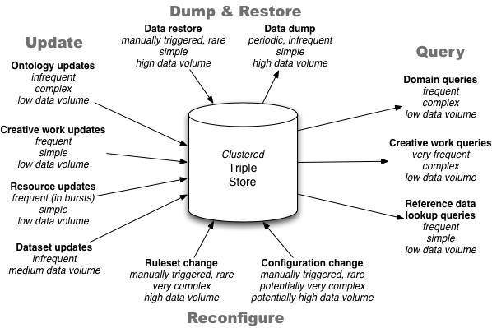
Data inputs & outputs

Slide 5
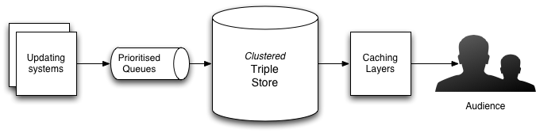
High-level architecture

Slide 6
Update: Resource
Resource = Geo Location, Politician, 2016 Olympics
i.e. concepts or things that can be used in ‘tags’
90% Creation 10% Update
Variable data structure
Small data volume < 100 statements
SPARQL 1.1 Update
Frequent (10,000/hour)
Bursts in response to periodic update
Bursts in response to bulk loading
Low level of manual updates
Medium latency requirement

Slide 7
Update: Resource
DROP GRAPH <urn:graphForResourceX> ;
INSERT DATA {
GRAPH <urn:graphForResourceX> {
any rdf data
}
}
Note: idempotency

Slide 8
Update: Creative Works
Creative Work = News Article, TV Programme, Recipe etc…
99% Creation 1% Update
Uniform data structure
Currently Sesame
Imminently: SPARQL 1.1 Update
Frequent (100/hour)
Occurs in response to action by content creator
E.g. Journalist publishes new news article
Caveat
Bootstrapping of bulk content
E.g. Archive
Low latency requirement

Slide 9
Update: Creative Works
DROP GRAPH <urn:graphForCWorkX> ;
INSERT DATA {
GRAPH <urn:graphForCWorkX> {
<http://www.bbc.co.uk/things/guidX#id> a cwork:CreativeWork ;
cwork:title "All about Linked Data" ;
cwork:dateModified "2012-10-13T14:56:01+00:00"^^xsd:dateTime ;
cwork:about <http://www.bbc.co.uk/things/guidY#id> ;
cwork:mentions <http://www.bbc.co.uk/things/guidZ#id> ;
cms:locator <urn:cps:987634463> ;
bbc:primaryContentOf <http://www.bbc.co.uk/news/article/highweb> ;
bbc:primaryContentOf <http://www.bbc.co.uk/news/article/mobile> .
<http://www.bbc.co.uk/news/article/highweb>
bbc:webDocumentType <http://www.bbc.co.uk/ontologies/bbc/HighWeb> .
<http://www.bbc.co.uk/news/article/mobile>
bbc:webDocumentType <http://www.bbc.co.uk/ontologies/bbc/Mobile> .
<urn:cps:987634463> a cms:Locator ;
cms:locatorType cms:CPS .
}
}

Slide 10
Update: Dataset
Dataset = A grouping of resources that are managed as a single serialised, versioned file
10% Creation 90% Update
Variable data structure
SPARQL 1.1 Update
Infrequent (10/hour)
Low level of manual updates
Higher data volume: current limit is 1MB
Medium latency requirement
Legacy solution?

Slide 11
Update: Dataset
DROP GRAPH <urn:graphForDatasetX> ;
INSERT DATA {
GRAPH <urn:graphForDatasetX> {
any rdf data up to 1Mb
}
}
Note: idempotency

Slide 12
Update: Ontology
10% Creation 90% Update
Restricted to ontological statements
SPARQL 1.1 Update
Infrequent (1/hour)
Low level of manual updates
Low data volume
Medium latency requirement
Conflict: high impact change vs. versioning
Solution: difference analysis?
Solution: maintain separately with semi-automatic change

Slide 13
Update: Ontology
DELETE DATA {
GRAPH <http://namedGraphForOntologyX> {
statements to delete
}
}
INSERT DATA {
GRAPH <http://namedGraphForOntologyX> {
statements to insert
}
}

Slide 14
Domain queries
Queries that touch on one of our domains
E.g. Most recent news article for each Premier League team
E.g. All ‘Key Stages’ in the English National Curriculum
Variable size & complexity
Variable caching
Variable approaches to efficiency
Efficiency is not always the priority
Efficiency is hard to gauge
Accurate metric dependent on the full graph

Slide 15
Creative Work Queries
Standard SPARQL template
Variable use of parametisation
Geo filter
Tag filter (about, mentions)
Creation-time filter
Performance extremely dependent on full data
High performance in testing
Low performance in production
Many thousands of requests/sec
Our principal query

Slide 16
Creative Work Query Filters
{{#about}}
FILTER (?about = <{{about}}>) .
?creativeWork cwork:about ?about .
{{/about}}
{{#format}}
FILTER (?format = cwork:{{format}}) .
?creativeWork cwork:primaryFormat ?format .
{{/format}}
{{#mentions}}
FILTER (?mentions = <{{mentions}}>) .
?creativeWork cwork:mentions ?mentions .
{{/mentions}}
{{#audience}}
OPTIONAL { ?creativeWork cwork:audience ?audience . }
FILTER (?audience = <{{audience}}> || NOT EXISTS { ?creativeWork cwork:audience ?audience } ) .
{{/audience}}
{{#within}}
?creativeWork cwork:tag ?location .
?location a geoname:Feature ;
omgeo:within( {{within}} ) .
{{/within}}

Slide 17
Fundamental changes
Fundamental changes need to be fast in production
Ruleset changes
Configuration/administrative changes
Index creation/update
Re-indexing
Memory allocation
Naming
Dumping and restoring data can support this
Other approaches?

Slide 18
Finally
Most important part of the BBC use-case:
We need 99.99% availability of reads
We need 99% availability of writes
We need 99.99% availability of writes during critical periods
Ontologies and rules can and should change over time
Changes to these must limit their effect on:
Availability
Latency
Our approaches are constantly evolving

