Slide 1

The need for benchmarks for geographical data Frans Knibbe Geodan
Introduction

Slide 2
Geographical data
Data about where things are in relation to the earth’s surface.
Handling this kind of data is well established in relational databases. This should also be the case for RDF databases.
Two broad categories of geographical data:
Textual data
Numerical data

Slide 3
Textual geographical data
Addresses:
Science Park 402
1098 XH Amsterdam
The Netherlands
Geographical names (toponyms):
‘Amsterdam’
‘My house’
‘Europe’
No special datatypes are needed for storage.

Slide 4
Numerical geographical data
Raster data:
Vector data:

Slide 5
Raster data in SQL databases
Support usually follows support for vector data.
Rectangles of grid cells are stored as single objects. Other table columns store metadata needed to correcly interpret the raw raster values.

Slide 6
Vector data in SQL databases
Major RDBMSs have vector data support: Oracle, IBM, Microsoft, PostgreSQL, SQLite, ...
Standardization was helped by the OGC Simple Features standard (version 1 in 1998), which specifies the geometry datatype and the operations that this datatype can support.
Examples of geometry: point, line, polygon, multiline, multipolygon, ...
Examples of geometry functions: calculate distance or area, transform coordinates, add or substract geometries, filter on topological relationships, ...
Notes:
Miss Globe is

Slide 7
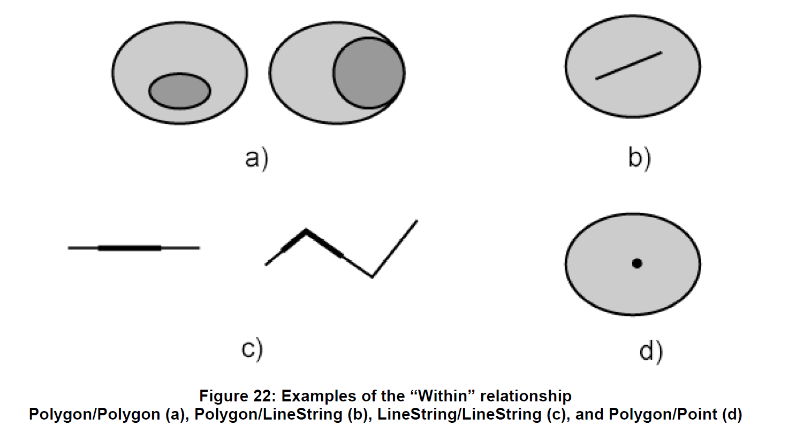
Topological relationship example 1
Notes:
Critical mass is a stage that mr. Cube would very much would like to reach. There are a lot of linked data on the web, but compared to the total amount of available data, the volume is small. The dataweb needs to grow to become self sustainable, just like the web of documents did. When it is big enough, it will have reached critical mass, which means that continued growth will be effortless. Data supply and demand will keep giving each other positive feedback and make each other better. Miss Globe has a lot to offer on both sides: lots of data and lots of developers that are good at creating data visualizations.

Slide 8
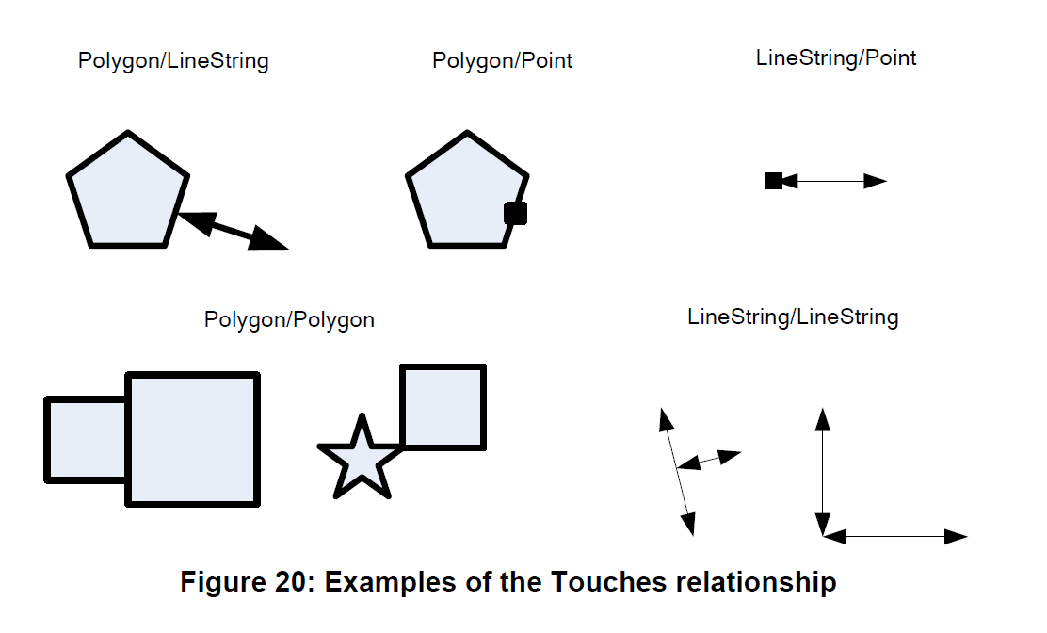
Topological relationship example 2

Slide 9
Vector data in the semweb (1)
2003: W3C basic geo vocabulary:
<xmlns:geo="http://www.w3.org/2003/01/geo/wgs84_pos#"> <geo:Point>
<geo:lat>55.701</geo:lat>
<geo:long>12.552</geo:long>
</geo:Point>
Schema.org: GeoShape (box, circle, line, polygon)
2009: NeoGeo:
ex:way_1 rdf:type ngeo:LineString .
ex:way_1 ngeo:posList (
[geo:lat "-34.622148"; geo:long "-58.380603"]
[geo:lat "-34.591532"; geo:long "-58.381960"]
) .

Slide 10
Vector data in the semweb (2)
2012: GeoSPARQL (OGC):
SELECT ?f
WHERE { ?f my:hasPointGeometry ?fGeom .
?fGeom geo:asWKT ?fWKT .
FILTER (geof:sfWithin(?fWKT,
"<http://www.opengis.net/def/crs/OGC/1.3/CRS84>
Polygon ((-83.4 34.0, -83.1 34.0,
-83.1 34.2, -83.4 34.2,
-83.4 34.0))"^^geo:wktLiteral))
}
Current situation: Vocabularies seem to be converging, OGC and W3C are considering cooperation, software implementations are emerging.

Slide 11
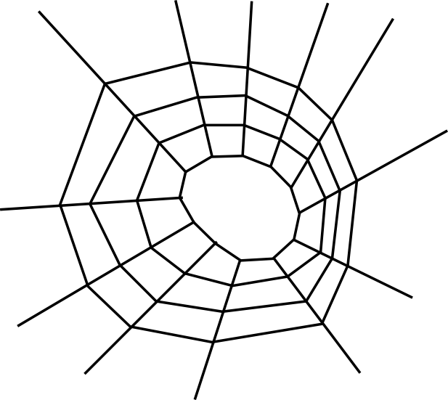
Why benchmark geographical data support?
“ABC’’
3.14
2014-03-05

Slide 12
Why benchmark geographical data support?
Geography needs the dataweb:
Improved handling of dataset metadata
Global semantics
Easier discovery and access of data
The dataweb needs geographical data:
More data
More applications and services
Improved data connectivity through topological relationships

Slide 13
Things to benchmark
Support for inserting and updating geometry.
Which geometry types are supported?
Which geometry notations are supported?
Support for multiple Coordinate Reference Systems.
Support for functions that operate on geometry.
Performance of all supported operations.
Validation of results.
How can we make this happen?
Lehigh University Benchmark has seen a first extension for spatial data. Continue from there?

Slide 14
The end

Slide 15
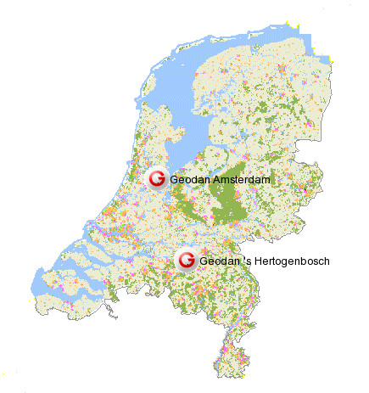
Geodan President Kennedylaan 1 1079 MB Amsterdam (NL) Tel: +31 (0)20 – 5711 311 Fax: +31 (0)20 – 5711 333 E-mail: info@geodan.nl
Web: www.geodan.nl
Copyright © Geodan 2012
This document is provided for information purposes only and the information herein is subject to change without notice. Geodan does not provide any warranties covering and specifically disclaiming any liability in connection with this document. Geodan is a registered trademark. All other company and product names mentioned are used for identification only and may be trademarks of their respective owners. All pictures and illustrations are provided for information only and do not necessarily represent a realistic visualization of the services described in this document.

