Slide 1
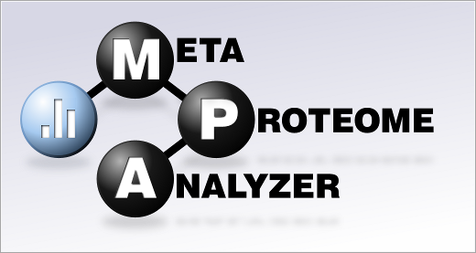
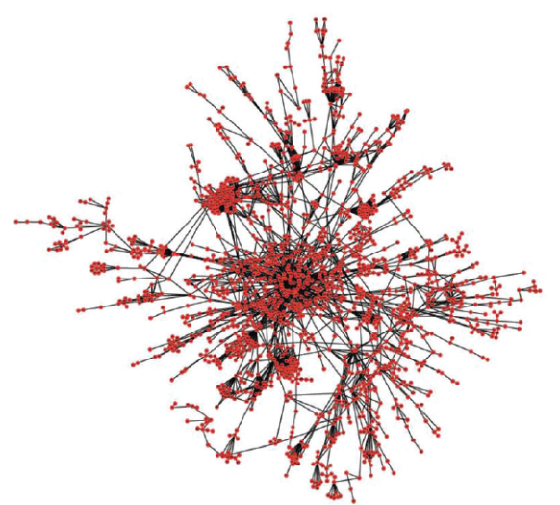

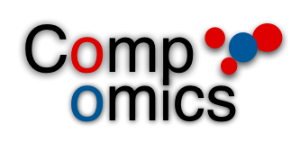
Meta-Proteome-Analyzer: a graph database backed protein analysis software
Thilo Muth
MPI Magdeburg / Germany
(cooperation with CompOmics group in Ghent / Belgium)

Slide 2
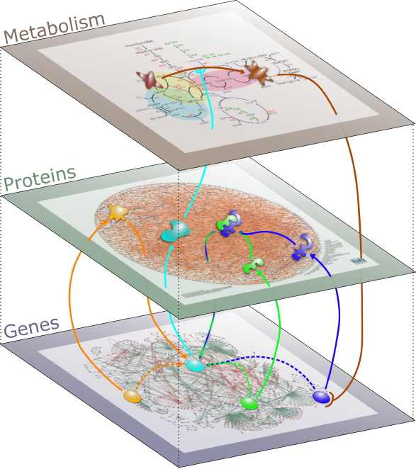
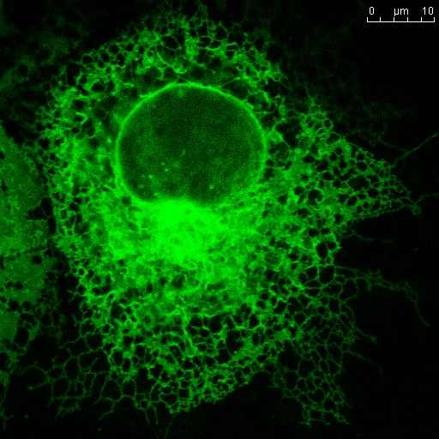
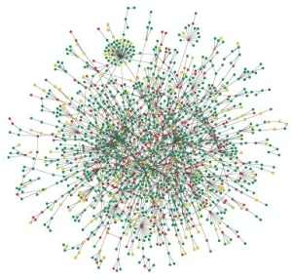
Introduction
Life Sciences + Graph Database?
Life scientists are interested in genes, proteins, metabolites, relationships, interactions and biological networks...

Slide 3
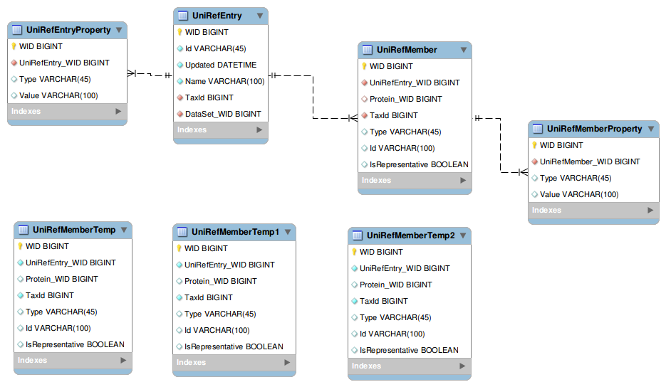

Introduction
...but not so much in a bunch of boring tables.

Slide 4
Introduction
Classical way:
Most biological data are being stored and provided in excel sheets or SQL databases.
Shortcomings:
Scalability and performance issues (data growth)
Complexity
Lack of information
Models far away from biological reality

Slide 5
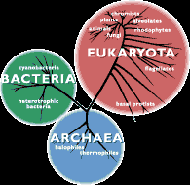
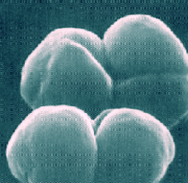
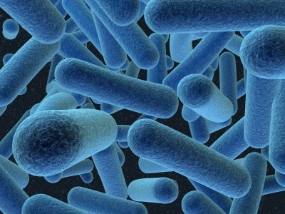
Metaproteomics
What is metaproteomics ?
Metaproteomics studies reveal functional activities
in microbial communities
Metaproteomics results can also be used for
taxonomic assignment (proteins to species).

Slide 6
Metaproteomics
One Protein - Different Organisms
Species A
Protein
1 : n
Species B
Species C

Slide 7
Metaproteomics
How to handle more complex structures?
Protein A
Peptide A
Species A
Protein B
Peptide B
Protein C
Species B

Slide 8
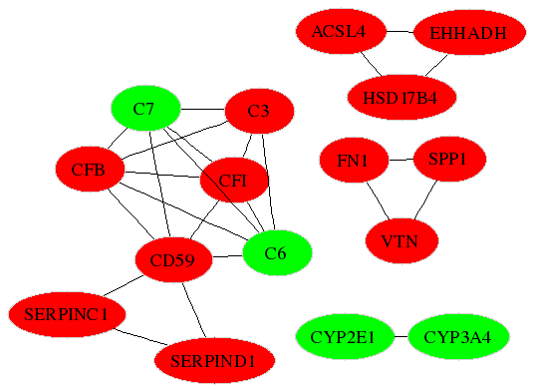
Metaproteomics
Find a more „natural“ model:
Transfer the graph model of biological data back to the database storage level.
USE A GRAPH DATABASE

Slide 9
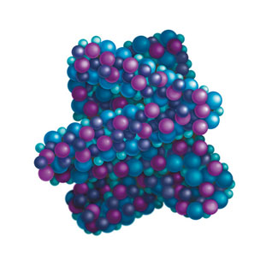

Graph Database
Biology + Graphs!
We implemented the graph database Neo4j
into our free software Meta-Proteome-Analyzer.

Slide 10
Graph Database
Graph nodes/vertices:
NODE
Peptides
Proteins
Species
Enzymes
Pathways
Ontologies
NODE

Slide 11
Graph Database
Graph edges/relationships:
NODE
Peptide-BELONGS-TO-Protein
Species-HOLDS-Protein
Protein-BELONGS-TO-Pathway
NODE

Slide 12
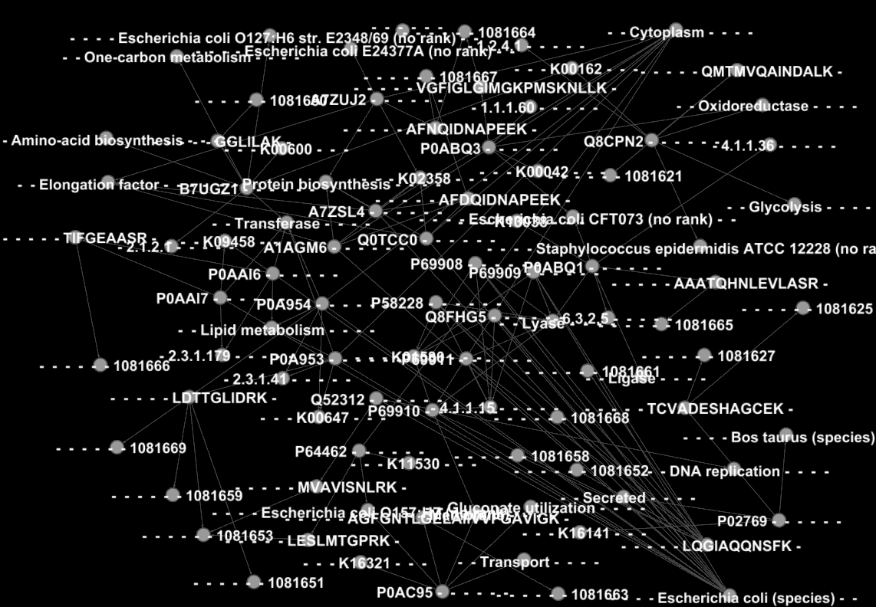

Slide 13
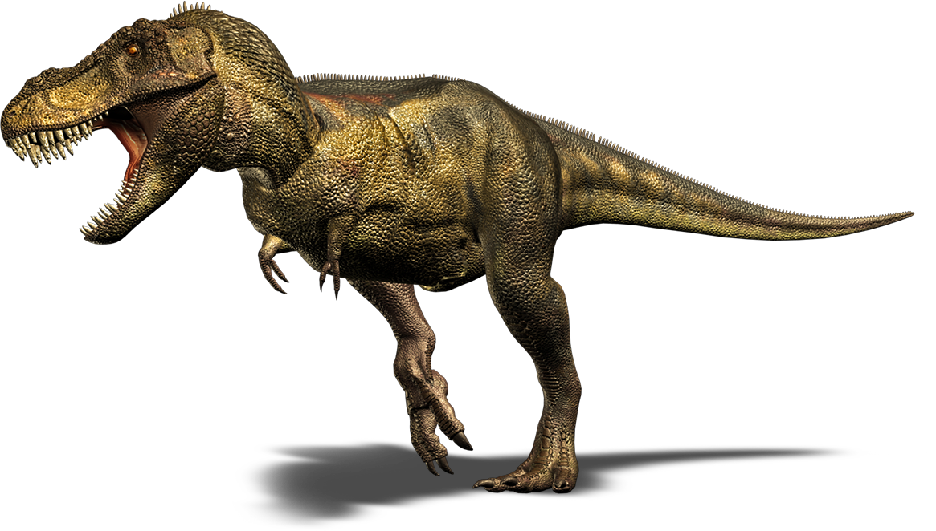
„Complex“ Data
Did you find that guy in here?

Slide 14
„Complex“ Data
No ?
Me neither!
Asara et al. (Science 2007) reported the detection of collagen protein fragments in a 68-million-year-old Tyrannosaurus rex bone by shotgun proteomics.
This finding has been called into question by researchers marking these proteins as contaminants from modern species.

Slide 15
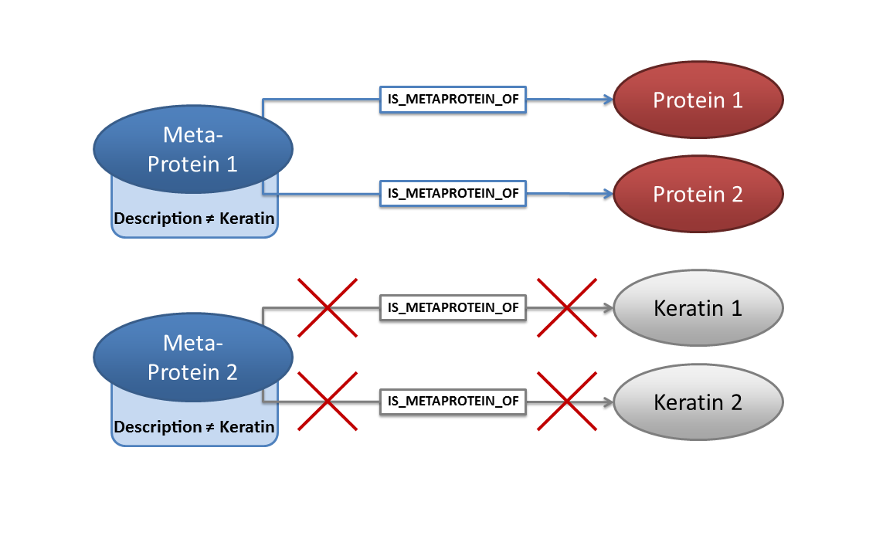
Graph Database Queries
Simple Query: Filter out (T.Rex) contaminants

Slide 16
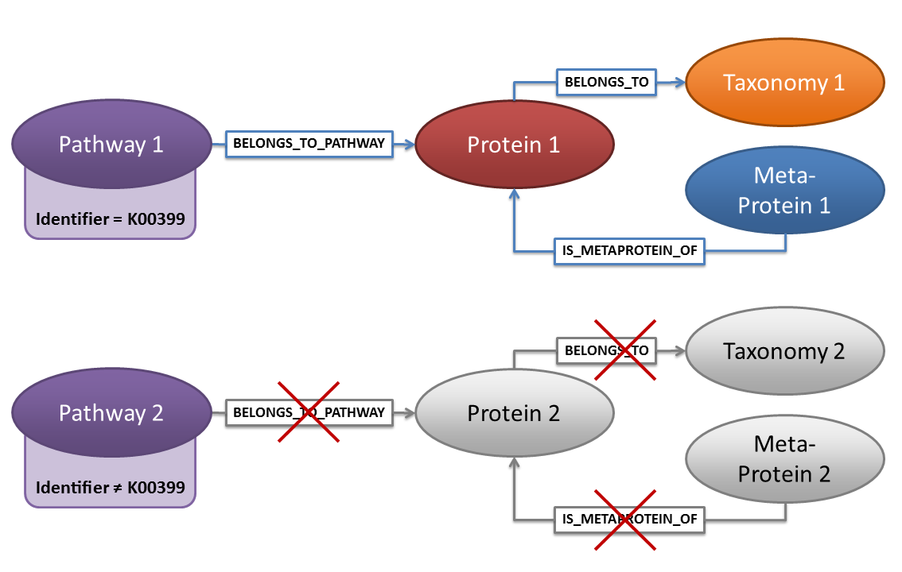
Graph Database Queries
Find a certain pathway and its related entitites

Slide 17
Graph Database Queries
Neo4j Cypher Query
START pathways = nodeathways("Identifier:*")
MATCH (pathways)<-[rel:BELONGS_TO_PATHWAY]-(proteins)<-[:IS_METAPROTEIN_OF]-(metaproteins)
WHERE (pathways.Identifier='K00399')
WITH pathways, proteins, metaproteins
MATCH (proteins)-[:BELONGS_TO]->(taxa)
RETURN pathways, taxa, metaproteins, proteins

Slide 18
Performance
Test Datasets:
A) 1388 proteins
B) 4946 proteins
C) 9393 proteins

Slide 19
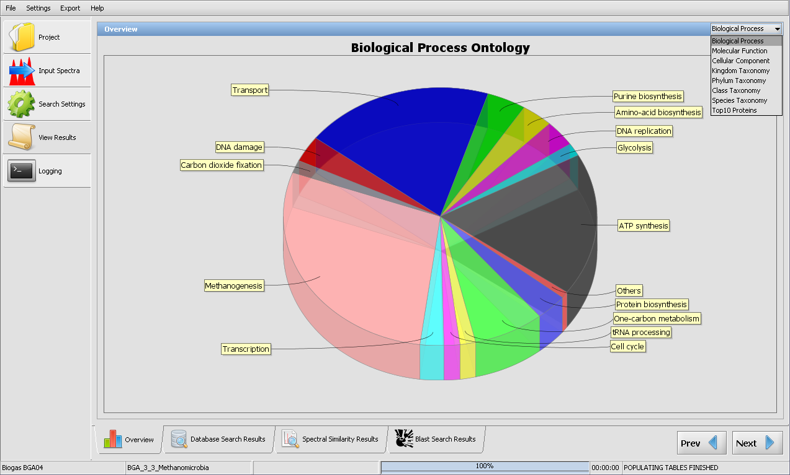
Software

Slide 20
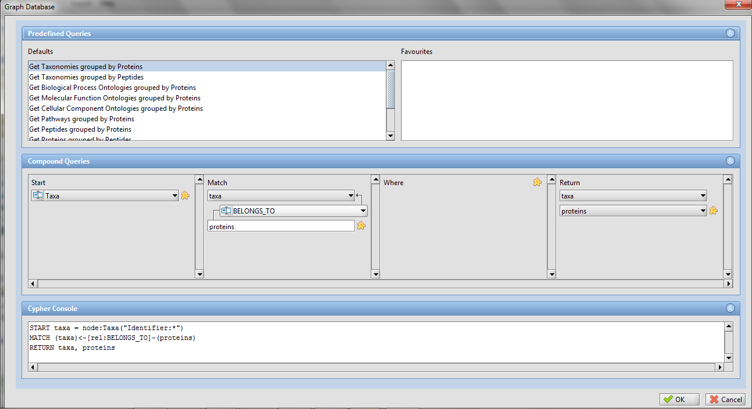
Software

Slide 21
Software
Current State
Tested by four differents labs (Magdeburg, Leipzig, Helsinki, Alghero)
Documentation and manuscript in preparation
Testing and fixing bugs for release version 1.0
Meta
Pr
teome
meta
Analyzer
proteome
P
P
A

Slide 22
Thanks for your attention!
Questions ? Comments ?
The software is available here:
http://meta-proteome-analyzer.googlecode.com

