Slide 1
VOCBENCH 2.0
A Collaborative Environment for SKOS/SKOS-XL Management: scalability and (inter)operatibility challenges
Armando Stellato
ART Group, Dept of Enterprise Engineering, University of Rome Tor Vergata, Via del Politecnico 1, 00133 Rome, Italy
Food and Agricultural Organization of the United Nations (FAO), Viale delle Terme di Caracalla, 00153 Rome, Italy
Email: stellato@info.uniroma2.it
LDBC2014 Fourth TUC Meeting
Amsterdam, 3rd Apr 2014

Slide 2
Why was it built?
AGROVOC (big agriculture vocabulary developed by FAO)
In 2004: >32 000 concepts in up to 22 languages
A global group of terminologists.
No existing standard for thesauri
No existing tool that met FAO’s needs
Notes:
No

Slide 3
V1 – 2010 ¹
Google Web Toolkit
Lucene
Protégé API
OWLART API
MySQL
Custom OWL
model for modeling thesauri
GWT / Presentation
Business logic
OWLART API
Protégé 3.4
MySQL

Slide 4
V1 Problems
Couldn’t support other triple stores (mostly glued to Protégé API)
Custom OWL model for thesauri modeling
No support for emerging standards, e.g. SKOS
No import
Complicated export (pretty tight to Agrovoc Model)
No support for alignments
AGROVOC aligned to a dozen other vocabularies
No SPARQL support

Slide 5
Objectives for VB2.0…
A completely rebuilt backing framework for the service and data layers, based on an already existing open source project: Semantic Turkey¹
Based on OSGi Open Services Gateway
Open Connectibility to most notable RDF middleware and triple storing technologies (Sesame2, Jena, Allegrograph…)
Native support for SKOS and SKOSXL over RDF (no more conversions from internal legacy models), other than OWL
VB1.0 User Interface remains mostly unchanged in the first release of VB2.0
1. http://semanticturkey.uniroma2.it/

Slide 6
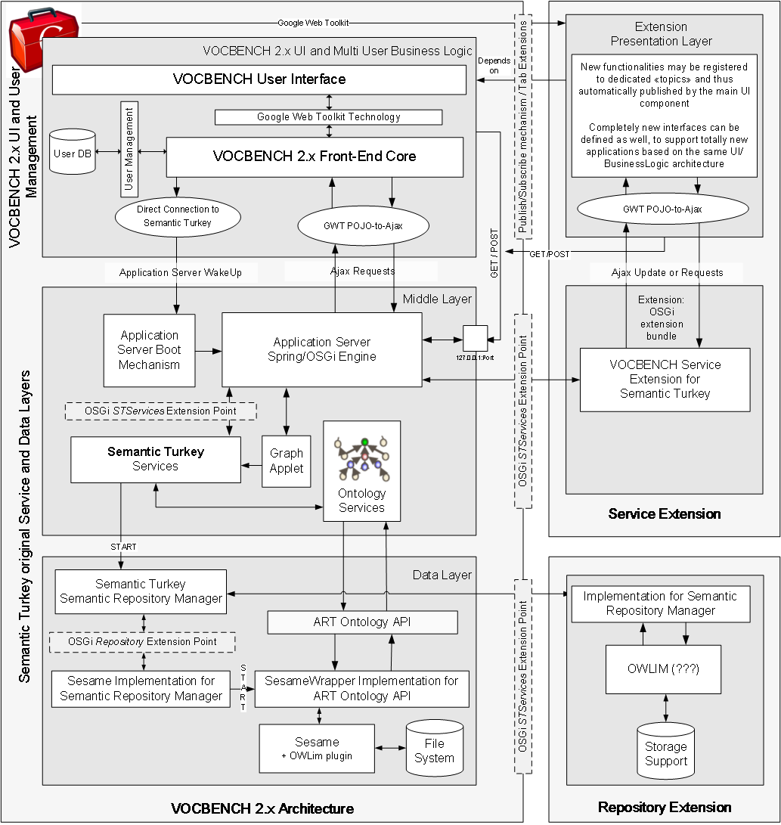
Vocbench 2.0 (and ST) Architecture
Three layered extensible architecture
Presentation Layer
GWT (Google Web Toolkit) Vocbench User Interface (Mozilla apps in the original framework)
Services Layer
Enables communication between the client (Vocbench UI) and the ontology persistence layer.
HTTP based Services accessed through the Ajax paradigm
OSGi Extensible Servicing System
Persistence Layer
Access to ontological knowledge.
Based on dedicated ontology API, which can be implemented through use of different technologies.

Slide 7
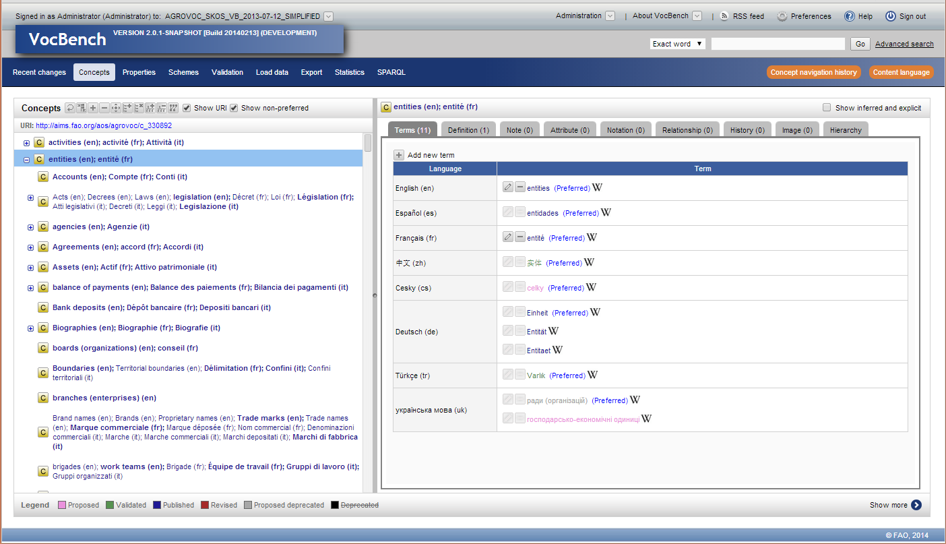
…and here we are!!

Slide 8
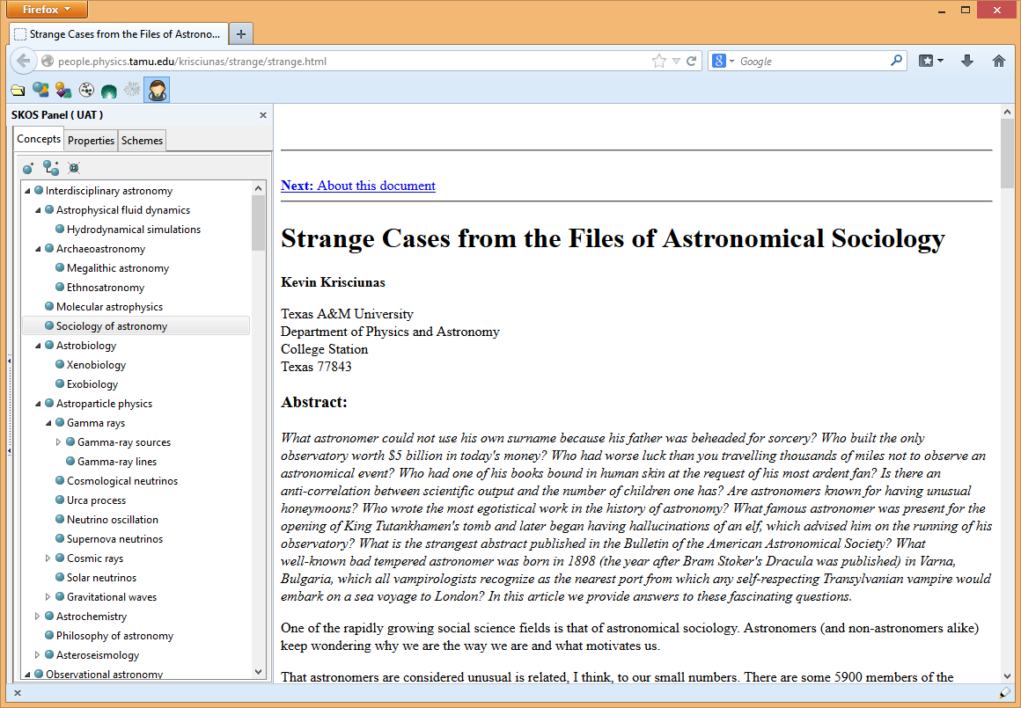
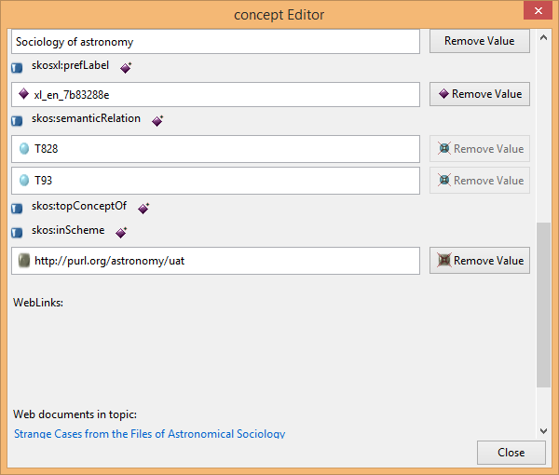
VB “desktop version”: Semantic Turkey for Firefox

Slide 9
Why should I buy it?
Collaborative Management
Validation&Publication Workflow (propose, validate, publish, revise, deprecate…)
Fine grained user management
both users and functionalities may be associated in groups
Functionalities (or groups of) may be assigned to different users (or groups of)
Full editing history (not only concepts, but most of the actions can be subject to validation too)
RSS Feeds
Fine-grained metadata and editorial notes: SKOS-XL and reified definitions allow for timestamped status and rich editorial notes
Multilinguality
Strong support for multi-lingual thesauri management
Application itself is also multilingual (currently support for english, dutch, spanish, more languages coming)
Native RDF support
Support for different triple stores
Possibilty to SPARQL query/update through a dedicated interface with syntax completion/highlight
SKOS-XL management
If preferred, SKOS-core export through available conversion tools
Large scale thesauri management
Scalability limited only by the underlying triple store
Extensibility
OSGi connectable services
And, last but not the least: Free and Open Source! (http://vocbench.uniroma2.it)

Slide 10
V2.0 Partners
Here is a list of partners adopting, or concretely considering the adoption of, VB2.0:
FAO (Agrovoc, Biotech, Land and Water, FAO Topics, etc..)
EU Documentation Office (EUROVOC)
Italian Senate (Teseo)
European Environment Agency (GEMET)
Harvard (UAT: Unified Astronomy Thesaurus)
EC Parliament Library
INRA (Infrastructure nationale AnaEE France , in the context of AnaEE project)
CABI
UNCCD: United Nations Convention to Combat Desertification (…)
Scottish Government (gov metadata)
…and others more

Slide 11
VocBench Evolution
This is a non-exhaustive list of features added along the various versions. Only the major news are reported here
VB2.1 (coming in these days)
A completely rebuilt installation mechanism for an headache-free installation experience!
Self-installing DB, with auto-updating scripts
Wizard-driven system configuration, with import/export of configuration profiles
SPARQL module: query/update content directly through the SPARQL query language for RDF; syntax completion & highlight
Multi scheme management: now concepts can be shared among different schemes
RSS feeds for all editing actions
VB2.0
A Completely re-engineered RDF backend, based on RDF Management platform Semantic Turkey
Support for different triple stores
Extension mechanism based on OSGi
Multi scheme management. Several skos:ConceptSchemes can be developed for the same dataset, providing different views on the data
Statistics module: a module providing resuming information about the loaded data.
Export module: for exporting all or part of the content of a project according to several existing RDF serialization standards
Load data module: for loading bulk data serialized in some RDF serialization standard
Ontology Import Management (Administration-->Ontologies): to owl:import ontologies to be used as property vocabularies for the modeled thesauri
New tabs under the concept view for covering extensively the SKOSXL standard (note, notations)

Slide 12
Interoperability Issues
Obstacles towards interoperable components…

Slide 13
Dataset Management
Operations which are strongly bound to the specific technology being adopted
Dataset creation/deletion
Indexing

Slide 14
SKOS Management
SKOS / SKOS-XL Management.
Currently VB works with the more expressive SKOS-XL and exports data to SKOS
Question for the future: native SKOS core support?
For sure, in VB2.2 a lot of data lifting/fixing utilities
Multi scheme management
SKOS is maybe «too» permissive on the way information may be organized, this results in non-clear semantics
Not easy to deal with multiple schemes, compromise between powerful operations and simple management

Slide 15
Scalability and Extensibility¹
Extensions
We are rebuilding the extension mechanism of Semantic Turkey, the RDF services engine behind VB
Dependency injection and Aspect programming → agile direct-to-businesslogic development of new functionalities and plugins
Multi-project Management
Traditional plugin-based approach with local models/repositories is good for toy datasets or ontologies.
In a multi-user environment, working on large repositories, we cannot allow users to freely load huge amount of data
VB2.(>2): projects and their data can be accessed through other projects
Read/write access and locks can be specified for each project
Definition of an ACL (access control list)
1. These and other related improvements, in the context of developing «Ontology Alignment over bigdata» extensions, are funded by the SemaGrow project, Seventh Framework Programme (FP7) of the European Commision (FP7-ICT-2011.4.4a Intelligent Information Management) under Grant Agreement No. 318497

Slide 16
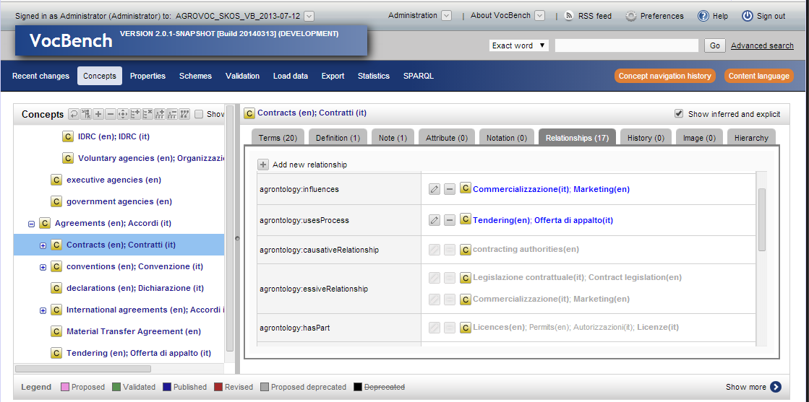
Reasoning
«Inferred triples» are not something easily manageable.
No standard for storing/accessing them
Each triple store adopts its own way:
an «inferred triples graph (which graph? No standard!)
default graph
with «inferred» switch (such as in sesame), but how to get only them?
In sesame, even with an empty null context, they ended up being mixed with other triples, such as the sum of all named graphs

Slide 17
The hatred "default graph mantra"
Accessing the default graph
The SPARQL UPDATE specs (http://www.w3.org/TR/sparql11-update/#graphStore) tell that: «a Graph Store contains one (unnamed) slot holding a default graph and zero or more named slots holding named graphs. Operations may specify graphs to be modified, or they may rely on a default graph for that operation. Unless overridden (for instance, by the SPARQL protocol), the unnamed graph for the store will be the default graph for any operations on that store. Depending on implementation, the unnamed graph may refer to a separate graph, a graph describing the named graphs, a representation of a union of other graphs, etc”
So, the default graph is not standardized. If we interpret it as a separate graph (e.g. Sesame2 null context)… …there is no way, in a SPARQL QUERY, to access it!
Very long story:
http://www.openrdf.org/forum/mvnforum/viewthread?thread=1518
http://www.openrdf.org/issues/browse/SES-849
http://www.openrdf.org/issues/browse/SES-848
http://www.openrdf.org/issues/browse/SES-850
https://openrdf.atlassian.net/browse/SES-850
http://sourceforge.net/p/sesame/mailman/message/31585163/
And probably many more…
Default graph mantra: never use the default graph! (other versions: never use the default graph for anything else than metadata)
So…it’s like…my finger hurts…cut it!
This really hinders interoperability

Slide 18
Shareability of non-open source software
What we would expect from triple store producers
Sometimes their products require dedicated/customized clients (mostly compliant with notable APIs, though with some underlying differences, or offering more functionalities)
Sometimes they have light versions of their triple stores completely bundled into a compact solution
Surely understandable not to have them open-source …
…please make them maximally:
Accessible (Maven?)
Redistributeable with tools

Slide 19
References & Links
Vocbench
home: http://vocbench.uniroma2.it/
Fao VB user community: http://aims.fao.org/tools/vocbench-2/
user and developer groups: http://groups.google.com/group/vocbench-user http://groups.google.com/group/vocbench-developer
Publications:
Armando Stellato, Ahsan Morshed, Gudrun Johannsen, Yves Jaques, Caterina Caracciolo, Sachit Rajbhandari, Imma Subirats and Johannes Keizer A Collaborative Framework for Managing and Publishing KOS, The 10th European Networked Knowledge Organisation Systems (NKOS) Workshop, Berlin, Germany, September, 2011
Semantic Turkey
home: http://semanticturkey.uniroma2.it
user and developer groups: http://groups.google.com/group/semanticturkey-user http://groups.google.com/group/semanticturkey-developer
Publications:
Maria Teresa Pazienza, Noemi Scarpato, Armando Stellato and Andrea Turbati Semantic Turkey: A Browser-Integrated Environment for Knowledge Acquisition and Management, Semantic Web Journal, 3, 2, 2012
Manuel Fiorelli, Maria Teresa Pazienza and Armando Stellato Semantic Turkey goes SKOS: Managing Knowledge Organization Systems, ISemantics 2012 Graz, Austria, 5-7 September, 2012

Slide 20


