Slide 1

Overview

Slide 2
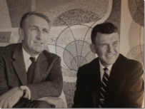
HP Labs: engine of innovation
1967
Cesium-beam atomic clock
1984
Inkjet Printer
2001
Utility Data Center
2010
ePrint
2014
Location Aware
1972
Pocket Scientific Calculator
1986
3D graphics workstations
2012
StoreAll
OpenFlow switches
2002
Rewritable DVD for standard players
1980
Office Laser Printer
1994
64-bit architecture
2008
Memristor discovered
1975
Standard for Interface Bus
1989
Digital Data Storage Drive
2005
Virus Throttle
1966
2013
Moonshot
2011
MagCloud
1968
Programmable Desktop Calculator
1986
Commercialized RISC chips
Threat Central
2003
Smart Cooling
SureStart
3D Photon
Engine
1966
Light Emitting Diode (LED)
1980
64-channel Ultrasound
1999
Molecular Logic Gate
StoreOnce
Notes:
Many people know HP as an iconic American company started by Dave Packard and Bill Hewlett.
They know us by the famous garage that came to symbolize the most celebrated and productive concentration of innovation anywhere: Silicon Valley.
HP’s reputation is the result of 75 years of innovation, featuring over 45 years of achievement on the part of HP Labs.
1968: First programmable scientific desktop calculator. Virtually the first PC, the HP 9100A solves science and engineering problems 10x faster than other machines.
1972: First pocket scientific calculator, the HP-35 that fits in a shirt pocket.
1984: HP launches its first inkjet printer. Based on thermal inkjet technology from HPL, the ThinkJet is high-quality, low-cost and much quieter than noisy dot matrix models.
1986: HP is first to commercialize Reduced Instruction Set Computing. RISC is faster and more productive than previous generations of chips.
1999: HP and UCLA build first molecular logic gate, a key step in creating chemically assembled electronic nanocomputers.
2002: HPL creates technology for first rewritable DVD system (DVD+RW) compatible with standard DVD players.
Successful technology transfer is a key focus for us, and an important part of how we interact with the HP business units and ultimately HP customers. Here are a few of our more recent results.
2010 ePrint -- 30 years ago, HP introduced Printer Command Language so PCs can talk to printers; ePrint lets you use any Web-connected printer anywhere. Take a photo on vacation and send it so it comes out of the printer at your Mom’s house -- easily without inputting IP addresses.
2011 MagCloud pioneers a new era of self-service printing and distribution, where anyone can affordably turn content into professional publications in print or digital format. This technology has been used to create communications – many of them award-winning – that capture a moment and are ready in an instant.
2011 3D Photon Engine technology: Immersive 3D that combines innovations in screen technology, software, and camera equipment so realistic that some viewers have tried to walk through the screen.
2011 StoreOnce: HP StoreOnce deduplication and HP StoreOnce Catalyst— using a single deduplication engine designed at HP Labs—deliver the first federated deduplication solution in the industry. Our more efficient approach optimizes backup processes, eliminates wasted resources, reduces network bandwidth costs, and improves backup throughput.
2012 StoreAll with Express Query: HP’s revolutionary hyperscale storage platform provides massive scalability and structure to unstructured data, with Express Query from HP Labs, that lets you access billions of files in minutes.
2013 Project Moonshot: revolutionary new way to build servers based on low-powered chips with ARM or Intel Atom architectures, like those in cell phones and other mobile devices. Reduces costs by 50%, cuts power consumption by nearly 90%, and reduces footprint of a server group by 80%.
2014: HP Location Aware (CUPID): CUPID is an indoor positioning system that relies only on WiFi infrastructure, yet is accurate and inexpensive to implement. CUPID does not require any client side modification or smartphone-based application for use. HP Location Aware, which leverages CUPID technology, is being piloted by HP Networking and ES to enable novel location-aware applications and services.
These successful transfers – and many more currently in the pipeline – are examples of how HP Labs is continuing a 45-year record of achievement…and driving the HP reputation for innovation into the future.

Slide 3
Innovation horizons
Evolutionary
Revolutionary
Business Units
HP Labs
Advanced Development
Up to 2 years
Applied Research
2 – 5 years
Exploratory Research
5 – 20+ years
1
2
3
4
5
6
10
20
The future
Notes:
HP Labs is one of two primary innovation drivers at HP.
HP’s Business Units are powered by 60K engineers and technologists working on innovation that evolves current technology into the near future, i.e. evolutionary innovation, aiming for impact within 1 to 3 years.
HP Labs is chartered with revolutionary innovation. These are the technologies that can be disruptive to today’s business, but will drive our business – and the world – 5, 10, or 20 years into the future.
Disruptive innovation can create new markets or set new standards in existing markets; delivers big “first-mover” advantage.
Innovation is so important that it’s stated explicitly as a strategic priority for HP. We invest more than $3 billion a year in research and development across HP.
HP Labs: 60% applied research, 20% exploratory research, and 20% whitespace
It’s a combination of delivering tangible results for the business and creating the transformative technologies of the future.
Sustaining innovation
Addresses existing markets, improving value and competitiveness
Can be evolutionary or revolutionary
Whitespace is a quick win in an area of adjacency or extension; the sum is more than the parts
Shorter-term: faster ROI, incremental impact
Disruptive innovation
Displaces existing markets, creates new markets, values and competitiveness
Introduces new technologies, products or services
Whitespace is an opportunity no one else sees or can address
Longer-term: higher risk/return, potential for advantage and differentiation

Slide 4
HP Labs charter Delivering innovations that transform business, life, and society
Deliver breakthrough technologies
Create opportunities for our business and customers
Advance fundamental science
Engage with customers and partners
Notes:
Where do we innovate to bring value and when to we leverage the broader ecosystem?
When do we go deep? When we’re the only ones
When do we leverage? When building on the work of others brings better results

Slide 5
Data explosion outpacing technology
2020 44 ZB
(figure exceeds
prior forecasts by 9 ZBs)
2015
2010
2012
2005
0.1 ZB
1.2 ZB
2.8 ZB
8.5 ZB
(1)
Next-generation competitive advantage delivered through:
Business insight at real-life speeds
Personalized content that follows you
Questions that arise automatically from data
(1) IDC "The Digital Universe of Opportunities: Rich Data and the Increasing Value of the Internet of Things" April 2014
Notes:
The digital universe — the data we create and copy annually — is currently doubling in size every two years, and by 2020 will have reached 44 zettabytes, or 44 trillion gigabytes. It includes not only the increasing number of people and enterprises that are doing everything online, but also all the "things" — smart devices, meters, sensors — that will be connected to the Internet.
We want to be able to garner competitive advantage from all of that data, so that:
It helps us gain business insights at real-life speeds
The content that we need follows us no matter where we are, and is tailored to our context, location, and device
We don’t have to know what questions to ask in advance – the most important information will arise automatically, helping us make better, faster decisions.

Slide 6


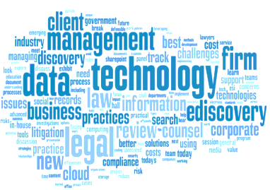












Today’s computing infrastructure unable to keep up
/
You won’t be able to get more capacity for less
Internet of Things
By 2020
Big Data will be too big to extract meaning from
200
Billion
(1)
IoT “Things”
You won’t be able to move your data from where it’s created – useful data may get ignored or discarded
30
Billion
(2)
Connected
Devices
By the time you’ve analyzed your data – it will be out of date
1
Billion
Smart Meters
(3)
Your infrastructure will require more resources than you can get
… for 8
Billion
Securing your enterprise will take more computing resources than you have
Pervasive Connectivity
Smart Device Expansion
Explosion of
Information
(4)
(1) IDC “Worldwide Internet of Things (IoT) 2013-2020 forecast” October 2013. (2) IDC "The Digital Universe of Opportunities: Rich Data and the Increasing Value of the Internet of Things" April 2014 (3) Global Smart Meter Forecasts, 2012-2020. Smart Grid Insights (Zypryme), November 2013 (4) http://en.wikipedia.org
Notes:
This massive data explosion will be so big, in fact, that today’s computing infrastructure eventually won’t be able to keep up:
You will no longer be able to get more computing, processing, storage capacity for less cost
DRAM scaling has stopped and Flash is slowing
Big Data sets will become so big, we’ll be unable to extract meaning from them
Current memory hierarchy becomes a limiting factor –separate memory and storage is too inefficient
You can’t use your data because you can’t move it from where it’s created
The data from your end points may be too big to move
Or, you may not be able to move it because you’re forbidden to move your data, due to privacy and data sovereignty rules
Potentially useful data may get ignored (dark data) or even discarded because you can’t move it from where it’s created
You may not be able to get enough bandwidth to move the data – either it will take too long to move it or will be created faster than you can move it
The destination may be overwhelmed – not enough storage available or not fast enough storage to handle the volume of data you want to analyze.
By the time you’ve analyzed your data, it will be out of date, leaving it too late to help you make business decisions.
And you won’t be able to just throw technology at the problem, because your computing infrastructure will require more resources than will be available to you.
There’s no point in building bigger data centers if you won’t be able to get the electricity to run them, or the system administrators to manage them at that massive scale.
Finally, current security technology isn’t nearly good enough to inspect and classify every bit of data entering and leaving your enterprise, without bringing your computing infrastructure to its knees.
What is driving this enormous explosion in data?
We’re seeing an explosion in the number of connected devices and web content – more than today’s server infrastructure was designed to handle.
Consider that by 2020, there will be 32 billion internet-connected devices, 212 billion “things” – sensors, meters, actuators - connected to the internet, for a population of about 8 billion across the world.
How will we be able to harness the internet of people, things and information to ensure a better quality of life for all of us?

Slide 7

A radically new approach is required
Electrons
Compute
Photons
Communicate
Ions
Store
Notes:
Current systems won’t be able to handle where we are headed and we need a radically new approach to computing to solve these looming challenges.
These six words summarize how we’re thinking about new computing hardware: we’ll use electrons to compute, photons to communicate, and ions to store.

Slide 8
Driving data to value
Data
Value
Goal: fastest, most secure, most efficient route
data
storage & processing
analysis
meaning
insights
actions
outcomes
Notes:
The whole point is to take that deluge of data and find the fastest, most secure and efficient route for gaining real value from that data.
HP Labs is building on HP’s strengths across this entire value chain, from storing, managing and processing the data, to being able to analyze and mine it to gain meaningful insights that can lead to decision made at the right time, for improved business outcomes.

Slide 9







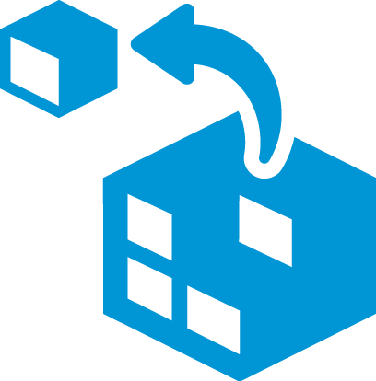






HP Labs research agenda
Digital
Mobile
Context-aware
Content Consumption
Data
Value
Software Defined IT
Million-node
management
Next-generation
analytics
Visualization
Insight
Foundational hardware
breakthroughs
Distributed data sources
Physical
Notes:
Let’s take a closer look at how we’re transforming data into value:
As we discussed earlier, the data we need is being generated by both physical systems and “things”, as well as the digital devices that we connect and interact with in increasing numbers.
Our vision for a new computing architecture enables fundamental changes in applications and how we interact with them:
Scale to empower you – not data scientists - to extract meaning from massive data sets in close to real time.
Security – trust – is built in throughout the entire system, from embedded device security to privacy and accountability throughout the data analytics and visualization chain. We’ll have the ability to ingest, analyze and act up upon every one of the millions of events per second, instead of the tiny fraction we’re able to act on today.
We’re building new “software-defined systems” on foundational hardware breakthroughs from HP Labs that change the way we think about computing:
We will fuse memory and storage through universal memory, flattening complex data hierarchies, bringing processing closer to the data.
Photonics – using light to communicate instead of copper – will allow these systems to communicate at the speeds that massive-scale computing will require.
We’ll extend HP’s pioneering Moonshot concept to enable specialized, highly efficient systems-on-a-chip that are tailored to different computing requirements to maximize execution speed.
And highly scalable and reliable storage systems will enable substantial improvements in capacity and speed, at a fraction of the space, power and materials required today.
Now that we’ve found new ways to store and process all this information, we will also need new ways to:
Manage these massive systems at scale, across millions of nodes, with optimized human resources and smarter, better automation;
Analyze the data with new exascale algorithms that can truly take advantage of the new capabilities and speed these systems will provide;
And once we’ve analyzed the data, we need to be able to visualize and interact with it in real-time, on any platform or computing device, so we can make better, more intuitive business decisions.
And that, is what allows those insights to true deliver value to your business and your daily life.

Slide 10




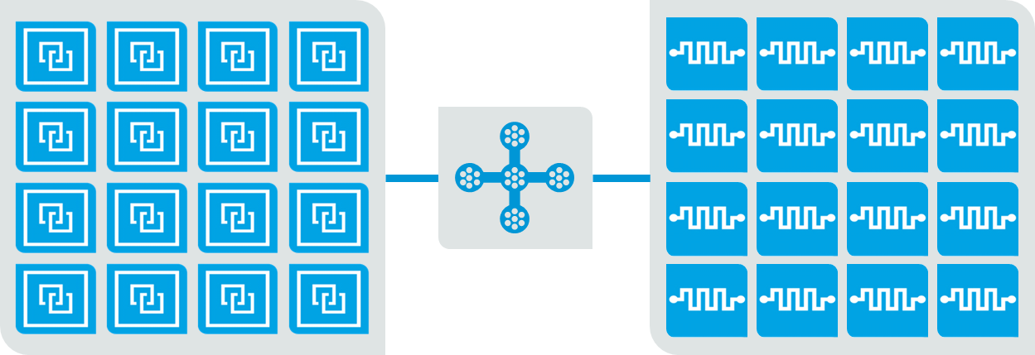
The Machine: towards a new computing paradigm
Value
Analytics and visualization
Exabyte-scale algorithms
Million-node management
Security built-in from silicon upwards
Machine OS
Data
Ultra-efficient hardware
Notes:
Let’s get more specific about what we mean when we say we’re building “software-defined systems”. HP Labs, in partnership with HP’s businesses, is creating a completely new computing paradigm to address the looming challenges of the data explosion.
The Machine reinvents the fundamental architecture of computers to enable a quantum leap in performance and efficiency, lower costs over the long term, and improve security.
It will also be scalable from handheld to laptop to workstation to data center to supercomputer.
The Machine will communicate using light – photonics – instead of electrons for massive bandwidth and power-efficiency increases.
We will collapse the current memory hierarchy, combining memory and storage using Memristors, to enable the manipulation of massive data sets that are impossible using today's technology.
We’ll extend HP’s pioneering Moonshot concept to enable specialized, highly efficient systems-on-a-chip that are tailored to different computing requirements to maximize execution speed.
To harness these new technologies, we are building the first all-new operating system in decades. Programming will be radically simplified and enable new applications that we can’t start to build today.
We understand that innovations to the hardware alone – no matter how revolutionary – will useless without the software stack that can take advantage of it.
The Machine OS has two phases:
First, we will use familiar programming constructs to allow legacy applications to run with improved performance.
The second phase will build on this to deliver the first all-new OS in decades, enabling developers to achieve orders-of-magnitude improvements in speed and scale from a whole new class of applications
Our new clean-sheet Machine OS will be Open Source. HP is all in on open source, agile development and the new DevOPS model.
Proof points: OpenStack (HP #1 committer) and Trafodion
We want to re-ignite operating system research that’s been mostly stagnant in our universities for the last few decades. Part of the reason we’ve launched the machine is because we wanted to engage the world in a new open source operating system built with security as a first-class citizen and optimized for non-volatile memory.
In addition to these radically new approaches to store and process all this information, we will also need new ways to:
Manage these massive systems at scale, across millions of nodes, with optimized human resources and smarter, better automation;
Proof point: Loom - HP’s Helion includes a management tool called Loom from HP Labs that lets you manage 40,000 VMs today.
Analyze the data with new exascale algorithms that can truly take advantage of the new capabilities and speed these systems will provide;
Visualize and interact with it in real-time, on any platform or computing device, so we can make better, more intuitive business decisions, harnessing humans’ natural ability to spot patterns and anomalies.
Icons from top to bottom:
Analytics solutions and visualization
Next-gen core enabling algorithms
Distributed workloads at cloud scale
The Machine Operating System
New compute architecture

Slide 11
Delivering the fastest, most secure and efficient route to value
Systems Research
Networking and Mobility
Security
and Cloud
Analytics
Printing
and Content
Notes:
HP Labs’ research agenda is addressing our goal of delivering the fastest, most secure and efficient route from data to value by innovating in 5 areas: systems research, networking and mobility, security and cloud, analytics and printing and content.
Let’s take a look at each of these areas in a little more detail.

Slide 12
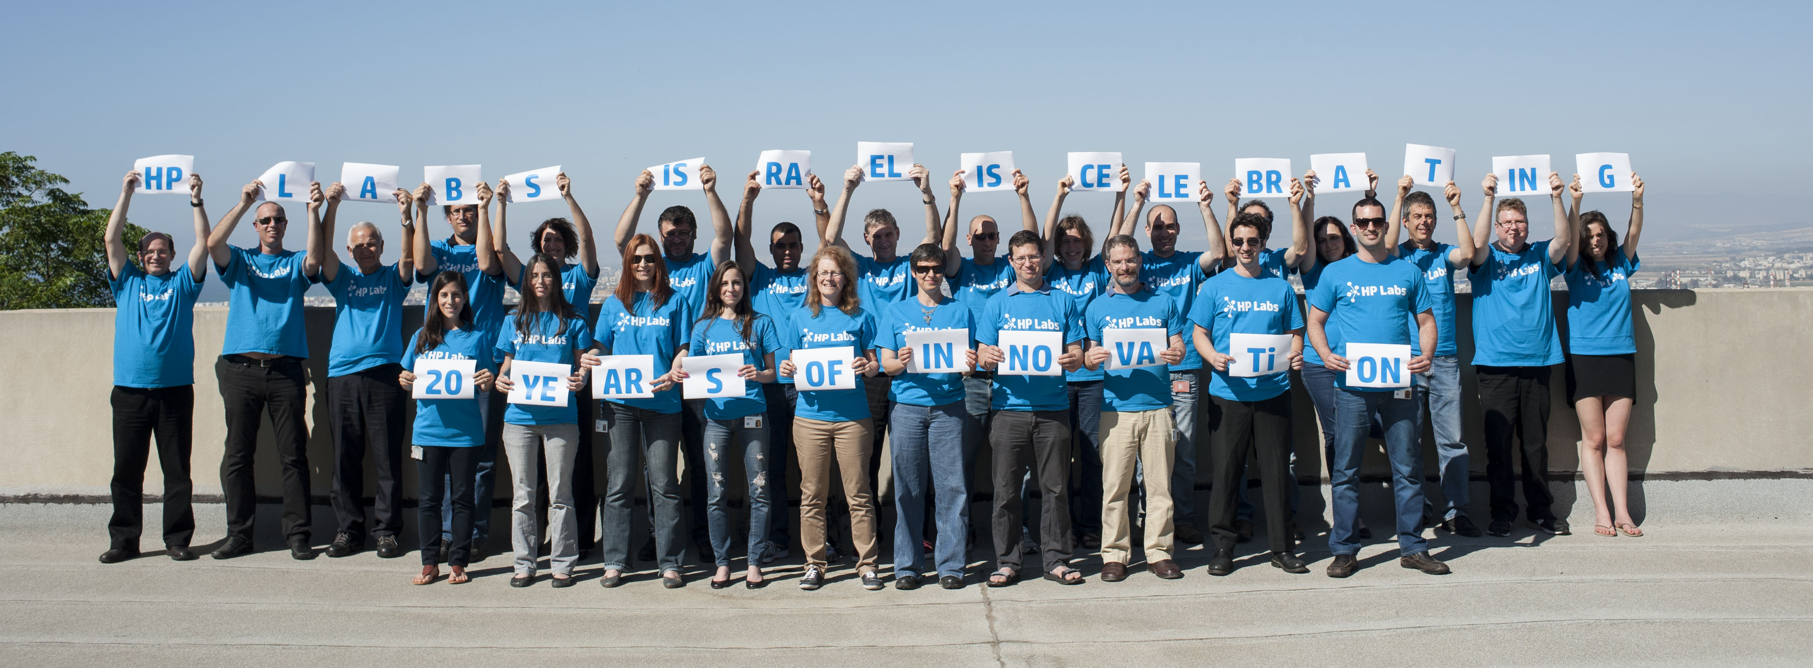
HP Labs Israel
Analytics
Notes:
HP Labs’ research agenda is addressing our goal of delivering the fastest, most secure and efficient route from data to value by innovating in 5 areas: systems research, networking and mobility, security and cloud, analytics and printing and content.
Let’s take a look at each of these areas in a little more detail.

Slide 13


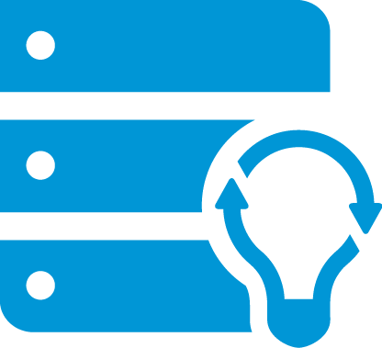
Systems
We need to get radical about efficiency.
HP Labs is breaking through the current limits on storing and transforming data – creating software-defined systems that range from the personal to the zettascale.
Photons for Communication
Transmitting data at light speed and low cost
Universal Memory
Non-volatile, high-speed, scalable, low-cost memory and storage with Memristors
Systems on a Chip
Power consumption and costs way down, performance way up
Memory-based Data Stores
Scalable, resilient stores for big data applications
Cog ex Machina Massively parallel cognitive computing architecture
Notes:
OLD TALKING POINTS:
We’re developing radical new approaches to collect, process, store, and analyze data to create the next generation of large-scale, high-performance infrastructure to support the data-centric world.
Photonics: We’re working to make photons the vehicle of choice for communication all the way down to the microprocessor core. Why? Wires can’t get any smaller, faster or less energy intensive. Instead of using copper wire to transmit data, we have working prototypes of optical backplanes that shoot data via light beams. How fast? At the speed of light.
Universal Memory: We’re fusing memory and storage. Our Memristor non-volatile memory is a resistor with memory, so it can store and process at the same time with incredible efficiency and is the foundational technology for a universal memory. Think of a Flash drive that can store 100 hours of high-def video or DRAM that never loses state.
Systems on a Chip: We’re making systems vastly more powerful, programmable and efficient. Leveraging a variety of standard and application-specific computing cores, we’re integrating processing, memory, management and fabric all on one chip. This allows for systems customized for workload, algorithms and energy requirements.
Memory-based data stores: We’re creating scalable, resilient data stores based on the groundbreaking capabilities of universal memory, to enable an entirely new class of big data applications.
Cog ex Machina: Our advanced cognitive computing allows us to place massively parallel processing into efficient packages. We’re able to put thousands of learning machines in places where they’ve never been before. Imagine a mobile phone with the ability to zero in on a particular speaker in a crowd, and provide you with simultaneous language translation into your earpiece.

Slide 14
Networking and Mobility
When everything is connected, connection is everything.
HP Labs is developing next-generation network architectures that provide predictable, high-quality, and power-efficient networks, and creating new experiences for the devices that use them.
Software-Defined Networking
Creating a future of programmable network devices
Cloud Network Management
Developing open source Networking-as-a-Service technology to greatly simplify the delivery and management of cloud networks
Seamless Mobile Connectivity
Connecting users, resources, and services seamlessly and securely – anywhere and anytime
New Devices and Experiences
Exploring new frontiers in wearables, low-power devices, personal identification and context-aware experiences
Notes:
We’re delivering network innovations an order of magnitude faster than what exists today -- at a tenth of today’s cost.
Software Defined Networking (SDN): We’re developing new networking and communications technologies to enable bandwidth, speed and latency for extreme data volumes, enabled by a rapidly customizable and programmable datacenter, enterprise and device network.
Cloud Network Management: When your computing infrastructure is virtual, your networking needs to be able to keep up too. We’re employing SDN technologies to react to changing SLAs and automatically re-configuring virtual networks to provide you with the right level of bandwidth, at the right time.
Seamless Mobile Connectivity: We’re delivering a mobile experience that’s secure and free of irritants -- like when your calls get dropped because of too much traffic on 3G or 4G networks. We’re empowering mobile users with simple, cloud-assisted ubiquitous connectivity services; and mobile device and persona management, disrupting the economics of apps and user experiences in the enterprise.
New devices and experiences: We’re exploring new frontiers in wearable computers, including technologies for low-power devices, energy harvesting, personal identification and context-aware experiences.

Slide 15
Analytics
Data so smart it can tell you what's really important.
HP Labs is integrating data sources, transforming business processes, and driving relevant insights at unprecedented scale – so business questions can arise proactively from the data for easy access by business users.
Rapid Discovery to Deployment
Simplifying and democratizing the information technology that enables businesses to run using ubiquitous data and analytics
Distributed Mesh Computing
Enabling the collection, management, and analysis of vast amounts of data about the world around us
Universal Memory-driven Analytics
Creating transformative algorithms, architectures, and platforms driven by access to Universal Memory
Notes:
Organisations have multiple sources of data, which can be structured and unstructured. We’re connecting them all together, allowing our customers to transform and automate business processes, and act on relevant insights, at unprecedented scale.
Rapid Discovery to Deployment: We’re simplifying and democratizing the information technology that enables businesses to run, ensuring that everyone will be able to use ubiquitous data and analytics to make informed business decisions in real time.
Distributed Mesh Computing: Enabling the collection, management, and analysis of vast amounts of data about the world around us, enabling us to extract value from the growing internet of things at the facility, campus and even city scale.
Universal Memory-driven Analytics: As our research in next-generation systems comes to fruition, we’re also working on co-designed software and analytics platforms, enabling us to shape the future of analytics at zettascale, in real time.

Slide 16
Security and Cloud
Embedded Control Points
Building trustworthy foundations in next-gen platforms
Protecting your enterprise even when most of it is in the cloud.
Against increasingly complex threats, HP Labs is delivering a robust chain of trust across all devices and geographies – to provide assurance, insight and control.
Continual Assurance
From low-level probes to the analysis of big security data
Management at Scale and Across Boundaries
Orchestrating data and computation to create trusted data-centric clouds
Big Data for Security
Delivering actionable insight from ever-increasing volumes of security data
Notes:
Our world – and our data – is facing increasingly complex threats, even more so with our move toward computing in the cloud. We’re providing our customers with assurance, insight and control when using HP’s products and services in this new world.
Embedded control points: We’re building security into the hardware level from the bottom up – whether that’s tomorrow’s personal computing devices or data center infrastructure - using cryptography techniques and secure operating systems.
Continual assurance: We’re developing self-monitoring and self-healing systems, inspired by biological defence mechanisms. We can spot massive-scale malware attacks that have never been seen before (i.e. “zero day attacks”), looking inside virtual machines to spot “symptoms” of a problem. Forensic Virtual Machines demonstrator is part of this project.
Management at scale and across boundaries: As we move our computing and data to the cloud, we need to operate across enterprise, regulatory and geographic boundaries. We’re helping manage data across geographies, services and organisations, creating trusted data and providing assurances to administrators. This project builds on our prior work on the G Cloud demonstrator (Government grade cloud).
Big Data for Security: We’re devising new, more sophisticated analytics to deliver actionable insight from the ever-increasing volumes of security data that enterprises are faced with today.

Slide 17
Printing and Content
Content access so smooth, you don't even have to think about it.
HP Labs is ensuring a secure, seamless flow of information between digital and physical formats, and is creating technology innovations in digital printing and materials that enhance commercial printing devices and processes.
Digital Commercial Printing
Accelerating the analog-to-digital transformation
Personality-customized Content
Redefining the print experience to deliver content the way people want it
Enterprise Document Ecosystem
Ensuring that information flows smoothly and securely from analog to digital and back again
3D Printing
Enabling future devices and materials that bridge the digital and physical worlds
Notes:
By enabling ubiquitous access to data and content, we’re providing new ways to consume and interact with information.
Digital Commercial Printing: We’re delivering breakthrough commercial printing technologies that deliver amazing quality digital prints, while making commercial printing easier and more automated than ever.
Personality-customized content: We’re developing new ways to transform, package and deliver personalized content to you, based on your preferences, consumption device, or context.
Enterprise Document Ecosystem: We’re providing assurances for secure and authentic documents, so that you know if you have the right document, in the right place, and that your data is safe from tampering. We’re also delivering this authentication and assurance to physical supply chains through advanced track-and-trace and document forensic technologies, helping curb counterfeits and keep high-value products - like medicines – safe.
3D Printing: We’re exploring new techniques to enabling future devices and materials that will bridge the digital and physical worlds

Slide 18


HP Labs driving innovation to market
Cloud
Security
Big Data
Mobility
Commercialized via
Technology Transfer
Supply Chain
Innovations across portfolio: technology components, systems, and solutions
Software Defined IT
Licensing
Million-node
management
Next-generation
analytics
Enterprise Services
Foundational hardware
breakthroughs
HP on HP
Open Source
Incubations and Spin outs
Notes:
At HP Labs, we are passionate about making our research real – driving technology to commercialization through a variety of avenues, matching the right technology with the right opportunity.
We deliver business value to HP through a steady stream of technologies that support our existing businesses and that have the potential to create new markets for HP.
We also look more broadly at opportunities for our research to deliver value, such as deploying our technologies inside HP, innovating our supply chain, licensing our intellectual property for others to bring to market, contributing to the open source community, and even creating technology incubators or spin outs in some cases.
This entrepreneurial approach to R&D helps us drive greater, faster returns on our research investments.

Slide 19
Innovation is multidimensional
Creativity
The new and different approaches to, or reframing of, what we do to generate new ideas or solve problems
Passion
The enthusiasm and optimism we demonstrate in our work and interactions
Analytical Skills
The ability to evaluate ideas and opportunities objectively and efficiently; to observe and experiment
Emotional Intelligence
The ability to handle criticism, conflict, and risk
Influence
The ability to build support for a new idea within teams, across a lab, or across business unit boundaries
Leadership
The ability to create meaningful innovation, strive for continuous improvement and adapt quickly to change
Connectivity
The networks we create to collaboratively build and test new ideas
Notes:
Technology can change the world for the better and we’re determined to make it happen. Our researchers act as a global team to bring together diverse perspectives and knowledge, working closely with commercial and academic research partners. We also engage with our most forward-thinking customers to tackle challenging problems, jointly innovate the next generation of HP products and services, and create business value.
Behind every one of our breakthroughs are world-class technologists from across the globe – talented men and women with a range of backgrounds and skills. We know there’s power in diversity. Plurality of perspective and creative new ways of collaborating and problem-solving have been instrumental to the innovations that we’re bringing to market now. And they’ll help us achieve even more in the future.

Slide 20
The Machine: The future of technology
HP Labs
June 19, 2014

Slide 21


What are the questions you can’t ask today?
Magnitude of the data
+
Flash flooding of legacy data bases
+
Unable to secure
+
=
Time consuming data integration
+
Real-time insight needed
+
Insufficient resources
+
The end of cheap hardware
/
Notes:
We’re reaching the point where the data is too big to move (even with photonics). You can’t work with the data if you can’t ingest it.
Also, flash flooding of database systems, the time consuming nature of traditional data integration methods, and the inability to properly secure this data.
Enterprises are further challenged by the escalating demands required by the line of business for real time analytical insights.
Scaling out infrastructure is becoming impossible: you can’t get the electricity at any price, for example.
Lastly, the cozy, Moore’s Law era of ever more powerful, ever-cheaper hardware is coming to an end.
The upshot is that there’s an inflection point coming…
This won’t happen tomorrow, we have great technology on the shelves and in development. This is what’s further out.

Slide 22

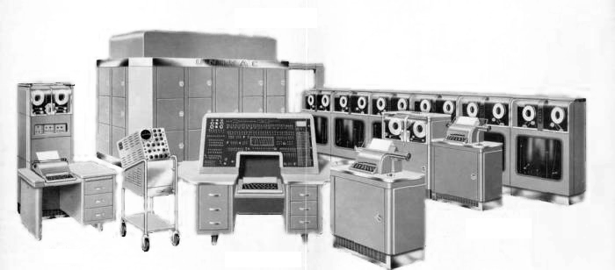
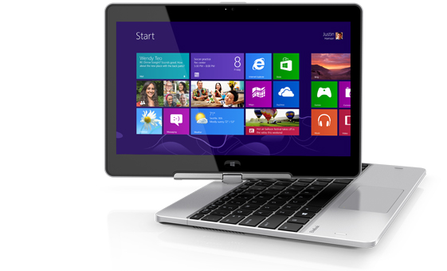
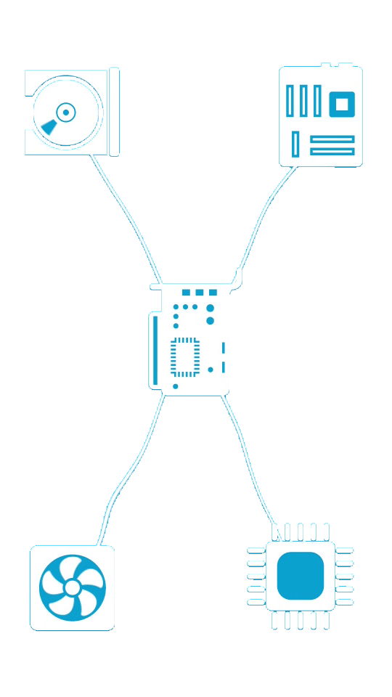
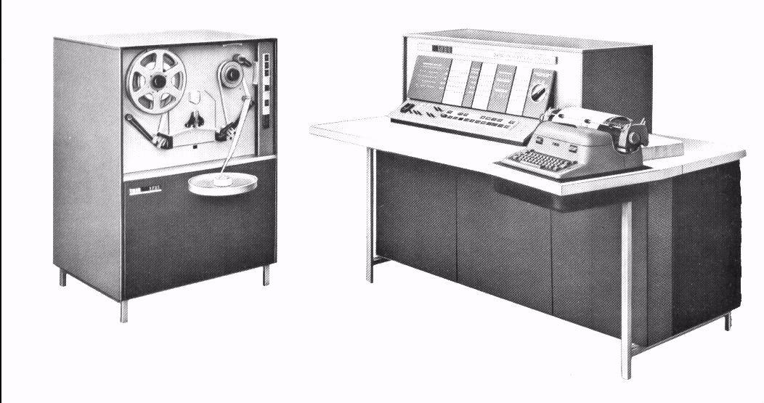
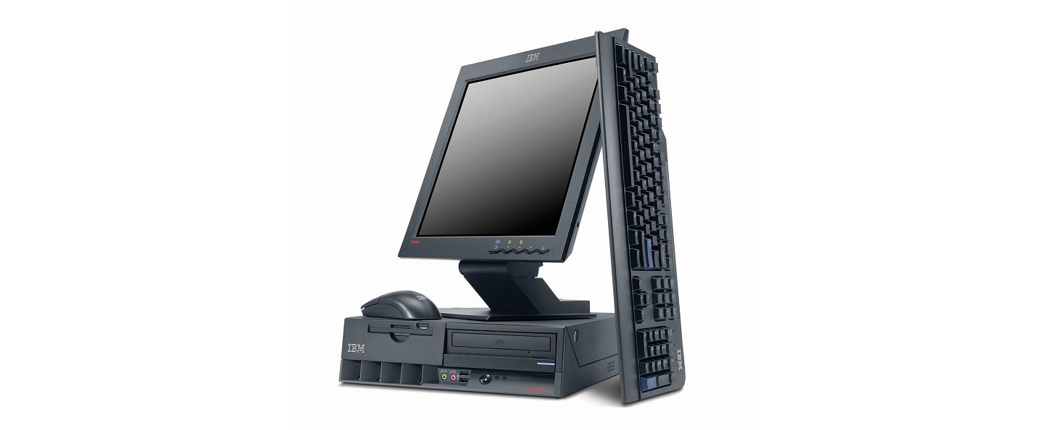
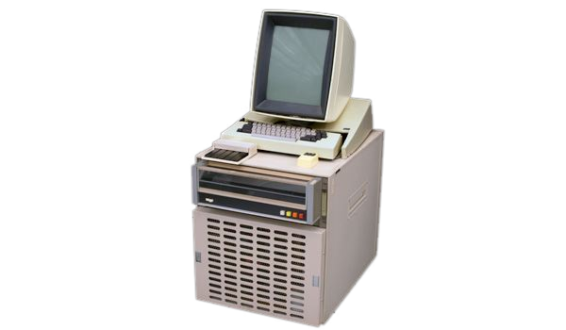
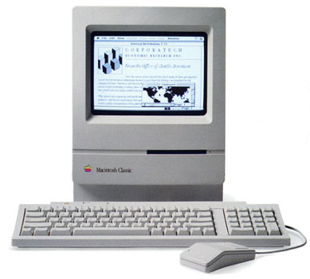
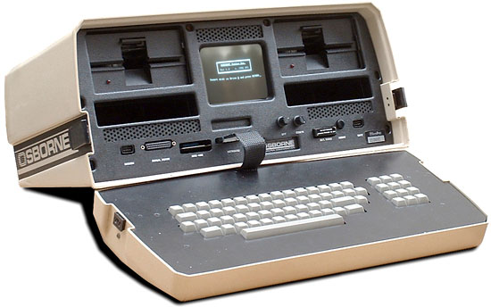
1950s
today
1960s
2000s
1970s
1990s
1980s
Notes:
The central reason that we’re staring down the looming problems is that we’ve been doing the same thing for 60 years.
General purpose processors, copper connectors, with tiers of memory and storage, all on a transactional system.
It’s time to stop.
I’m here to give you a peek behind the curtain of HP Labs. Show you an ambitious research project to rethink how computers are built, from the ground up.
Images:
1951 UNIVAC 1
1959 IBM 1620
1974 Xerox Alto
1981 Osborne 1
1990 Macintosh Classic
2002 Generic IBM desktop
2013 HP Revolve

Slide 23
HP Labs: engine of innovation
2014 ⇨
The Machine
1980
Office Laser Printer
2001
Utility Data Center
1967
Cesium-beam atomic clock
2012
StoreAll
1984
Inkjet Printer
2002
Rewritable DVD for standard players
1972
Pocket Scientific Calculator
2010
ePrint
1986
3D graphics workstations
1994
64-bit architecture
2013
Moonshot
1980
64-channel Ultrasound
2008
Memristor
Discovered
2011
MagCloud
1989
Digital Data Storage Drive
1975
Standard for Interface Bus
2011
3D Photon
Engine
1986
RISC chips
2005
Virus Throttle
1968
Programmable Desktop Calculator
1986
Commercialized RISC chips
2003
Smart Cooling
2011
StoreOnce
1966
Light Emitting Diode (LED)
1999
Molecular Logic Gate
Notes:
HP Labs is no stranger to big projects.
The last grand pan-HP project was building the world’s first commercial RISC computer. Our RISC chip effort was code named “Spectrum” and the first Server was called “Indigo”.
It’s time for another one!
We’ve embarked on a project that we call The Machine
We call it “The Machine” because HP Labs has no marketing budget!

Slide 24
Photonics
Special purpose cores
Massive memory pool
The Machine
Notes:
This is what we’re building instead.
SoC, universal memory and photonics are the key parts of the architecture of the future
With this architecture, we can ingest, store and manipulate truly massive datasets while simultaneously achieving multiple orders of magnitude less energy/bit

Slide 25
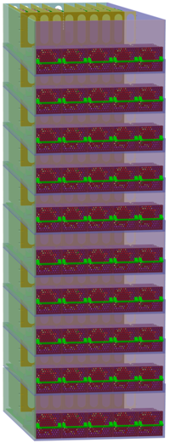
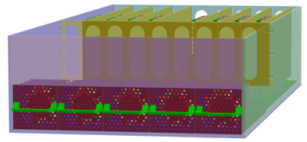
Notes:
Architecture scales so that every car, every plane, every device can contain some form of Machine appliance.
That’s why we called it the Machine, because we didn’t want to suggest any one form factor.
[animation: one enclosure builds to 160 racks]

Slide 26

Massive memory pool
Speed
Cost per bit
On-chip cache
SRAM
Main memory
DRAM
Mass storage
Flash
Hard disk
Capacity
Universal memory obsoletes this hierarchy
Notes:
90% of a computer’s work is shuffling data between tiers.
Today, scientists, mathematicians and economists have had to spend their careers working out how to perform their calculations instead of their actual work – translating simple equations into complex parallel processing tasks because the core/memory ratio is off
This picture is a simple version of the hierarchy. In some cases, it can be 9 or even 11 layers deep. In geek land, we call this “the volatility chain”.
We’re going to throw out the memory hierarchy – universal memory collapses the time to solution
Stop wasting time and energy shuffling; enable massive data sets impossible today.
Memristor is the best candidate
Non-volatile = robust
High density – replace storage
Very fast – line of sight beyond DRAM
Low power – down to 10⁶ less energy than flash or hard drive memory
[connect to today]
Today’s 3PAR technology extends to give us the model for long-lived petabyte-scale data sets.

Slide 27
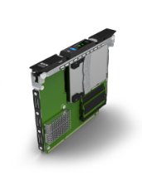
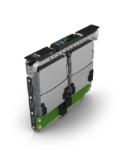
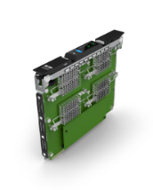
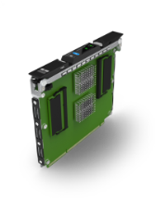
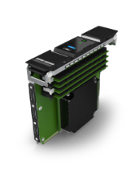
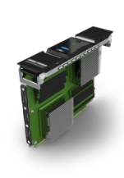
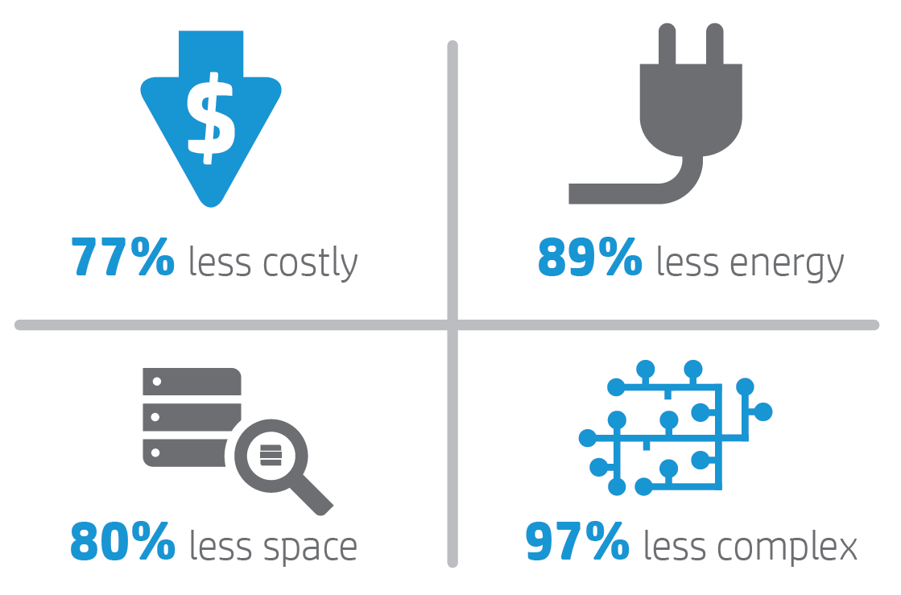
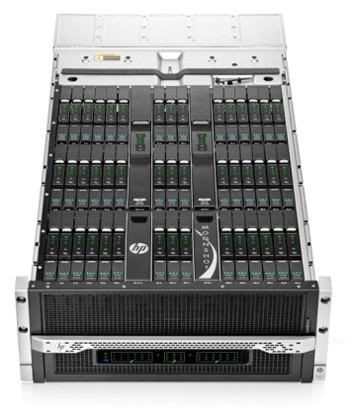
Special purpose cores
**
*
*
*
HP Moonshot is the first step
* Based on HP internal analysis of HP Moonshot with ProLiant Moonshot Server Cartridges.
** Based on HP internal estimates of total cost to operate HP Moonshot with ProLiant Moonshot Server Cartridges as compared to traditional servers.
Notes:
We’re going to replace virtualization on general purpose µprocessors with task-specific silicon.
Customize the hardware to the workload to dramatically change the cost/power curve.
[connect to today]
HP Moonshot was the first step along this path and delivers major efficiency gains.
The Machine will continue along this path, integrating standard cores, application-specific cores, memory, management, and fabric all in a single package.

Slide 28
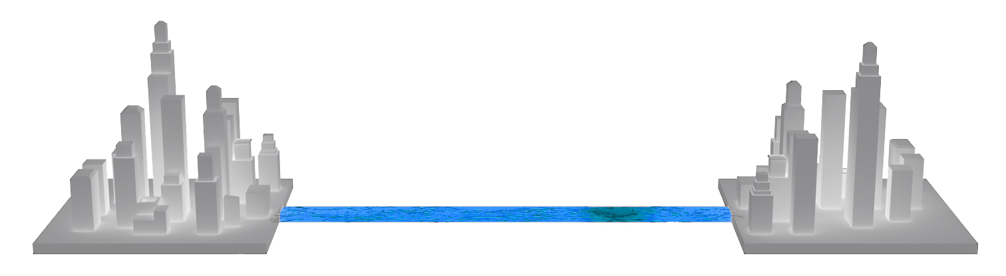
Photonics
Photonics destroys distance
Notes:
Communicating with light instead of electrons is key to the scalability of The Machine. Consider the illustration you just saw. Using photonics we can make approx. 160 racks – about 4 pods – behave as a single server today.
We will be able to address any bit in 160 petabytes in a few hundred nanoseconds (line of sight to an exabyte)
Photonics also enables a massive reduction in energy-bit.
Photonics is not just about intersystem communications, it’s also about intra-system communications -> let me show you with a prop.

Slide 29
Electrons
Compute
Photons
Communicate
Ions
Store
Notes:
These six words summarize the new hardware: electrons compute, photons communicate, ions store.
What is HP doing here that is truly different?
Rather than look to new technologies like photonics and Memristor as substitutional technologies and keep doing things the same old way, we’re re-architecting how all these components come together.

Slide 30

Physical
Digital
Content consumption
Value
Analytics and visualization
Exabyte-scale algorithms
Security built-in from silicon upwards
Million-node management
Machine OS
Data
Ultra-efficient hardware
Notes:
Hardware alone – no matter how revolutionary – is useless without the software stack.
In order to take advantage of the new hardware, we’re building the first clean sheet OS in decades. Because we’re Labs, we run experiments – in addition to clean sheet, we’re also stripping Linux while keeping the POSIX interface, and we’re adapting Android to be optimized for non-volatile memory. That’s why the first version of the machine will support today’s applications.
Our new clean-sheet Machine OS will be Open Source. HP is all in on open source, agile development and the DevOPS model.
OpenStack (HP #1 committer) and Trafodion as proof points
We want to re-ignite operating system research that’s been mostly stagnant in our universities for the last few decades. Part of the reason we’re launching the machine today is because we wanted to engage the world in a new open source operating system built with security as a first class citizen and optimized for non-volatile memory.
How do you manage a million nodes? We’re building the tools now. HP’s Helion includes a management tool called Loom to let you manage 40,000 VMs today.
Next-gen core enabling algorithms – HAVEn on steroids.
New visualization technology to harness our amazing ability to spot patterns and anomalies.

Slide 31
Performance estimates – graph traversal
What could you do with 16 trillion edges per second (TEPS)?
16 TEPS
15.3 TEPS
7,900 kW
4 trillion
Graph 500-like workload
Sequoia, Blue Gene Q at Livermore
64,000 nodes, > 1M cores total
HP – The Machine
20 racks, 256 SoCs / rack, 122k cores total
256 GB NVM per SoC, 1.3 PB total
256 NICs per rack, 2*100 Gbps links / NIC
Utilization < 70%
1 trillion
400 kW
Notes:
These are supercomputer numbers.
But the low-power, non-volatile nature of The Machine also enables to rethink The Cloud…
Note that “problem size” is the number of vertices.
Blue Gene Q manages problem of scale 40 = 2E40 vertices.
The Machine estimate problem of scale 42 = 2E42 vertices.
One TEPS is the number of trillion edges per second traversed. The problem is breadth first search on a huge graph with no locality. Start at one vertex and build a sequence of frontiers, all the vertices at distance k from start. Frontiers become huge due to the small world property. There is no locality -- neighboring vertices live on different nodes almost always. To traverse an edge, the program suffers a cache line read miss.
Graph500 generates a distributed synthetic undirected graph using RMAT, a well known random graph generator that generates graphs with some characteristics seen “in the wild” for very large graphs such as the web graph and social networking graphs. One of these is the small world property – there is a giant connected component with very small diameter.
The benchmark performs a breadth first search of the graph from one vertex. It proceeds in stages. At each stage there is a set of vertices that constitute “the frontier”. This is a distributed set; each node knows which of its stored vertices is on the frontier. All these vertices and their neighbor lists are then read from memory and the union of those neighbor lists accumulated and partitioned according to which node owns the neighbor. Messages are sent then to all nodes with neighbors of the current frontier. These are checked and if they have not yet been reached, they join the next frontier. The dominant costs are, for each edge in the graph, twice, scanning the neighbor list of one endpoint, and sending a vertex number, as part of a large message, over the network. Thus, we will use a network bandwidth based lower bound on the communication time, and a memory bandwidth based lower bound on the computation time.

Slide 32
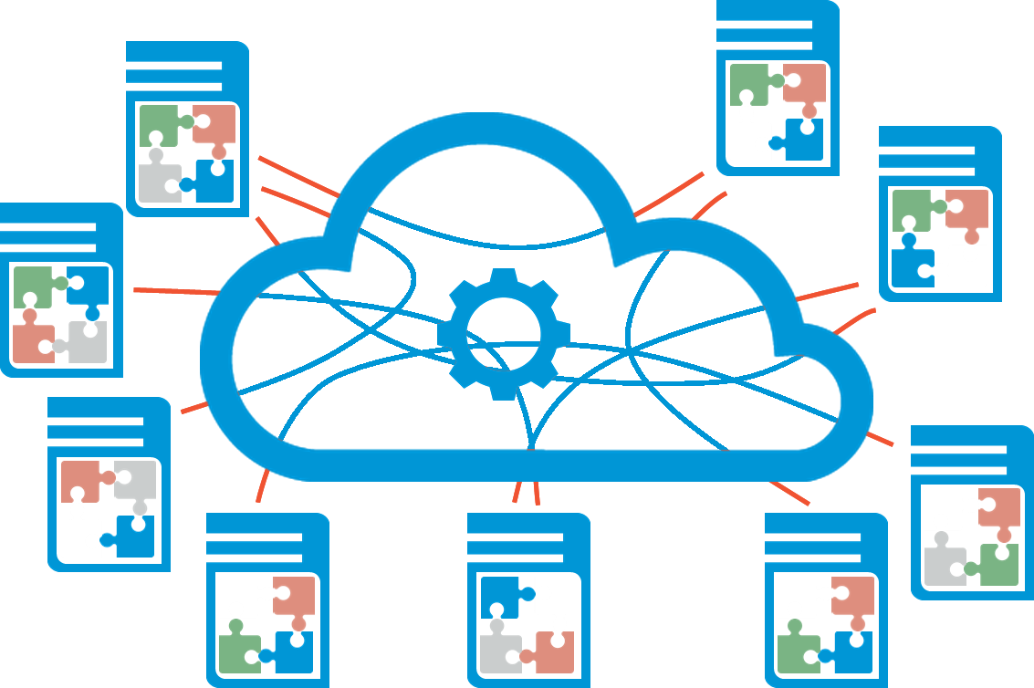
Translator
Coordinator
Orchestrator
Arbitrator
Aggregator
Replicator
Anonymizer
Border guard
Learning engine
Notes:
Move the compute out to the edge where the data is collected.
Why?
The data is too big to move
Legal restrictions
Sovereign boundaries
Privacy
Competitive intelligence
We call this Distributed Mesh Compute and it extends today’s Cloud into the Internet of Things era.

Slide 33







A mesh of connected aircraft …
Notes:
Let’s look at a possible use case:
[Use case]
On a routine flight, a 737 archives just 31kB of data: everything that happened thrown away because it’s “normal”. But who knows what insight has just been lost?
Now put a multi-petabyte Machine on the plane and record EVERYTHING: wind direction, exterior temperature, down to what movies are being watched and the status of the window shades.
This data is far too big/expensive/insecure to move even with photonic links. Instead, send an index of the stored data to the cloud – scrubbed per a set of commercial, privacy, regulatory rules.
What can you do with a mesh of connected aircraft?
Usual single-plane example of saving fuel, avoiding turbulence etc.
Use a graph of everything – planes, people, gates etc. – to provide ability of system to recover from disruption

Slide 34







Use case: the smart cell tower
Notes:
Our telecom service providers have a vision of smaller, smarter cell towers – towers in a closet.
The volume of data is extremely fast-changing and far too big/expensive to move even with photonic links (and it makes security problematic).
Imagine 5 million “radios”, each with a Machine. Instead, send an index of the stored data to the cloud (metadata)
We can move the transform to the data.
[icons] Local processing reduces latency, saves energy, reduces cost, and reduces physical service.
Also provides full network virtualization, enabling lightning-fast roll-out of new capabilities – new services appear at point-of-service without needing IT people or field service personnel.
This is one of the reasons that HP rolled out our OpenNFV program for the telco industry. We’re not just going to virtualize network functions, we can rethink how services are delivered.

Slide 35
Future History
SoC Partners selected for co-development
Machine OS development begins
Edge devices ship in volume
Core Machines running real-world workloads at scale
Machine OS released
Memristors begin sampling
Physical infrastructure of Core prototypes established
Open Source Machine OS SDK and emulators released
ISV Partner collaborations begin
Core devices at volume
Machine available as product, service, and as a business process transformation
2014
2015
2016
2017
2018
2019
2020
Memristor DIMMs launched
Integrated core technologies demonstrated
Distributed mesh compute goes mainstream
Edge devices begin sampling
Machine OS enters public beta
Notes:
Need to stress these are intentions not commitments.
This is what we intend to have happened by the end of the decade.
Today, we have all the pieces in development at various stages.
Next year, we’re planning to make a Machine SDK and emulators available so the developer community can start to explore what The Machine can do.
[connect to today]
We intend to deliver a steady stream of technologies that will transform our vision for The Machine into a reality. Our customers will be positioned to evolve along with us.
We wanted you to see how the technologies we’re delivering today are part of a bigger picture and an amazing future.

Slide 36
This changes everything
Notes:
Once again, HP is leading the way.
It’s real.
HP defining the future of computing so mankind can move forward for the next 60 years.
Join us.

Slide 37
Does it? How?
Notes:
Once again, HP is leading the way.
It’s real.
HP defining the future of computing so mankind can move forward for the next 60 years.
Join us.

Slide 38
Graph Workloads
Questions under investigation
What is the read-write ratio of real-life workloads?
What are the implications of a universal memory on graph analytics?
Is the OLAP / OLTP split avoidable?
Can we use a graphDB (e.g. Titan) to efficiently support both?
What do we compare our performance to?
Does it still make sense to keep resources and data separate?

Slide 39
Implementing LDBC for TitanFTM
It’s great to be part of the open-source community!
Multiple moving targets…
Imperative (Gremlin) query language optimization seems brittle
Is LDBC representative of a live graph?

Slide 40
Thank you

