Slide 1

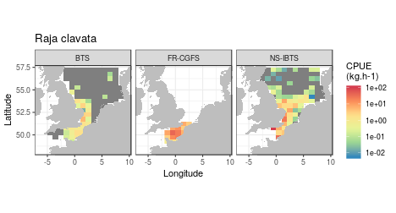










SUMARiS WORKING GROUP 03/14/2019
Atlas of the distribution of skates and rays
“This project has received funding from the Interreg 2 Seas programme 2014-2020 co-funded by the European Regional Development Fund under subsidy contract No 2S03-024”
Notes:
A presentation about the processing framework used to elaborate the atlas of the distribution of skates and rays of the SUMARiS project.

Slide 2


Atlas of rays and skates
"Atlas of the spatial distribution of the different species of skates and rays in the Channel and the Southern North Sea built on historical data per species and per fishery and information collected during the project, including reconstructed per-specie catches and landings, and new information from the fisheries campaigns."
Framework:
"Developing a modern data workflow for regularly updated data" (Yenni et al 2019 PLOS ONE).
One output (an atlas), different forms (document, html page, database)
In short: data + processing = atlas
Notes:
The aim of this atlas was to provide to the SUMARiS project an atlas of the spatial distribution of the different species of skates and rays in the Channel and the Southern North Sea built on historical data per species and per fishery and information collected during the project, including reconstructed per-specie catches and landings, and new information from the fisheries campaigns. During this presentation I will present the framework used to build the atlas. The atlas is based on a modern data workflow implemented to use regularly updated data. Saying that I'm just repeating the title of a very recent paper (published last week), who described more or less the same approach for biological data (to underline how the framework is sooooo up-to-date). In our case, we need different shapes for the same output: a report, as the one delivered a few weeks ago, a dashboard (an HTML tools easily integrated in a web site), and a local database (in order to be able to use the data and the map for the other tasks of the project).

Slide 3
Atlas of rays and skates
Data
Data were collected from three sources:
• landing: from logbooks and sales notes collected at the national level, the landings weights are reported in space and time,
• fishery sampling: fishery catches are sampled at the national level and they provide information in weights and size of the catches (landings and discards),
• survey sampling: fishery survey provide indices of the species distribution (density. . . ), and biological information of the individuals (size, weights, sex, maturity).
Notes:
The data used to build the atlas are coming from three sources. The landings report landings weights in space and time and are collected at the national level. The fishery samplings are following the same structure. For the survey, the information is available at the European level thanks to ICES and the DATRAS database.

Slide 4
Atlas of rays and skates
Data
2000-2017: landings*, commercial sampling**, DATRAS data (FR-CGFS, *BTS)
 |  |  | Commercial sampling** |  | Survey
name | spp | Landings* | FRA | GB_ENG | BTS | FR-CGFS | NS-IBTS
Rays and skates nei | Rajidae | 19462.37564 | 575 | 0 | 0 | 0 | 1
Thornback ray | Raja clavata | 10178.53867 | 4397 | 2411 | 713 | 705 | 489
Spotted ray | Raja montagui | 5999.31999 | 1443 | 876 | 338 | 52 | 414
Cuckoo ray | Leucoraja naevus | 3839.20146 | 1245 | 518 | 115 | 9 | 476
Blonde ray | Raja brachyura | 2012.58064 | 1758 | 431 | 97 | 76 | 73
Rays, stingrays, mantas nei | Rajiformes | 366.69752 | 9 | 0 | 0 | 0 | 3
Small-eyed ray | Raja microocellata | 278.36561 | 239 | 130 | 24 | 28 | 3
Undulate ray | Raja undulata | 255.31925 | 1976 | 212 | 48 | 150 | 8
Blue skate | Raja batis | 200.27901 | 49 | 11 | 0 | 0 | 7
White skate | Raja alba | 149.5257 | 1 | 0 | NA | NA | NA
Common stingray | Dasyatis pastinaca | 78.02172 | 93 | 0 | 0 | 50 | 0
Sandy ray | Raja circularis | 46.12907 | 11 | 10 | 2 | 2 | 1
Shagreen ray | Raja fullonica | 43.48156 | 58 | 0 | 0 | 1 | 0
Longnosed skate | Raja oxyrinchus | 25.67172 | 7 | 0 | NA | NA | NA
Starry ray | Raja radiata | 2.53272 | 9 | 796 | 723 | 2 | 1984
* France
**France and UK
Notes:
For the period 2000-2017, the availability of the information is presented in this ugly table. For 15 species, the landings (in tons including only the French data), the commercial sampling (in number of hauls for France and UK with this species) and the survey data (in number of hauls containing the species) are given. For example for the thornback ray, 10178 tons were landed between 2000 and 2017, with 4397 and 2411 samplings from fishery for France and UK, and 1907 samplings from the surveys. That's a lot. Building an atlas manually (using GIS tools for example) is no more possible in this case.

Slide 5




Processing framework
Atlas of rays and skates
Landing
Sampling
Survey
Country A
Country A
Survey A
Atlas
(report)
Atlas
(html)
Country B
Country B
SurveyB
...
...
...
Source X
Source X
Survey X
Processing:
QC, analyses, map
local files/web services
Database
(map and data)
Local
database
Filtering
https://github.com/ldbk/SUMARiS
Notes:
For this amount of information, and taking into consideration the fact that the data are updated regularly, the processing framework was set up in this form. The data (landing, sampling and survey) are or downloaded or requested using web services (DATRAS data are the only one available in this form). Then the data are filtered, and these filtered data are uploaded in a local database. From this local database, the processing is done, and the atlas is generated (in three forms as said before).

Slide 6
Atlas of rays and skates
Processing
• data access: webservice (survey), local files (landing and sampling)
• filtering: space, time, species
• processing: quality check, computing (CPUE, interpolation), maps
• outputs:
report (the SUMARiS deliverable)
html (static or dynamic)
database
Code:
https://github.com/ldbk/SUMARiS
Notes:
Here is a summary of the central processing tasks: data access, filtering and processing. For the outputs, there are three outputs possibly available: a report, a dashboard (static or dynamic) and a database. Oh, the code to do almost all of these tasks (at the exception of the data harvesting) is available on GitHub (use the link), and is -obviously- open source and licensed under an MIT license.

Slide 7
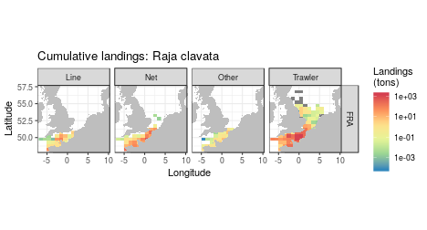
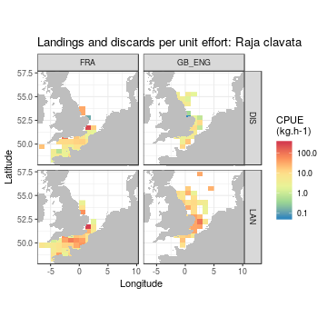
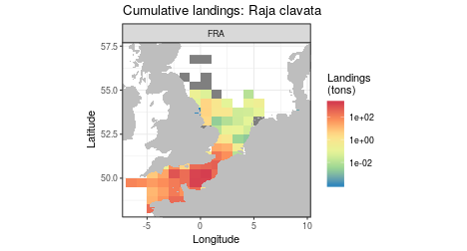
Atlas of rays and skates
The present atlas
• A pdf document of 246 pages for 15 species
• raw data (almost no processing)
• averaged and annual maps of survey and fishery dependent
• thornback ray example:
Notes:
The present atlas is a pdf document of 246 describing the spatial distribution from 2000 to 2017 of 15 species (kind of species: some of them are a group of species). There is only raw data in this report. For example, still for the beautiful thornback ray, you can see the cumulative landings distribution, total and by gears, the CPUE seen by the commercial sampling for France and UK and the CPUE for the survey.

Slide 8
Atlas of rays and skates
Possible improvements
• update the atlas with new data
• monthly map: ~4000 pages for a report -> interactive dashboard
• landings: using FDI data to complete the landings data base (but low taxonomic precision)
• surveys: add nursery survey data (NOURSOMME, NOURSEINE from IFREMER, others ?)
• add processing: CPUE, combine data from different sources (presented during the ICES conference in 2018)
• output: the local database can be used by the project (post-doc ?)
Notes:
The possible improvements for this atlas are numerous. First, we can update the atlas in a matter of a few minutes if the data used in this version are updated. Then we can shift from the yearly view to a monthly view of the maps (this is mainly for the fishery dependent data). But in this case, we need to move to an intervative dashboard because the pdf report could contain more than 4000 pages. For the data availability issue (to my knowledge, some country didn't share their data until now, but I can be wrong), FDI data could be used to provide the landings maps. But the taxonomic precision of this data regarding our species of interest is questionable. For the survey, adding the nursery data (the NOURSOMME and NOURSEINE data) should be interesting. For now the atlas focus only on raw data, but some processing can be done: the CPUE is badly computed (it is a division) and could be improved using modelling (delta model and co), and building some general maps combining data from different sources can be done (this work was presented during the last ICES conference). Finally, I would like to highlight the availability of the data extracted for the consortium. We need to set up a framework on how to share this data.

Slide 9
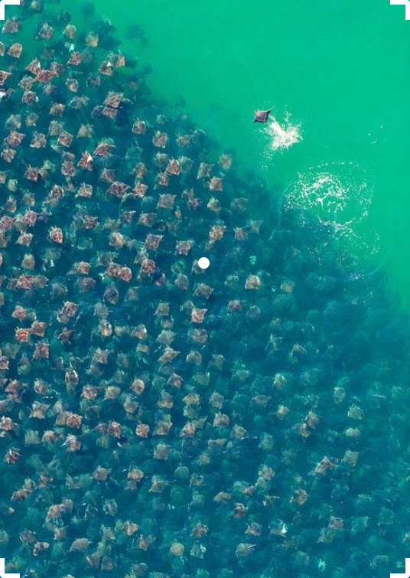
Thank you for your kind attention
Icons from popcomarts (processing), Shmidt Servey (database), Saifurrijal (file), ProSymbols US (atlas) Noun Project (https://thenounproject.com)
Natural atlas: aerial view of Munk's devil rays
https://imgur.com/r/pics/S12f84o
Notes:
Thank you!
Here the references of the icons used in this presentation, and a final picture of a natural atlas: aerial photography of the munk's devil ray.

