Slide 1
A Messaging and Notification System for Job Management
Logan D.C. Bishop, Nathan Giles, Ryan Lorey

Slide 2
Purpose
To provide a notification management system for a variety of users with multiple unique groupings.
Providing user access privileges for management of these lists.
Big Data with Real-time analysis of network traffic, analyzed with cloud support and quantum computation.

Slide 3
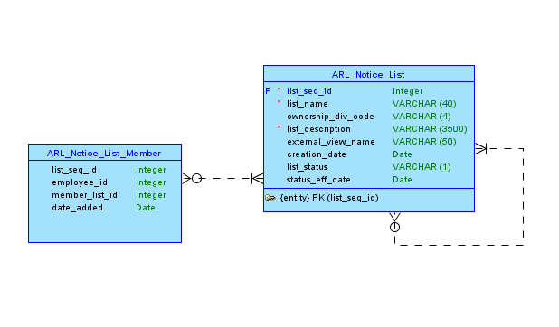
Conceptual Model of the System

Slide 4
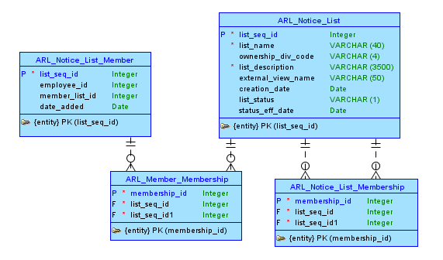
Logical Model of the System

Slide 5
Information Needed from Customer

