Slide 1

Creating an Algorithm to predict house pricing
Analysis and Interpretation by Leticia Fernandes

Slide 2

Business Problem
Help a startup company to predict house prices in the King county region to compete with Zillow in the consumer information marketing business.

Slide 3
Summary
Create an Algorithm to predict prices on properties in King county. Noted important factors included:
Zip Code,
Sqft
Grade (Condition)
Renovated

Slide 4

Data
Data provide by Flatiron School corresponding zip codes taken from King County Open Data Source.
Our variables include:
  View;
  Waterfront;
  Number of Bedrooms;
  Number of Bathrooms,
  SQFT living;
  Grade (condition);
  Year Built;
  Renovated, etc.

Slide 5


Modeling and Methods
  Linear Regression - OLS model
  Baseline Model
  Log Transformation
  R^2
  Dummy variables

Slide 6
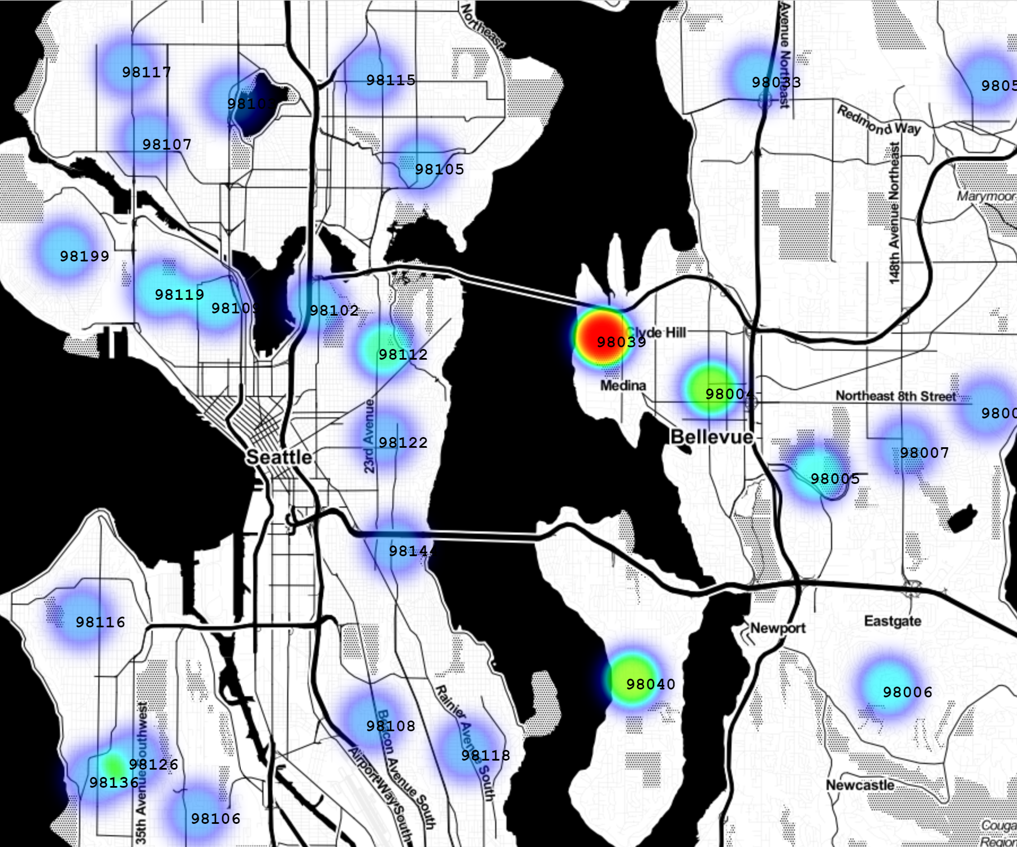
Results
Important parameters in the model, as:
Waterfront properties;
Centrally located;
Zip code
proved increase prices significantly.

Slide 8
Technical
Results
  R² final model
  0.826
  Train RMSE
    $ 117,768.73
  Test RMSE
    $ 117,182.99

Slide 9
Future Work
      To better predict prices:
        Larger, recent, accurate data.
        More parameters.

Slide 10
Thank you!
Leticia Fernandes

