Slide 1
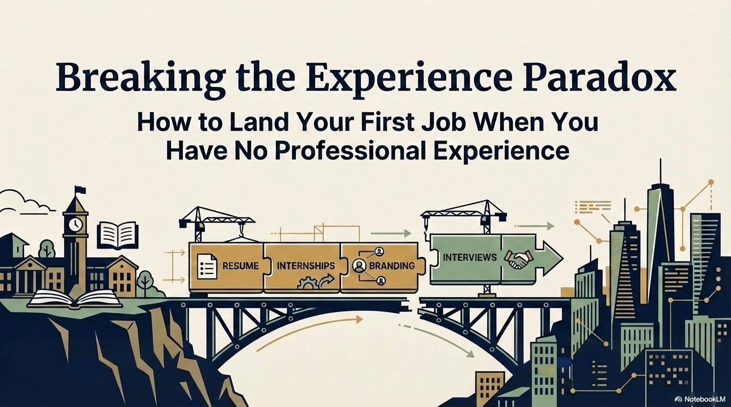
Notes:
Welcome to 'Breaking the Experience Paradox.' This presentation addresses one of the most common challenges new graduates face: being told you need experience to get experience. The good news? That's a myth. Today we'll walk through four pillars that will help you land your first job even without traditional work history. These are practical, research-backed strategies — not just advice, but a proven framework.

Slide 2
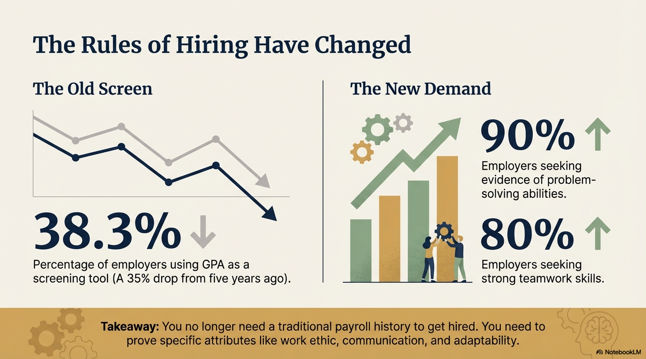
Notes:
The hiring landscape has fundamentally shifted over the past decade. GPA, once the dominant filter, has dropped to just 38.3% of employers using it — a 35% decline in five years. Meanwhile, what employers want most is problem-solving ability (90%) and teamwork (80%). This is great news: those skills can be demonstrated through academic projects, volunteer work, clubs, and campus leadership — not just paid jobs.

Slide 3
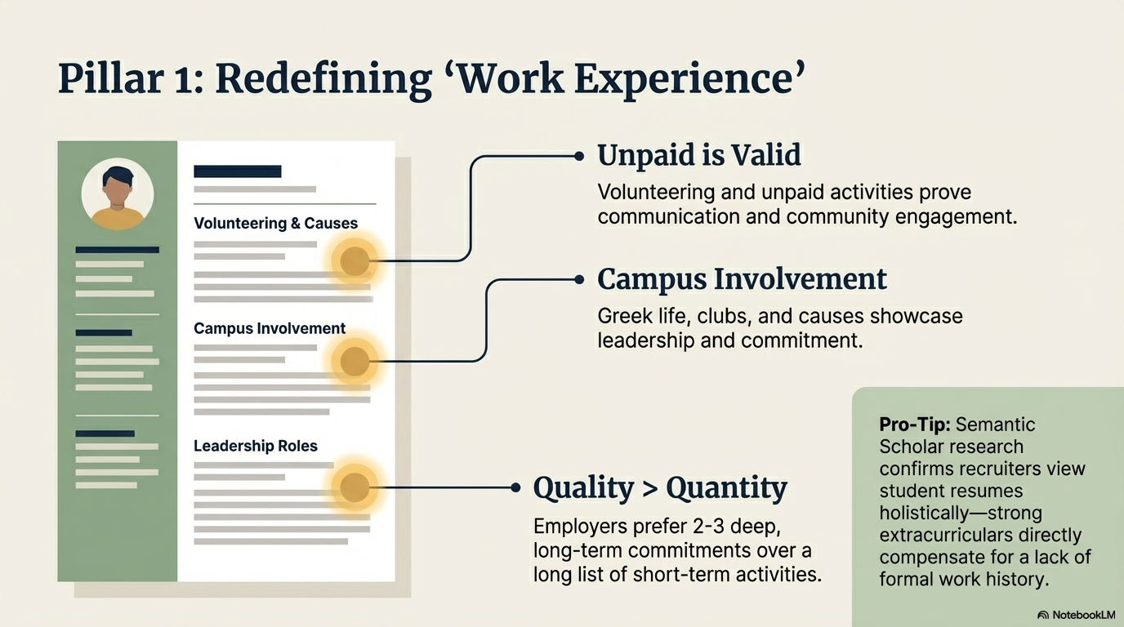
Notes:
Pillar 1 is about reframing what 'experience' actually means on a resume. Many students undersell themselves because they think only paid work counts. It doesn't. Volunteering shows communication and community engagement. Campus involvement — Greek life, clubs, causes — signals leadership and commitment. But here's the key: quality over quantity. Recruiters want to see 2-3 deep, sustained commitments, not a long list of brief activities. Research from Semantic Scholar confirms that strong extracurriculars directly compensate for a lack of formal work history.

Slide 4
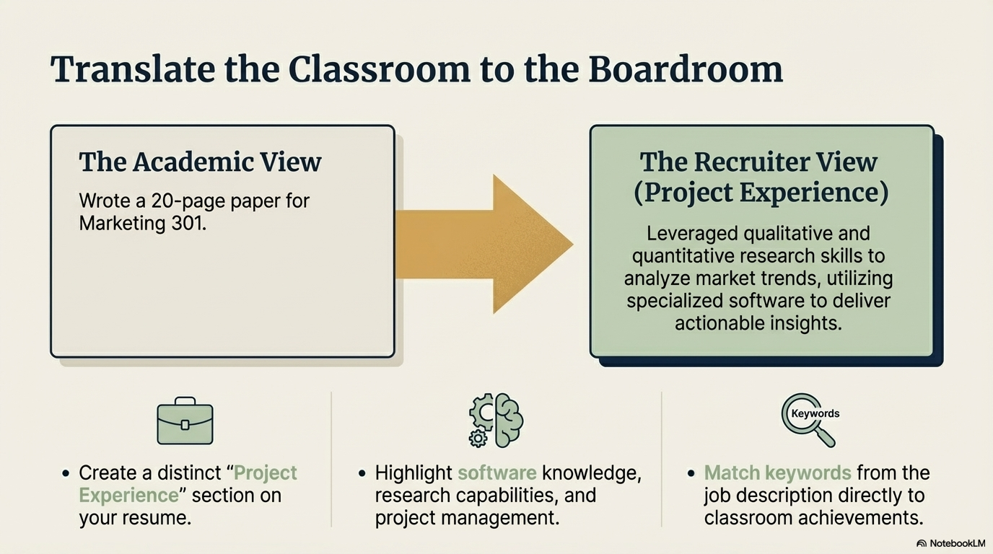
Notes:
This slide is about language. How you describe your academic work makes all the difference. 'Wrote a 20-page paper' tells a recruiter nothing. 'Leveraged qualitative and quantitative research skills to analyze market trends using specialized software to deliver actionable insights' — that's a resume bullet. The technique is simple: create a dedicated 'Project Experience' section, mirror keywords from the job description, and highlight software, research, and project management skills embedded in your coursework.

Slide 5
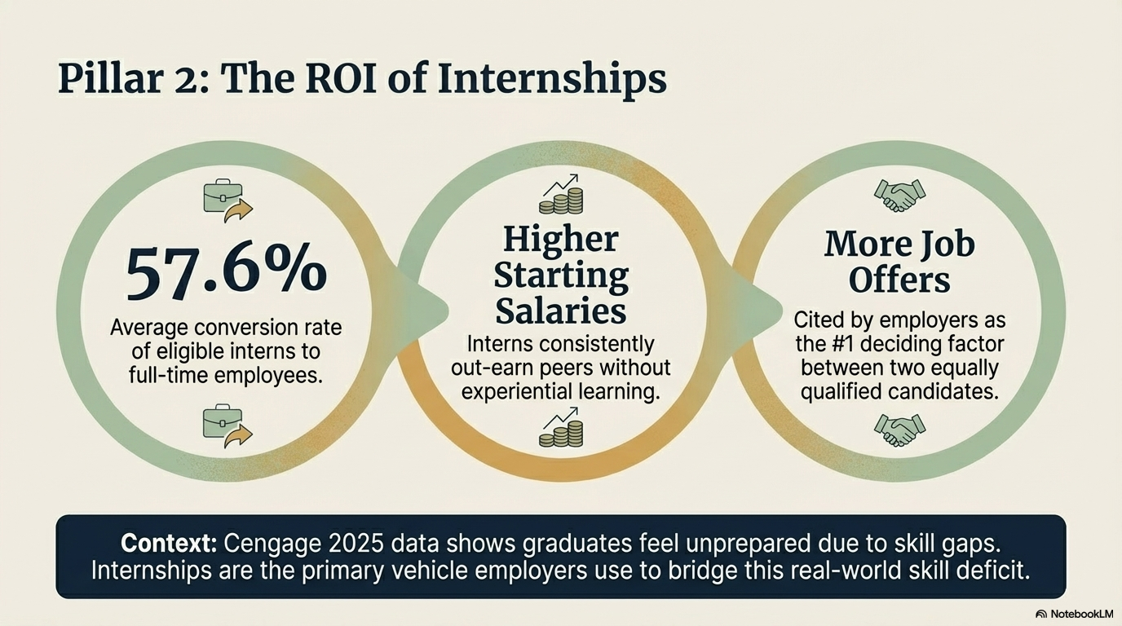
Notes:
Pillar 2: Internships are the single highest-ROI investment you can make in your career right now. 57.6% of eligible interns convert to full-time employees. Interns consistently earn higher starting salaries than peers who skipped experiential learning. And internship experience is the number-one deciding factor employers cite when choosing between two equally qualified candidates. The Cengage 2025 data shows graduates feel underprepared due to skill gaps — internships are the primary bridge employers use to close that gap.

Slide 6
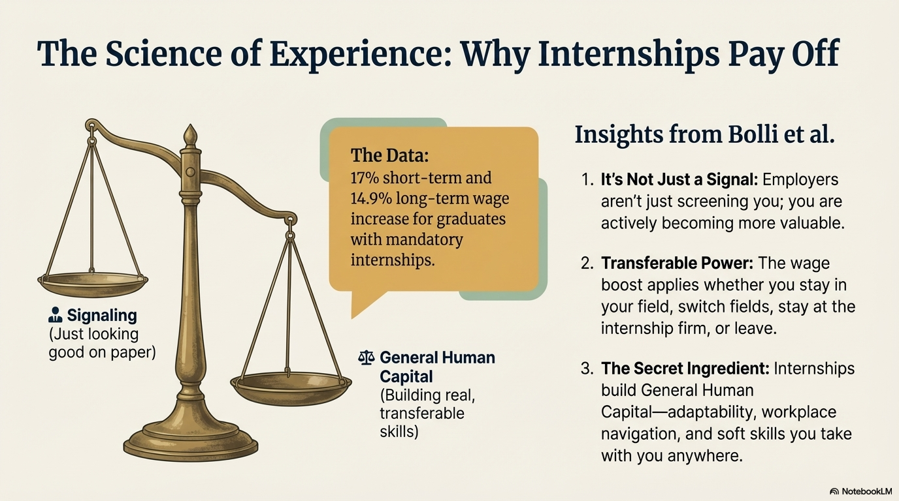
Notes:
This slide digs into the research behind why internships pay off so much. The Bolli et al. study found 17% short-term and 14.9% long-term wage increases for graduates from programs with mandatory internships. The key insight is that internships build 'General Human Capital' — adaptability, workplace navigation, and soft skills — not just job-specific knowledge. That's why the wage boost applies whether you stay at the internship firm, switch industries, or change careers entirely. It's not just a signal to employers. It actually makes you more valuable.

Slide 7
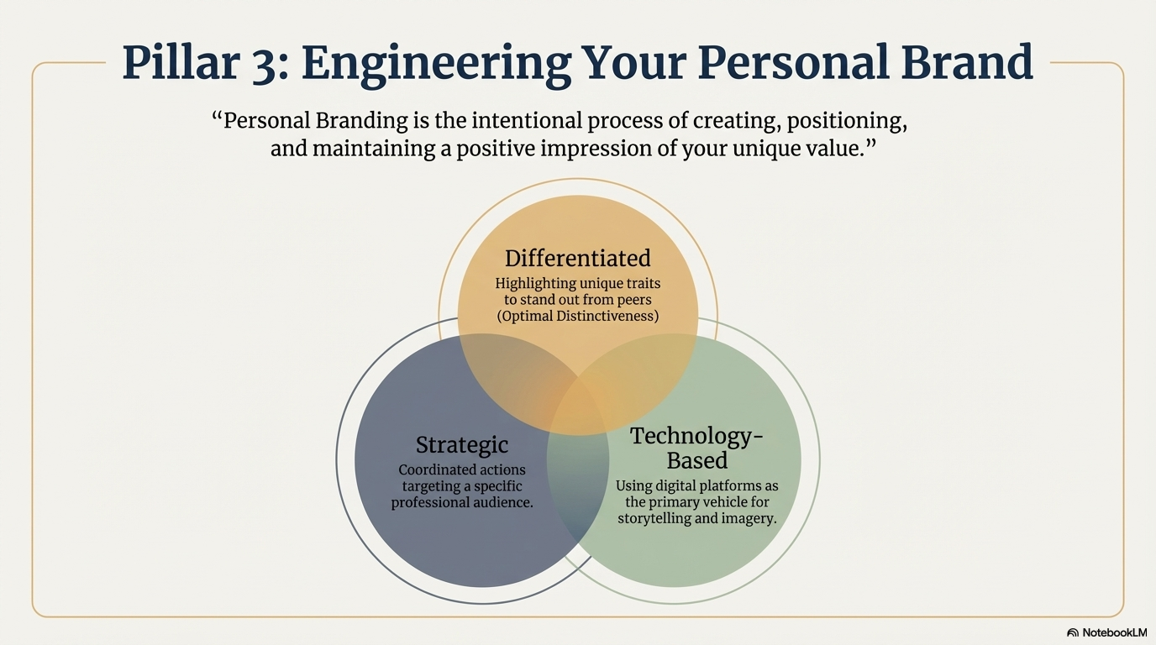
Notes:
Pillar 3 is personal branding — and it's more than just LinkedIn. A strong personal brand is differentiated (you highlight what makes you uniquely valuable), strategic (you're deliberately targeting a specific professional audience), and technology-based (you use digital platforms as your primary storytelling vehicle). The Venn diagram on this slide shows the sweet spot where all three overlap. That intersection is where you become memorable to recruiters.

Slide 8
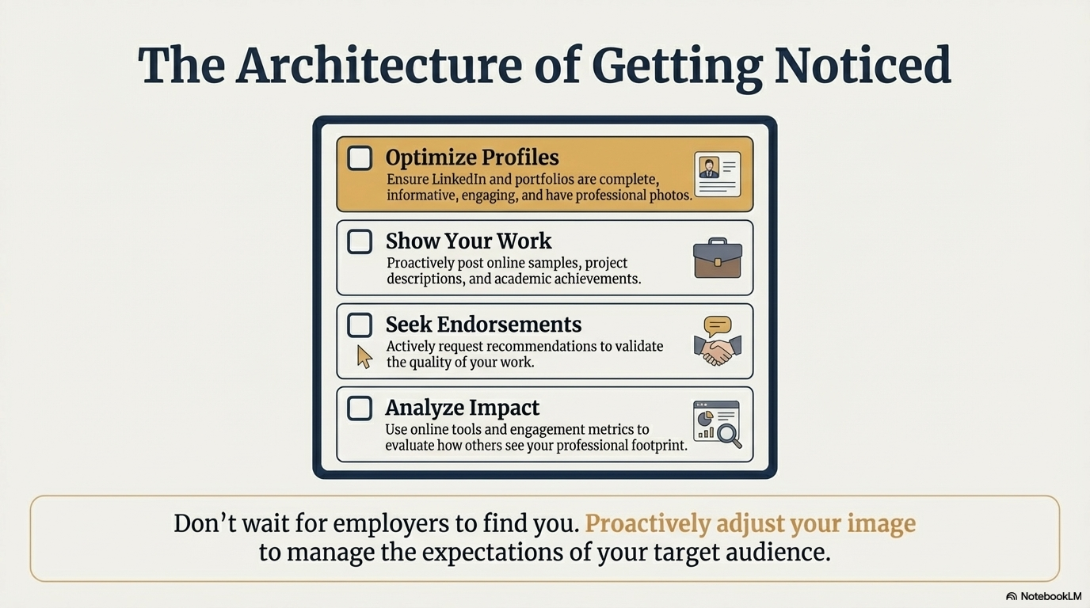
Notes:
Now let's get tactical. To build your digital presence, start by optimizing your LinkedIn and any portfolio sites — complete profiles with professional photos. Then show your work: post project write-ups, academic achievements, and work samples. Seek endorsements and recommendations from professors, club advisors, or volunteer coordinators to validate the quality of your work. Finally, analyze your impact — use LinkedIn analytics and Google search to understand your professional footprint. Don't wait for employers to find you; proactively manage your image.

Slide 9
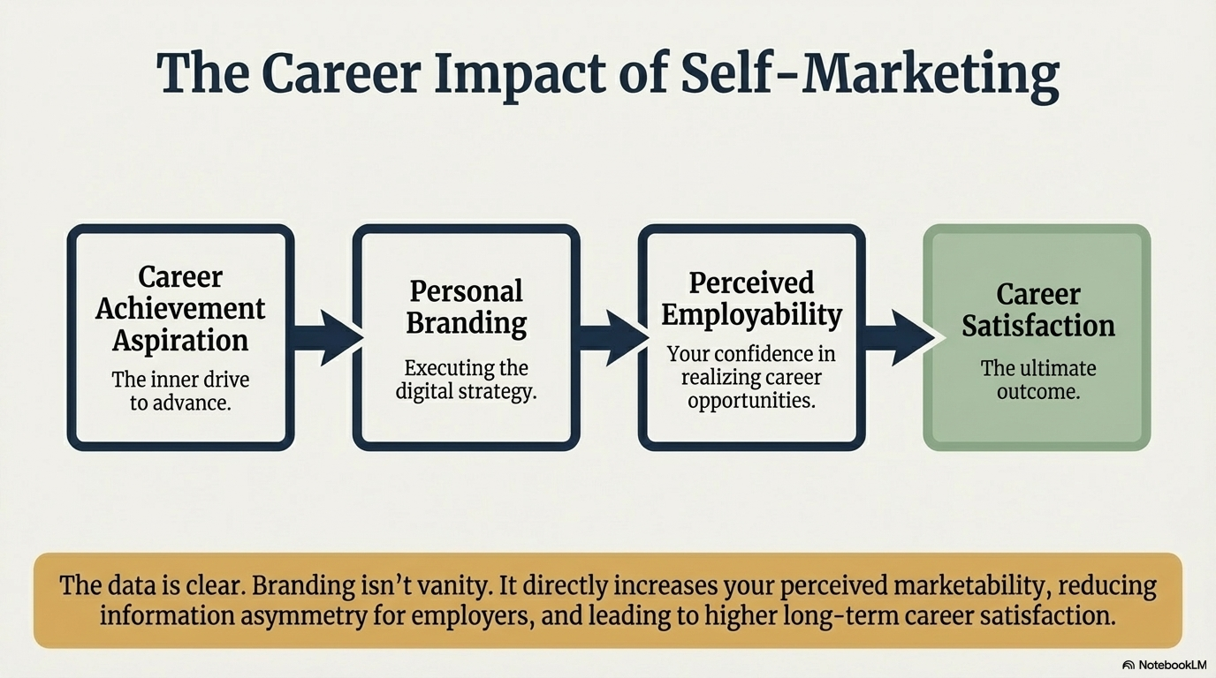
Notes:
Research confirms that personal branding isn't vanity — it's a career multiplier. The data shows a clear chain: Career Achievement Aspiration drives Personal Branding activity, which increases your Perceived Employability (your own confidence in landing opportunities), which ultimately leads to higher Career Satisfaction. Branding reduces information asymmetry — it helps employers understand your value before they even meet you. That's a significant competitive advantage in a crowded entry-level job market.

Slide 10
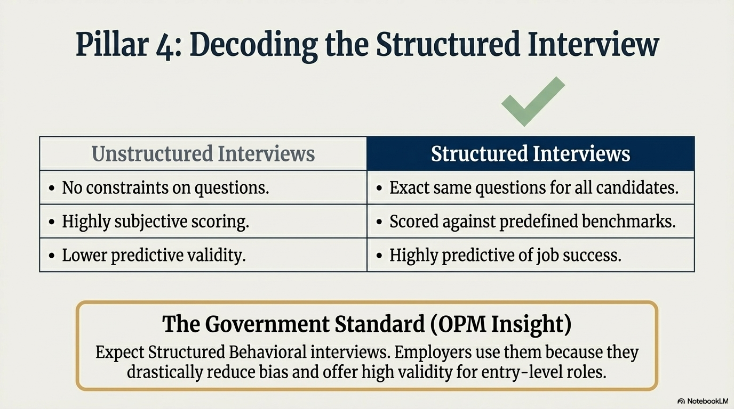
Notes:
Pillar 4: Structured interviews. Most entry-level roles — especially in government, finance, and large corporations — use structured behavioral interviews. Unlike unstructured interviews (which are highly subjective and easily biased), structured interviews ask every candidate the exact same questions and score responses against predefined benchmarks. The OPM (U.S. Office of Personnel Management) specifically uses this format because it drastically reduces bias and is highly predictive of job success. Knowing this format is coming gives you a huge preparation advantage.

Slide 11
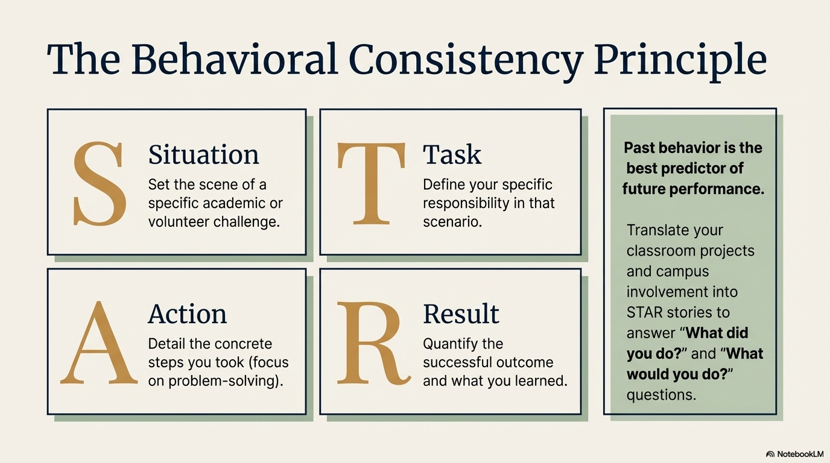
Notes:
The STAR method is your framework for structured interview success. Interviewers are applying the Behavioral Consistency Principle: past behavior is the best predictor of future performance. So they'll ask 'Tell me about a time when...' questions. Your job is to answer with Situation (set the scene), Task (your specific role), Action (what you did — focus on problem-solving), and Result (quantify the outcome and what you learned). The game-changer: you can use classroom projects and campus involvement as your stories. You don't need paid work experience to ace these questions.

Slide 12
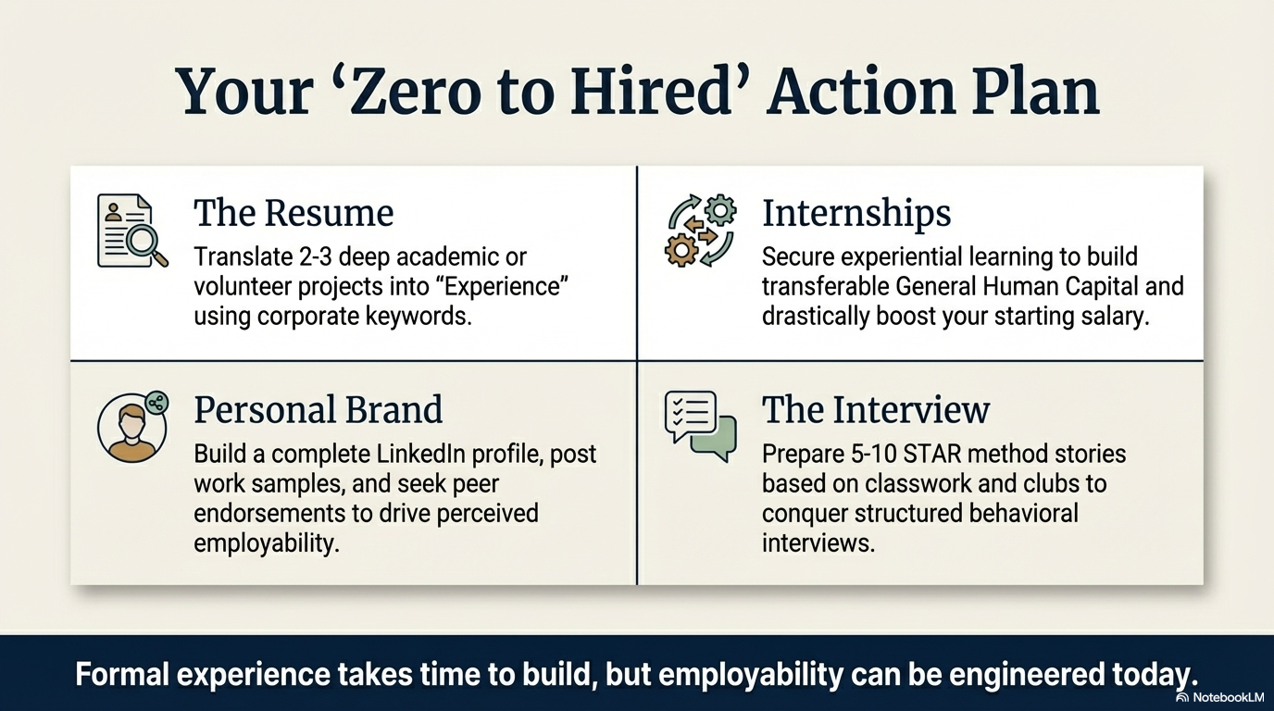
Notes:
Here's your action plan to go from Zero to Hired. On the resume: translate 2-3 deep academic or volunteer projects using corporate language and keywords. On internships: prioritize securing experiential learning — even unpaid — to build General Human Capital and boost your future salary. On personal brand: build out your LinkedIn, post work samples, and actively seek endorsements. And on interviews: prepare 5-10 STAR method stories drawn from classwork and clubs. Remember: formal experience takes time to build — but employability can be engineered starting today.

Slide 13
