Slide 1
Group 15
Project #1
Ben Williams
Luke Ehrisman

Slide 2
Preprocessing
Notes:
Let's just quickly go over the steps for preprocessing the data.

Slide 3
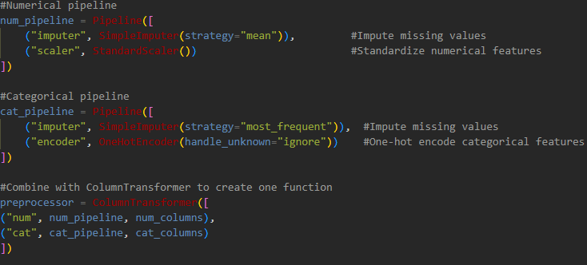
Notes:
For both the training and the validation datasets, I simply used sklearn's pipelines to create mini-functions for each type of data. For the numerical columns, I first imputed the values based on the mean of that column, then scaled the values using the StandardScaler of sklearn. For categorical columns, I first used the mode of each column as the imputation value, then encoded each column using the one-hot encoder. I will note here that the training dataset had a few values that were not present in the validation dataset, causing a mismatch is the number of columns and causing some issues when trying to apply the created models to the validation set. To get around this, I chose to add these columns to the validation dataset, but ensured that every row's value for that column was a zero.

Slide 4
Perceptron & Adaline

Slide 5
Perceptron
Notes:
First, lets start with Logistic Regressions

Slide 6
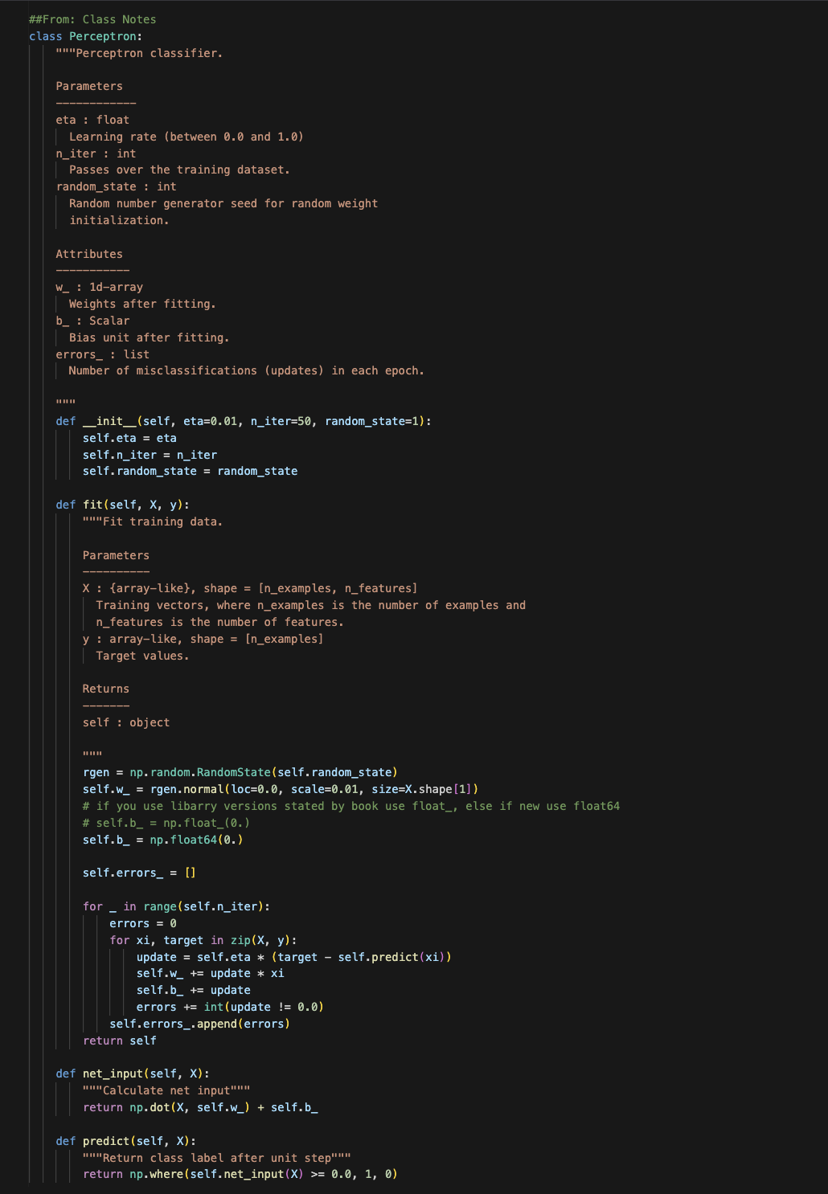
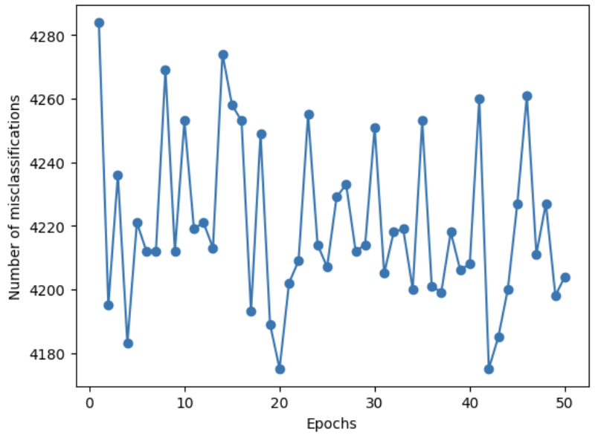
Perceptron

Slide 7
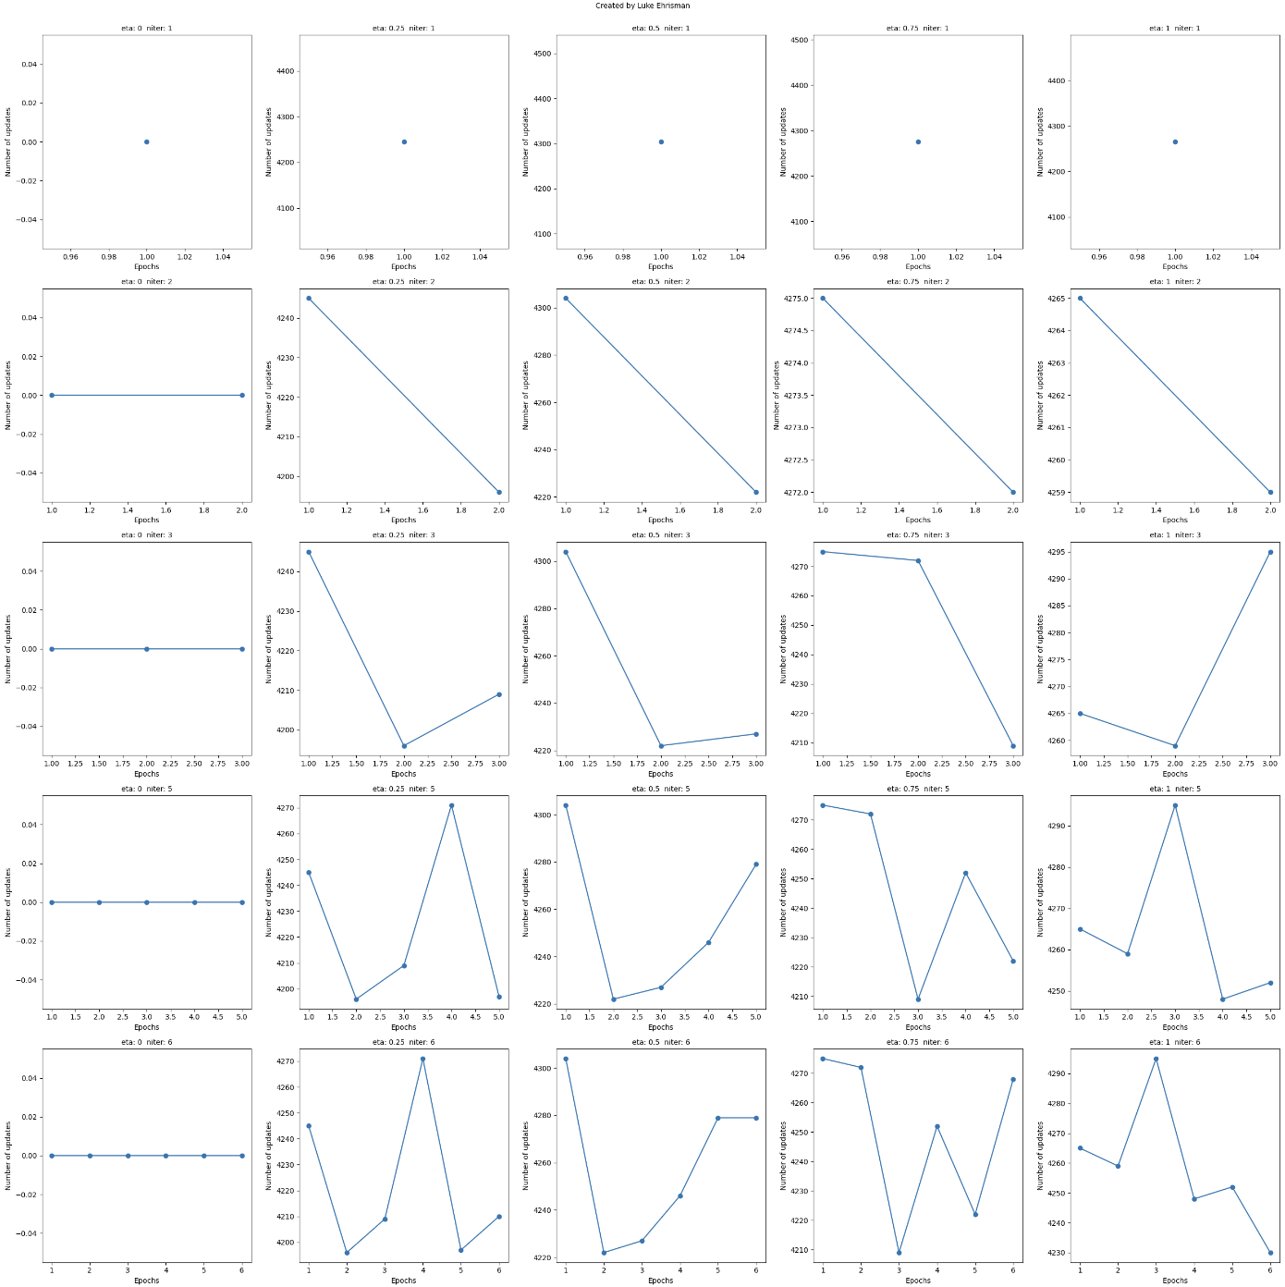
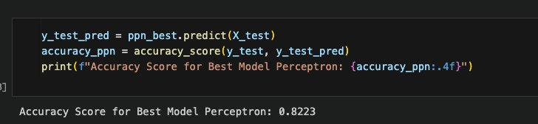
Results
ppn_best = Perceptron(eta=0.5, n_iter=5, random_state=1)
Notes:
Here are the results of the trained model. I was able to get a weighted average accuracy of about 84% across multiple runs of the model. On the left is the confusion matrix for the model. It is worth nothing in this dataset that the disparity of data points may have some influence on the model's predictive power. Specifically, there are significantly more data points where the label is <=50k than >=50k. On the right is a more detailed breakdown of the classification. After this, I

Slide 8
Adaline
Notes:
First, lets start with Logistic Regressions

Slide 9
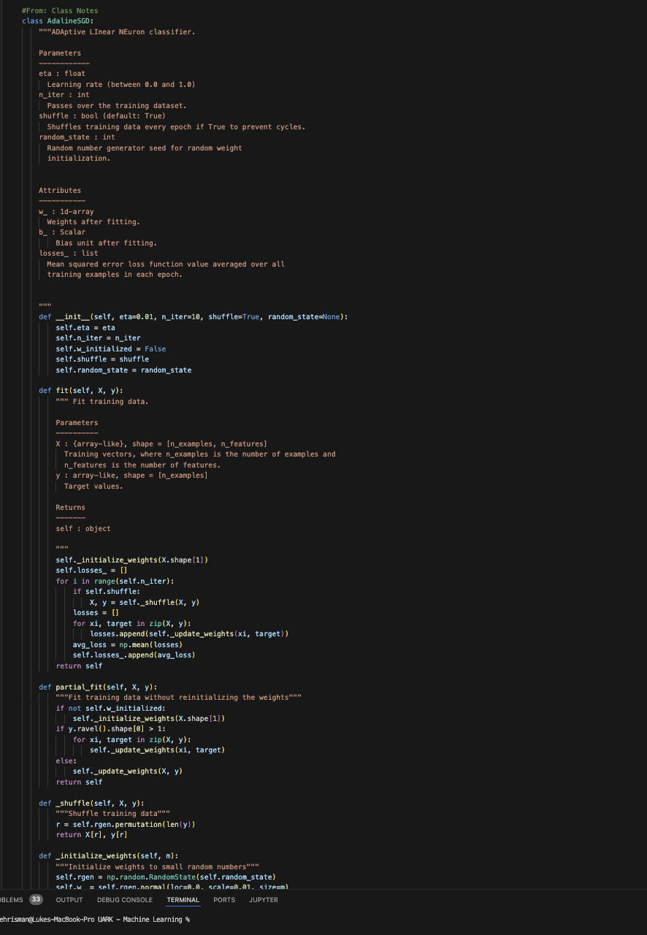
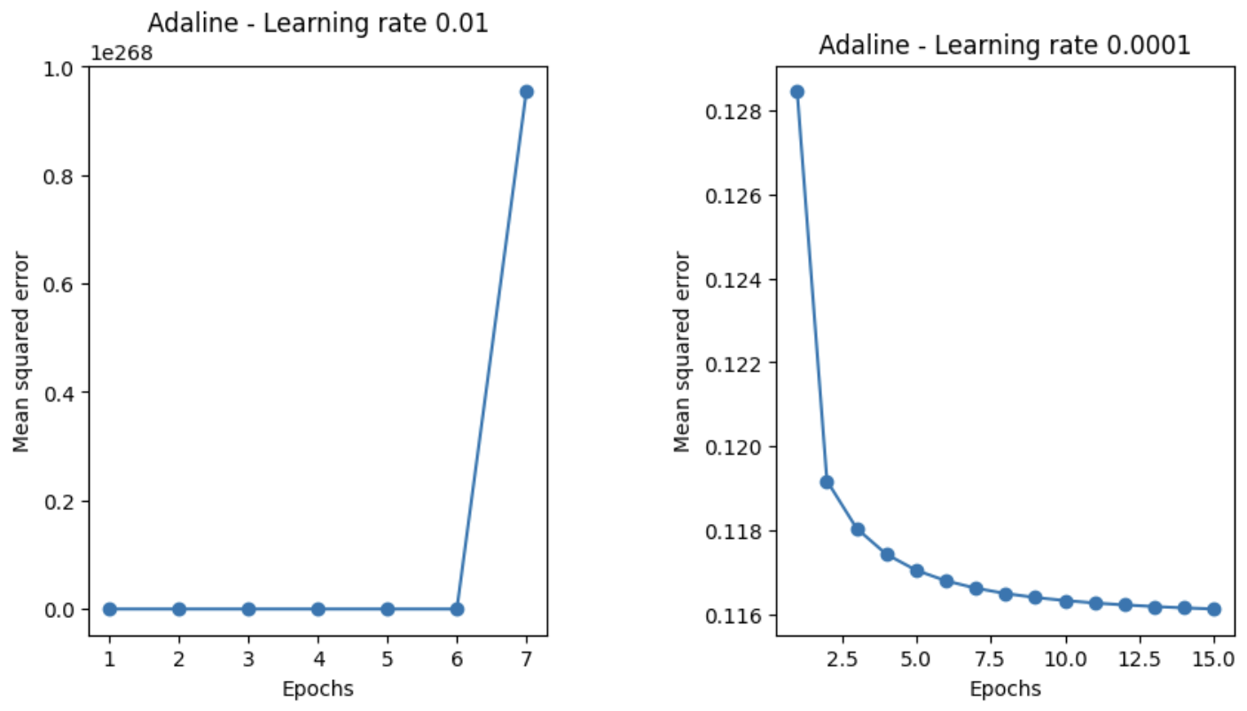
Adaline
Notes:
Here are the results of the trained model. I was able to get a weighted average accuracy of about 84% across multiple runs of the model. On the left is the confusion matrix for the model. It is worth nothing in this dataset that the disparity of data points may have some influence on the model's predictive power. Specifically, there are significantly more data points where the label is <=50k than >=50k. On the right is a more detailed breakdown of the classification. After this, I

Slide 10
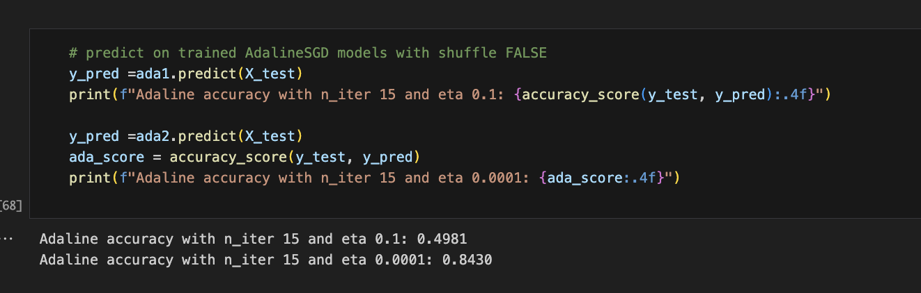
Results

Slide 11
Comparisons
Notes:
First, lets start with Logistic Regressions

Slide 12
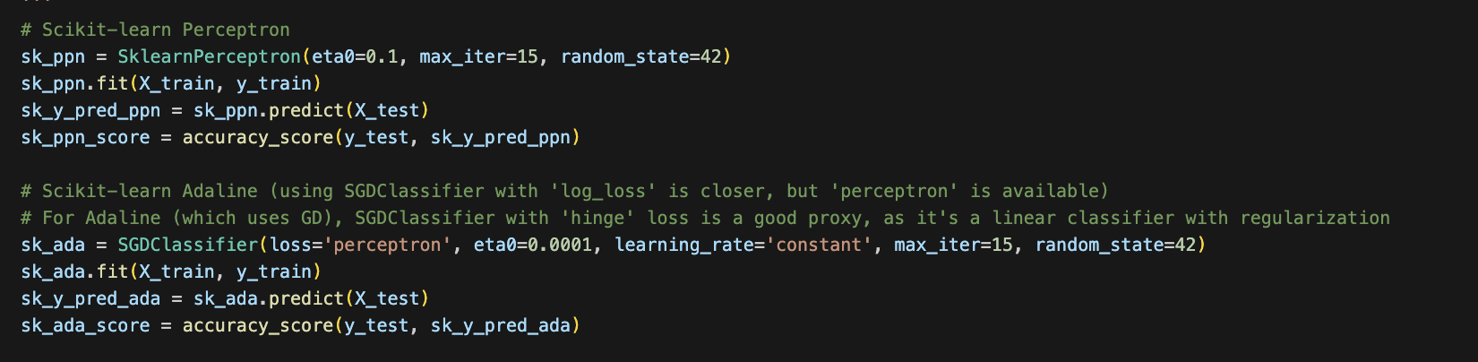
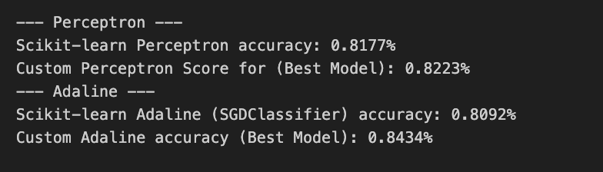
Comparison w/ Sklearn
Notes:
Here are the results of the trained model. I was able to get a weighted average accuracy of about 84% across multiple runs of the model. On the left is the confusion matrix for the model. It is worth nothing in this dataset that the disparity of data points may have some influence on the model's predictive power. Specifically, there are significantly more data points where the label is <=50k than >=50k. On the right is a more detailed breakdown of the classification. After this, I

Slide 13
Why Sklearn should perform better
Optimized for speed, stability, and scalability
High level coding practices from Professional ML engineers

Slide 14
Logistic Regression (LR) & Support Vector Machines (SVM)
Notes:
Now lets look at a little more complicated classification models: Logistic Regression and Support Vector Machines

Slide 15
Logistic Regression
Notes:
First, lets start with Logistic Regressions

Slide 16
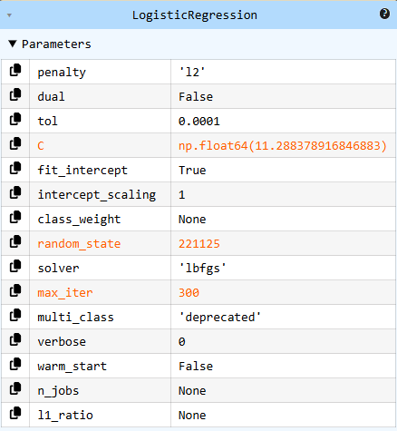
Model Set-up and Definition
GridSearchCV used for hyperparameter tuning
20 C values between 10⁻⁴to 10⁴
'lbfgs' as solver
300 maximum iterations
10 folds of cross validation
Notes:
I chose to use Scikit Learn's GridSearchCV in order to handle the hyperparameter tuning. Not only is this what we used in class, but the ability of automatic parameter tuning can usually surpass what I choose to do. Here, I decided to vary the C values heavily to see what works best, with 300 iterations and 10 cross-validation folds. Here you can see the results of the GridSearchCV.

Slide 17
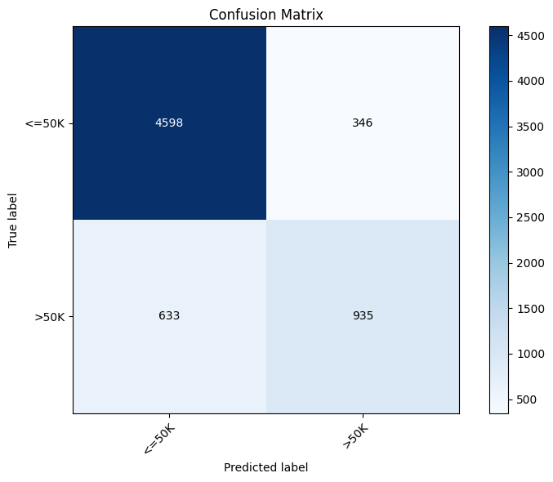
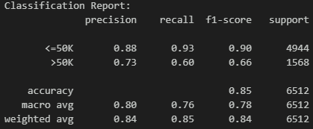
Results
Notes:
Here are the results of the trained model. I was able to get a weighted average accuracy of about 84% across multiple runs of the model. On the left is the confusion matrix for the model. It is worth nothing in this dataset that the disparity of data points may have some influence on the model's predictive power. Specifically, there are significantly more data points where the label is <=50k than >=50k. On the right is a more detailed breakdown of the classification. After this, I

Slide 18
Support Vector Machines (SVMs)
Notes:
Now, lets look at the more versatile Support Vector Machine

Slide 19
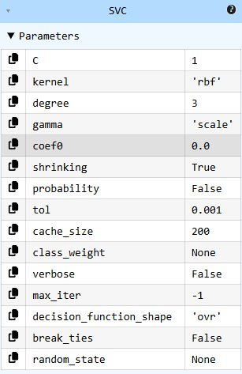
Model Set-up and Definition
GridSearchCV used for hyperparameter tuning
C values of 0.1, 1, and 10
Kernels of linear, rbf, and poly
Gamma values of 'scale' or 'auto'
5 folds of cross validation
Notes:
In order to make the best model possible, I again decided to use GridSearchCV through ScikitLearn to tune the hyperparameters. After setting up the SVC model, I threw 3 different values of C for regularization, a couple different kernel types, and two values of gamma to control influence of individual values. Here you can see what GridSearchCV produced.

Slide 20
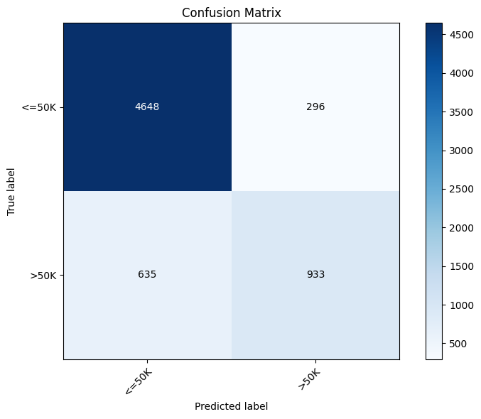
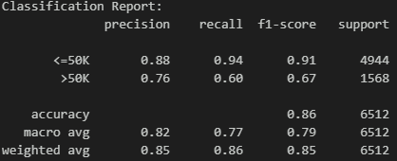
Results
Notes:
Here are the results of the trained model. I was able to get a weighted average accuracy of about 85% across multiple runs of the model. On the left is the confusion matrix for the model. It is worth nothing in this model as well that the disparity of data points may have some influence on the model's predictive power. On the right is a more detailed breakdown of the classification.

Slide 21
Comparisons
Notes:
Now we'll look at the comparisons between Logistic Regression and SVM as it pertains to this project

Slide 22
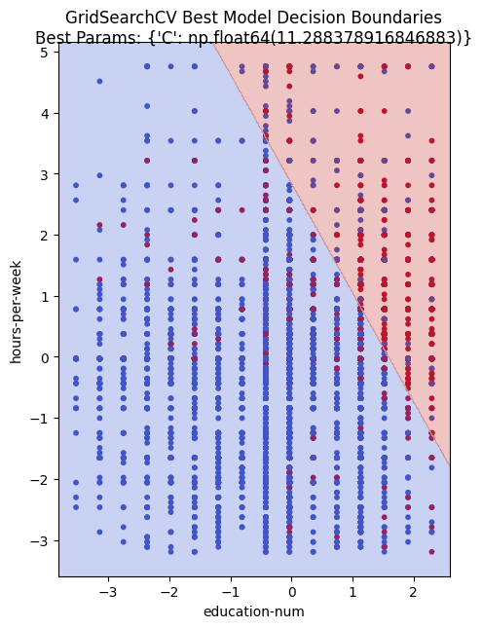
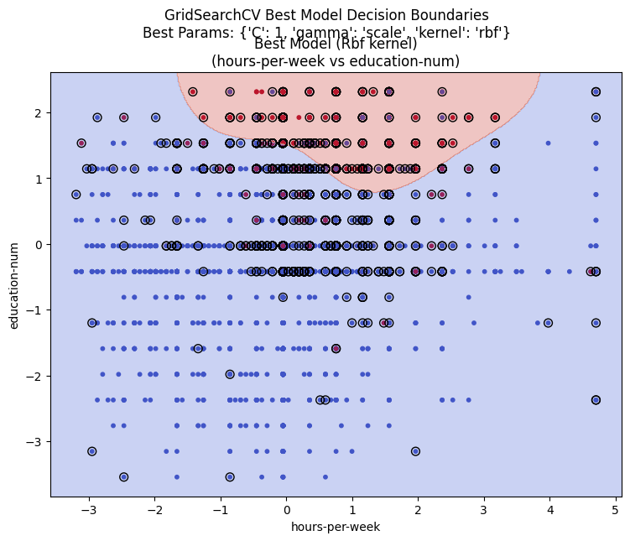
Decision Boundaries
Logistic Regression
Support Vector Machine
Notes:
Firstly is the differences between the decision boundaries of the two models. As you can see on the left, the Logistic Regression model had a very binary decision space. The large red area taking up the top right of the screen shows this best. Now on the contrary, the SVM developed a 'squiggly' decision space. The main difference between the models can be seen here. When creating the decision spaces, SVMs are able to create non-linear decision spaces by mapping the input data to a higher-dimensional space, then using a linear hyperplane to separate the data into it's (usually) binary classification.

Slide 23
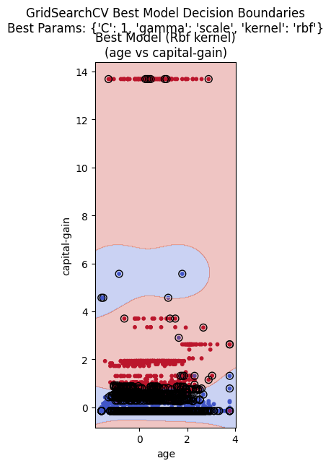
Notes:
Here is another example of a SVM decision space. As you may be able to see, there is actually 2 completely separated sections of blue here, lending to SVMs ability to create non-linear decision boundaries even when projected onto a 2D surface.

Slide 24
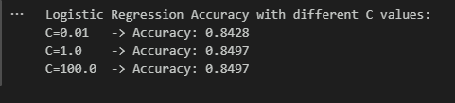

Role of Regularization and Varying 'C' Values
Logistic Regression
Support Vector Machine
Notes:
The role of regularization is to reduce overfitting, but every model does it differently. These two models handle it a little differently. In Logistic Regression, the values of C do not hold as large of a role as some other models, as you can see in the output of the code. Usually with Logistic Regression, a regularization term is added to the function, with the most common types being L1 regularization (also known as Lasso) or L2 regularization (usually known as Ridge). However, SVMs' C value IS the regularization parameter for the model. As you can see, the model reacts slightly stronger to the changes in C compared to Logistic Regression. As the values of C increase, SVMs prioritize fitting the training points correctly, but this in turn allows for more chances of overfitting, as the model begins to align very closely to the training data. However, as C decreases, the accuracy of the model will go down, but the decision boundaries will become simpler and likely more accurate overall (within reason).

Slide 25
Agreements
Agree: 6246/6513 (95.90%)
Disagree: 267/6513 (04.10%)
Notes:
Overall, the Logistic Regression model and SVM models happened to have similar results. Across the two models, they had the same result for 6,246 of the data points, which ends up being an almost 96% agreement rate. This obviously leaves 267 disagreements, or around 4% of the data.

Slide 26
Additional Reflection (Part 4)
a. Why is feature scaling important for gradient-based algorithms?
Feature scaling is important because it ensures that all input features contribute equally during optimization. Without scaling, features with large values dominate the gradient, causing unstable updates and slow convergence. By normalizing or standardizing the data, gradient descent can move smoothly toward the minimum and reach solutions faster.
b. Explain the difference between batch gradient descent and stochastic gradient descent.
Batch gradient descent uses the entire dataset to update the model in each step, which is stable but computationally heavy. Stochastic gradient descent, on the other hand, updates the model using just one sample at a time. This makes it faster and more scalable, though a bit noisier. In practice, a middle ground called mini-batch gradient descent is often used to balance efficiency and stability.
e. What is the role of regularization in preventing overfitting?
Regularization helps prevent overfitting by discouraging the model from relying on overly complex patterns in the training data. By adding penalties to large weights, it reduces the risk of fitting to noise and improves generalization.
**4c, 4d, and 4f have been answered in previous slides
Notes:
Firstly is the differences between the decision boundaries of the two models. As you can see on the left, the Logistic Regression model had a very binary decision space. The large red area taking up the top right of the screen shows this best. Now on the contrary, the SVM developed a 'squiggly' decision space. The main difference between the models can be seen here. When creating the decision spaces, SVMs are able to create non-linear decision spaces by mapping the input data to a higher-dimensional space, then using a linear hyperplane to separate the data into it's (usually) binary classification.

Slide 27
Thank you

