Slide 1
Optuna quick tutorial

Slide 2
Agenda
Some slides
Jupyter notebooks to try

Slide 3
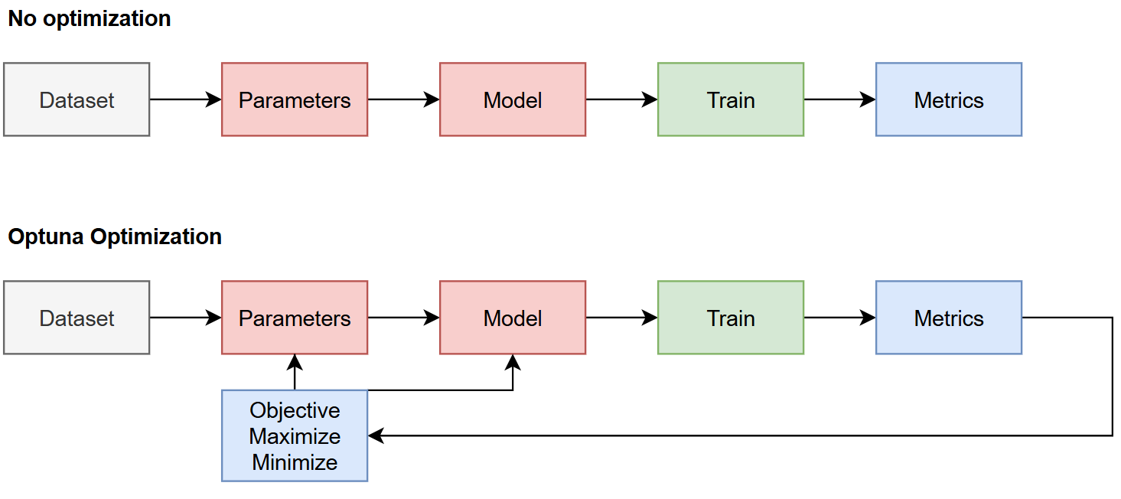
Overview

Slide 4
Steps for optuna
Define the study:
Direction (“max accuracy” or “min loss”)
Number of trials
Define the hyperparameters to optimize
Categorical, int, float
Train

Slide 5
Optimization Algorithms
Optuna provides the following sampling algorithms:
Grid Search
Random Search
Tree-structured Parzen Estimator
CMA-ES based algorithm
Gaussian process-based algorithm
Algorithm to enable partial fixed parameters
Nondominated Sorting Genetic Algorithm II
A Quasi Monte Carlo sampling algorithm

Slide 6
Optimization Algorithms
 | P1 | P2
 | 1 | 0
 | 0 | 1
 | 1 | 1
 | 0 | 0
Optuna provides the following sampling algorithms:
Grid Search
Random Search
Tree-structured Parzen Estimator
CMA-ES based algorithm
Gaussian process-based algorithm
Algorithm to enable partial fixed parameters
Nondominated Sorting Genetic Algorithm II
A Quasi Monte Carlo sampling algorithm

Slide 7
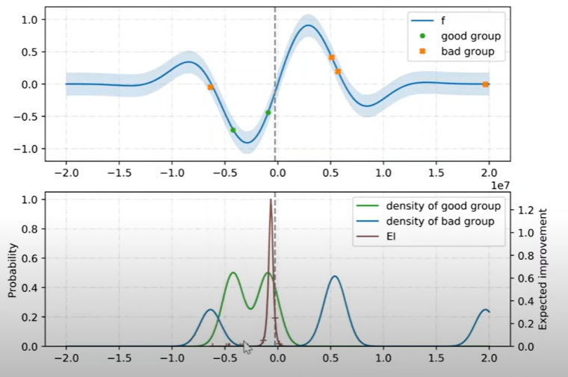
Optimization Algorithms
Optuna provides the following sampling algorithms:
Grid Search
Random Search
Tree-structured Parzen Estimator
CMA-ES based algorithm
Gaussian process-based algorithm
Algorithm to enable partial fixed parameters
Nondominated Sorting Genetic Algorithm II
A Quasi Monte Carlo sampling algorithm
Explore then improve
https://youtu.be/bcy6A57jAwI?si=R6OO8gj0p4oMSVgp

Slide 8
Variations
Optuna provides the following sampling algorithms:
Pytorch
Tensorflow
Keras
Scikit-Learn
Dmlc-XGBoost
Light GBM
Others
Install
Pip install optuna

Slide 9
Dashboard

Slide 10
Jupyter notebooks to try
https://github.com/ldelaoa/OptunaWorkshop

