Slide 1
Glaciology
EESCGU4220
Practical 6:
Comparing SIA to measured flow speeds

Slide 2
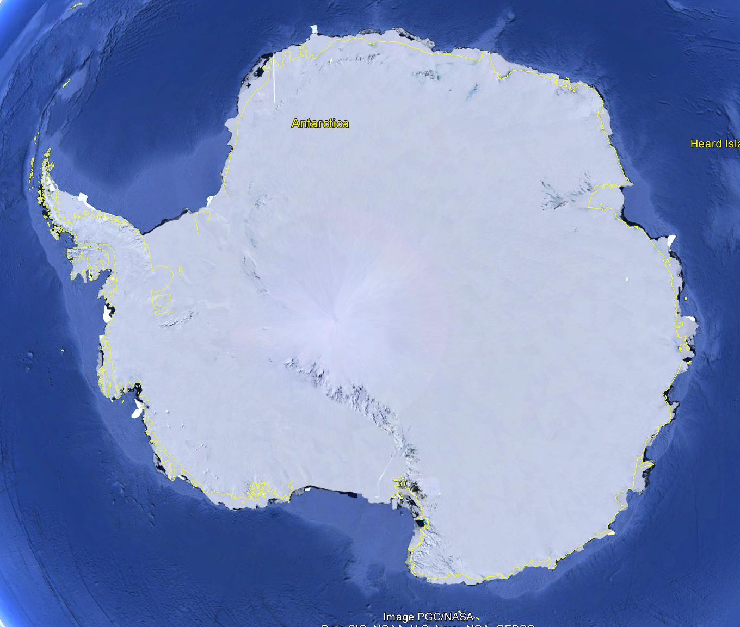

Slide 3
Download the data from here:
https://drive.google.com/file/d/1bh88YHW0iv-p3TwxseJRXXDO-2FZoBQ0/view?usp=sharing
and
https://drive.google.com/file/d/1Mbo6XzZjw1YCItBeA9DOXqW5iVpXzEUU/view?usp=sharing
Goal: create a script to compare measured speed (contained in MeasuredSpeed.mat) to speed computed using the SIA, along lines in Antarctica.
Start with
P4_MissingCode.m
Notes:
MeasuredSpeed.mat
contains maps of the two components of horizontal surface velocity at the surface of the Antarctic ice sheet. x and y are polar stereographic coordinates in meters. Vx and Vy are the two horizontal components of surface speed in meters/year
Bedmap2.mat
contains maps of ice thickness and slope on a different grid to the speed data. x_bedmap and y_bedmap are polar stereographic coordinates in meters. thickness is ice thickness in meters. slope is surface slope (dimensionless).

Slide 4
Code:
%% 0. load data
% load('MeasuredSpeed') % This comes from an model inversion (Arthern et al., 2015), which is closely constrained by satellite observations of flow spped
% load('BedMap2_forP4') % This is a data product derived from continent-wide observations of ice thickness and surfaec elevation.
%% 1. plot a map of speed
close all
figure(1)
speed =
imagesc(
xlabel 'x [km]'
ylabel 'y [km]'
title 'Speed [m yr^-^1]'
caxis([0 100])
set(gca,'YDir','normal')
%% 2. ask the user to choose the start and end points of the profile
P = ginput(
%% 3. use the start and ends points to calculate a line of points in between
numberofpoints = 500;
x_i = linspace(
y_i = linspace(
%% 4. plot the line on the map
hold on
plot(
%% 5.interpolate and plot speed (from Measuredelocities.m; Arthern et al., 2015) at each point along the line
u_i = interp2(
figure (2)
subplot 311
plot(
xlabel 'point number'
ylabel 'speed [m yr^-^1]'
%% 6. interpolate and plot thickness (from Bedmap2) at each point along the line
h_i = interp2(
figure (2)
subplot 312
plot(
xlabel 'point number'
ylabel 'thickness [m]'
%% 7. interpolate and plot slope (from Bedmap2) at each point along the line
s = interp2(
figure (2)
subplot 313
plot(
xlabel 'point number'
ylabel 'slope [-]'
%% 8. smooth the slope profile with smooth.m (try a moving average with a window of 100)
s_smooth = smooth(
figure (2)
subplot 313
hold on
plot(s_smooth,'k')
legend('Slope','Smoothed slope')
%% 8. compute surface speed (constants copied over from SIA.m)
% constants
n = 3; % Glen's flow law exponent
A = 24e-25 *(365*24*60*60); % Glen's flow law parameter original value from Cuffey and Paterson 24e-25
rho=917; % ice density
g=9.8; % acceleration due to gravity
% use equation from slide 30 of lecture 6 to compute surface speed u(H)
u_m =
% plot over the measured speed for comparison
figure (2)
subplot 311
hold on
plot(
legend('Speed','Modelled Speed')
%% References
%{
Arthern, Robert J., Richard CA Hindmarsh, and C. Rosie Williams.
"Flow speed within the Antarctic ice sheet and its controls inferred from
satellite observations." Journal of Geophysical Research 120, no. 7 (2015): 1171-1188.
Fretwell, Peter, Hamish D. Pritchard, David G. Vaughan, Jonathan L. Bamber,
N. E. Barrand, R. Bell, C. Bianchi et al. "Bedmap2: improved ice bed,
surface and thickness datasets for Antarctica." (2013).
%}

