Slide 1

Microbial slurry
Live Field Soil
Sterile
Field Soil
Autoclaved Sand and Vermiculite (50:50)

Slide 2
Brassica rapa (Fast Plants)
Seed
Grown for 27 days
Microbial slurry
N = 15 per treatment; 5 blocks with 3 reps each
Live Field Soil
Sterile
Field Soil
Autoclaved Sand and Vermiculite (50:50)
Drought
15mL 3 days;
no water last week
Ambient
15mL daily
Live Field Soil
Sterile Field Soil
5
Spectrum DS (IAA production) – SDS product
Drought tolerant microbes – Good Isolates
Drought sensitive microbes – Bad Isolates
Isolates from Spectrum DS – Product Microbes
Sterile Control

Slide 3
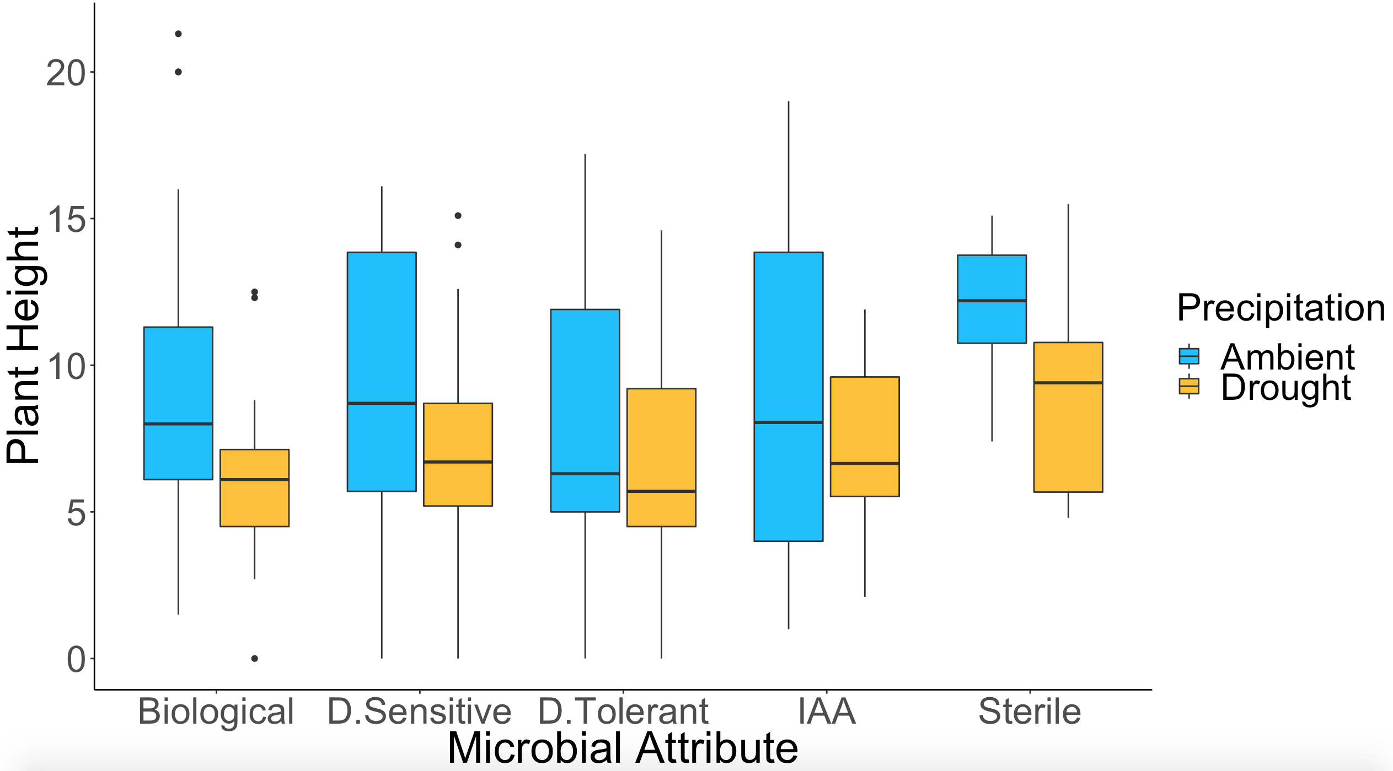
SDS Product Bad Isolates Good Isolates Product Microbes Sterile
Credit: Harry Ervin

Slide 4
> Anova(FP_tot_bio_model.2, type=3)
Anova Table (Type III tests)
Response: sqrt(tot_bio + 1e-04)
Sum Sq Df F value Pr(>F)
(Intercept) 1.1015 1 77.6464 2.4e-16 ***
precip 0.0672 1 4.7349 0.030521 *
inocul 0.2440 4 4.2996 0.002225 **
as.factor(block) 0.1933 4 3.4073 0.009836 **
precip:inocul 0.1455 4 2.5645 0.038962 *
Residuals 3.4471 243
---
Signif. codes: 0 ‘***’ 0.001 ‘**’ 0.01 ‘*’ 0.05 ‘.’ 0.1 ‘ ’ 1
P=0.027

Slide 5
> Anova(FP_tot_bio_model.3, type=3)
Anova Table (Type III tests)
Response: sqrt(tot_bio + 1e-04)
Sum Sq Df F value Pr(>F)
(Intercept) 15.7370 1 1339.8596 < 2.2e-16 ***
precip 0.0063 1 0.5359 0.46494
soil_status 0.2774 1 23.6161 2.299e-06 ***
inocul 0.0330 3 0.9365 0.42391
as.factor(block) 0.1544 4 3.2868 0.01223 *
precip:soil_status 0.0056 1 0.4796 0.48937
precip:inocul 0.1344 3 3.8154 0.01083 *
soil_status:inocul 0.0503 3 1.4269 0.23592
precip:soil_status:inocul 0.0370 3 1.0505 0.37122
Residuals 2.4665 210
---
Signif. codes: 0 ‘***’ 0.001 ‘**’ 0.01 ‘*’ 0.05 ‘.’ 0.1 ‘ ’ 1

Slide 6
> Anova(FP_root_bio_model.2, type=3)
Anova Table (Type III tests)
Response: sqrt(root_weight + 1e-04)
Sum Sq Df F value Pr(>F)
(Intercept) 14.2938 1 979.0599 < 2.2e-16 ***
precip 0.1016 1 6.9570 0.008888 **
inocul 0.4931 4 8.4438 2.148e-06 ***
as.factor(block) 0.1729 4 2.9615 0.020467 *
precip:inocul 0.1879 4 3.2181 0.013439 *
Residuals 3.5477 243
---
Signif. codes: 0 ‘***’ 0.001 ‘**’ 0.01 ‘*’ 0.05 ‘.’ 0.1 ‘ ’ 1
P=0.0022
P=0.019

Slide 7
> Anova(FP_root_bio_model.3, type=3)
Anova Table (Type III tests)
Response: sqrt(root_weight + 1e-04)
Sum Sq Df F value Pr(>F)
(Intercept) 11.0771 1 908.0332 < 2.2e-16 ***
precip 0.0605 1 4.9586 0.027023 *
soil_status 0.1194 1 9.7865 0.002008 **
inocul 0.0393 3 1.0733 0.361387
as.factor(block) 0.1385 4 2.8375 0.025395 *
precip:soil_status 0.0000 1 0.0033 0.954506
precip:inocul 0.1749 3 4.7802 0.003037 **
soil_status:inocul 0.0580 3 1.5850 0.194062
precip:soil_status:inocul 0.0747 3 2.0412 0.109191
Residuals 2.5618 210
---

Slide 8
> Anova(FP_shoot_bio_model.2, type=3)
Anova Table (Type III tests)
Response: sqrt(shoot_weight + 1e-04)
Sum Sq Df F value Pr(>F)
(Intercept) 4.4370 1 1583.4782 < 2.2e-16 ***
precip 0.0636 1 22.7127 3.233e-06 ***
inocul 0.0352 4 3.1417 0.01523 *
as.factor(block) 0.0262 4 2.3395 0.05582 .
precip:inocul 0.0075 4 0.6703 0.61316
Residuals 0.6837 244
---
Signif. codes: 0 ‘***’ 0.001 ‘**’ 0.01 ‘*’ 0.05 ‘.’ 0.1 ‘ ’ 1

Slide 9
> Anova(FP_shoot_bio_model.3, type=3)
Anova Table (Type III tests)
Response: sqrt(shoot_weight + 1e-04)
Sum Sq Df F value Pr(>F)
(Intercept) 3.9124 1 1942.0642 < 2.2e-16 ***
precip 0.0676 1 33.5768 2.469e-08 ***
soil_status 0.1919 1 95.2530 < 2.2e-16 ***
inocul 0.0008 3 0.1349 0.93913
as.factor(block) 0.0215 4 2.6703 0.03323 *
precip:soil_status 0.0119 1 5.9212 0.01579 *
precip:inocul 0.0075 3 1.2328 0.29876
soil_status:inocul 0.0025 3 0.4138 0.74325
precip:soil_status:inocul 0.0060 3 0.9902 0.39834
Residuals 0.4251 211
---
Signif. codes: 0 ‘***’ 0.001 ‘**’ 0.01 ‘*’ 0.05 ‘.’ 0.1 ‘ ’ 1

Slide 10
Samples flagged as sandy removed
P=0.0081
> Anova(FP_root_NS_bio_model.2, type=3)
Anova Table (Type III tests)
Response: sqrt(root_weight + 1e-04)
Sum Sq Df F value Pr(>F)
(Intercept) 8.1263 1 718.1413 < 2e-16 ***
precip 0.0749 1 6.6177 0.01076 *
inocul 0.1369 4 3.0236 0.01871 *
as.factor(block) 0.1298 4 2.8675 0.02412 *
precip:inocul 0.0642 4 1.4183 0.22888
Residuals 2.4555 217
---
Signif. codes: 0 ‘***’ 0.001 ‘**’ 0.01 ‘*’ 0.05 ‘.’ 0.1 ‘ ’ 1
P=0.0722

Slide 11
Samples flagged as sandy removed
> Anova(FP_root_NS_bio_model.3, type=3)
Anova Table (Type III tests)
Response: sqrt(root_weight + 1e-04)
Sum Sq Df F value Pr(>F)
(Intercept) 9.1561 1 906.6496 < 2.2e-16 ***
precip 0.0522 1 5.1655 0.0241248 *
soil_status 0.1374 1 13.6025 0.0002925 ***
inocul 0.1157 3 3.8201 0.0108617 *
as.factor(block) 0.1019 4 2.5222 0.0423638 *
precip:soil_status 0.0003 1 0.0337 0.8546090
precip:inocul 0.0565 3 1.8637 0.1370482
soil_status:inocul 0.0280 3 0.9246 0.4298932
precip:soil_status:inocul 0.0659 3 2.1752 0.0922345 .
Residuals 1.9794 196
---
Signif. codes: 0 ‘***’ 0.001 ‘**’ 0.01 ‘*’ 0.05 ‘.’ 0.1 ‘ ’ 1

Slide 12
P <0.0001
P= 0.0440
P =0.0001
> Anova(FP_root_shoot_model.2, type=3)
Anova Table (Type III tests)
Response: log(root_shoot)
Sum Sq Df F value Pr(>F)
(Intercept) 225.758 1 197.8806 < 2e-16 ***
precip 35.762 1 31.3463 6.1e-08 ***
inocul 5.270 4 1.1549 0.3316
as.factor(block) 3.382 4 0.7410 0.5649
precip:inocul 10.541 4 2.3097 0.0587 .
Residuals 263.543 231
---
Signif. codes: 0 ‘***’ 0.001 ‘**’ 0.01 ‘*’ 0.05 ‘.’ 0.1 ‘ ’ 1
P =0.0371

Slide 13
*
****
*P<0.05
**P<0.01
***P<0.001
****P<0.0001
***
> Anova(FP_root_shoot_bio_model.3, type=3)
Anova Table (Type III tests)
Response: log(root_shoot)
Sum Sq Df F value Pr(>F)
(Intercept) 196.799 1 201.3560 < 2.2e-16 ***
precip 33.624 1 34.4030 1.854e-08 ***
soil_status 15.588 1 15.9487 9.169e-05 ***
inocul 2.961 3 1.0100 0.389387
as.factor(block) 3.634 4 0.9296 0.447772
precip:soil_status 0.000 1 0.0003 0.986943
precip:inocul 11.394 3 3.8858 0.009950 **
soil_status:inocul 2.559 3 0.8727 0.456197
precip:soil_status:inocul 14.233 3 4.8542 0.002789 **
Residuals 193.519 198
---
Signif. codes: 0 ‘***’ 0.001 ‘**’ 0.01 ‘*’ 0.05 ‘.’ 0.1 ‘ ’ 1

