Slide 1
Artificial Intelligence Lecture 4: Adversarial Search (Games) & CSP (Chapter 5 & 6 )
Summer 2016
Instructor: Sheila Tejada

Slide 2
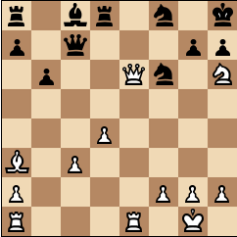
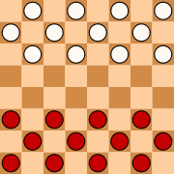
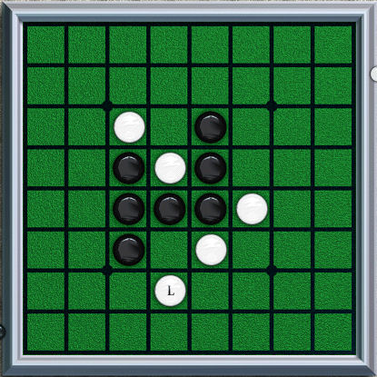
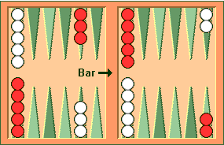
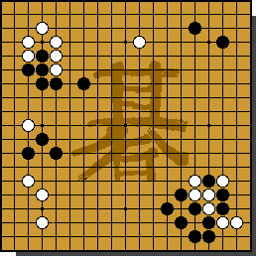
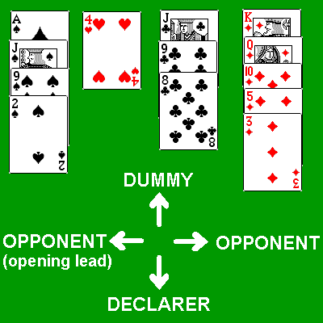
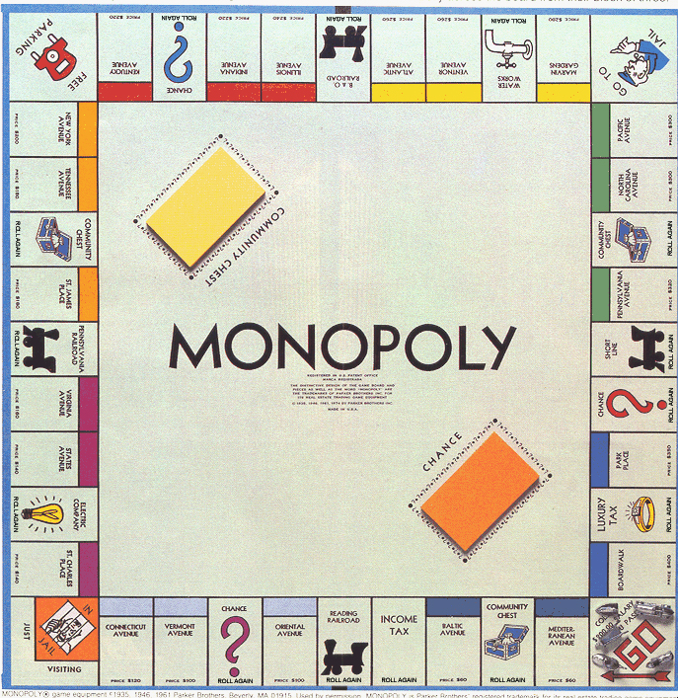
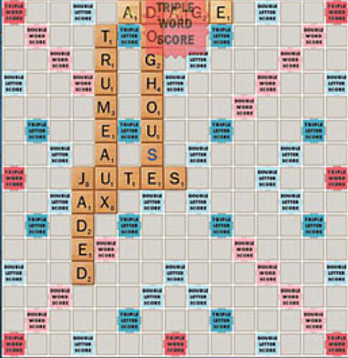
Games and Search
What we have seen so far is single-agent search
Solution is usually a single path to a goal state
Focus is frequently on finding optimal solutions
f(n) is an estimate of cost from start to goal through given node
Examples: path planning, scheduling, puzzles
Games are two-or-more person adversarial search
Solution usually a branching (tree) contingency plan: need to consider all your opponent might do
Examples: chess, checkers/draughts, othello/reversi, backgammon, go, bridge, poker, monopoly, scrabble

Slide 3
Types of Games
Deterministic
Stochastic
chess, checkers, go, othello, … | backgammon, monopoly, …
Battleship, above with time/space limits | Bridge, poker, scrabble, …
Perfect
Information
Imperfect
Information
Notes:
Differentiate whether game itself is stochastic versus uncertainty due to other players.
Differentiate whether all information is available to players versus some hidden.

Slide 4
Game Formulation
Two players: MAX and MIN
MAX moves first and then take turns until game is over
Each move by a player is called a ply
Winner gets reward, loser gets penalty
Formulating the game/problem
Initial state: Initial board configuration
Successor function: (move,state) pairs specifying legal moves
Goal/terminal test: Is the game finished?
Evaluation/utility function: Numerical values of terminal states
E.g. win (+1), lose (-1) and draw (0)
Or the number of points won or lost
MAX starts by using search tree to determine next move

Slide 5
Generate Game Tree

Slide 6
Generate Game Tree
MAX
x
 | x
x
 |  | x

Slide 7
Generate Game Tree
MAX
 | x
MIN
 | x | o
o | x
 | x
 | o
 | x
o

Slide 8
Generate Game Tree
MAX
 | x
1 ply
MIN
1 move
 | x | o
o | x
 | x
 | o
 | x
o

Slide 9
A subtree
x
o
x
o
x
o
win
MAX
lose
x
o
x
x
o
x
x
o
x
draw
x
o
x
o
x
o
x
MIN
o
x
o
x
o
x
o
x
x
o
x
x
o
x
x
o
x
x
o
x
x
o
x
x
o
x
x
o
x
o
o
x
o
x
o
o
x
o
x
o
o
o
o
x
o
x
o
o
x
o
o
x
o
MAX
x
o
x
x
o
x
x
o
x
x
o
x
x
o
x
o
o
x
o
o
x
x
o
x
o
x
o
x
x
o
x
x
o
o
x
o

Slide 10
What is a good move?
x
o
x
o
x
o
win
MAX
lose
x
o
x
x
o
x
x
o
x
draw
x
o
x
o
x
o
x
MIN
o
x
o
x
o
x
o
x
x
o
x
x
o
x
x
o
x
x
o
x
x
o
x
x
o
x
x
o
x
o
o
x
o
x
o
o
x
o
x
o
o
o
o
x
o
x
o
o
x
o
o
x
o
MAX
x
o
x
x
o
x
x
o
x
x
o
x
x
o
x
o
o
x
o
o
x
x
o
x
o
x
o
x
x
o
x
x
o
o
x
o

Slide 11
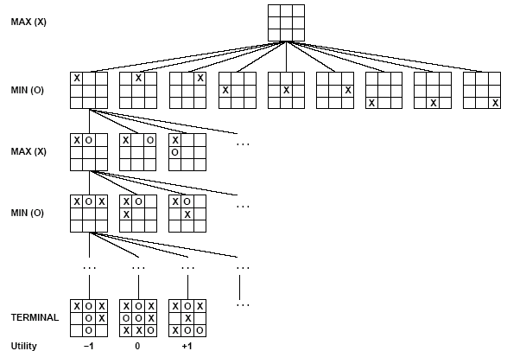
Partial Game Tree for Tic-Tac-Toe
Max tries to maximize utility (from X’s perspective) of move
Min tries to minimize utility (from X’s perspective) of move

Slide 12
Optimal Strategies
Find a contingent strategy for MAX assuming infallible MIN
Assumption: Both players play optimally
Given a game tree, the optimal strategy can be determined by using the minimax value of each node:
MINIMAX-VALUE(n)=
UTILITY(n) If n is a terminal
max_{s ∈ successors(n)} MINIMAX-VALUE(s) If n is a max node
min_{s ∈ successors(n)} MINIMAX-VALUE(s) If n is a min node
Implicitly defines a recursive search algorithm (Minimax)

Slide 13
Minimax
3
12
8
2
4
6
14
5
2
Minimize opponent’s chance
Maximize your chance

Slide 14
Minimax
3
2
2
MIN
3
12
8
2
4
6
14
5
2
Minimize opponent’s chance
Maximize your chance

Slide 15
Minimax
3
MAX
3
2
2
MIN
3
12
8
2
4
6
14
5
2
Minimize opponent’s chance
Maximize your chance

Slide 16
Minimax
3
MAX
3
2
2
MIN
3
12
8
2
4
6
14
5
2
Minimize opponent’s chance
Maximize your chance

Slide 17
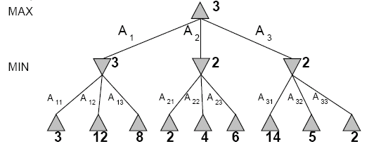
Two-Ply Game Tree
Search proceeds depth first
Backing up values as it completes search of successors
Minimax does its best for MAX under the assumption that MIN will do its worst
Notes:
End up at bottom left if both play optimally

Slide 18
Minimax Algorithm

Slide 19
Evaluation of Minimax
Completeness
Yes (exhaustive)
Optimality
Yes (exhaustive)
Time complexity
O(b^{m})
Space complexity
O(bm) or O(m)
Time Complexity is the Big Problem

Slide 20
Searching for the next move
Resource (e.g., time, memory) limit: optimal solution not feasible/possible, thus must approximate
Pruning: makes the search more efficient by discarding portions of the search tree that cannot improve quality result.
Evaluation functions: heuristics to evaluate utility of a state without exhaustive search.

Slide 21
Minimax algorithm
MAX
6
MIN
6
-8
-9
15 10 6 12 -8 7 5 25 -9

Slide 22
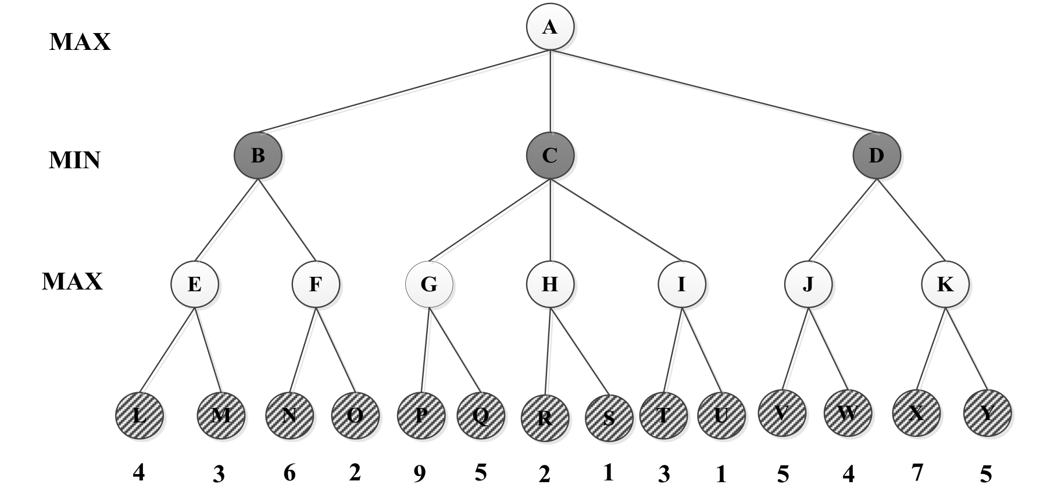
=-∞
β = +∞
v = -∞
=5
β = +∞
v = 5
=4
β = +∞
v = 4
= 4
β = 9
v = 2
= 4
β = +∞
v = ∞
= 4
β = 9
v = 9
= 4
β = +∞
v = ∞
=-∞
β = 4
v = 4
= 4
β = 5
v = 5
=-∞
β = +∞
v = ∞
=9
β = ∞
v = 9
=4
β = ∞
v = -∞
=4
β = +∞
v = 4
=-∞
β = +∞
v = -∞
=4
β = +∞
v = 4
=4
β = 5
v = -∞
=-∞
β = 4
v = 6
=4
β = 9
v = 2
=4
β = 5
v = 7
=4
β = 9
v = -∞
=4
β = ∞
v = -∞
=-∞
β = 4
v = -∞
=5
β = ∞
v = 5
Max Node
Min Node

Slide 23
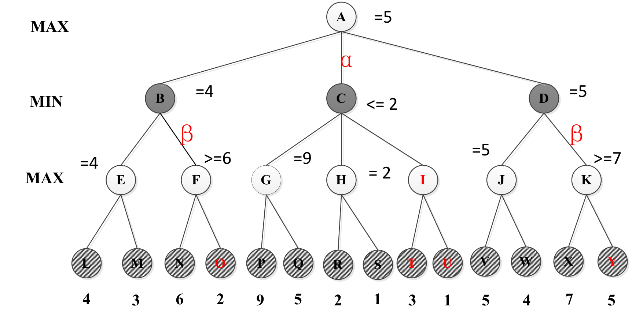

Slide 24
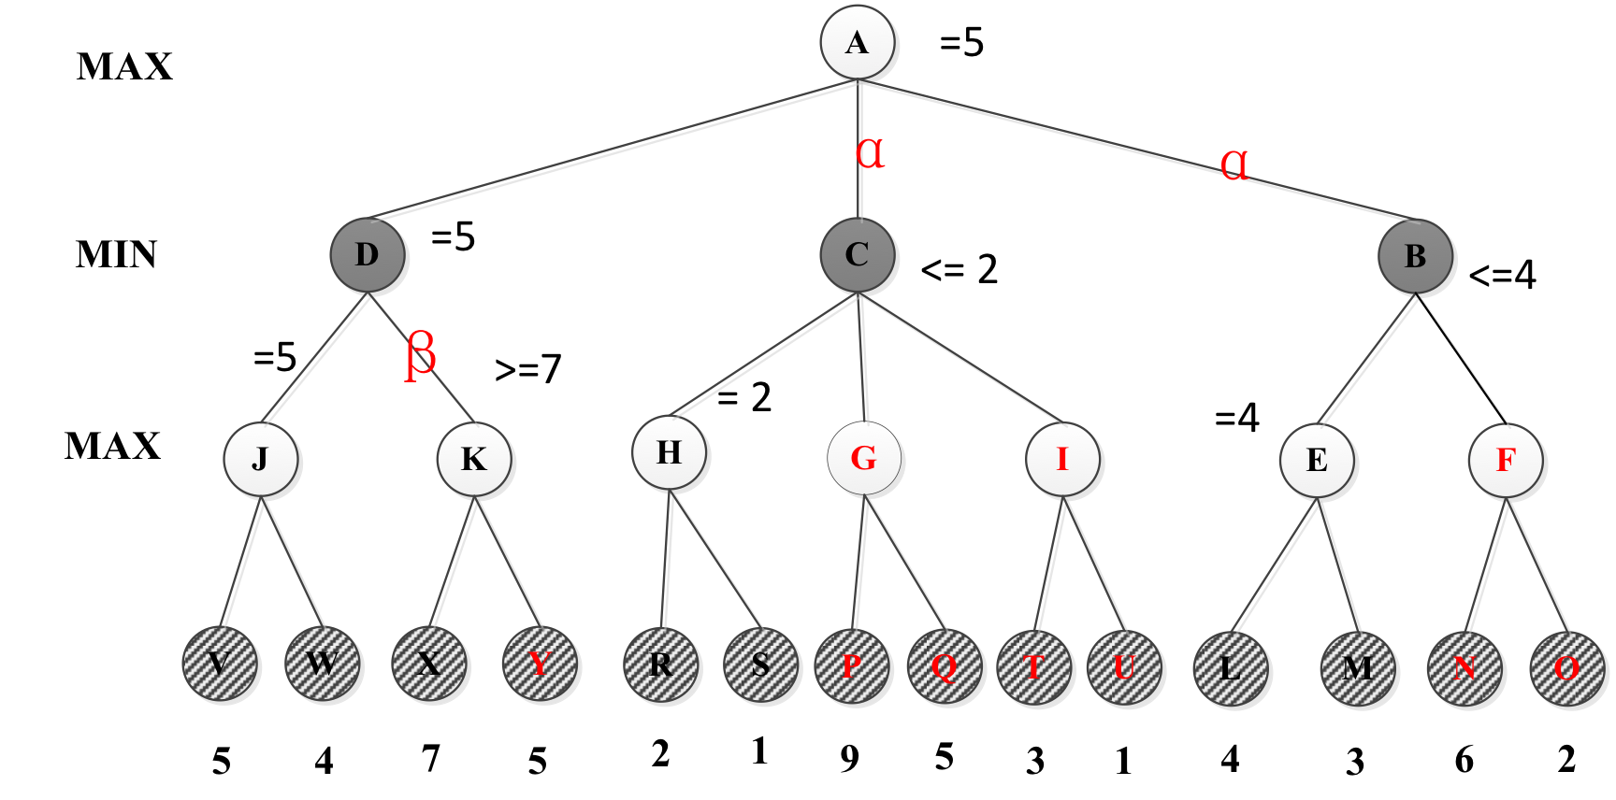

Slide 25
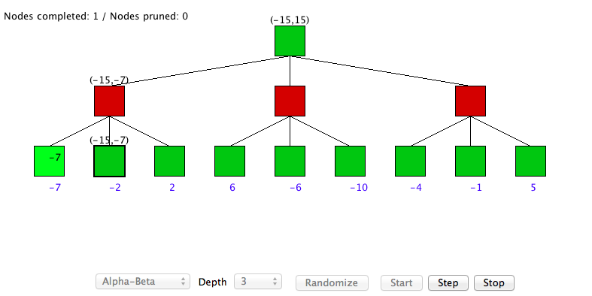
α-β algorithm DEMO
http://www.ocf.berkeley.edu/~yosenl/extras/alphabeta/alphabeta.html

Slide 26
Comments on Alpha-Beta
Pruning does not affect final results
Entire subtrees can be pruned
Good move ordering improves effectiveness of pruning
Want to look at best child first
With “perfect ordering,” time complexity is O(b^{m/2})
Search is effectively only half as deep [b^{(m/2)}]
Can look twice as far as minimax in the same amount of time
Various other improvements are also possible
However, still not good enough to reach end of any significant games in real time!

Slide 27
Making Game Search Tractable Shifting to Heuristic/Imperfect Information
Minimax and alpha-beta pruning require too much search to reach leaf nodes of game
Usually impractical within reasonable time bounds
Although recent approaches are doing huge searches offline and storing tables for use during games
Alternative
Cut off search earlier (replace TERMINAL-TEST by CUTOFF-TEST)
Apply heuristic evaluation function EVAL to replace the utility function of alpha-beta
Deal with other consequences of cutting off search

Slide 28
Cutting Off Search
Change:
if TERMINAL-TEST(state) then return UTILITY(state)
into
if CUTOFF-TEST(state,depth) then return EVAL(state)
Introduces a fixed-depth limit depth
Depth usually set by time available
When cuttoff occurs, the evaluation is performed

Slide 29
Heuristic EVAL
EVAL idea: produce an estimate of the expected value of the game at a given position
Performance depends critically on quality of EVAL
Desiderata:
EVAL should order terminal nodes in same way as UTILITY
Computing EVAL should not take too long
Whatever time is spent in EVAL isn’t spent searching other nodes
For non-terminal states, EVAL should be strongly correlated with the actual chance of winning

Slide 30
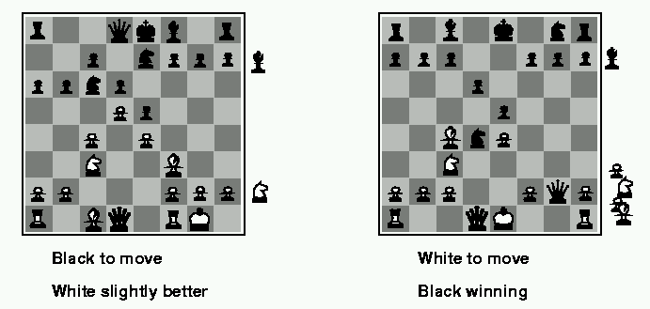
Evaluation functions
Weighted linear evaluation function: to combine n heuristics f = w₁f₁ ₊ w₂f_{2 + … +} w_{n}f_{n}
E.g, w’s could be the values of pieces (1 for prawn, 3 for bishop etc.) f’s could be the number of type of pieces on the board

Slide 31
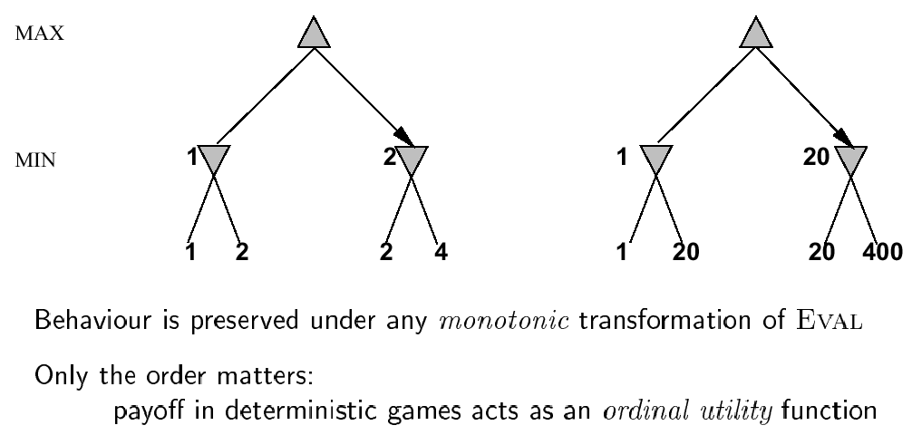
Note: exact values do not matter

Slide 32
Key Problem with Cutoff/EVAL
Can’t see what happens beyond cutoff
Can overvalue a position where disaster will happen immediately after last ply actually searched
E.g., in chess, where queen is taken on next move
Can add useless or counterproductive delaying moves to push disasters past cutoff
Called the horizon effect
Searching deeper helps avoid both problems
There are also approaches for going deeper selectively
E.g., Quiescence search and singular extensions
Notes:
Quiescence search: Search active positions (evaluation more labile) than quiet positions
Singular extensions: Extend search one ply for moves that are relevant and look much better than alternatives

Slide 33
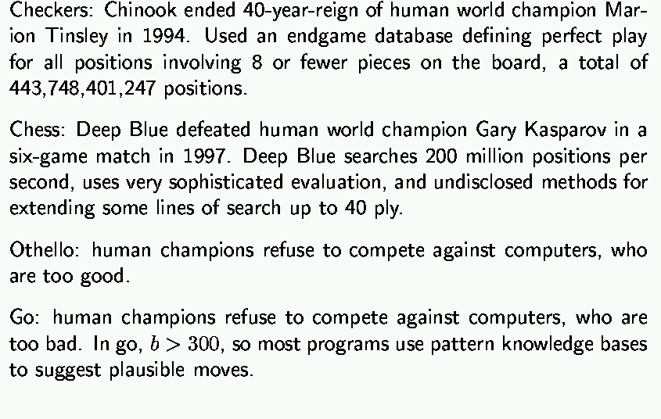
State-of-the-art for deterministic games

Slide 34
CSP Example: Map Coloring
NT
NT
Q
Q
WA
WA
SA
SA
NSW
NSW
V
V
T
T
7 variables {WA,NT,SA,Q,NSW,V,T}
Each variable has the same domain {red, green, blue}
No two adjacent variables have the same value:
WA≠NT, WA≠SA, NT≠SA, NT≠Q, SA≠Q, SA≠NSW, SA≠V,Q≠NSW, NSW≠V

Slide 35
Constraint Graph
Binary constraints
NT
What is the constraint graph for sudoku?
Q
WA
SA
NSW
V
T
Two variables are adjacent or neighbors if they
are connected by an edge or an arc

Slide 36
Backtracking Search
empty assignment
1st variable
2nd variable
3rd variable
Assignment = {}

Slide 37
Backtracking Search
empty assignment
1st variable
2nd variable
3rd variable
Assignment = {(var1=v11)}

Slide 38
Backtracking Search
empty assignment
1st variable
2nd variable
3rd variable
Assignment = {(var1=v11),(var2=v21)}

Slide 39
Backtracking Search
empty assignment
1st variable
2nd variable
3rd variable
Assignment = {(var1=v11),(var2=v21),(var3=v31)}

Slide 40
Backtracking Search
empty assignment
1st variable
2nd variable
3rd variable
Assignment = {(var1=v11),(var2=v21),(var3=v32)}

Slide 41
Backtracking Search
empty assignment
1st variable
2nd variable
3rd variable
Assignment = {(var1=v11),(var2=v22)}

Slide 42
Backtracking Search
empty assignment
1st variable
2nd variable
3rd variable
Assignment = {(var1=v11),(var2=v22),(var3=v31)}

Slide 43
Constraint Propagation
Which variable X should be assigned a value next?
In which order should its values be tried?
Variable Selection:
“Most constrained variable” or “Minimum Remaining Values”
Degree: variable involved in most constraints on others (tiebreaker)
Value Selection:
Least constraining value
NT
NT
Q
WA
WA
SA
NSW
V
{blue}
T

Slide 44
Map Coloring
{}
WA=red
WA=green
WA=blue
WA=red
NT=green
WA=red
NT=blue
NT
Q
WA
WA=red
NT=green
Q=red
WA=red
NT=green
Q=blue
SA
NSW
V
T

Slide 45
Map Coloring: Forward Checking
NT
Q
WA
NSW
T
SA
V
WA | NT | Q | NSW | V | SA | T
RGB | RGB | RGB | RGB | RGB | RGB | RGB

Slide 46
Map Coloring: Forward Checking
NT
Q
WA
NSW
T
SA
V
WA | NT | Q | NSW | V | SA | T
RGB | RGB | RGB | RGB | RGB | RGB | RGB
1: R | RGB | RGB | RGB | RGB | RGB | RGB

Slide 47
Map Coloring: Forward Checking
NT
Q
WA
NSW
T
SA
V
WA | NT | Q | NSW | V | SA | T
RGB | RGB | RGB | RGB | RGB | RGB | RGB
1: R | RGB | RGB | RGB | RGB | RGB | RGB

Slide 48
Map Coloring: FC
NT
Q
WA
NSW
T
SA
V
WA | NT | Q | NSW | V | SA | T
RGB | RGB | RGB | RGB | RGB | RGB | RGB
R | RGB | RGB | RGB | RGB | RGB | RGB
R | RGB | 2: G | RGB | RGB | RGB | RGB

Slide 49
Map Coloring: FC
NT
Q
WA
NSW
T
SA
V
WA | NT | Q | NSW | V | SA | T
RGB | RGB | RGB | RGB | RGB | RGB | RGB
R | RGB | RGB | RGB | RGB | RGB | RGB
R | RGB | 2: G | RGB | RGB | RGB | RGB

Slide 50
Map Coloring: FC
NT
Q
WA
NSW
T
SA
V
WA | NT | Q | NSW | V | SA | T
RGB | RGB | RGB | RGB | RGB | RGB | RGB
R | RGB | RGB | RGB | RGB | RGB | RGB
R | RGB | G | RGB | RGB | RGB | RGB
R | RGB | G | RGB | 3:B | RGB | RGB

Slide 51
Map Coloring: FC
NT
Q
WA
NSW
T
SA
V
WA | NT | Q | NSW | V | SA | T
RGB | RGB | RGB | RGB | RGB | RGB | RGB
R | RGB | RGB | RGB | RGB | RGB | RGB
R | RGB | G | RGB | RGB | RGB | RGB
R | RGB | G | RGB | 3:B | RGB | RGB

Slide 52
Other inconsistencies
NT
Q
WA
NSW
T
SA
V
Impossible assignments that forward
checking does not detect
WA | NT | Q | NSW | V | SA | T
RGB | RGB | RGB | RGB | RGB | RGB | RGB
R | RGB | RGB | RGB | RGB | RGB | RGB
R | RGB | G | RGB | RGB | RGB | RGB
R | RGB | G | RGB | 3:B | RGB | RGB

Slide 53
Constraint Propagation
Forward checking just checks immediate neighbors of variable that gets value assigned, misses more distant consequences
Constraint propagation continues to check the arc consistency of the neighbors of the neighbors and so on until quiescence.

Slide 54
Map Coloring: CP
NT
Q
WA
NSW
T
SA
V
WA | NT | Q | NSW | V | SA | T
RGB | RGB | RGB | RGB | RGB | RGB | RGB
R | RGB | RGB | RGB | RGB | RGB | RGB
R | RGB | 2: G | RGB | RGB | RGB | RGB
Go back to assigning “GREEN” to Queensland

Slide 55
Map Coloring: CP
NT
Q
WA
NSW
T
SA
V
WA | NT | Q | NSW | V | SA | T
RGB | RGB | RGB | RGB | RGB | RGB | RGB
R | RGB | RGB | RGB | RGB | RGB | RGB
R | RGB | 2: G | RGB | RGB | RGB | RGB
Immediate propagation removes GREEN for NSW, SA & NT

Slide 56
Map Coloring: CP
NT
Q
WA
NSW
T
SA
V
WA | NT | Q | NSW | V | SA | T
RGB | RGB | RGB | RGB | RGB | RGB | RGB
R | RGB | RGB | RGB | RGB | RGB | RGB
R | RGB | G | RGB | RGB | RGB | RGB
Since possible values for NT changed, continue to check arc consistency from NT

Slide 57
Map Coloring: CP
NT
Q
WA
NSW
T
SA
V
WA | NT | Q | NSW | V | SA | T
RGB | RGB | RGB | RGB | RGB | RGB | RGB
R | RGB | RGB | RGB | RGB | RGB | RGB
R | RGB | G | RGB | RGB | RGB | RGB
Constraint
NT≠SA
Constraint violation with SA immediately detected

Slide 58
Another approach
So far, we’ve considered approaches to solving CSP’s that keep track of possible assignments and maintain consistency….
What about taking a “greedy” approach. Make local assignments as consistent as possible, but allow inconsistencies, then do fix ups.

Slide 59
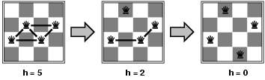
Local Search for CSP
Pick initial complete assignment (at random)
Repeat
Pick a conflicted variable v (at random)
Set the new value of v to minimize the number of conflicts
If the new assignment is not conflicting then return it
(min-conflicts heuristics)

Slide 60
Surprisingly this approach scales…
Figure 6.9 A two-step solution using min-conflicts for an 8-queens problem. At each stage, a queen is chosen for reassignment in its column. The number of conflicts (in this case, the number of attacking queens) is shown in each square. The algorithm moves the queen to the min-conflicts square, breaking ties randomly.

Slide 61
Other example: 4 house problem
4 families A, B, C and D live next to each other in houses numbered 1, 2, 3 and 4.
D lives in a house with lower number than B,
B lives next to A in a house with higher number,
There is at least one house between B and C,
D does not live in the house with number 2,
C does not live in the house with number 4.
Which family lives in which house ?

Slide 62
When to Use CSP Techniques?
When the problem can be expressed by a set of variables with constraints on their values
When constraints are relatively simple (e.g., binary)
When constraints propagate well (AC3 eliminates many values)
Local Search: when the solutions are “densely” distributed in the space of possible assignments

Slide 63
What you should know( WEEK3)
What are the characteristics of local search? Is it complete? Optimal? Time and Space complexity?
What problem domains are well-suited to each type of search technique? Ill-suited? Why?
Know how to compare their performance in general and in a specific domain or problem.
What are the characteristics of Adversarial Search? Why is meta-reasoning important in this type of search?

Slide 64
Want more?
Practice Exercises in AIMA
1.7,14,15
2.5,13
3.2,6,10,15,21
4.2
5.9
6.1,5,8

