Slide 1
Building Java Programs
Appendix B
JavaDoc Comments
Copyright (c) Pearson 2013.
All rights reserved.

Slide 2
Javadoc comments
  /**
  * description of class/method/field/etc.
  *
  * @tag attributes
  * @tag attributes
  * ...
  * @tag attributes
  */
Javadoc comments: Special comment syntax for describing detailed specifications of Java classes and methods.
  Put on class headers, methods, constructors, public fields, ...
    Benefit: Tools can turn Javadoc comments into HTML spec pages.
  Eclipse and other editors have useful built-in Javadoc support.
    Main drawback: Comments can become bulky and harder to read.

Slide 3
Javadoc tags
on a method or constructor:
on a class header:
tag | description
@param name description | describes a parameter
@return description | describes what value will be returned
@throws ExceptionType reason | describes an exception that may be thrown (and what would cause it to be thrown)
{@code sourcecode} | for showing Java code in the comments
{@inheritDoc} | allows a subclass method to copy Javadoc comments from the superclass version
tag | description
@author name | author of a class
@version number | class's version number, in any format

Slide 4
Javadoc example
/**
* Each BankAccount object models the account information for
* a single user of Fells Wargo bank.
* @author James T. Kirk
* @version 1.4 (Aug 9 2008)
*/
public class BankAccount {
/** The standard interest rate on all accounts. */
public static final double INTEREST_RATE = 0.03;
...
/**
* Deducts the given amount of money from this account's
* balance, if possible, and returns whether the money was
* deducted successfully (true if so, false if not).
* If the account does not contain sufficient funds to
* make this withdrawal, no funds are withdrawn.
*
* @param amount the amount of money to be withdrawn
* @return true if amount was withdrawn, else false
* @throws IllegalArgumentException if amount is negative
*/
public boolean withdraw(double amount) {
...
}
}

Slide 5
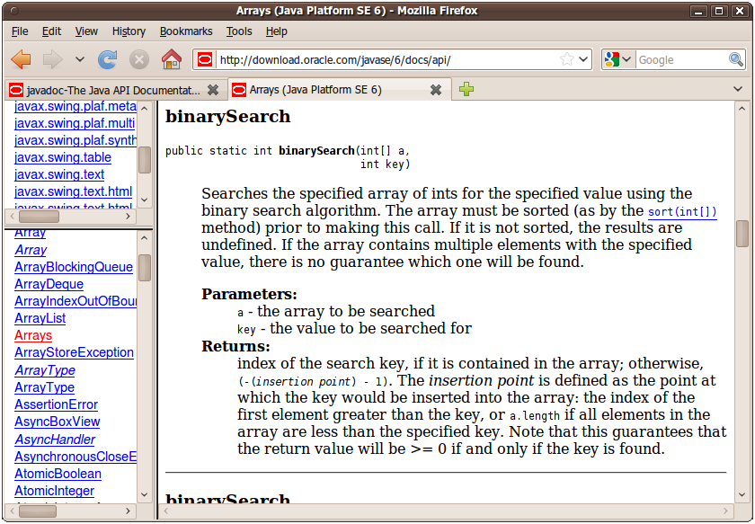
Javadoc output as HTML
Java has tools to convert Javadoc comments into web pages
  from Terminal: javadoc -d doc/ *.java
  Eclipse has this built in: Project → Generate Javadoc...
  The actual Java API
  spec web pages are
  generated from Sun's
  Javadoc comments on
  their own source code:

Slide 6
Javadoc HTML example
from java.util.List interface source code:
  /**
  * Returns the element at the specified position
  * in this list.
  * <p>This method is <em>not</em> guaranteed to run
  * in constant time. In some implementations it may
  * run in time proportional to the element position.
  *
  * @param index index of element to return; must be
  * non-negative and less than size of this list
  * @return the element at the specified position
  * @throws IndexOutOfBoundsException if the index is
  * out of range
  * ({@code index < 0 || index >= this.size()})
  */
  public E get(int index);
  Notice that HTML tags may be embedded inside the comments.

Slide 7
Javadoc enums, constants
Each class constant or enumeration value can be commented:
  /**
  * An instrument section of a symphony orchestra.
  * @author John Williams
  */
  public enum OrchestraSection {
  /** Woodwinds, such as flute, clarinet, and oboe. */
  WOODWIND,
  /** Brass instruments, such as trumpet. */
  BRASS,
  /** Percussion instruments, such as cymbals. */
  PERCUSSION,
  /** Stringed instruments, such as violin and cello. */
  STRING;
  }

Slide 8
Using @param/return
Don't repeat yourself or write vacuous comments.
  /** Takes an index and element and adds the element there.
  * @param index index to use
  * @param element element to add
  */
  public boolean add(int index, E element) { ...
better:
  /** Inserts the specified element at the specified
  * position in this list. Shifts the element currently at
  * that position (if any) and any subsequent elements to
  * the right (adds one to their indices). Returns whether
  * the add was successful.
  * @param index index at which the element is to be inserted
  * @param element element to be inserted at the given index
  * @return true if added successfully; false if not
  * @throws IndexOutOfBoundsException if index out of range
  * ({@code index < 0 || index > size()})
  */
  public boolean add(int index, E element) { ...

Slide 9
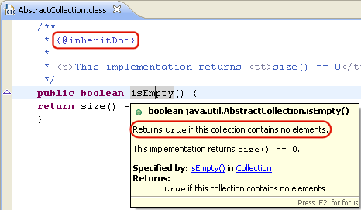
Your Javadoc is your spec
Whenever you write a class to be used by clients, you should write full Javadoc comments for all of its public behavior.
  This constitutes your specification to all clients for your class.
  You can post the generated HTML files publicly for clients to view.
  Common distribution of a library of classes:
    binaries (.class files, often packaged into an archive)
    specification (Javadoc .html files, or a public URL to view them)
  Eclipse uses Javadoc for auto-completion.
Write Javadoc comments for all
exposed API elements.
  (anything that is non-private)

Slide 10
Javadoc and private
Private internal methods do not need Javadoc comments:
  /** ... a Javadoc comment ... */
  public void remove(int index) { ... }
  // Helper does the real work of removing
  // the item at the given index.
  private void removeHelper(int index) {
  for (int i = index; i < size - 1; i++) {
  elementData[i] = elementData[i + 1];
  }
  elementData[size - 1] = 0;
  size--;
  }
  Private members do not appear in the generated HTML pages.

Slide 11
Custom Javadoc tags
Javadoc doesn't have tags for pre/post, but you can add them:
  By default, these tags won't show up in the generated HTML. But...
tag | description
@pre condition (or @precondition) | notes a precondition in API documentation; describes a condition that must be true for the method to perform its functionality
@post condition (or @postcondition) | notes a postcondition in API documentation; describes a condition that is guaranteed to be true at the end of the method's functionality, so long as all preconditions were true at the start of the method

Slide 12
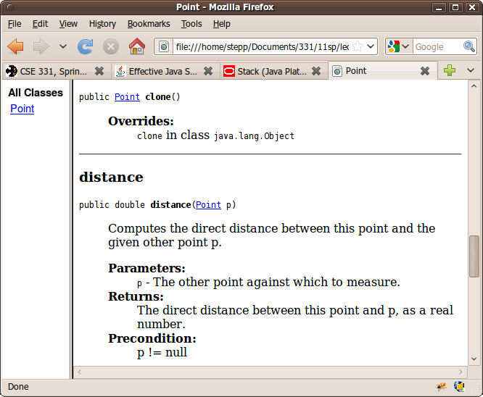
Applying custom tags
  from Terminal: javadoc -d doc/
  -tag pre:cm:"Precondition:"
  -tag post:cm:"Postcondition:" *.java
  in Eclipse: Project → Generate Javadoc... → Next → Next →
  in the "Extra Javadoc options" box, type:
  -tag pre:cm:"Precondition:" -tag post:cm:"Postcondition:"
  The generated Java API web pages
  will now be able to display pre
  and post tags properly!

Slide 13
More custom Javadoc tags
tag | description
@modifies object(s) | a more specific postcondition; describes any state of this object or other object(s) that may be changed by a call to this method
@effects object(s) | a more specific postcondition; describes any promises this method makes about the final state in which it will leave some other object(s) when it is done running

Slide 14

Programming by contract
programming by contract (design by contract): Defining formal, precise and verifiable interface specifications for software components, which extend the ordinary definition of abstract data types with preconditions, postconditions and invariants.
Three key questions that the designer must repeatedly ask:
  What does this code expect?
  What does it guarantee?
  What does it maintain?

Slide 15
Preconditions
precondition: Something assumed to be true at the start of a call.
  // Returns the element at the given index.
  // Precondition: 0 <= index < size
  public int get(int index) {
  return elementData[index];
  }
  Stating a precondition doesn't "solve" the problem of users passing improper indexes, but it at least documents our decision and warns the client what not to do.
index | 0 | 1 | 2 | 3 | 4 | 5 | 6 | 7 | 8 | 9
value | 3 | 8 | 9 | 7 | 5 | 12 | 0 | 0 | 0 | 0
size | 6

Slide 16
Choosing preconditions
Examples of poorly chosen preconditions:
  Stating the obvious:
    pre: String s is a string! The computer has enough memory to run!
  Making up for a lazy or poor implementation:
    for pow: Exponent can't be negative; can only do positive powers.
    for list.isSorted: List shouldn't contain any duplicates because our code messes up in that case and returns the wrong answer.
  Things that clients cannot check, avoid, or ensure:
    for stack.push: Stack's internal array capacity must be >= stack size.
    for a download: If it starts, the whole file will arrive successfully.
The client must be able to check the preconditions of a method before calling it.

Slide 17
Precondition violations
Formally, if a client violates a precondition, (by default)
the object does not specify what will happen.
  It makes no promise that the method will work successfully.
    might do nothing
    might return an unusual value or "error" value (null, 0, -1, "", etc.)
    might throw an exception
    might get stuck in an infinite loop
    might leave the object in a corrupt state, save the wrong file, etc.
  What is the best way to handle a precondition violation?

Slide 18
Approach 1: return error
can handle a precondition violation by returning a special value:
  // Returns the element at the given index.
  // Precondition: 0 <= index < size
  public int get(int index) {
  if (index < 0 || index >= size) {
  return -1;
  } else {
  return elementData[index];
  }
  }
  Is this a good or bad approach?
    Bad. The -1 returned is indistinguishable from a -1 in the actual data.
    Bad. The client might not notice the error and won't fix their bug.

Slide 19
Approach 2: exception
can handle a precondition violation by throwing an exception:
  // Returns the element at the given index.
  // Precondition: 0 <= index < size
  public int get(int index) {
  if (index < 0 || index >= size) {
  throw new IndexOutOfBoundsException(index);
  } else {
  return elementData[index];
  }
  }
  fail-fast: Client learns about the problem immediately and can fix it. Passing a bad value usually indicates a bug in the client, so this is good.

Slide 20

Exceptions in the contract
from java.util.Stack : public E pop()
  Removes the object on top of this stack and returns it.
  Returns: The object at the top of this stack.
  Throws: EmptyStackException - if stack is empty.
Most preconditions are things the stack assumes to be true.
  (as far as the client knows, that are not checked by the stack)
  If client violates a precondition, stack could do anything.
In this case the stack documents a predictable behavior (throw) in response to the empty stack condition.
  So we say that the exception is part of the contract .
  If you change it (say, to return null), you have changed the contract.

Slide 21
Preconditions and private
Private internal methods do not usually test preconditions:
  // Helper does the real work of removing an item.
  private void removeHelper(int index) {
  // should I check 0 <= index < size here?
  for (int i = index; i < size - 1; i++) {
  elementData[i] = elementData[i + 1];
  }
  elementData[size - 1] = 0;
  size--;
  }
Why not?
  Since the method can only be called internally, the class author can make sure to call it only when the preconditions hold.
  If any check at all is made, make it an assert statement.

Slide 22
Precondition example
Binary search on an int[] : from Java API
"Searches the specified array of ints for the specified value using the binary search algorithm. The array must be sorted (as by the sort method, above) prior to making this call. If it is not sorted, the results are undefined. ..."
Why doesn't Sun just check whether the array is sorted? :
  Idea #1: If it isn't sorted, sort it.
  Idea #2: If it isn't sorted, throw an exception.
  Sort is costly (takes O(n log n) or worse; search is O(log n)).
  Checking to see if the array is sorted is costly (O(n)); omitting this check and assuming it to be true makes binary search run much faster.
  Sort modifies the input array; binarySearch would have a side effect.
    So how do we catch bugs where the client violates this precondition? ...

Slide 23
Checking preconditions
assertion: A logical statement that can be made about a program at a point in time and is expected to be true.
  "At this point in the code, it should be the case that x > 0."
Java and other languages supply an assert statement.
  Assert statements can be en/disabled; they are off by default.
  Assertions check your basic assumptions that should never fail; they uncover things that should not have happened!
    For example, verify preconditions when testing/debugging.
  When an assertion fails, this is considered an error on the part of the developer and should be fixed immediately.
    Exceptions in the contract are more common.

Slide 24
Postconditions
postcondition: Something your method promises will be true at the end of its execution, if all preconditions were true at the start of the call.
  // Makes sure that this list's internal array is large
  // enough to store the given number of elements.
  // Precondition: capacity >= 0
  // Postcondition: elementData.length >= capacity
  public void ensureCapacity(int capacity) {
  while (capacity > elementData.length) {
  elementData = Arrays.copyOf(elementData,
  2 * elementData.length);
  }
  }
  If your method states a postcondition, clients should be able to rely on that statement being true after they call the method.

