Slide 1
Building Java Programs
Appendix C
Additional Java Syntax
Copyright (c) Pearson 2013.
All rights reserved.

Slide 2
Primitive data types
type | kind of number | memory (bits) | range | examples
byte | integer | 8 | -128 .. 127 | (byte) 5
char | character (integer) | 16 | \u0000 .. \uFFFF | 'a', '\u2603'
float | real number | 32 | -3.4e38 .. 3.4e38 | 3.14f, 1.1e7f
double | real number | 64 | -1.8e308 .. 1.8e308 | 3.14, 6.022e23
int | integer | 32 | -2³¹ .. 2³¹ | 42, -17, 0xff
long | integer | 64 | -2⁶³ .. 2⁶³ | 42L, 21874109487L
short | integer | 16 | -2¹⁵ .. 2¹⁵ | (short) 42

Slide 3
The switch statement
  switch (boolean test) {
  case value:
  code;
  break;
  case value:
  code;
  break;
  ...
  default: // if it isn't one of the above values
  code;
  break;
  }
an alternative to the if/else statement
  must be used on integral types (e.g. int, char, long, enum)
  instead of a break, a case can end with a return, or if neither is present, it will "fall through" into the code for the next case

Slide 4
Catching Exceptions

Slide 5

Exceptions
exception: An object representing an error.
  Other languages don't have this concept;
  they represent errors by returning error codes
  (null, -1, false, etc.).
    Are exceptions better? What are their benefits?
throw: To cause an exception to occur.
  What are some actions that commonly throw exceptions?
catch: To handle an exception.
  If an exception is thrown and no code catches it, the program's execution will stop and an error trace will be printed.
  If the exception is caught, the program can continue running.

Slide 6
Code that throws exceptions
dividing by zero:
  int x = 0;
  System.out.println(1 / x); // ArithmeticException
trying to dereference a null variable:
  Point p = null;
  p.translate(2, -3); // NullPointerException
trying to interpret input in the wrong way:
  // NumberFormatException
  int err = Integer.parseInt("hi");
reading a non-existent file:
  // FileNotFoundException
  Scanner in = new Scanner(new File("notHere.txt"));

Slide 7
Exception avoidance
In many cases, the best plan is to try to avoid exceptions.
  // better to check first than try/catch without check
  int x;
  ...
  if (x != 0) {
  System.out.println(1 / x);
  }
  File file = new File("notHere.txt");
  if (file.exists()) {
  Scanner in = new Scanner(file);
  }
  // can we avoid this one?
  int err = Integer.parseInt(str);

Slide 8
Catching an exception
  try {
  statement(s);
  } catch (type name) {
  code to handle the exception
  }
  The try code executes. If the given exception occurs, the try block stops running; it jumps to the catch block and runs that.
  try {
  Scanner in = new Scanner(new File(filename));
  System.out.println(input.nextLine());
  } catch (FileNotFoundException e) {
  System.out.println("File was not found.");
  }

Slide 9
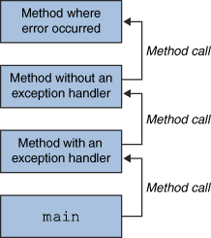
Throwing and catching
At any time, your program has an active call stack of methods.
When an exception is thrown, the
JVM looks up the call stack until
it finds a method with a
matching catch block for it.
  If one is found, control jumps
  back to that method.
  If none is found, the program crashes.
Exceptions allow non-local error handling.
  A method many levels up the stack can handle a deep error.

Slide 10
Catch, and then what?
  public void process(String str) {
  int n;
  try {
  n = Integer.parseInt(str);
  } catch (NumberFormatException nfe) {
  System.out.println("Invalid number: " + str);
  }
  ...
Possible ways to handle an exception:
  retry the operation that failed
  re-prompt the user for new input
  print a nice error message
  quit the program
  do nothing (!) (why? when?)

Slide 11
Exception methods
All exception objects have these methods:
  try {
  readFile();
  } catch (IOException e) {
  System.out.println("I/O error: " + e.getMessage());
  }
Method | Description
public String getMessage() | text describing the error
public String toString() | exception's type and description
getCause(), getStackTrace(), printStackTrace() | other methods

Slide 12
Design and exceptions
Effective Java Tip #57:
Use exceptions only for exceptional conditions.
  The author of the Integer.parseInt method got this wrong.
  Strings that are not legal as ints are common (not "exceptional").
    (What should they have done instead?)
  // Can we avoid this one? Not really. :-(
  int n;
  try {
  n = Integer.parseInt(str);
  } catch (NumberFormatException nfe) {
  n = -1;
  }

Slide 13

Ignoring exceptions
Effective Java Tip #65: Don't ignore exceptions.
  An empty catch block is (a common) poor style.
    often done to get code to compile or hide an error
  try {
  readFile(filename);
  } catch (IOException e) {} // do nothing on error
  At a minimum, print out the exception so you know it happened.
  } catch (IOException e) {
  e.printStackTrace(); // just in case
  }

Slide 14
Catch multiple exceptions
  try {
  statement(s);
  } catch (type1 name) {
  code to handle the exception
  } catch (type2 name) {
  code to handle the exception
  ...
  } catch (typeN name) {
  code to handle the exception
  }
  You can catch more than one kind of exception in the same code.
  When an exception is thrown, the matching catch block (if any) is used.
  If multiple catch blocks match, the most specific match is chosen.

Slide 15
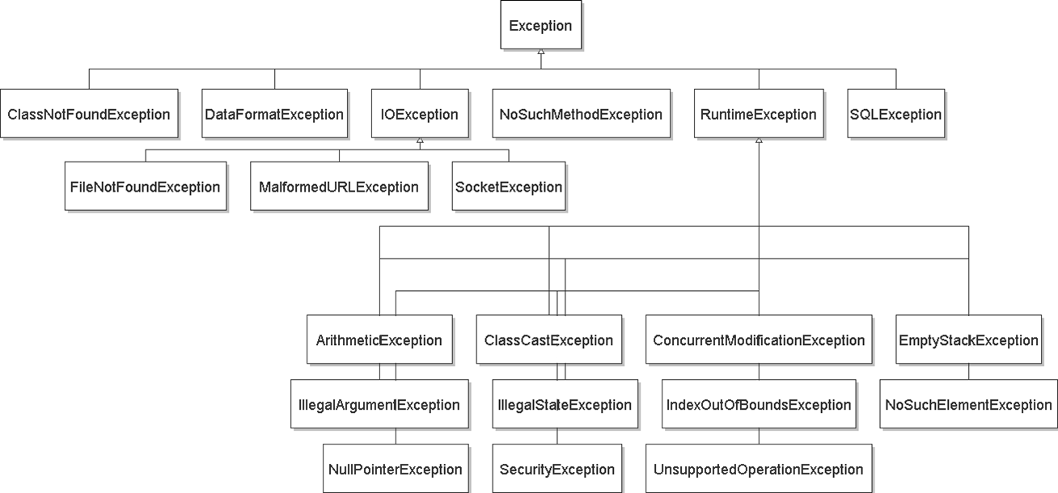
Exception inheritance
All exceptions extend from a common superclass Exception

Slide 16
Some common exceptions
ArithmeticException
BufferOverflowException
ClassCastException
ClassNotFoundException
CloneNotSupportedException
ConcurrentModificationException
EmptyStackException
IllegalArgumentException
IllegalStateException
IndexOutOfBoundsException
InterruptedException
IOException
  EOFException, FileNotFoundException, InterruptedIOException, MalformedURLException, ...
  ... NotSerializableException, SocketException, SSLException, UnknownHostException, ZipException
JarException
MalformedURLException
NegativeArraySizeException
NoSuchElementException
NullPointerException
ProtocolException
RuntimeException
SecurityException
UnknownElementException
UnsupportedOperationException
see also:
http://mindprod.com/jgloss/exception.html

Slide 17
Inheritance and exceptions
You can catch a general exception to handle any subclass:
  try {
  Scanner input = new Scanner(new File("foo"));
  System.out.println(input.nextLine());
  } catch (Exception e) {
  System.out.println("File was not found.");
  }
Similarly, you can state that a method throws any exception:
  public void foo() throws Exception { ...
  Are there any disadvantages of doing so?

Slide 18
Catching with inheritance
  try {
  statement(s);
  } catch (FileNotFoundException fnfe) {
  code to handle the file not found exception
  } catch (IOException ioe) {
  code to handle any other I/O exception
  } catch (Exception e) {
  code to handle any other exception
  }
  a SocketException would match the second block
  an ArithmeticException would match the third block

Slide 19
Who should catch it?
The code that is able to handle the error properly should be the code that catches the exception.
  Sometimes this is not the top method on the stack.
Example:
  main → showGUI() → click() → readFile() → FileNotFoundException!
    Which method should handle the exception, and why?
  main → new PokerGame() → new Player() → loadHistory() → Integer.parseInt() -> NumberFormatException
    Which method should handle the exception, and why?

Slide 20
Throwing an exception
throw new ExceptionType("message");
It is common practice to throw exceptions on unexpected errors.
  public void deposit(double amount) {
  if (amount < 0.0) {
  throw new IllegalArgumentException();
  }
  balance += amount;
  }
  Why throw rather than just ignoring the negative value?
    Why not return a special error code, such as -1 or false?

Slide 21
Good throwing style
An exception can accept a String parameter for a message describing what went wrong.
  This is the string returned by getMessage in a catch block.
  public void deposit(double amount) {
  if (amount < 0.0) {
  throw new IllegalArgumentException(
  "negative deposit: " + amount);
  }
  balance += amount;
  }
EJ Tip #63: Include failure-capture information in detail messages.
  Tell the caller what went wrong, to help them fix the problem.

Slide 22
Commenting exceptions
If your method throws, always explain this in the comments.
  State the types of exceptions thrown and under what conditions.
  // Places the given amount of money into this account.
  // Throws an IllegalArgumentException on negative deposits.
  public void deposit(double amount) {
  if (amount < 0.0) {
  throw new IllegalArgumentException(
  "negative deposit: " + amount);
  }
  balance += amount;
  }
EJ Tip #62: Document all exceptions thrown by each method.
  The client must know this in order to avoid or catch the exceptions.

Slide 23
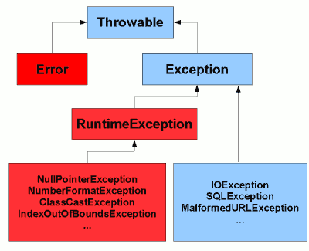
Checked exceptions
Java has two major kinds of exceptions:
  checked exceptions: Ones that MUST be handled by a try/catch block (or throws clause) or else the program will not compile.
    Meant for serious problems that the caller ought to deal with.
    Subclasses of Exception in the inheritance tree.
  runtime exceptions: Ones that don't have to be
  handled; if not handled, the program halts.
    Meant for smaller errors or programmer errors.
    Subclasses of RuntimeException in the tree.
    Mistakes that could have been avoided by a test.
      check for null or 0, check if a file exists, check array's bounds, ...

Slide 24
The throws clause
  public type name(parameters) throws type {
A clause in a method header claiming it may cause an exception.
  Needed when a method may throw an uncaught checked exception.
  public void processFile(String filename)
  throws FileNotFoundException {
  The above means one of two possibilities:
    processFile itself might throw an exception.
    processFile might call some sub-method that throws an exception, and it is choosing not to catch it (rather, to re-throw it out to the caller).

Slide 25
Writing an exception class
EJ Tip #61: Throw exceptions appropriate to the abstraction.
  When no provided exception class is quite right for your app's kind of error, you should write your own Exception subclass.
  // Thrown when the user tries to play after the game is over.
  public class GameOverException extends RuntimeException {
  private String winner;
  public GameOverException(String message, String winner) {
  super(message);
  this.winner = winner;
  }
  public String getWinner() {
  return winner;
  }
  }
  // in Game class...
  if (!inProgress()) {
  throw new GameOverException("Game already ended", winner);

Slide 26
Checked exceptions suck!
EJ Tip #59: Avoid unnecessary use of checked exceptions.
  Checked exceptions are (arguably) a wart in the Java language.
  It should be the client's decision whether or not to catch exceptions.
  When writing your own exception classes, extend RuntimeException so that it doesn't need to be caught unless the client wants to do so.
    Some cases still require throwing checked exceptions (e.g. file I/O)
  public void play() throws Exception { // no
  public void play() throws RuntimeException { // better
  public void play() throws MP3Exception { // best
  public class MP3Exception extends RuntimeException { ... }

Slide 27
Problem: redundant code
  public void process(OutputStream out) {
  try {
  // read from out; might throw
  ...
  out.close();
  } catch (IOException e) {
  out.close();
  System.out.println("Caught IOException: "
  + e.getMessage());
  }
  }
  The close code appears redundantly in both places.
  Can't move it out below the try/catch block because close itself could throw an IOException.

Slide 28
The finally block
  try {
  statement(s);
  } catch (type name) {
  code to handle the exception
  } finally {
  code to run after the try or catch finishes
  }
  finally is often used for common "clean-up" code.
  try {
  // ... read from out; might throw
  } catch (IOException e) {
  System.out.println("Caught IOException: "
  + e.getMessage());
  } finally {
  out.close();
  }
    The catch block is optional; try/finally is also legal.

Slide 29
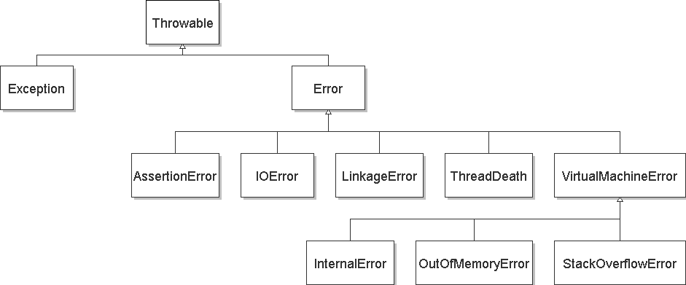
Exceptions and errors
There are also Errors, which represent serious Java problems.
  Error and Exception have common superclass Throwable.
  You can catch an Error (but you probably shouldn't)

Slide 30
Common errors
AbstractMethodError
AWTError
ClassFormatError
ExceptionInInitializerError
IllegalAccessError
InstantiationError
InternalError
LinkageError
NoClassDefFoundError
NoSuchFieldError
NoSuchMethodError
OutOfMemoryError
ServerError
StackOverflowError
UnknownError
UnsatisfiedLinkError
UnsupportedClassVersionError
VerifyError
VirtualMachineError

Slide 31
Logical Assertions
(assert)

Slide 32
Assertions in Java
  assert condition ;
  assert condition : message;
enabling assertions
  java -enableassertions ClassName
  (or tell your editor/IDE to enable them)
    Assertion code is zero-cost when disabled; very important!
  In C/C++, assert is a compile-time thing.
  In Java, you can selectively en/disable assertions at runtime.

Slide 33
Assert statement example
// Returns index of n in a, or -1 if not found.
// precondition: a is in sorted order.
public static int binarySearch(int[] a, int n) {
assert isSorted(a) : "Array must be sorted";
...
}
// Returns true if the given array is sorted.
public static boolean isSorted(int[] a) {
for (int i = 0; i < a.length - 1; i++) {
if (a[i] > a[i + 1]) {
return false;
}
}
return true;
}

Slide 34
Enumerated Types
(enum)

Slide 35
Anti-pattern: int constants
  public class Card {
  public static final int CLUBS = 0;
  public static final int DIAMONDS = 1;
  public static final int HEARTS = 2;
  public static final int SPADES = 3;
  ...
  private int suit;
  ...
  public void setSuit(int suit) {
  this.suit = suit;
  }
  }
What's wrong with using int constants to represent suits?
  variation (also bad): using Strings for the same purpose.

Slide 36
Enumerated types
enum: A type of objects with a fixed set of constant values.
  public enum Name {
  VALUE, VALUE, ..., VALUE
  }
    Usually placed into its own .java file.
    C has enums that are really ints; Java's are objects.
  public enum Suit {
  CLUBS, DIAMONDS, HEARTS, SPADES
  }
Effective Java Tip: Use enums instead of int constants.
  "The advantages of enum types over int constants are compelling. Enums are far more readable, safer, and more powerful."

Slide 37
What is an enum?
The preceding enum is roughly equal to the following short class:
  public final class Suit extends Enum<Suit> {
  public static final Suit CLUBS = new Suit();
  public static final Suit DIAMONDS = new Suit();
  public static final Suit HEARTS = new Suit();
  public static final Suit SPADES = new Suit();
  private Suit() {} // no more can be made
  }

Slide 38
What can an enum do?
use it as the type of a variable, field, parameter, or return
  public class Card {
  private Suit suit;
  ...
  }
compare them with == (why don't we need to use equals?)
  if (suit == Suit.CLUBS) { ...
compare them with compareTo (by order of declaration)
  public int compareTo(Card other) {
  if (suit != other.suit) {
  return suit.compareTo(other.suit);
  } ...
  }

Slide 39
Enum methods
method | description
int compareTo(E) | all enum types are Comparable by order of declaration
boolean equals(o) | not needed; can just use ==
String name() | equivalent to toString
int ordinal() | returns an enum's 0-based number by order of declaration (first is 0, then 1, then 2, ...)
method | description
static E valueOf(s) | converts a string into an enum value
static E[] values() | an array of all values of your enumeration

Slide 40
More complex enums
An enumerated type can have fields, methods, and constructors:
  public enum Coin {
  PENNY(1), NICKEL(5), DIME(10), QUARTER(25);
  private int cents;
  private Coin(int cents) {
  this.cents = cents;
  }
  public int getCents() { return cents; }
  public int perDollar() { return 100 / cents; }
  public String toString() { // "NICKEL (5c)"
  return super.toString() + " (" + cents + "c)";
  }
  }

Slide 41
Packages

Slide 42
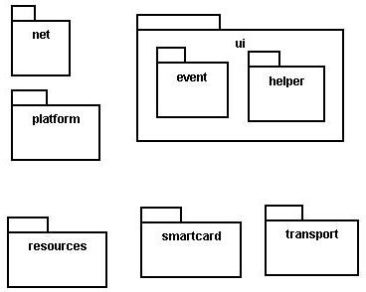
Java packages
package: A collection of related classes.
  Can also "contain" sub-packages.
  Sub-packages can have similar names,
  but are not actually contained inside.
    java.awt does not contain java.awt.event
Uses of Java packages:
  group related classes together
  as a namespace to avoid name collisions
  provide a layer of access / protection
  keep pieces of a project down to a manageable size

Slide 43

Packages and directories
package ←→ directory (folder)
class ←→ file
A class named D in package a.b.c should reside in this file:
a/b/c/D.class
  (relative to the root of your project)
The "root" directory of the package hierarchy is determined by your class path or the directory from which java was run.

Slide 44
Classpath
class path: The location(s) in which Java looks for class files.
Can include:
  the current "working directory" from which you ran javac / java
  other folders
  JAR archives
  URLs
  ...
Can set class path manually when running java at command line:
  java -cp /home/stepp/libs:/foo/bar/jbl MyClass

Slide 45
A package declaration
package name;
public class name { ...
Example:
package pacman.model;
public class Ghost extends Sprite {
...
}
File Sprite.java should go in folder pacman/model .

Slide 46
Importing a package
import packageName.*; // all classes
Example:
package pacman.gui;
import pacman.model.*;
public class PacManGui {
...
Ghost blinky = new Ghost();
}
PacManGui must import the model package in order to use it.

Slide 47
Importing a class
import packageName.className; // one class
Example:
package pacman.gui;
import pacman.model.Sprite;
public class PacManGui {
Ghost blinky = new Ghost();
}
Importing single classes has high precedence:
  if you import .*, a same-named class in the current dir will override
  if you import .className, it will not

Slide 48
Static import
import static packageName.className.*;
Example:
import static java.lang.Math.*;
...
double angle = sin(PI / 2) + ln(E * E);
Static import allows you to refer to the members of another class without writing that class's name.
Should be used rarely and only with classes whose contents are entirely static "utility" code.

Slide 49
Referring to packages
packageName.className
Example:
java.util.Scanner console =
new java.util.Scanner(java.lang.System.in);
You can use a type from any package without importing it if you write its full name.
Sometimes this is useful to disambiguate similar names.
  Example: java.awt.List and java.util.List
  Or, explicitly import one of the classes.

Slide 50
The default package
Compilation units (files) that do not declare a package are put into a default, unnamed, package.
Classes in the default package:
  Cannot be imported
  Cannot be used by classes in other packages
Many editors discourage the use of the default package.
Package java.lang is implicitly imported in all programs by default.
  import java.lang.*;

Slide 51
Package access
Java provides the following access modifiers:
  public : Visible to all other classes.
  private : Visible only to current class (and any nested types).
  protected : Visible to the current class, any of its subclasses, and any other types within the same package.
  default (package): Visible to the current class and any other types within the same package.
To give a member default scope, do not write a modifier:
  package pacman.model;
  public class Sprite {
  int points; // visible to pacman.model.*
  String name; // visible to pacman.model.*

