Slide 1
Building Java Programs
Chapter 14
Stacks and Queues
Copyright (c) Pearson 2013.
All rights reserved.

Slide 2
Runtime Efficiency (13.2)
efficiency: A measure of the use of computing resources by code.
  can be relative to speed (time), memory (space), etc.
  most commonly refers to run time
Assume the following:
  Any single Java statement takes the same amount of time to run.
  A method call's runtime is measured by the total of the statements inside the method's body.
  A loop's runtime, if the loop repeats N times, is N times the runtime of the statements in its body.

Slide 3
ArrayList methods
Which operations are most/least efficient, and why?
add(value) | appends value at end of list
add(index, value) | inserts given value at given index, shifting subsequent values right
clear() | removes all elements of the list
indexOf(value) | returns first index where given value is found in list (-1 if not found)
get(index) | returns the value at given index
remove(index) | removes/returns value at given index, shifting subsequent values left
set(index, value) | replaces value at given index with given value
size() | returns the number of elements in list
toString() | returns a string representation of the list such as "[3, 42, -7, 15]"

Slide 4
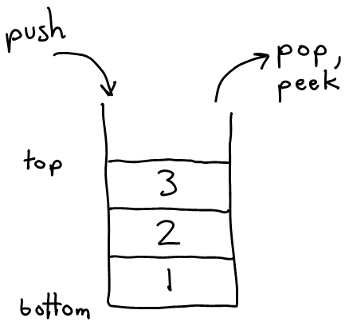
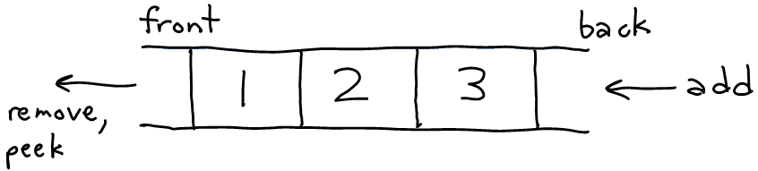
Stacks and queues
Sometimes it is good to have a collection that is less powerful, but is optimized to perform certain operations very quickly.
Today we will examine two specialty collections:
  stack: Retrieves elements in the reverse of the order they were added.
  queue: Retrieves elements in the same order they were added.
queue
stack

Slide 5
Abstract data types (ADTs)
abstract data type (ADT): A specification of a collection of data and the operations that can be performed on it.
  Describes what a collection does, not how it does it
We don't know exactly how a stack or queue is implemented, and we don't need to.
  We just need to understand the idea of the collection and what operations it can perform.
  (Stacks are usually implemented with arrays; queues are often implemented using another structure called a linked list.)

Slide 6
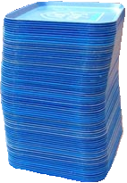
Stacks
stack: A collection based on the principle of adding elements and retrieving them in the opposite order.
  Last-In, First-Out ("LIFO")
  The elements are stored in order of insertion,
  but we do not think of them as having indexes.
  The client can only add/remove/examine
  the last element added (the "top").
basic stack operations:
  push: Add an element to the top.
  pop: Remove the top element.
  peek: Examine the top element.
Notes:
analogy: trays of food at the sizzler

Slide 7
Stacks in computer science
Programming languages and compilers:
  method calls are placed onto a stack (call=push, return=pop)
  compilers use stacks to evaluate expressions
Matching up related pairs of things:
  find out whether a string is a palindrome
  examine a file to see if its braces { } and other operators match
  convert "infix" expressions to "postfix" or "prefix"
Sophisticated algorithms:
  searching through a maze with "backtracking"
  many programs use an "undo stack" of previous operations
method3 | return var local vars parameters
method2 | return var local vars parameters
method1 | return var local vars parameters

Slide 8
Class Stack
  Stack<Integer> s = new Stack<Integer>();
  s.push(42);
  s.push(-3);
  s.push(17); // bottom [42, -3, 17] top
  System.out.println(s.pop()); // 17
  Stack has other methods, but we forbid you to use them.
Stack<E>() | constructs a new stack with elements of type E
push(value) | places given value on top of stack
pop() | removes top value from stack and returns it; throws EmptyStackException if stack is empty
peek() | returns top value from stack without removing it; throws EmptyStackException if stack is empty
size() | returns number of elements in stack
isEmpty() | returns true if stack has no elements

Slide 9
Stack limitations/idioms
Remember: You cannot loop over a stack in the usual way.
  Stack<Integer> s = new Stack<Integer>();
  ...
  for (int i = 0; i < s.size(); i++) {
  do something with s.get(i);
  }
Instead, you must pull contents out of the stack to view them.
  common idiom: Removing each element until the stack is empty.
  while (!s.isEmpty()) {
  do something with s.pop();
  }

Slide 10
Exercise
Consider an input file of exam scores in reverse ABC order:
  Yeilding Janet 87
  White Steven 84
  Todd Kim 52
  Tashev Sylvia 95
  ...
Write code to print the exam scores in ABC order using a stack.
  What if we want to further process the exams after printing?
Notes:
notion of looping over a collection while modifying it
notion of not destroying a stack while examining it (write 1st version that destroys stack, 2nd version puts it back)

Slide 11
What happened to my stack?
Suppose we're asked to write a method max that accepts a Stack of integers and returns the largest integer in the stack.
  The following solution is seemingly correct:
  // Precondition: s.size() > 0
  public static void max(Stack<Integer> s) {
  int maxValue = s.pop();
  while (!s.isEmpty()) {
  int next = s.pop();
  maxValue = Math.max(maxValue, next);
  }
  return maxValue;
  }
  The algorithm is correct, but what is wrong with the code?

Slide 12
What happened to my stack?
The code destroys the stack in figuring out its answer.
  To fix this, you must save and restore the stack's contents:
  public static void max(Stack<Integer> s) {
  Stack<Integer> backup = new Stack<Integer>();
  int maxValue = s.pop();
  backup.push(maxValue);
  while (!s.isEmpty()) {
  int next = s.pop();
  backup.push(next);
  maxValue = Math.max(maxValue, next);
  }
  while (!backup.isEmpty()) {
  s.push(backup.pop());
  }
  return maxValue;
  }

Slide 13
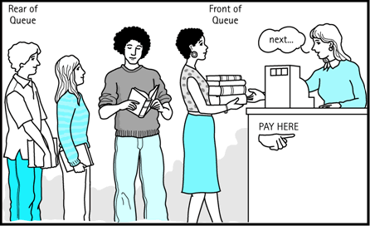
Queues
queue: Retrieves elements in the order they were added.
  First-In, First-Out ("FIFO")
  Elements are stored in order of
  insertion but don't have indexes.
  Client can only add to the end of the
  queue, and can only examine/remove
  the front of the queue.
basic queue operations:
  add (enqueue): Add an element to the back.
  remove (dequeue): Remove the front element.
  peek: Examine the front element.
Notes:
analogy: trays of food at the sizzler

Slide 14
Queues in computer science
Operating systems:
  queue of print jobs to send to the printer
  queue of programs / processes to be run
  queue of network data packets to send
Programming:
  modeling a line of customers or clients
  storing a queue of computations to be performed in order
Real world examples:
  people on an escalator or waiting in a line
  cars at a gas station (or on an assembly line)

Slide 15
Programming with Queues
  Queue<Integer> q = new LinkedList<Integer>();
  q.add(42);
  q.add(-3);
  q.add(17); // front [42, -3, 17] back
  System.out.println(q.remove()); // 42
  IMPORTANT: When constructing a queue you must use a new LinkedList object instead of a new Queue object.
    This has to do with a topic we'll discuss later called interfaces.
add(value) | places given value at back of queue
remove() | removes value from front of queue and returns it; throws a NoSuchElementException if queue is empty
peek() | returns front value from queue without removing it; returns null if queue is empty
size() | returns number of elements in queue
isEmpty() | returns true if queue has no elements

Slide 16
Queue idioms
As with stacks, must pull contents out of queue to view them.
  while (!q.isEmpty()) {
  do something with q.remove();
  }
  another idiom: Examining each element exactly once.
  int size = q.size();
  for (int i = 0; i < size; i++) {
  do something with q.remove();
  (including possibly re-adding it to the queue)
  }
    Why do we need the size variable?
Notes:
examining each element once is like

Slide 17
Mixing stacks and queues
We often mix stacks and queues to achieve certain effects.
  Example: Reverse the order of the elements of a queue.
  Queue<Integer> q = new LinkedList<Integer>();
  q.add(1);
  q.add(2);
  q.add(3); // [1, 2, 3]
  Stack<Integer> s = new Stack<Integer>();
  while (!q.isEmpty()) { // Q -> S
  s.push(q.remove());
  }
  while (!s.isEmpty()) { // S -> Q
  q.add(s.pop());
  }
  System.out.println(q); // [3, 2, 1]

Slide 18
Exercise
Modify our exam score program so that it reads the exam scores into a queue and prints the queue.
  Next, filter out any exams where the student got a score of 100.
  Then perform your previous code of reversing and printing the remaining students.
    What if we want to further process the exams after printing?
Notes:
You wouldn't want me to just throw your exam in the garbage as I read it, would you?

Slide 19
Exercises
Write a method stutter that accepts a queue of integers as a parameter and replaces every element of the queue with two copies of that element.
  front [1, 2, 3] back
  becomes
  front [1, 1, 2, 2, 3, 3] back
Write a method mirror that accepts a queue of strings as a parameter and appends the queue's contents to itself in reverse order.
  front [a, b, c] back
  becomes
  front [a, b, c, c, b, a] back

Slide 20
Stack/queue exercise
A postfix expression is a mathematical expression but with the operators written after the operands rather than before.
  1 + 1 becomes 1 1 +
  1 + 2 * 3 + 4 becomes 1 2 3 * + 4 +
  supported by many kinds of fancy calculators
  never need to use parentheses
  never need to use an = character to evaluate on a calculator
Write a method postfixEvaluate that accepts a postfix expression string, evaluates it, and returns the result.
  All operands are integers; legal operators are + , -, *, and /
  postFixEvaluate("5 2 4 * + 7 -") returns 6

Slide 21
Postfix algorithm
The algorithm: Use a stack
  When you see an operand, push it onto the stack.
  When you see an operator:
    pop the last two operands off of the stack.
    apply the operator to them.
    push the result onto the stack.
  When you're done, the one remaining stack element is the result.
  "5 2 4 * + 7 -"
5
5
2
2
5
4
4
2
5
*
8
5
+
13
7
7
13
-
6

Slide 22
Exercise solution
// Evaluates the given prefix expression and returns its result.
// Precondition: string represents a legal postfix expression
public static int postfixEvaluate(String expression) {
Stack<Integer> s = new Stack<Integer>();
Scanner input = new Scanner(expression);
while (input.hasNext()) {
if (input.hasNextInt()) { // an operand (integer)
s.push(input.nextInt());
} else { // an operator
String operator = input.next();
int operand2 = s.pop();
int operand1 = s.pop();
if (operator.equals("+")) {
s.push(operand1 + operand2);
} else if (operator.equals("-")) {
s.push(operand1 - operand2);
} else if (operator.equals("*")) {
s.push(operand1 * operand2);
} else {
s.push(operand1 / operand2);
}
}
}
return s.pop();
}

Slide 23
Stack/queue motivation
Sometimes it is good to have a collection that is less powerful, but is optimized to perform certain operations very quickly.
Stacks and queues do few things, but they do them efficiently.
stack
queue

