Slide 2
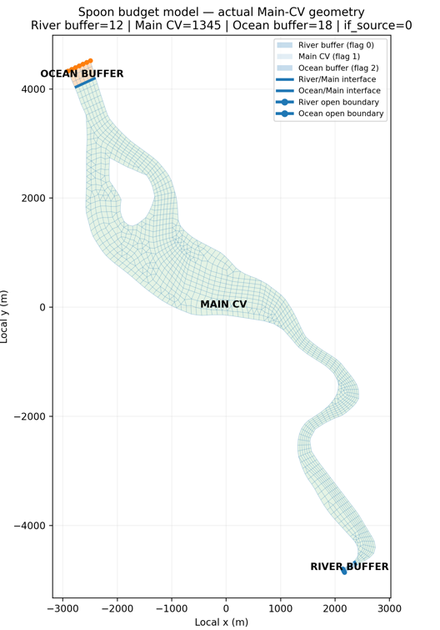
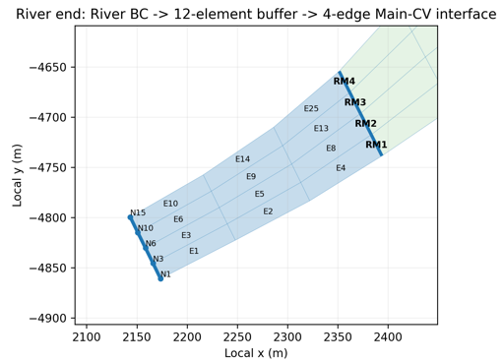
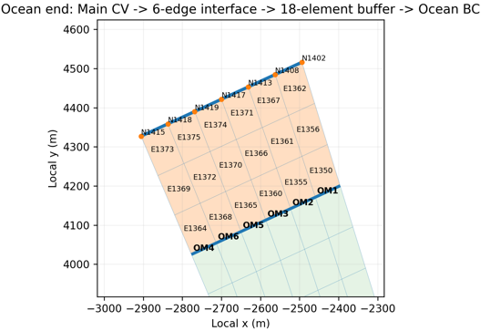
Main Control Volume (MainCV): Green area?
Whole domain: Main CV + Ocean buffer + river buffer

Slide 3
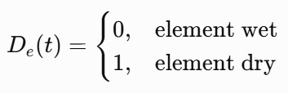


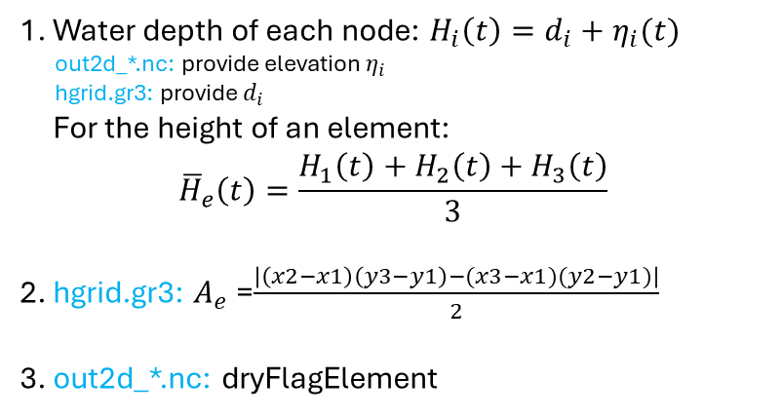










LHS
RHS
Domain integration
=
Flux analysis
?
ΔVdomain = V(tend) − V(tbegin)
LHS: Domain integration:
[$m^{3}$]
LHS-1: SCHISM node-based storage
surface
[$m$]
1. Water depth of each node: $H_{i}\left(t\right)=d_{i}+η_{i}(t)$
out2d_*.nc: provide elevation $η_{i}$
hgrid.gr3: provide $d_{i}$
For the height of an element:
$${\overline{H}}_{e}\left(t\right)=\frac{H_{1}\left(t\right)+H_{2}\left(t\right)+H_{3}\left(t\right)}{3}$$
2. hgrid.gr3: $A_{e}$​=$\frac{\left|\left(x2−x1\right)\left(y3−y1\right)−(x3−x1)(y2−y1)\right|}{2}$
3. out2d_*.nc: dryFlagElement
Node 1
(x1,y1)
Node 2
Node 3
(x2,y2)
(x3,y3)
[$m$]
$$A_{e}$$
[$m^{2}$]
(* $A_{e}$ is area of the element)
bottom
(* $D_{e}$is element dry mask)
[$m^{3}$]
$$∆V_{domain}=V_{domain}(t_{end})−V_{domain}(t_{begin})$$
$$V_{e}\left(t\right)=(1−D_{e}\left(t\right))×A_{e}×\frac{H_{1}\left(t\right)+H_{2}\left(t\right)+H_{3}\left(t\right)}{3}$$
4.
[$m^{3}$]
$$V_{domain}\left(t\right)=\sum_{e=1}^{N_{e}}{V_{e}\left(t\right)}$$
5.
[$m^{3}$]
* $N_{e}$ is number of element

Slide 4
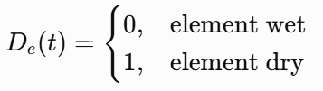




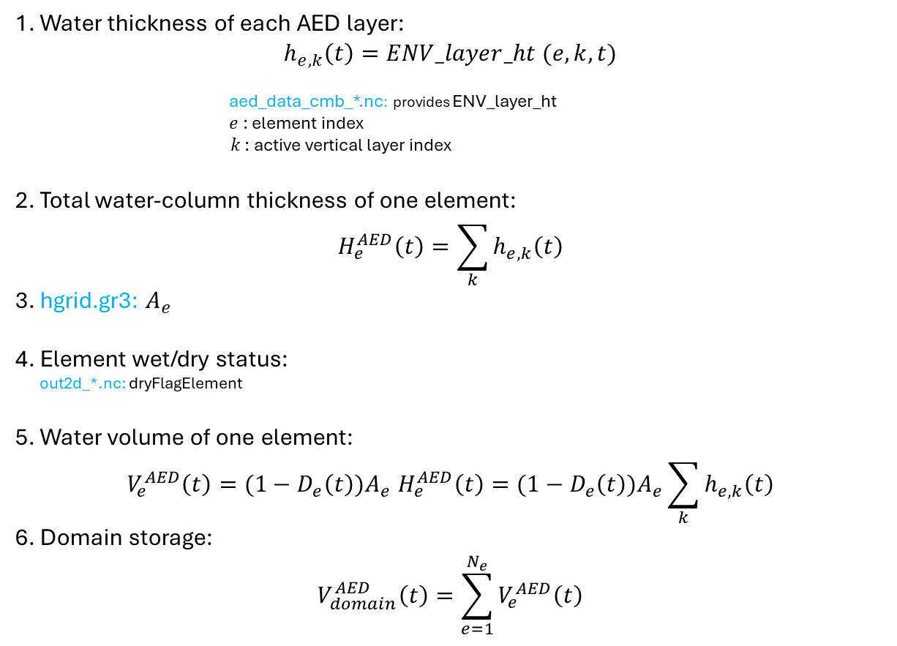







ΔVdomain = V(tend) − V(tbegin)
LHS: Domain integration:
[$m^{3}$]
LHS-2: AED element-layer storage
surface
1. Water thickness of each AED layer:
$$h_{e,k}\left(t\right)=ENV_layer_ht (e,k,t)$$
aed_data_cmb_*.nc: provides ENV_layer_ht
$e$: element index
$k$: active vertical layer index
2. Total water-column thickness of one element:
$$H_{e}^{AED}\left(t\right)=\sum_{k}{h_{e,k}\left(t\right)}$$
3. hgrid.gr3: $A_{e}$
4. Element wet/dry status:
out2d_*.nc: dryFlagElement
5. Water volume of one element:
$$V_{e}^{AED}\left(t\right){=(1−D_{e}\left(t\right))A}_{e}H_{e}^{AED}\left(t\right)=(1−D_{e}\left(t\right))A_{e}\sum_{k}{h_{e,k}\left(t\right)}$$
6. Domain storage:
$$V_{domain}^{AED}\left(t\right)=\sum_{e=1}^{N_{e}}{V_{e}^{AED}\left(t\right)}$$
[$m$]
k1
Element $e$
k2
$$A_{e}$$
k3
[$m$]
bottom
[$m^{2}$]
*same $A_{e}$ as LHS-1
$∆V_{domain}^{AED}=$ $V_{domain}^{AED}\left(t_{end}\right)− V_{domain}^{AED}\left(t_{begin}\right)$
[$m^{3}$]
[$m^{3}$]
[$m^{3}$]
* $N_{e}$ is number of element in the domain

Slide 5
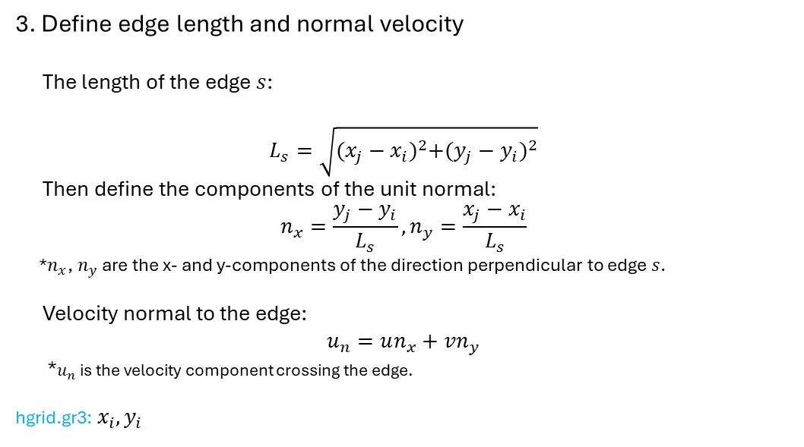


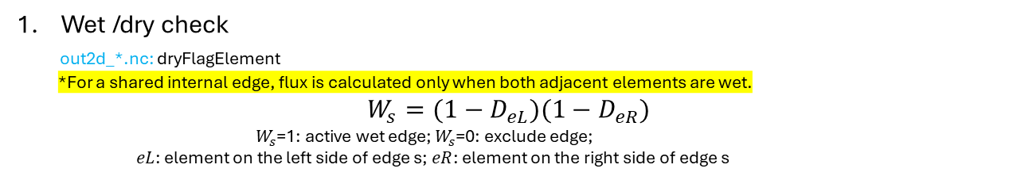




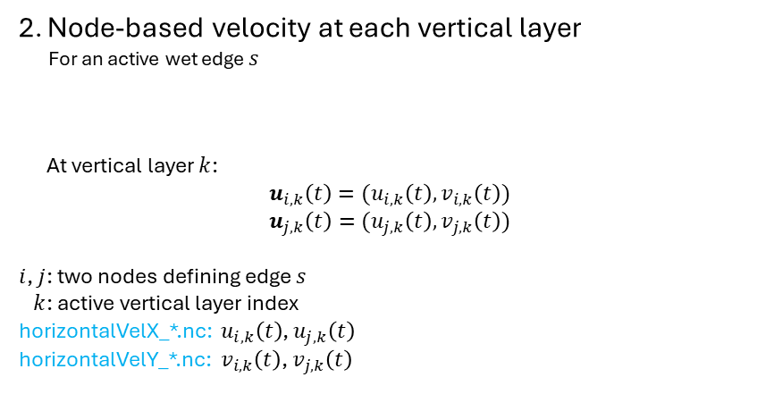

LHS
RHS
Domain integration
=
Flux analysis
?
RHS-Method B: Node-based reconstruction of edge-layer water flux
Wet /dry check
out2d_*.nc: dryFlagElement
*For a shared internal edge, flux is calculated only when both adjacent elements are wet.
$$W_{s}=(1−D_{eL})(1−D_{eR})$$
$W_{s}$=1: active wet edge; $W_{s}$=0: exclude edge;
$eL$: element on the left side of edge s; $eR$: element on the right side of edge s
3. Define edge length and normal velocity
The length of the edge $s$:
$$L_{s}=\sqrt{{(x_{j}−x_{i})}^{2}+{(y_{j}−y_{i})}^{2}}$$
Then define the components of the unit normal:
$$n_{x}=\frac{y_{j}−y_{i}}{L_{s}},n_{y}=\frac{x_{j}−x_{i}}{L_{s}}$$
*$n_{x}$, $n_{y}$ are the x- and y-components of the direction perpendicular to edge $s$.
Velocity normal to the edge:
$$u_{n}=un_{x}+vn_{y}$$
*$u_{n}$ is the velocity component crossing the edge.
hgrid.gr3: $x_{i},y_{i}$
Node $i$ ($x_{i},y_{i}$)
Node $j$
$$s$$
($x_{j},y_{j}$)
2. Node-based velocity at each vertical layer
For an active wet edge $s$
At vertical layer $k$:
$$u_{i,k}\left(t\right)=(u_{i,k}\left(t\right),v_{i,k}\left(t\right))$$
$$u_{j,k}\left(t\right)=(u_{j,k}\left(t\right),v_{j,k}\left(t\right))$$
$i$, $j$: two nodes defining edge $s$
$k$: active vertical layer index
horizontalVelX_*.nc: $u_{i,k}\left(t\right)$, $u_{j,k}\left(t\right)$
horizontalVelY_*.nc: $v_{i,k}\left(t\right)$, $v_{j,k}\left(t\right)$
Node $i$
Node $j$
$$s$$

Slide 6
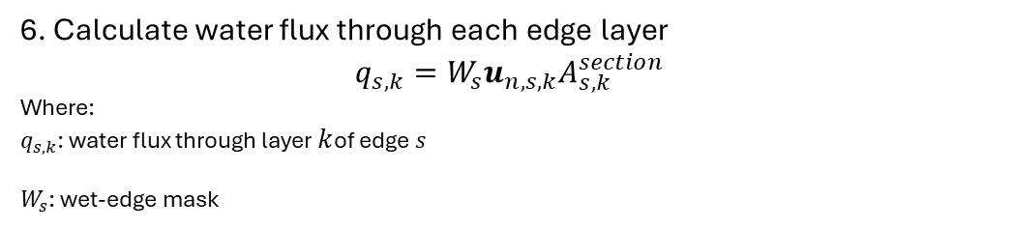


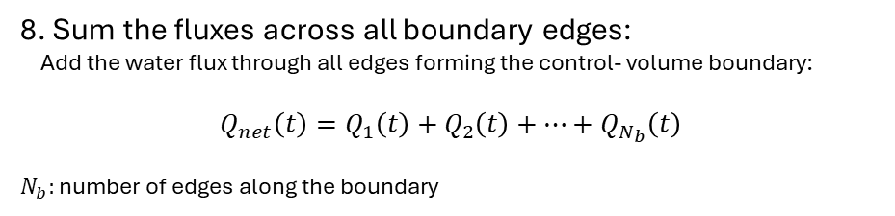
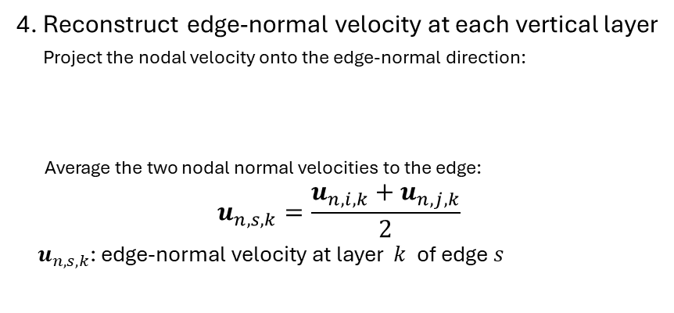


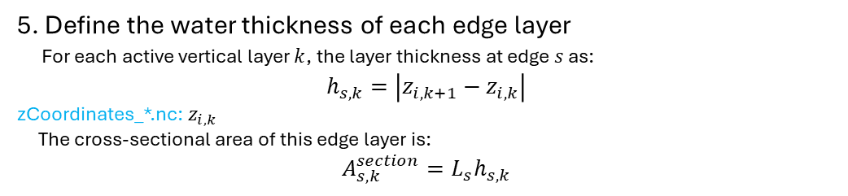

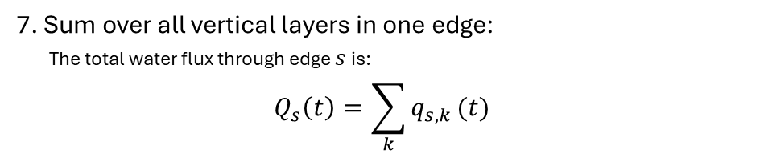


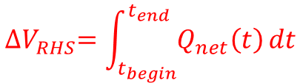
4. Reconstruct edge-normal velocity at each vertical layer
Project the nodal velocity onto the edge-normal direction:
Average the two nodal normal velocities to the edge:
$$u_{n,s,k}=\frac{u_{n,i,k}+u_{n,j,k}}{2}$$
$u_{n,s,k}$: edge-normal velocity at layer $k$ of edge $s$
7. Sum over all vertical layers in one edge:
The total water flux through edge $s$ is:
$$Q_{s}\left(t\right)=\sum_{k}{q_{s,k}}(t)$$
$$u_{n,i,k}=u_{i,k}n_{x}+v_{i,k}n_{y}$$
$$u_{n,j,k}=u_{j,k}n_{x}+v_{j,k}n_{y}$$
[$m^{3}/s$]
8. Sum the fluxes across all boundary edges:
Add the water flux through all edges forming the control- volume boundary:
$$Q_{net}\left(t\right)=Q_{1}\left(t\right)+Q_{2}\left(t\right)+…+Q_{N_{b}}\left(t\right)$$
$N_{b}:$ number of edges along the boundary
[$m/s$]
[$m^{3}/s$]
5. Define the water thickness of each edge layer
For each active vertical layer $k$, the layer thickness at edge $s$ as:
$$h_{s,k}=\left|z_{i,k+1}−z_{i,k}\right|$$
zCoordinates_*.nc: $z_{i,k}$
The cross-sectional area of this edge layer is:
$$A_{s,k}^{section}=L_{s}h_{s,k}$$
[$m$]
9. Integrate the flux over time
[$m^{2}$]
$${∆V}_{RHS}=\int_{t_{begin}}^{t_{end}}{Q_{net}\left(t\right)}dt$$
[$m^{3}$]
6. Calculate water flux through each edge layer
$$q_{s,k}=W_{s}u_{n,s,k}A_{s,k}^{section}$$
Where:
$q_{s,k}$: water flux through layer $k$of edge $s$
$W_{s}$: wet-edge mask
[$m^{3}/s$]

Slide 7
RHS – Method C: Native SCHISM interface flux
Define the control-volume regions
fluxflag.prop defines the element regions used by SCHISM for native flux accounting.
Region 0 = River buffer
Region 1 = Main control volume (Main CV)
Region 2 = Outside/Ocean
Region 0
River 2
River/main edge
Region 0
Region 0
Region 1
River 1
Main CV
River/main edge
Ocean
ocean/main edge

Slide 8
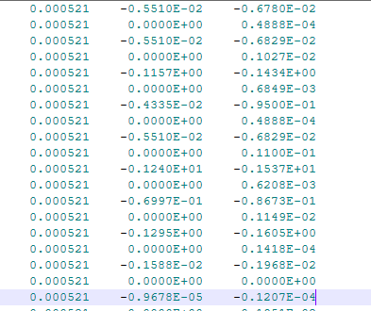








2. Read native interface flux from outputs/flux.out
Time
Region 0/1
Region 1/2
Volume NET
[$m^{3}/s$]
Volume positive
[$m^{3}/s$]
Volume negative
[$m^{3}/s$]
Heat transport-positive direction
[${\text{℃} ×m}^{3}/s$]
Heat transport-negative direction
[${\text{℃} ×m}^{3}/s$]
Salinity transport-positive direction
[${\text{P}SU ×m}^{3}/s$]
Salinity transport-negative direction
[${\text{P}SU ×m}^{3}/s$]
AED tracers
[${\text{tracer-}unit ×m}^{3}/s$]

Slide 9

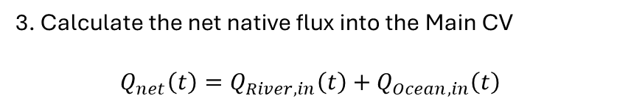

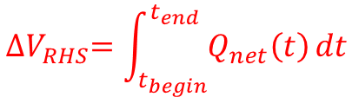
3. Calculate the net native flux into the Main CV
$$Q_{net}\left(t\right)=Q_{River,in}\left(t\right)+Q_{Ocean,in}\left(t\right)$$
[$m^{3}/s$]
4. Integrate over time
$${∆V}_{RHS}=\int_{t_{begin}}^{t_{end}}{Q_{net}\left(t\right)}dt$$
[$m^{3}$]

Slide 10






Whole Domain
Main CV
LHS (storage change)
RHS (flux analysis)
LHS (storage change)
RHS (flux analysis)
Method B
Method B
Method C
LHS-2: AED base (element)
Node-based reconstruction of edge-layer water flux (at external-boundary flux)
LHS-2: AED base (element)
Node-based reconstruction of edge-layer water flux (CV-interface flux)
LHS-1: node base
LHS-1: node base
Flux.out
$$∆V_LHS$$
$$∆V_RHS$$
$$∆V_LHS$$
$$∆V_RHS$$
$$=$$
$$=$$
Closure check
Closure check

