Slide 1
Sudoku Solver
Dongze Li

Slide 2
Contents
1. What is a Sudoku?
2. Why I implemented a Sudoku Solver?
3. How I implemented the Sudoku Solver?

Slide 3
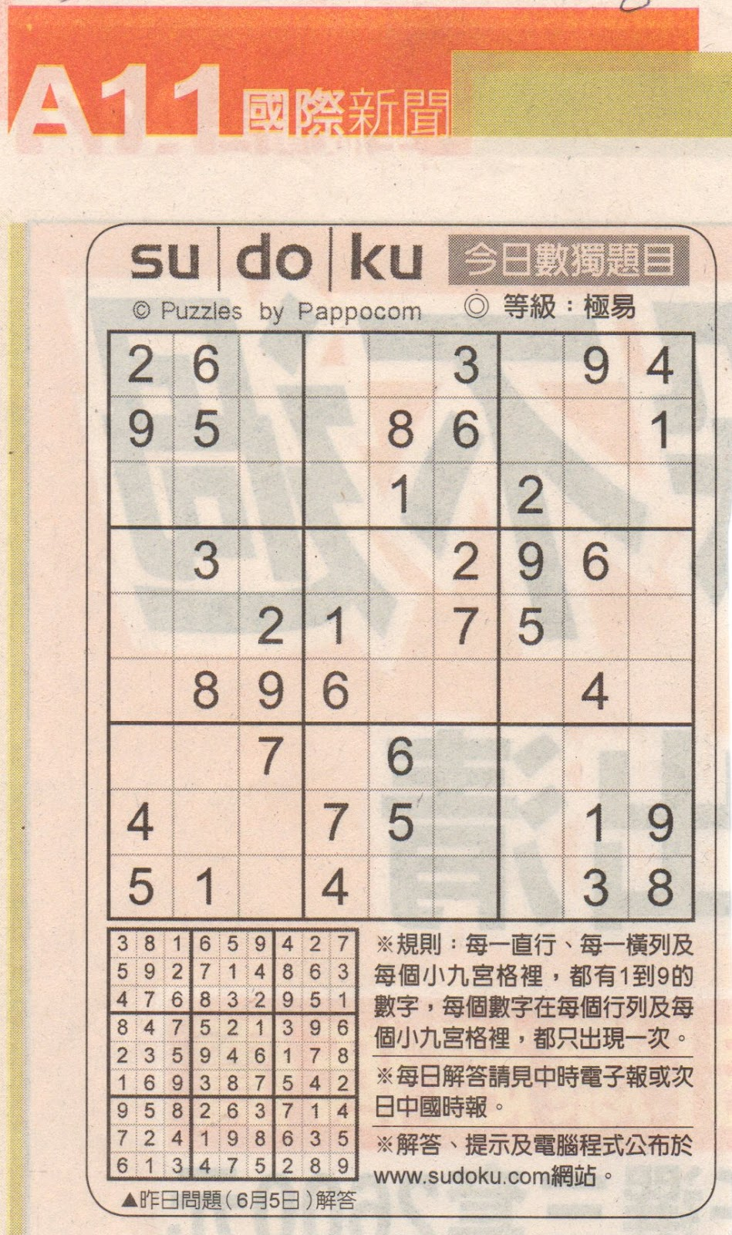
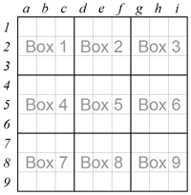
What is a Sudoku?

Slide 4

Why I implemented a Sudoku Solver?

Slide 5
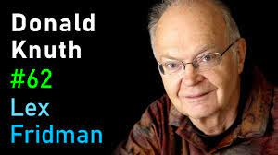
How I implemented the Sudoku Solver?
DLX:
Algorithm X
Dancing links

Slide 6
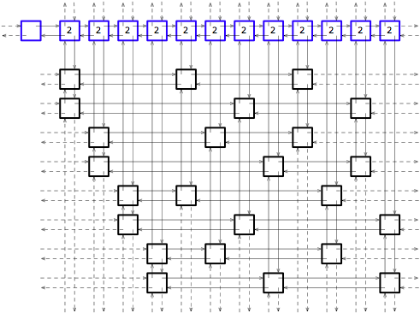

Slide 7
How I implemented the Sudoku Solver?
DLX
MVC:
SudokuModel
SudokuView
SudokuCommon

Slide 8
THANK YOU!

