Slide 1
Week 2 Class 1
Kinematics and Dynamics

Slide 2
Quadrotor: Reference Frame
The body frame and the inertial frame. A pair of motors (1 and 3) spins counterclockwise, while the other pair spins clockwise (2 and 4). The pitches on the corresponding propellers are reversed so that the thrust is always pointing in the b3 direction for all propellers. However, while the reaction moments on the frame of the robot are also in the vertical direction, the signs are such that they oppose the direction of the angular velocity of the propeller

Slide 3
Quadrotor: Hovering

Slide 4
Quadrotor: Basic Motions

Slide 5
Quadrotor: Basic Motions

Slide 6
Quadrotor: Basic Motions

Slide 7
Quadrotor: Basic Motions

Slide 8
Quadrotor State Variables

Slide 9
Quadrotor Kinematics: Translation

Slide 10
Quadrotor Kinematics: Rotation
?
?
?

Slide 11
Quadrotor Kinematics: Rotation

Slide 12
Quadrotor Dynamics: Translation
Newton’s 2nd Law
Apply equation of Coriolis
With and

Slide 13
Quadrotor Dynamics: Translation
Where
The equation is written in body frame.

Slide 14
Quadrotor Dynamics: Rotation
Euler’s 2nd Law
Apply equation of Coriolis

Slide 15
Quadrotor Dynamics: Rotation
Angular momentum
Where inertia matrix is given by

Slide 16
Quadrotor Dynamics: Rotation
Angular momentum
Where inertia matrix is given by

Slide 17
Quadrotor Dynamics: Rotation

Slide 18
Quadrotor Dynamics: Rotation
Tensor form
Where
The equation is written in body frame.

Slide 19
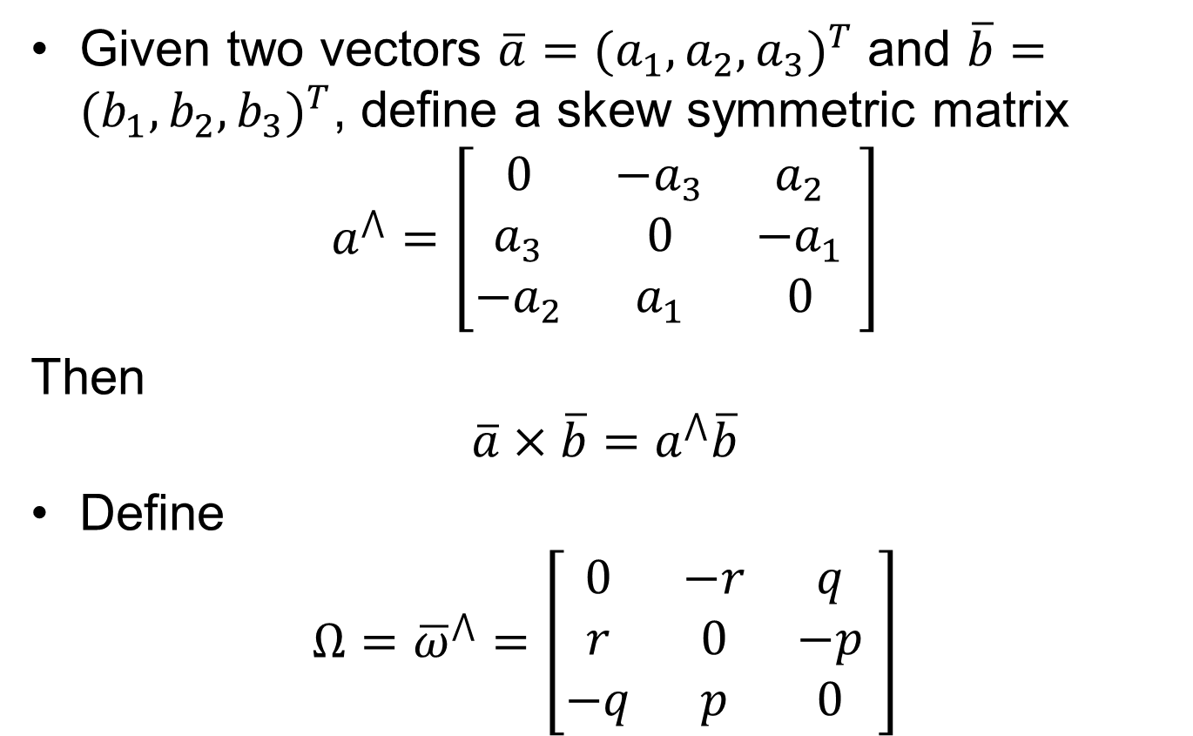
Tensor From
Given two vectors $\overline{a}=(a_{1},a_{2},a_{3})^{T}$ and $\overline{b}=(b_{1},b_{2},b_{3})^{T}$, define a skew symmetric matrix
$$a^{⋀}=\left[\begin{matrix}0 & −a_{3} & a_{2} \\ a_{3} & 0 & −a_{1} \\ {−a}_{2} & a_{1} & 0\end{matrix} \right]$$
Then
$$\overline{a}×\overline{b}=a^{⋀}\overline{b}$$
Define
$$Ω={\overline{ω}}^{⋀}=\left[\begin{matrix}0 & −r & q \\ r & 0 & −p \\ −q & p & 0\end{matrix} \right]$$

Slide 20
Quadrotor Kinematics and Dynamics

Slide 21
Material Covered
Section 2 of note “Quadrotor Dynamics and Control”

