Slide 1
Week 2 Class 2
Forces and Moments

Slide 2
Summary: Forces and Moments

Slide 3
Net Force

Slide 4
Torques
Rolling torque:
Pitching torque:
Yawing torque:

Slide 5

Force, Torque and Motor Command
Where $k_{1}$ and $k_{2}$ are constants that need to be determined experimentally, $δ_{∗}$ is the motor command signal, and * represents f, r, b and l.

Slide 6
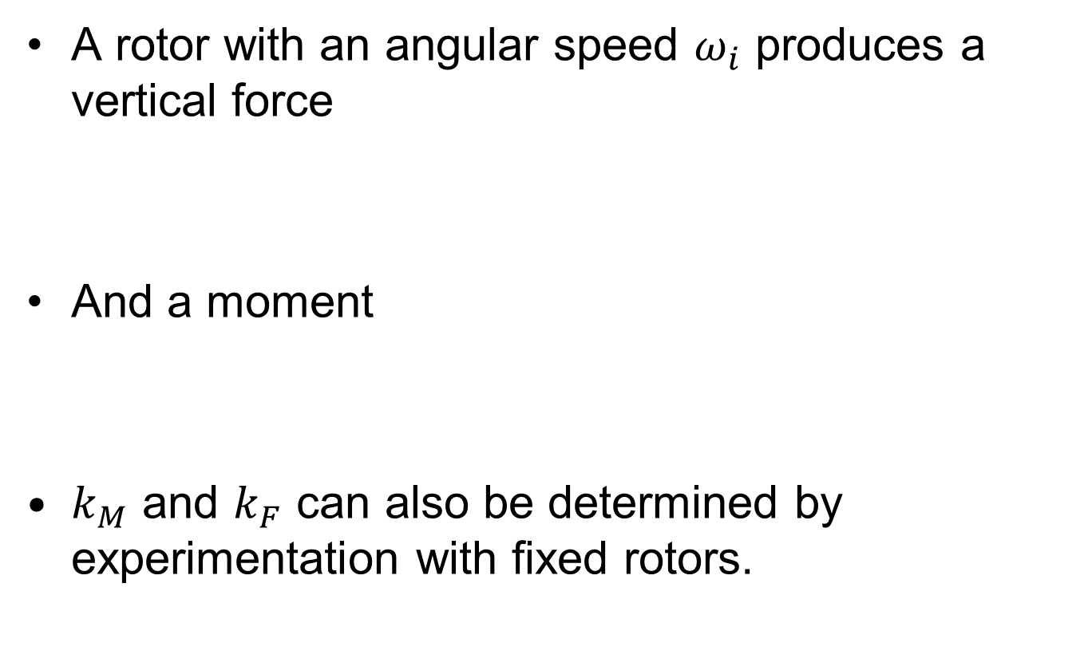
Motor Model
A rotor with an angular speed $ω_{i}$ produces a vertical force
And a moment
$k_{M}$ and $k_{F}$ can also be determined by experimentation with fixed rotors.

Slide 7
Motor Model

Slide 8
Gravity

Slide 9
Finally

Slide 10
Material Covered
Section 3 of note “Quadrotor Dynamics and Control”
Section 16.2.1-16.2.6 of the paper “Week_2 Quadrotor Kinematics and Dynamics”.

