Slide 1
Week 3 Class 1
Discussion: Quadcopter Model

Slide 2
What We Have Learned So Far

Slide 3
Quadcopter Model: Part I

Slide 4
Quadcopter Model: Part II

Slide 5
Discussion 1: Inertia Matrix

Slide 6
Discussion 1: Inertia Matrix
How to get J then?

Slide 7
Discussion 2: Aerodynamics
What is missing?

Slide 8
Elementary Aerodynamics
Lift

Slide 9
Elementary Aerodynamics
Lift

Slide 10
Elementary Aerodynamics
Profile Drag

Slide 11
Elementary Aerodynamics
Induced Drag

Slide 12
Elementary Aerodynamics
Blade Twist

Slide 13
Elementary Aerodynamics
Relative wind

Slide 14
Elementary Aerodynamics
Horizontal Component of Relative Wind
Vertical Component
(Induced Flow)

Slide 15
Elementary Aerodynamics
Rotational Relative Wind
Resultant Relative Wind

Slide 16
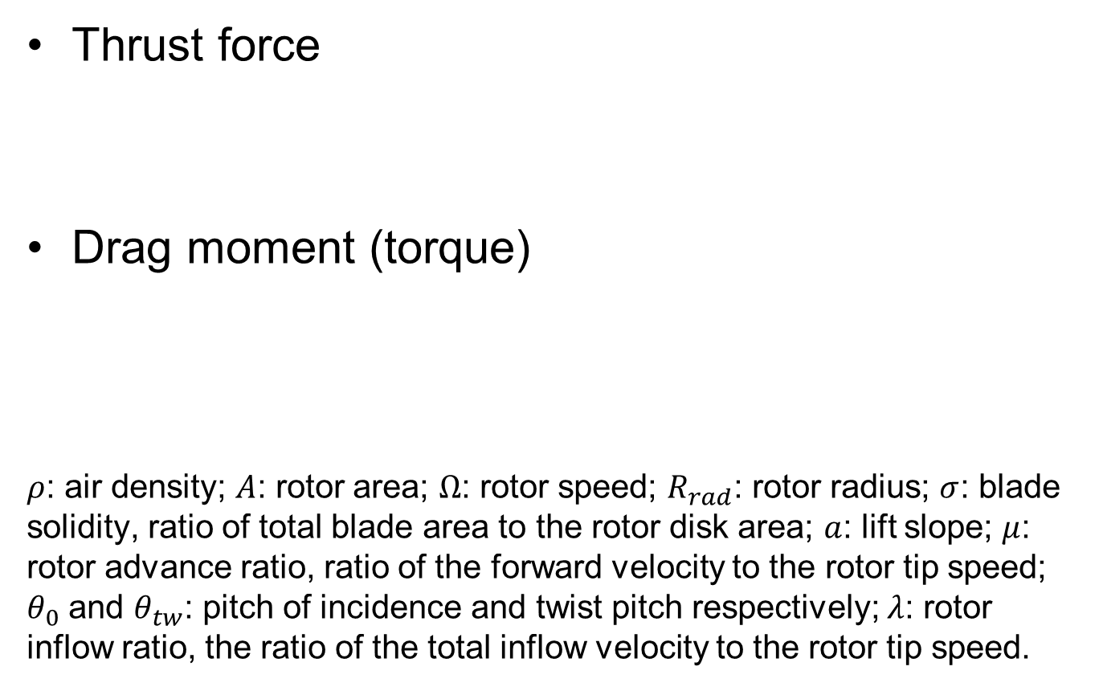
Discussion 2: Aerodynamics
Thrust force
Drag moment (torque)
$ρ$: air density; $A$: rotor area; $Ω$: rotor speed; $R_{rad}$: rotor radius; $σ$: blade solidity, ratio of total blade area to the rotor disk area; $a$: lift slope; $μ$: rotor advance ratio, ratio of the forward velocity to the rotor tip speed; $θ_{0}$ and $θ_{tw}$: pitch of incidence and twist pitch respectively; $λ$: rotor inflow ratio, the ratio of the total inflow velocity to the rotor tip speed.

Slide 17
Discussion 2: Aerodynamics
Dissymmetry of Lift

Slide 18
Discussion 2: Aerodynamics
In Ground Effect (IGE)

Slide 19
Discussion 2: Aerodynamics
Out of Ground Effect (OGE)

Slide 20
Discussion 2: Aerodynamics
Ground effect: thrust increase at constant power

Slide 21
Discussion 3: Underactuated System
The quad is an underactuated system
Six DOF but only four actuators
Second order controllable dynamical system
A slightly constrained form

Slide 22
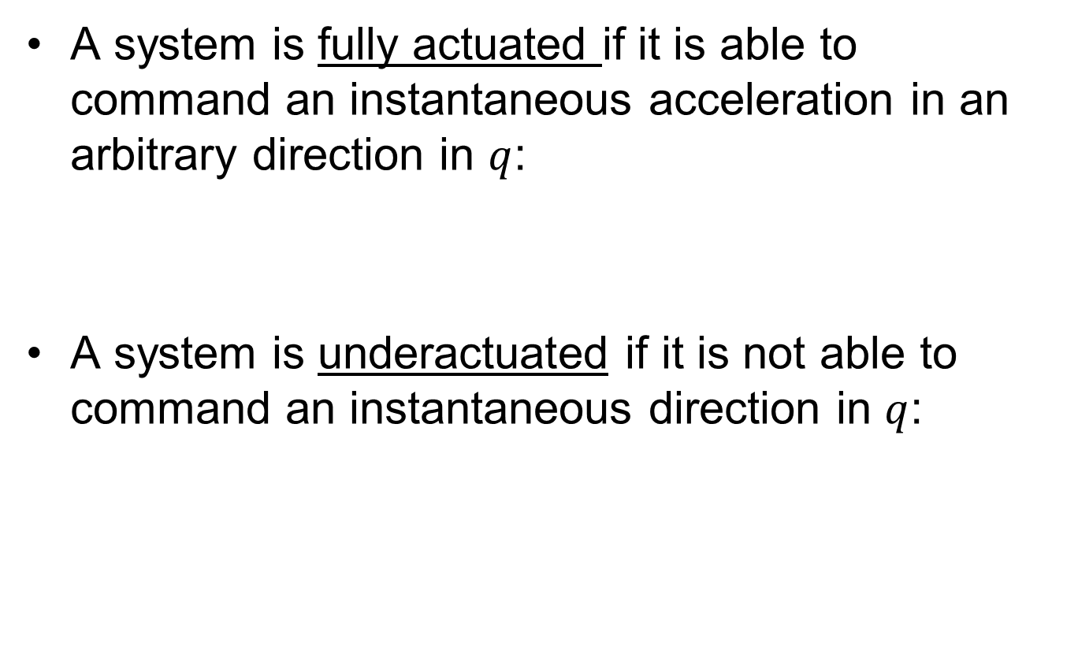
Discussion 3: Underactuated System
A system is fully actuated if it is able to command an instantaneous acceleration in an arbitrary direction in $q$:
A system is underactuated if it is not able to command an instantaneous direction in $q$:

Slide 23

Discussion 3: Underactuated System
Example: Robot Manipulators
$H(q)$ is the inertial matrix, thus invertable
The system is fully actuated with two actuators

Slide 24

Discussion 3: Underactuated System
Example: Car-like Robots
$q=(x,y,θ)^{T}$ and u$=(v,ω)^{T}$
Three DOF and two controls, thus underactuated.

Slide 25
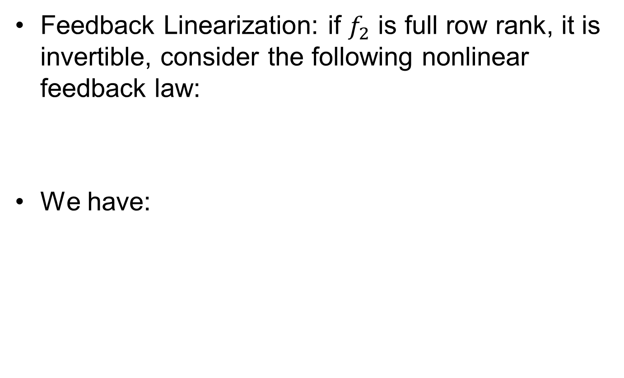
Discussion 3: Underactuated System
Feedback Linearization: if $f_{2}$ is full row rank, it is invertible, consider the following nonlinear feedback law:
We have:

Slide 26
Material Covered
Document “Week_3 Underactuated System”
Document “Week_3 Full control of a quadrotor”

