Slide 1
Unsupervised Feature Learning for Object Classification
by Keith Miller

Slide 2
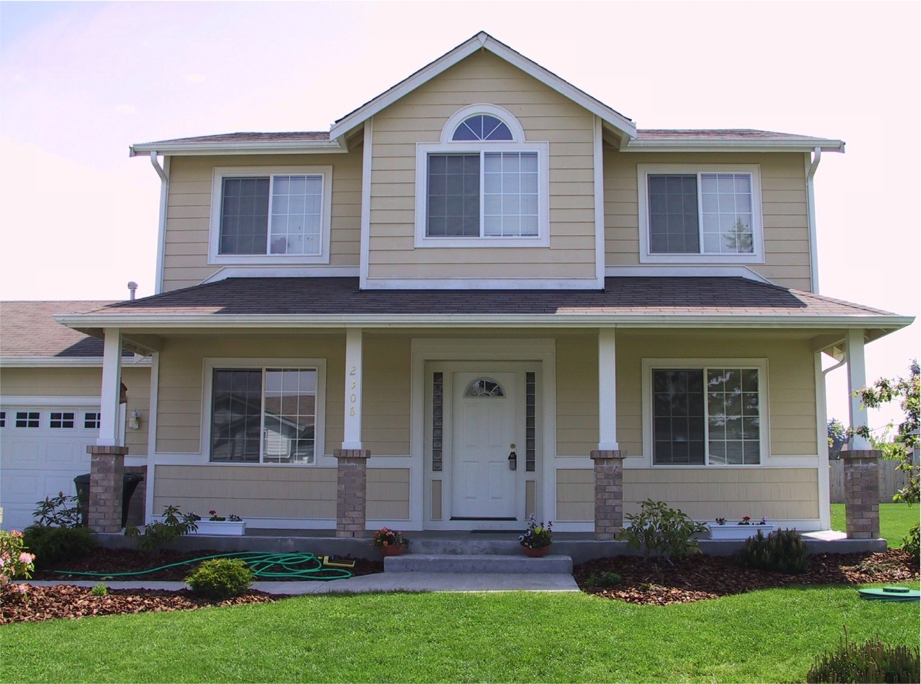
The Problem
Classify Images by feature identification in an unsupervised setting.
Notes:
Based on neuroscience where people use features of objects to identify them.

Slide 3
The Setting
Algorithm is from two papers by A. Coates, A. Y. Ng, and H. Lee.
Assume a large dataset with mostly relevant, unlabeled data.
Tested with Cifar-10 data-set.
50,000 training images
10,000 test images
Notes:
Advantage in that we can use less training data (expensive) and more unlabeled data (cheap)

Slide 4
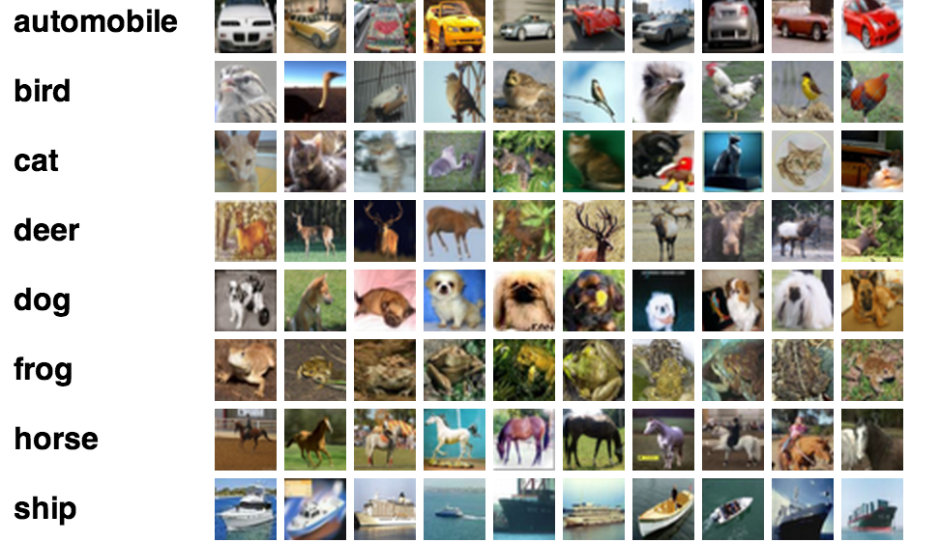
Cifar-10

Slide 5
High-Level Algorithm
Pre-process to identify a set of features, which appear to be important in classifying.
For each training example find the embedded features from before.
Use your favorite classifier to learn the feature-classification relationship.
Notes:
The interesting part is pre-processing and lesser in training
Reducing dimensionality for training

Slide 6
Pre-processing
Extract random patches from each image.
Normalize each patch so that it has mean 0 and variance 1.
Whiten the patches to make the covariance matrix close to the identity matrix.
Notes:
Patches might be 8x8 blocks of a 32x32 pixel image.
Patches take advantage of the fact that key features are likely to be in the middle of the picture.
Think of normalizing and whitening as removing useless information such as brightness or learning that adjacent pixels have similar colors.

Slide 7
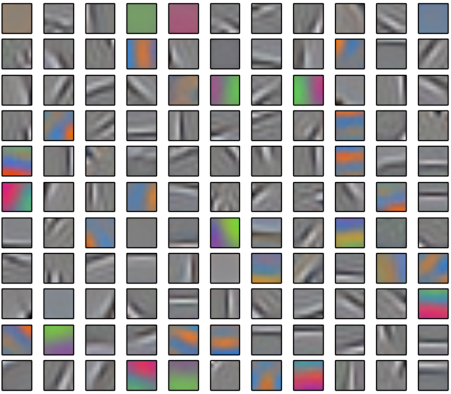
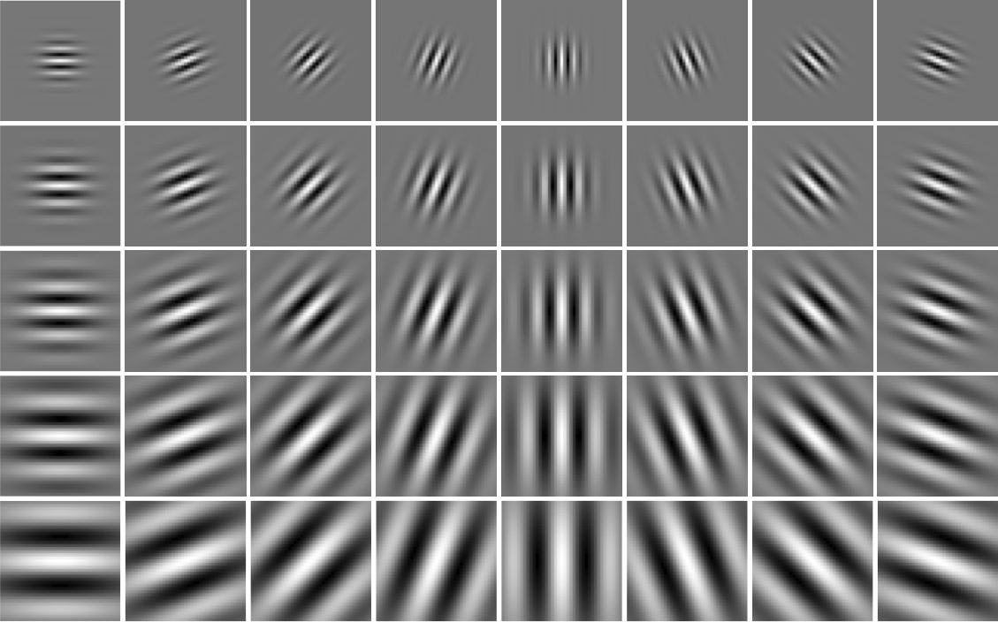
Pre-processing
Use K-means to find the centroids for each patch.
Gabor wavelet
100-centroids from Cifar-10
Notes:
K-means definition.
Similar to Gabor filters which are approximations of the way the brain breaks down images.

Slide 8
Finding the Features
Extract strided patches from the training/test images.
Whiten and Normalize as before.
For each patch find its distance to the k centroids.
Coates recommends using the following distance metric d_{ij} = max(0, u_{i} – x_{ij})
Notes:
i is patch and j is centroid.

Slide 9

Finding the Features

Slide 10
Reducing Dimensionality and Classifying
Coates recommends pooling the results in an n x n grid.
Pass the k x n² vectors to a linear classifier.
Used RBF-kernel SVM in tests

Slide 11
Results and Future Work
Ran code on Cifar-10 and got a 50% accuracy.
State of the art appears to be 89%
Try an independent dataset.
Vary the distance metric.

Slide 12
References
A. Coates and A. Y. Ng. Learning feature representations with k-means. In Neural Networks: Tricks of the Trade, pages 561–580. Springer, 2012.
A. Coates, A. Y. Ng, and H. Lee. An analysis of single-layer networks in unsupervised feature learning. In International Conference on Artificial Intelligence and Statistics, pages 215–223, 2011.
http://www.cs.toronto.edu/~kriz/cifar.html

