Slide 1



Integration and Persistance
ACC
ICS
JCS
DBaaS
SOA CS
Compute
Compute
JCS
Storage
Storage
DBaaS
Compute
Storage

Slide 2
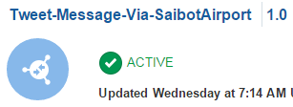
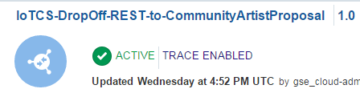
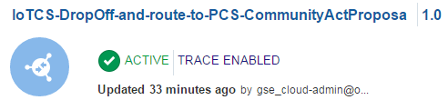
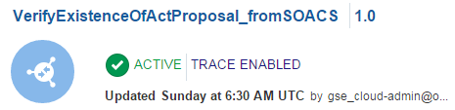
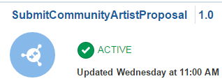
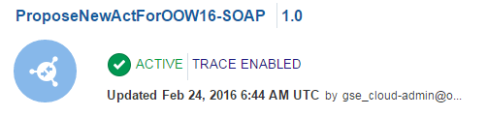
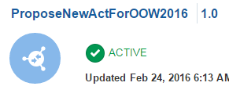
ICS is at the center of this world
REST
(publishes a Tweet through SaibotAirport )
REST
(hand off artist finding in proprietary IoT CS JSON format); forwarded to SOA CS
SOAP
(returns Y or N depending on whether a proposal exists using SOA CS)
IoT CS
ICS
REST
(hand off artist finding in proprietary IoT CS JSON format); forwarded to PCS
SOA CS
REST
(submit a proposal for an artist in decent JSON format; links to PCS to ask for approval of the proposal
SOAP
(calls to SOA CS to create enriched proposal in DB; this service is to be called by PCS)
PCS
REST API
(calls to SOA CS to create enriched proposal in DB)

Slide 3
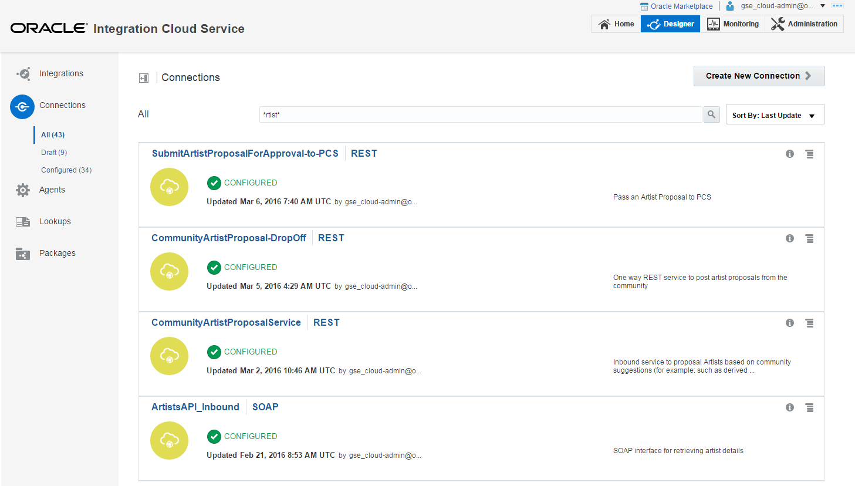
Defining Connections

Slide 4
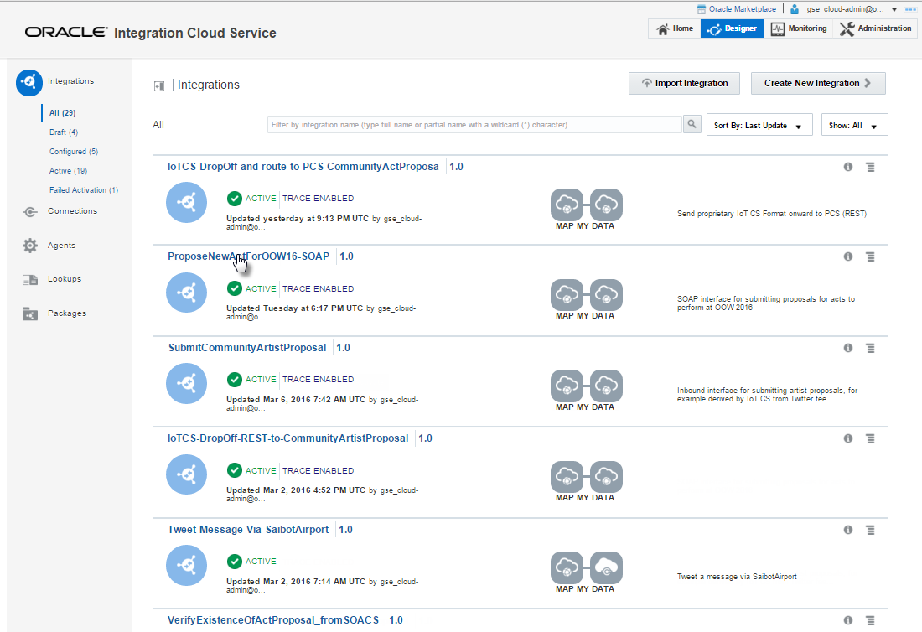
Defining Integrations

Slide 5
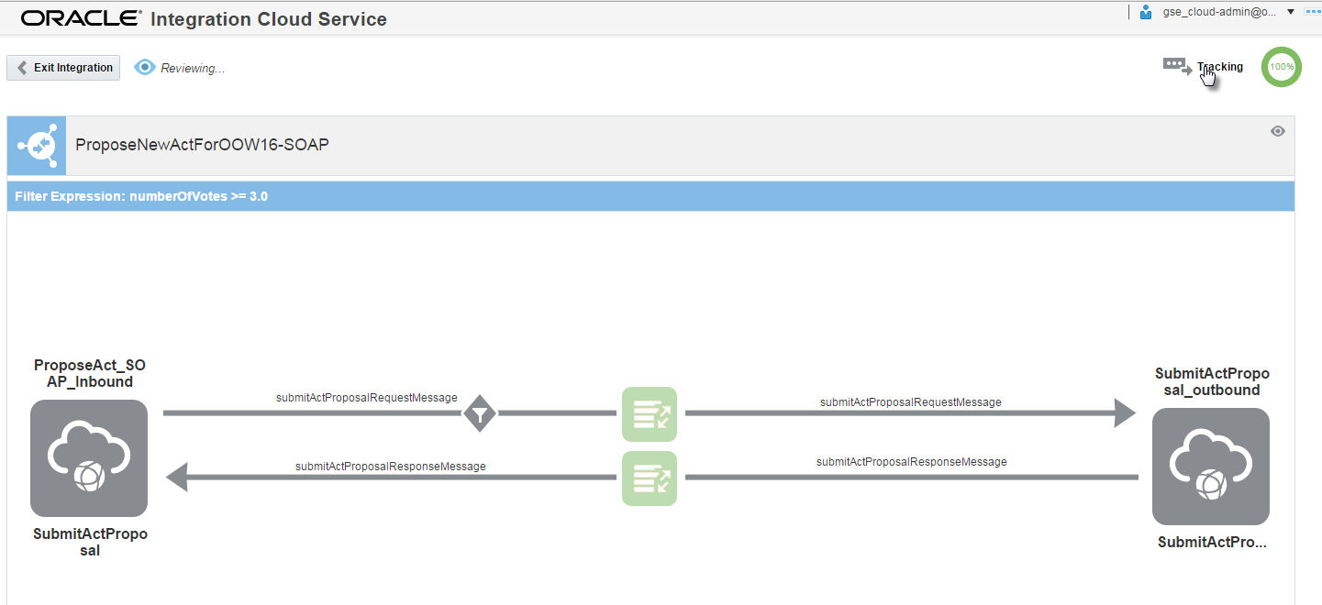
Integration: expose public SOAP, integrate with internal SOA CS

Slide 6
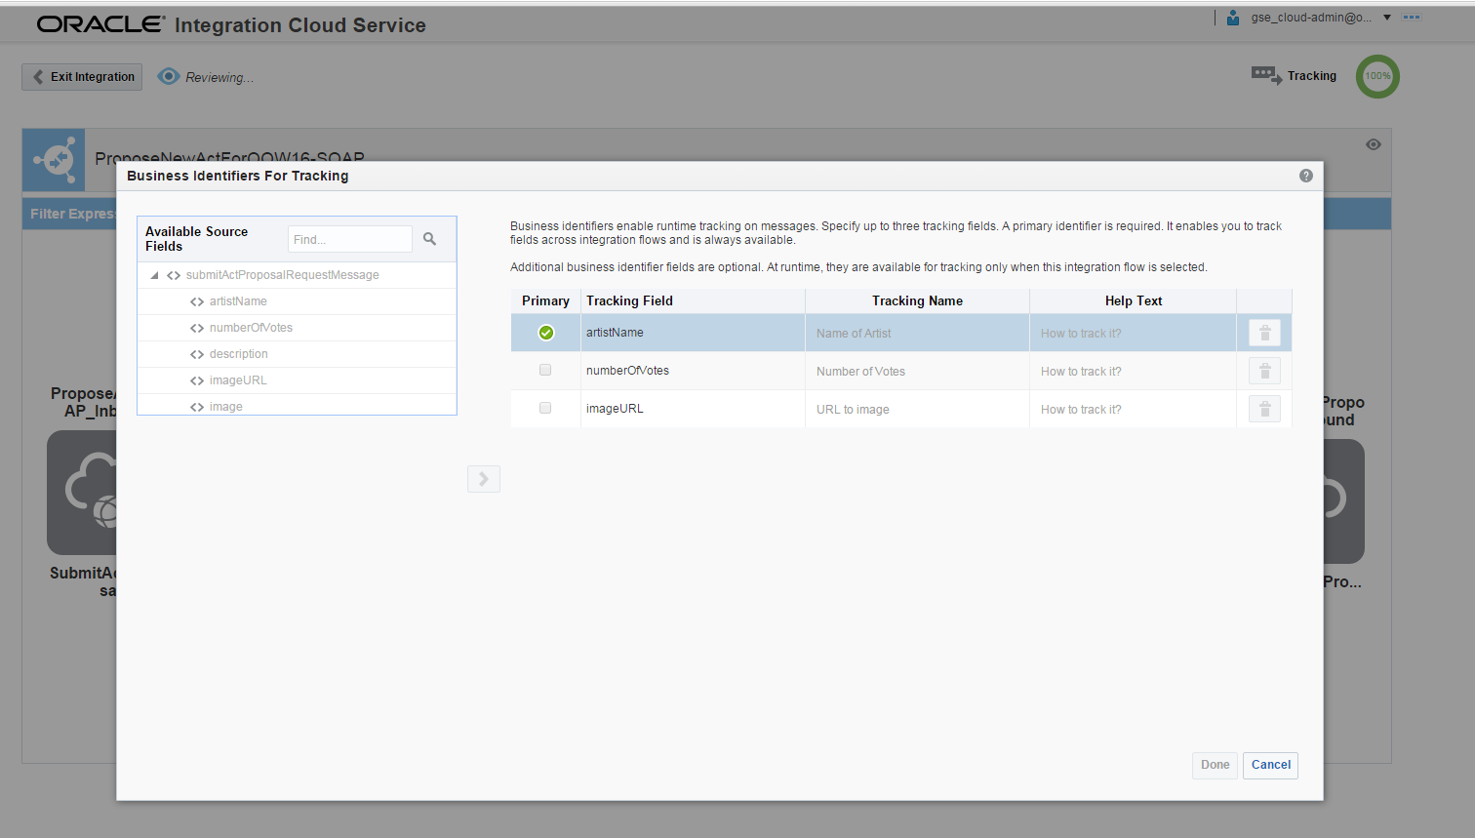
Configure business identifiers

Slide 7
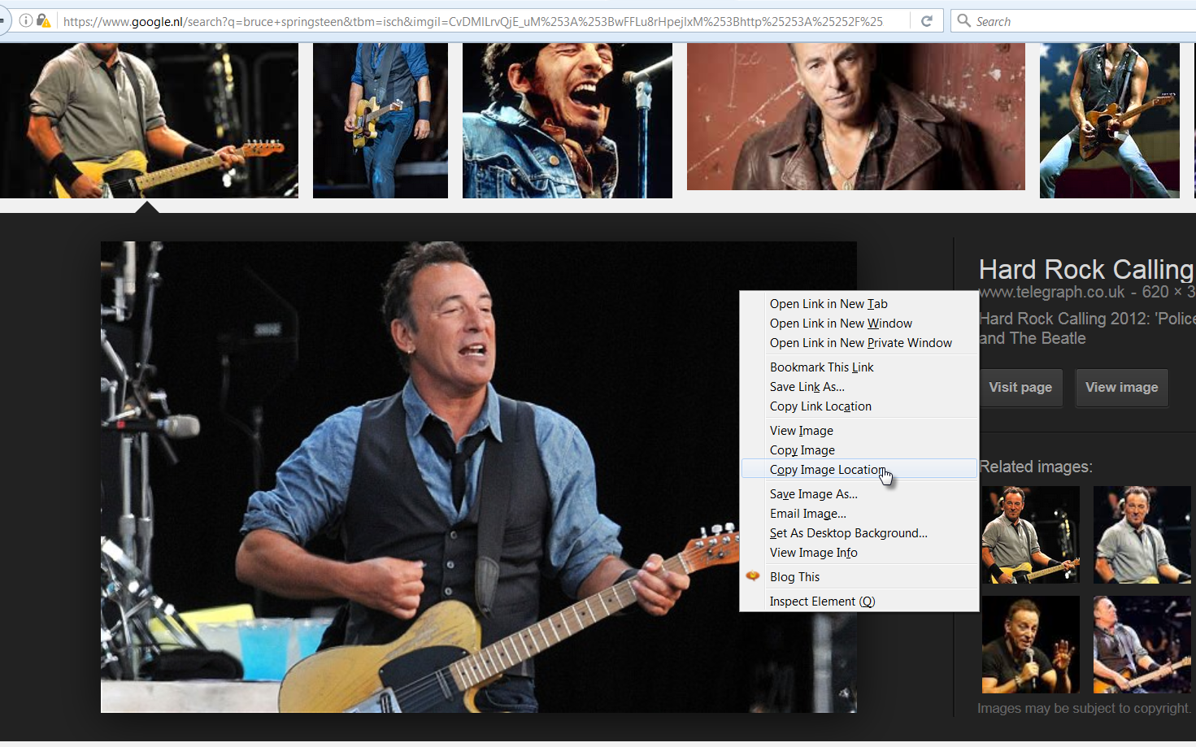
Action: Find a nice The Boss image

Slide 8
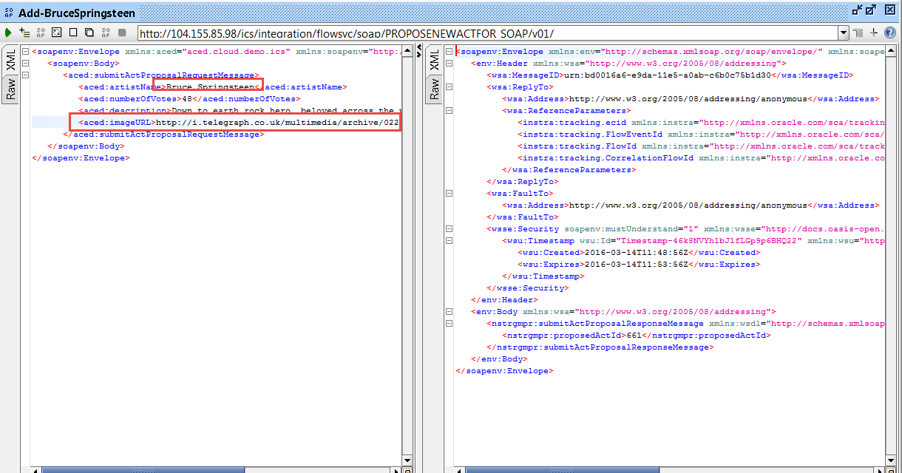
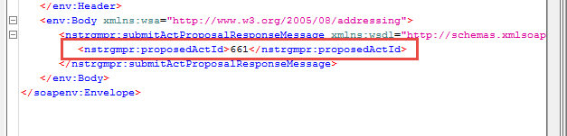
Submit proposal directly to ICS (pretending to be PCS)

Slide 9
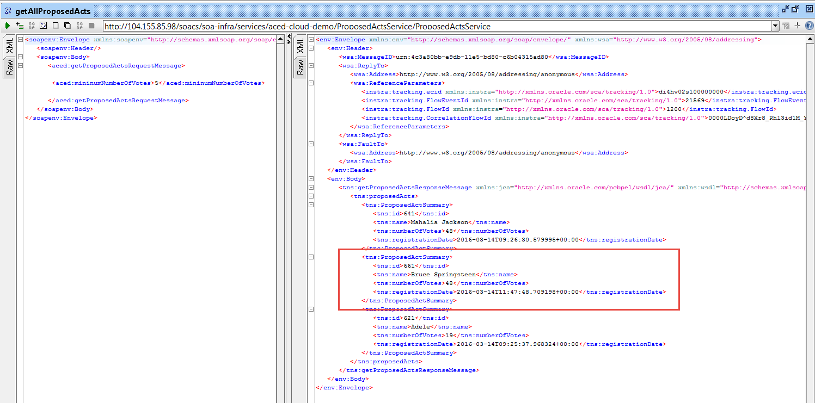
Verified with direct Soap Calls to SOA CS

Slide 10
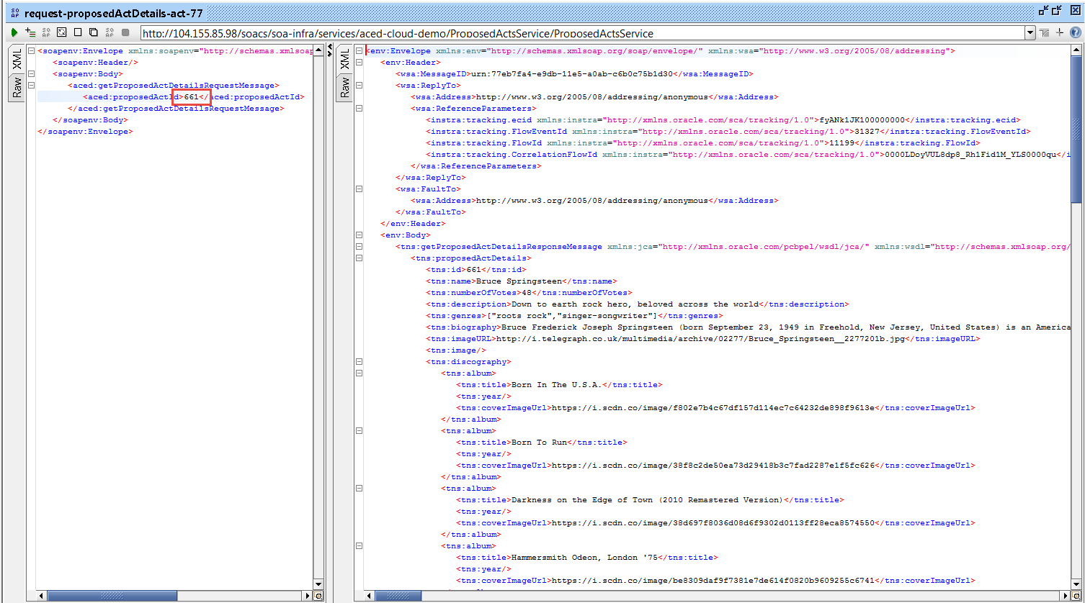
Verified with direct Soap Calls to SOA CS

Slide 11
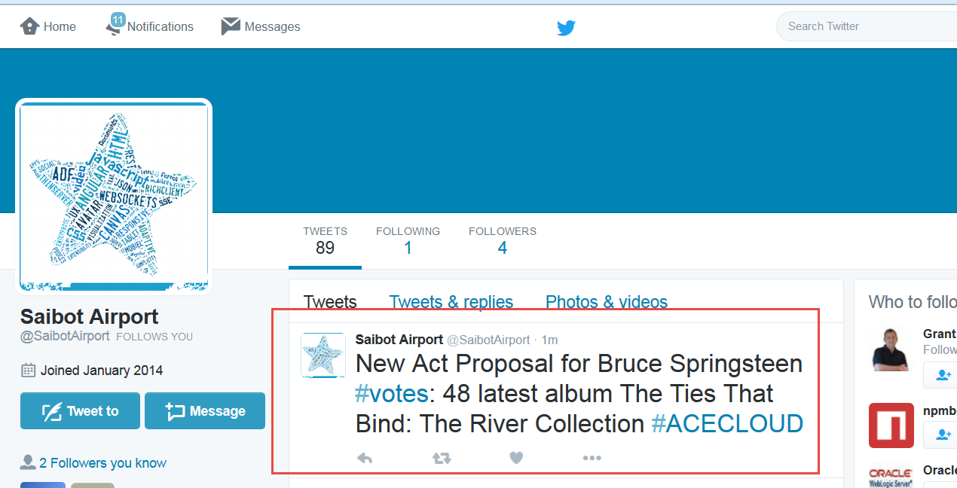
Seconds later…

Slide 12
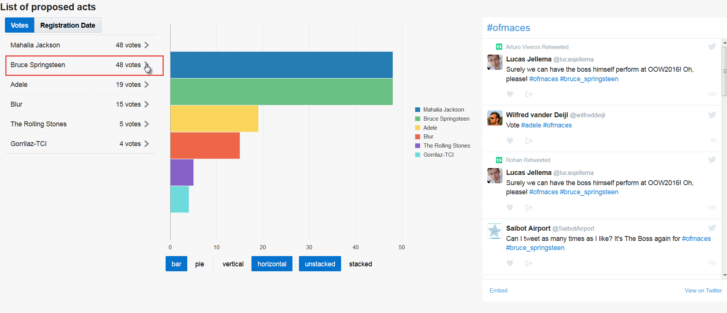
And published in the JET Web App

Slide 13
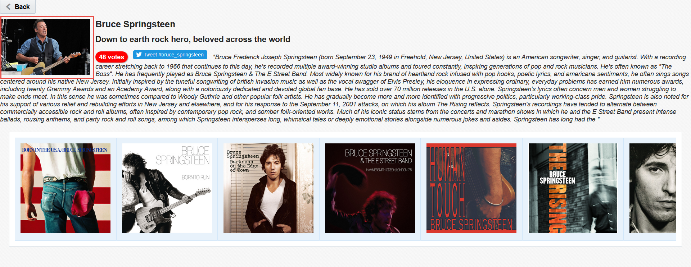
And published in the JET Web App

Slide 14
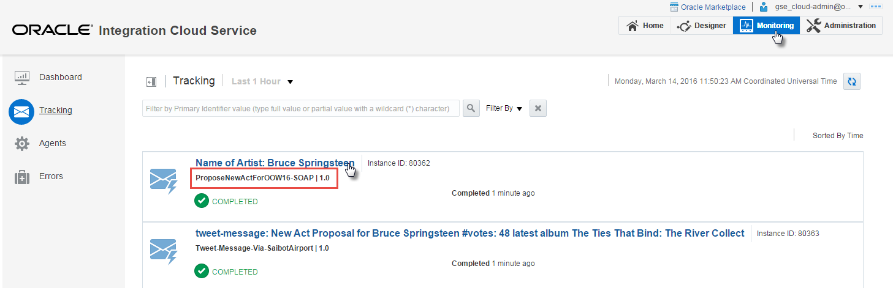
Traces in ICS

Slide 15
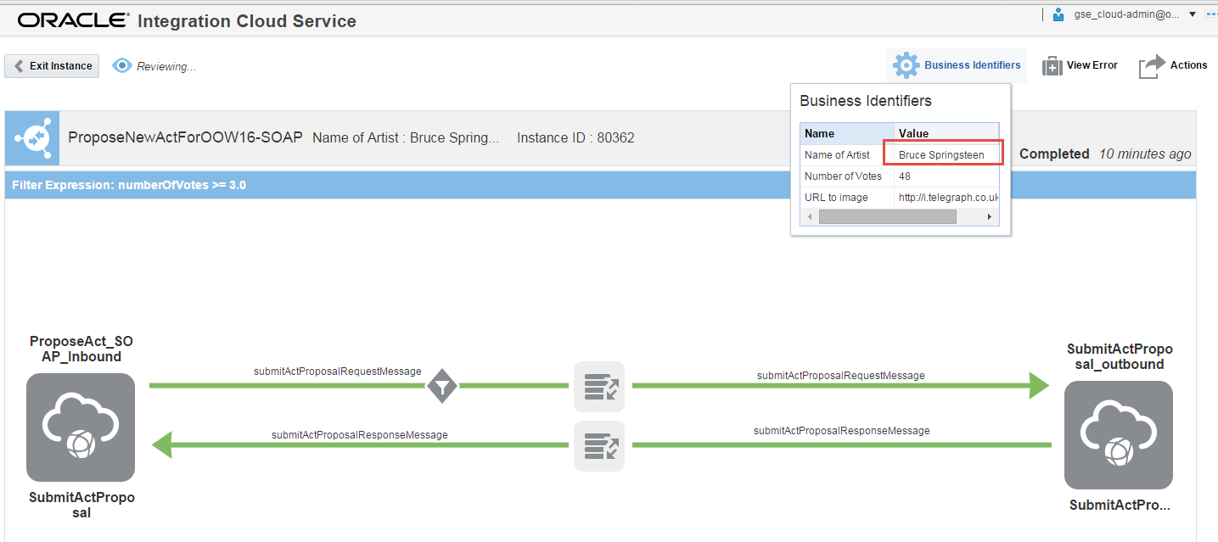
Traces in ICS

Slide 16
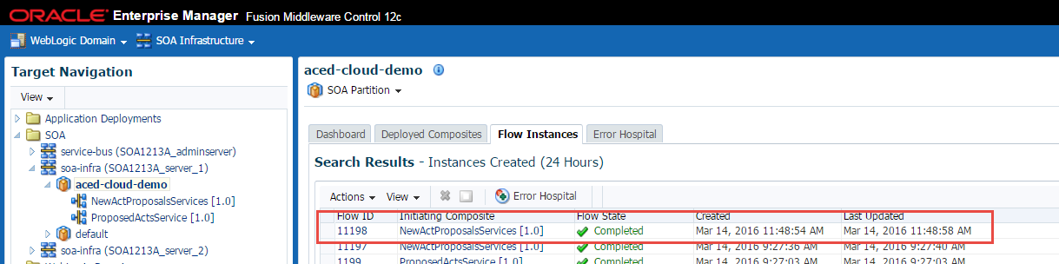
And in SOA CS

Slide 17
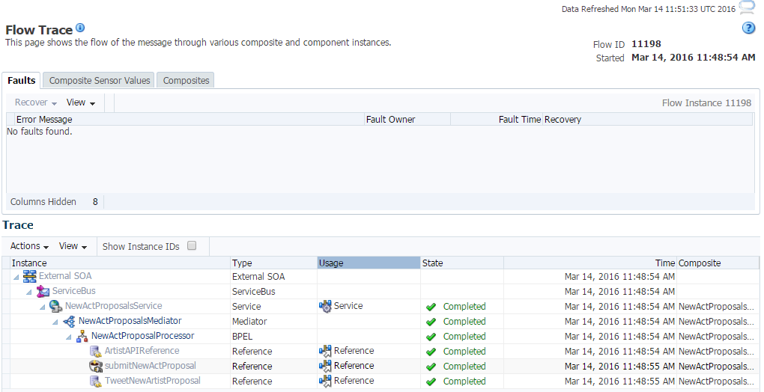
And in SOA CS

Slide 18
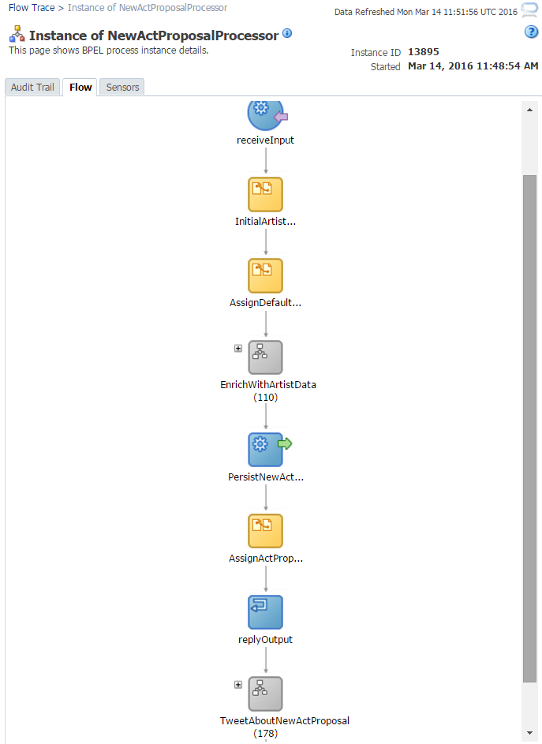
And in SOA CS

Slide 19
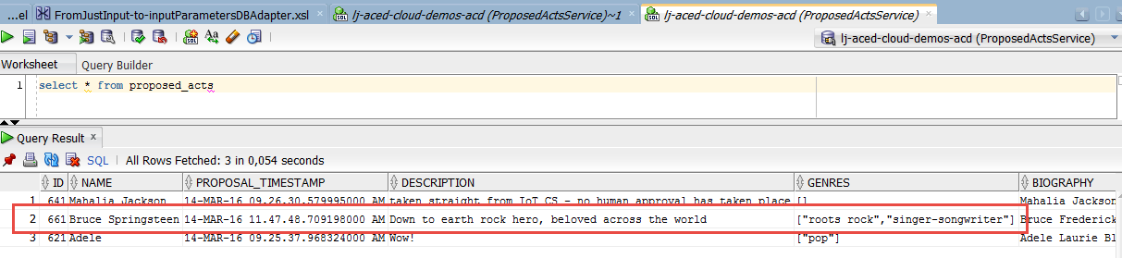
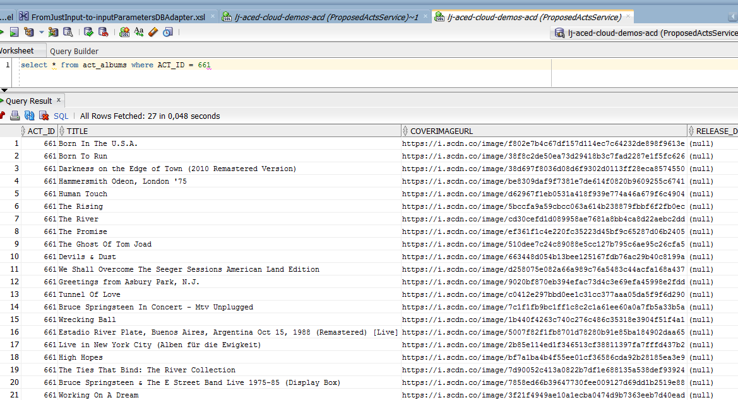
And in DBaaS

