Slide 1


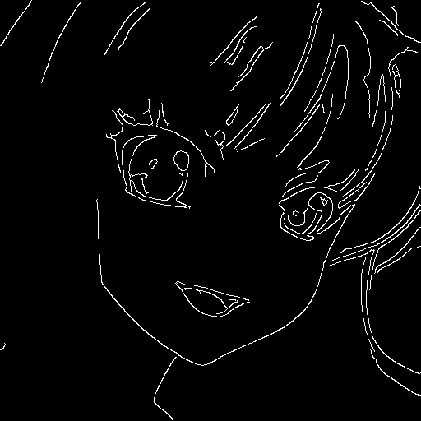
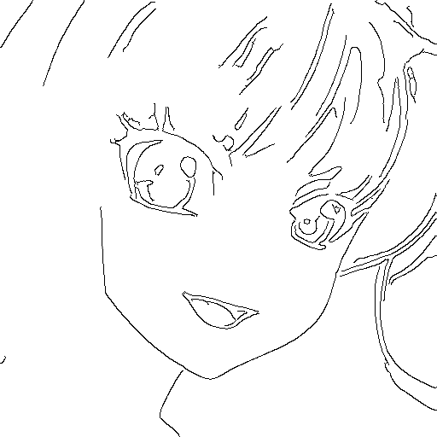
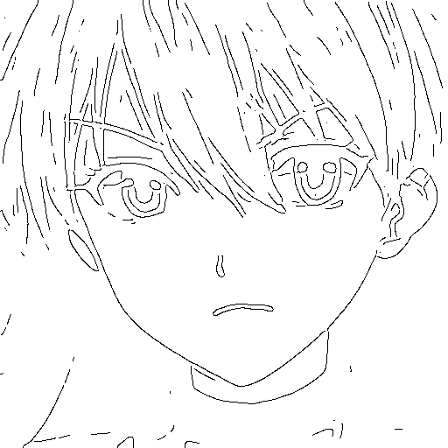
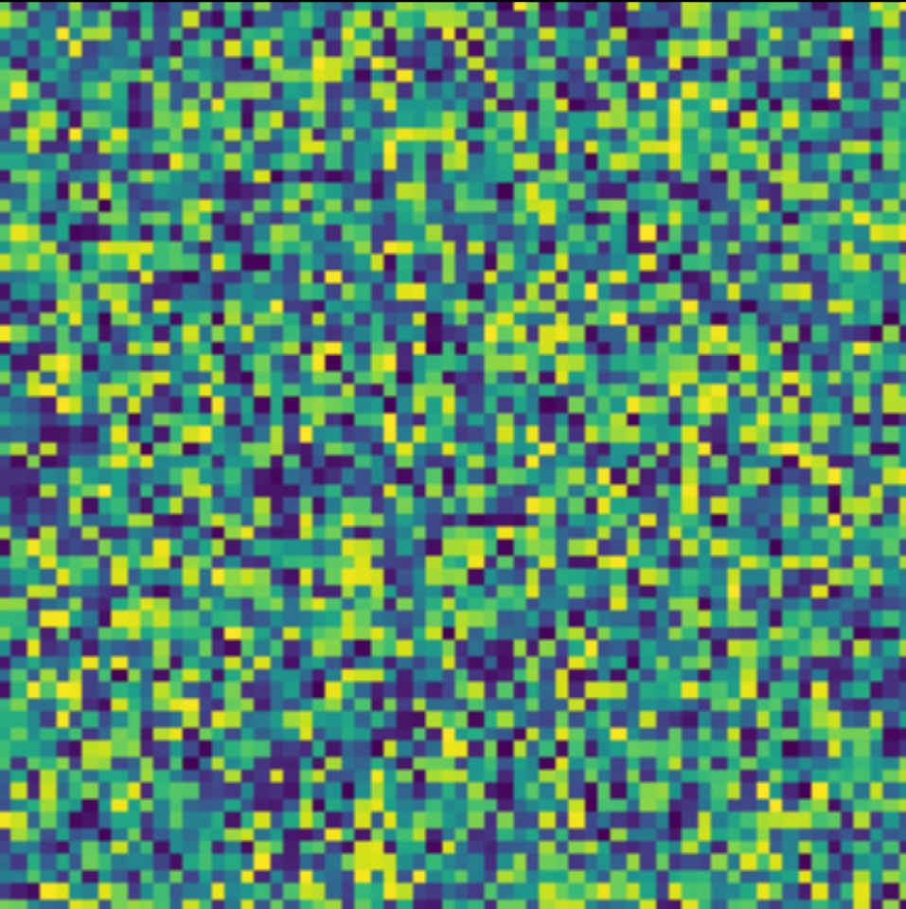


Original
Gauss
Edge
Invert
VAE
GAN
(gen)
GAN
(dis)
Recon Loss
Sketch Space
Latent Space

Slide 2

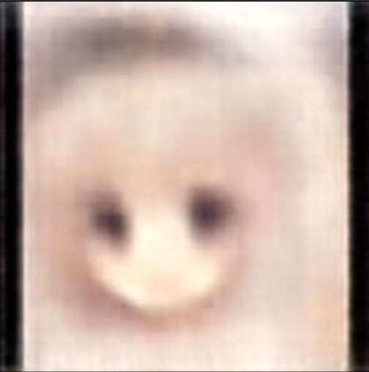



Epoch: 64
Batch size: 64
Latent space: 128
Runtime
3 hrs
Simulated
Sketch
(Train)
WaifuNet
Target
Real
Sketch
(Test)
WaifuNet
Input
Output

Slide 3
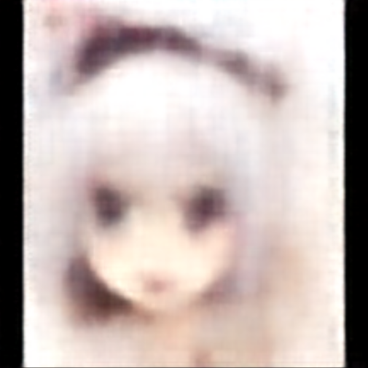

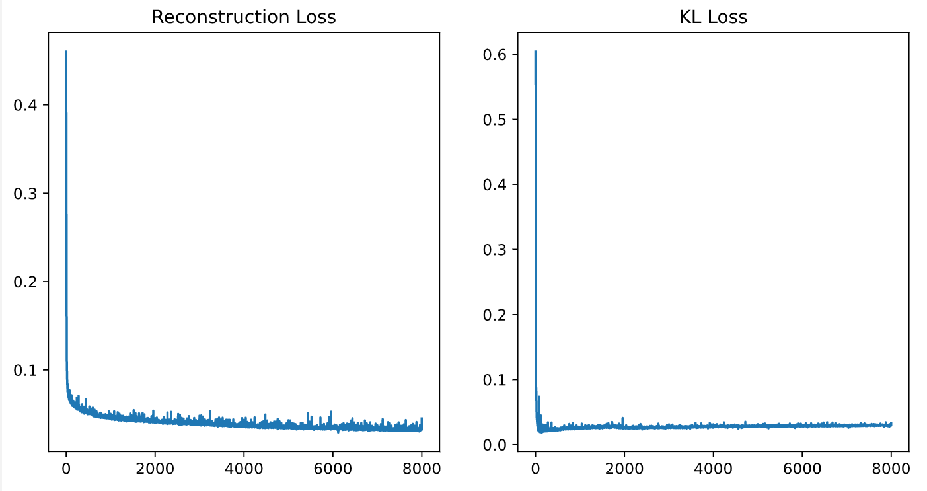
Epoch: 200
Batch size: 256
Latent space: 512
Runtime
9.5 hrs
Simulated
Sketch
(Train)
WaifuNet
Target
Real
Sketch
(Test)
WaifuNet
Input
Output

Slide 4
