Slide 1
Node.js

Slide 2
Blocking vs Non-Blocking

Slide 3
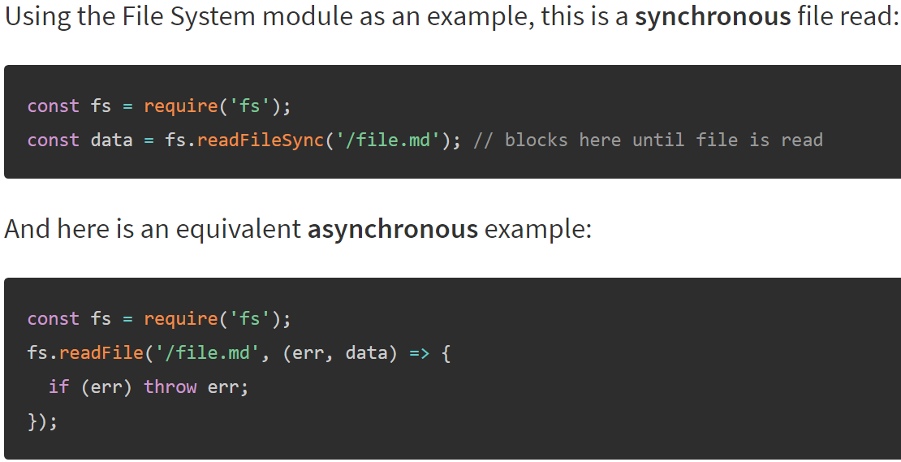

Slide 4
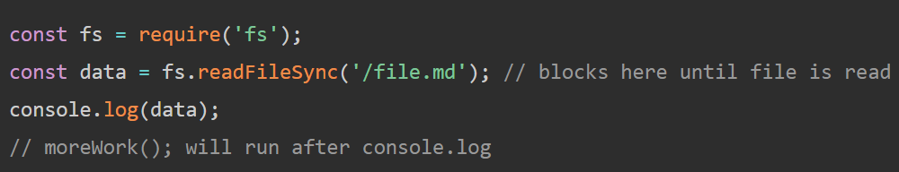
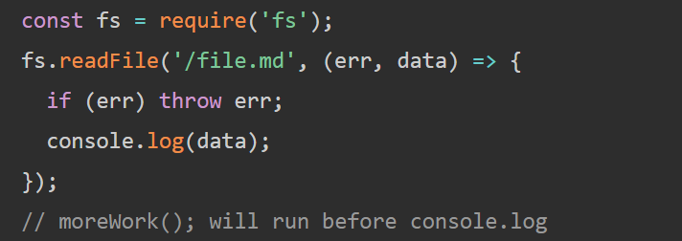
Let's expand our example a little bit:
And here is a similar,but not equivalent asynchronus example:

Slide 5
Concurrency and Throughput
blocking
50ms
80ms
50ms
non-blocking
50ms
80ms
50ms

Slide 6
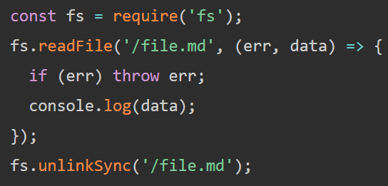
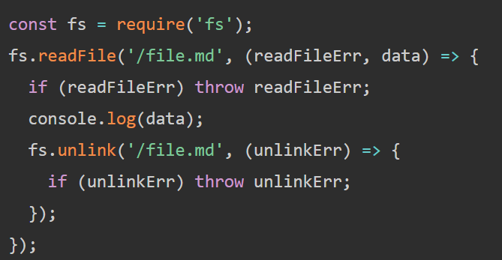
Dangers of Mixing Blocking and Non-Blocking Code
The right places a non-blocking call to fs.unlink() within the callback of fs.readFile() which guarantees the correct order of operations.

Slide 7
Modules

Slide 8
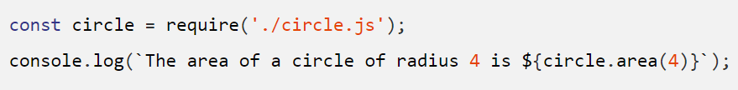
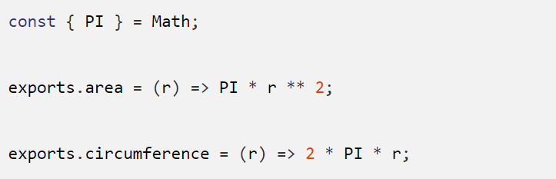
In the Node.js module system, each file is treated as a separate module.
foo.js:
circles.js:

Slide 9
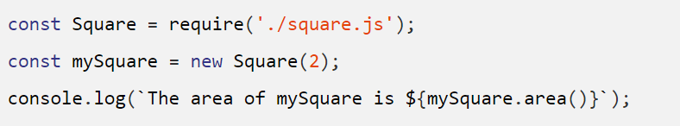
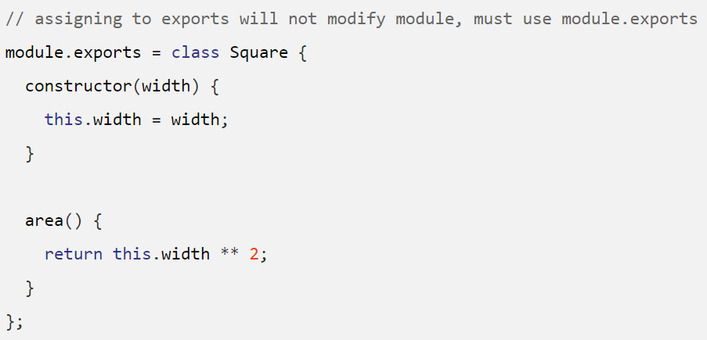
bar.js
square.js

Slide 10
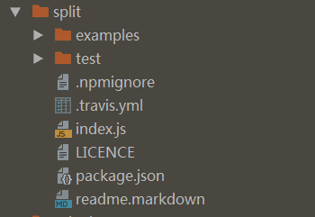
File Modules
extensions: .js, .json, and finally .node
Folders as Modules

Slide 11
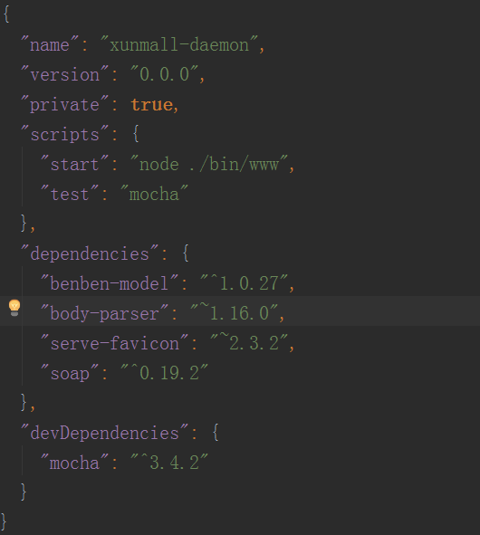
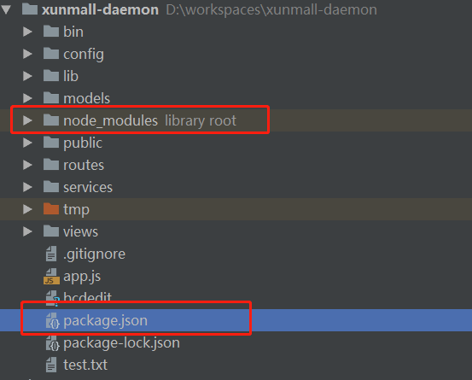
package.json

Slide 12
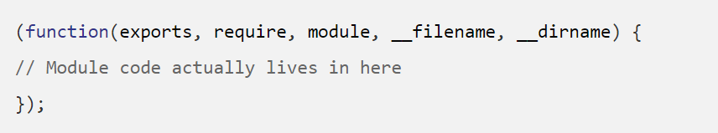
The module wrapper
Before a module's code is executed, Node.js will wrap it with a function wrapper that looks like the following:

Slide 13
The module wrapper
Before a module's code is executed, Node.js will wrap it with a function wrapper that looks like the following:

