Slide 1
Node.js

Slide 2
Blocking vs Non-Blocking

Slide 3
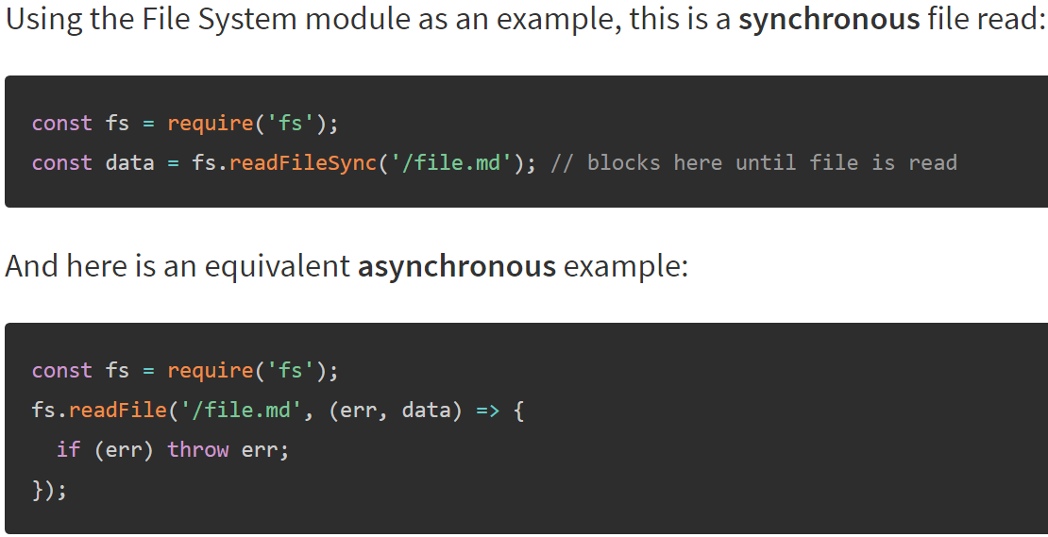

Slide 4
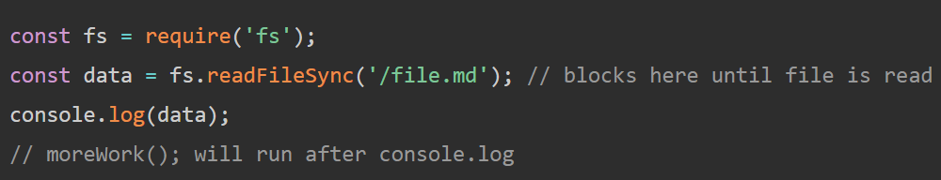
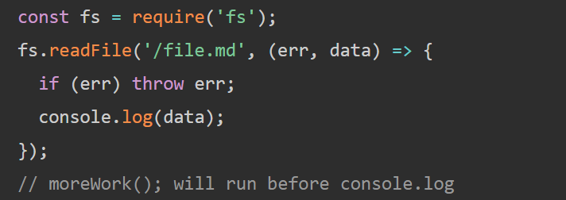
Let's expand our example a little bit:
And here is a similar,but not equivalent asynchronus example:

Slide 5
Concurrency and Throughput
blocking
50ms
80ms
50ms
non-blocking
50ms
80ms
50ms

Slide 6
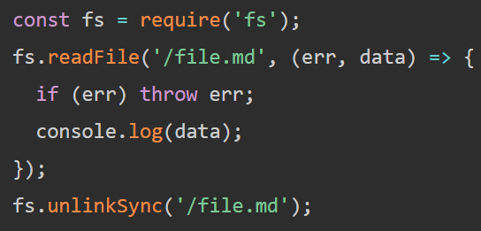
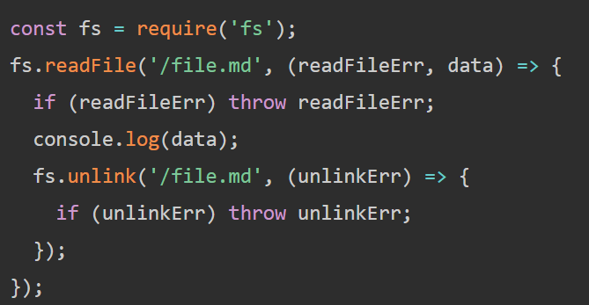
Dangers of Mixing Blocking and Non-Blocking Code
The right places a non-blocking call to fs.unlink() within the callback of fs.readFile() which guarantees the correct order of operations.

