Slide 1
OSGD Associate Project Presentation
Luke Kennedy

Slide 2
What Was the Project?
Spotify song data.
Predict popularity of 3 hypothetical artists.
Suggest a collaboration artist.

Slide 3
The Data
1920 – 2021
32,735 Unique Artists
174,389 Songs
Attributes + Popularity

Slide 4
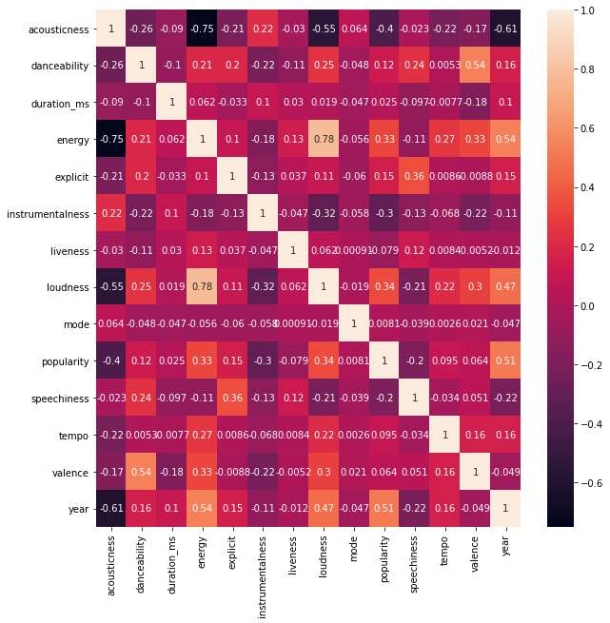
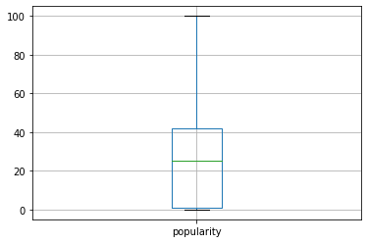

Slide 5
Predicting Popularity
Regression vs Classification
Popular?

Slide 6
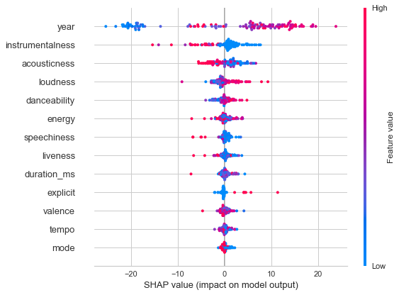
Extra Trees Regressor MAE: 8.3 RMSE: 12 R Squared: 0.68

Slide 7
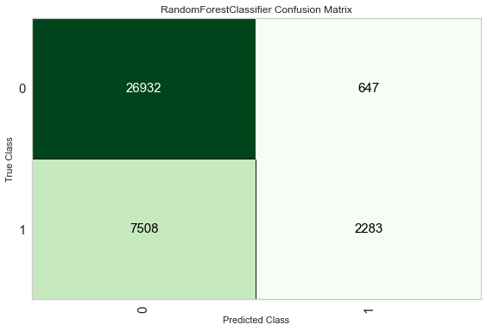
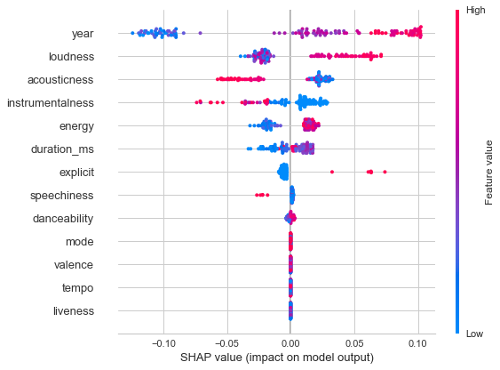
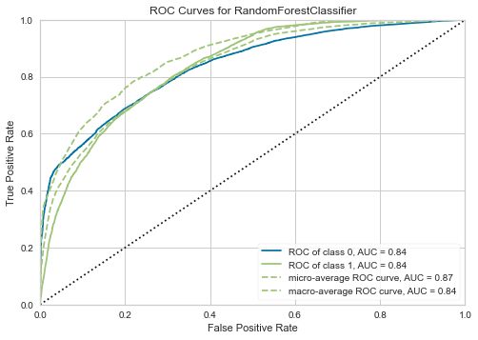
Random Forest Classifier Precision: 0.79 AUC: 0.84

Slide 8
Collaboration Artist
Good Fit
Genres (Clusters)
Artist Attributes
Projected Collaboration Popularity
Final List + Cost

Slide 9
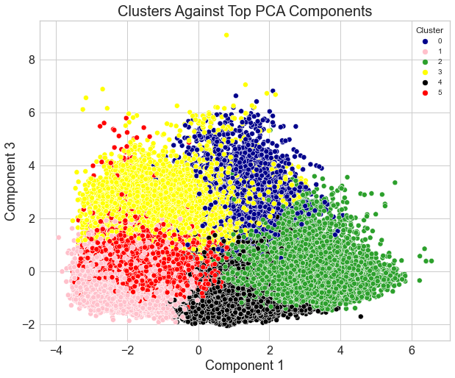
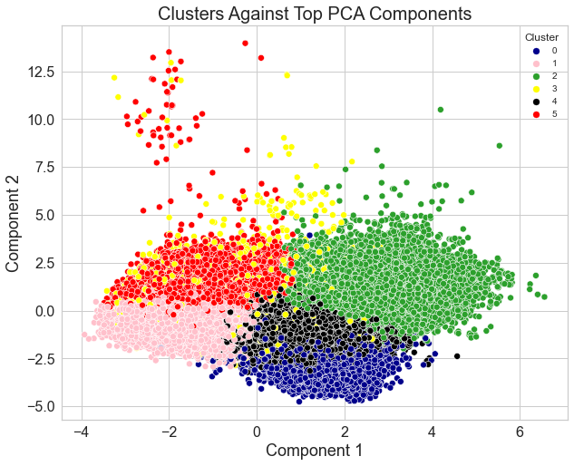

Slide 10
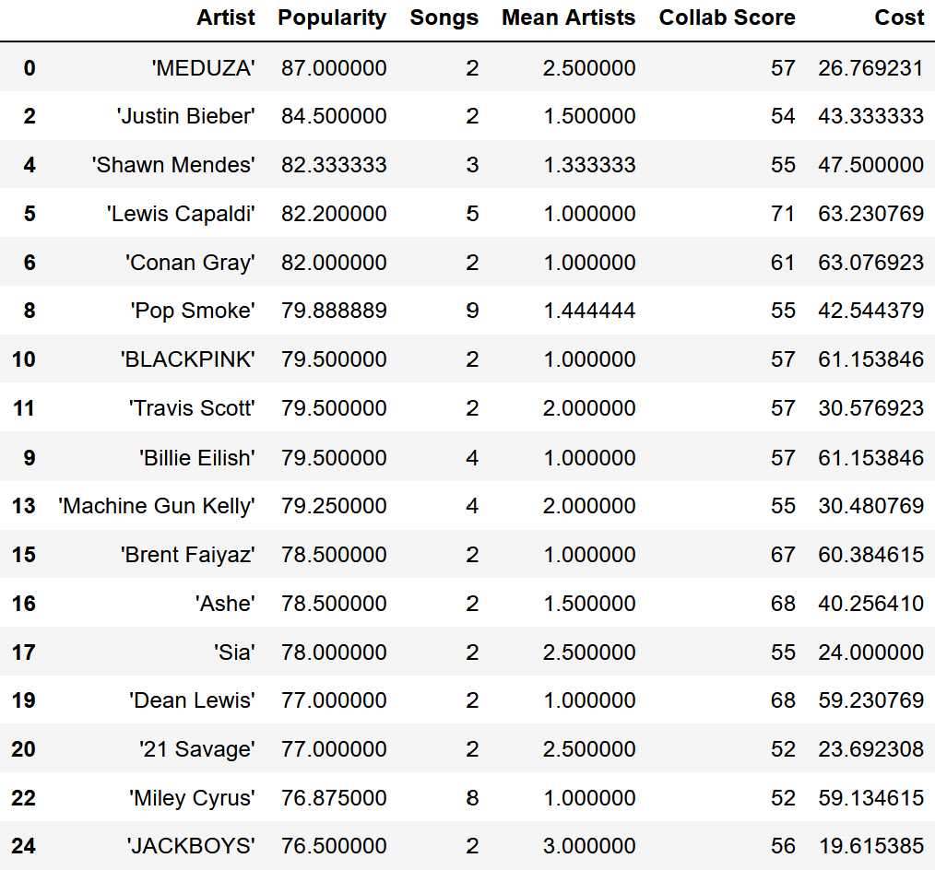

Slide 11
Conclusions and Things to Try
Try recent songs only
Affect of release month
Common words and popularity

Slide 12
Questions?

