Slide 1
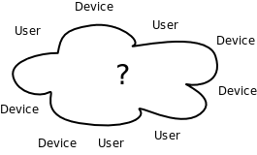
Devices and Users
Devices have different access methods (bluetooth, RS-232, RS-485, USB, etc...)
Users digest and display data differently
How can all these devices and users work together in harmony?

Slide 2

Networking
C3I Interoperability Specification states IP (Internet Protocol) shall be used for networking.

Slide 3
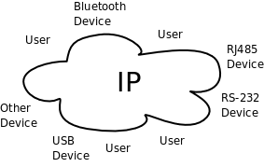
Heterogeneous Devices
Devices do not all use IP for communication (bluetooth, RS-232, RS-485, USB, other proprietary protocols, etc...), nor do the devices output the same data in the same units.
How can IP be used to connect non-IP devices?

Slide 4
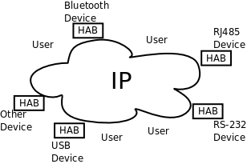
Hardware Abstraction (HAB)
Each device requires an abstraction layer to translate from its protocol to IP and normalize the device data to a common units understandable to the users.
The network then is a homogeneous IP network.
HABs have intimate knowledge of the devices they are abstracting.
How can users benefit from normalized data on an IP network?

Slide 5
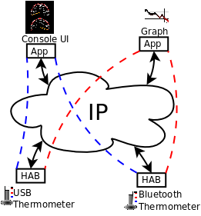
Common Device and User Interfaces
Users do not need any intimate knowledge of the devices.
All users can access all data without any knowledge of the hardware specifics because the data is normalized.

Slide 6
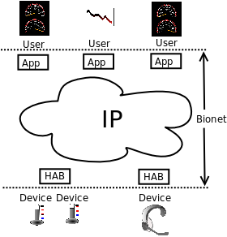
Bionet
Hardware Abstractors (HABs) publish data to Bionet. User applications subscribe to data in Bionet.
HABs deal directly with devices. User applications digest, process, and display the data.

Slide 7
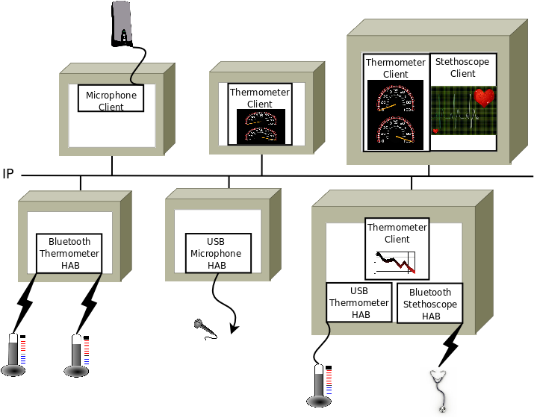
Bionet Network Diagram

