Slide 1
Definition of BDM System
Named Bionet Data Manager
Capability to store Bionet data
Capability to serve BDM clients interested in historical Bionet data
Capability to synchronize Bionet data between other instances of BDM

Slide 2
Design Drivers For BDM System
Same substrate as Bionet
  IP network
  Whole range of platforms
  Intermittently connected network segments
Complementary system to Bionet
  Store data from Bionet
  Complete history
  Serve data to BDM Clients
Security
  Same threat model as Bionet
  Deferred until model is agreed to for Bionet

Slide 3
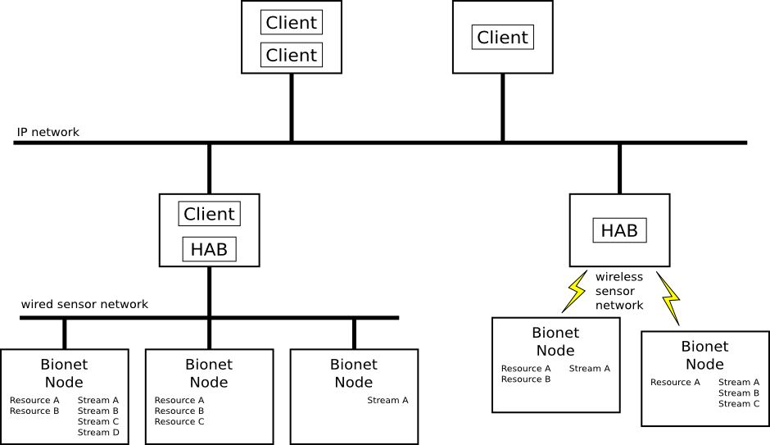
Bionet/BDM Coupling
BDM process is just a specialized Bionet Client
Notes:
specialized

Slide 4
BDM System Setup
BDM process can happily coexist on same network segment
  Identified by unique identifier
    Public key?
Most aspects of BDM are intended to be configurable
  Flexibility

Slide 5
Storing Bionet Data in BDM
Three types of Bionet data
  HAB Joining and Leaving
  New and Lost Node
  Resource Update
  BDM will not store streams in this version
Each datum is stored with unique identifier
  Concatenation of BDM process unique identifier and sequence number
  Sequence number is monotonically increasing
  BDM instance is responsible for maintaining semantics of sequence number across restarts
  Used for synchronization

Slide 6
BDM Client Interface
BDM Clients are interested in using stored Bionet data
Client-server model over TCP
  No subscription model planned for getting data from BDM processes to BDM Clients
  Polling model
BDM Clients use DNS-SD to find BDM servers
  Flexibility to use mDNS or managed DNS infrastructure
  With mDNS, provides zero configuration networking for BDM Clients to find BDM Servers

Slide 7
BDM Client Interface
Three types of information available
  HAB Joining and Leaving Events
  New and Lost Node Events
  Resource Updates

Slide 8
BDM Synchronization Protocol Requirements
Delayed/disrupted network
Asymmetric data rates
Data flows in one direction mostly
  These are essentially BCS-from-ISS communications characteristics
DTN-BP protocol similarities
  Datagram oriented
  Lessons learned from in-house playback system

Slide 9
BDM Synchronization Protocol Requirements
Relatively static BDM system configuration
  No anticipated need for discovery protocols
  Manual configuration guides flow of data
Data flows from source to sink
  Both are BDM processes
Data is synchronized in blocks organized into transactions

Slide 10
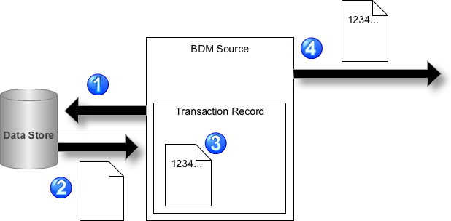
BDM Synchronization Protocol

Slide 11
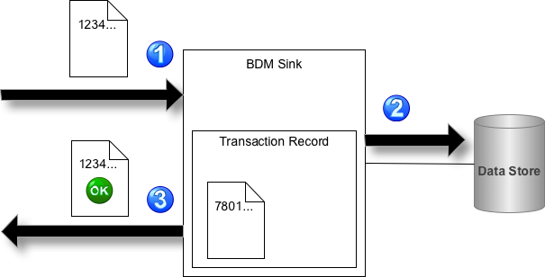
BDM Synchronization Protocol

Slide 12
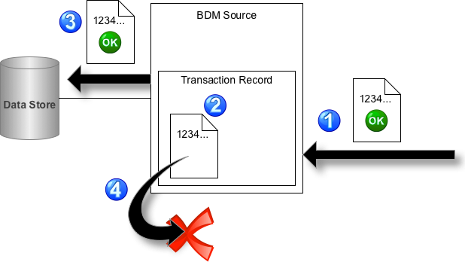
BDM Synchronization Protocol

Slide 13
BDM Process Architecture
Just like Bionet, BDM should run on range of hardware
  No ideal storage system for all hardware
Could create multiple implementations of BDM process, one for each target hardware platform
Split UDM software design into two parts
  Front-end
  Back-end

Slide 14
BDM Process Front-End
Front-end
  Implements UDM responsibilities
    UDM Client server
    Bionet Client, registers subscriptions
    UDM synchronization
  Starts and manages back-end
  Hands all data to back-end for storage
  Same software module for all UDM instances

Slide 15
BDM Process Back-End
Back-end
  Implements actual data storage
  Different, custom for every hardware platform
    Database
    Flat files
    Memory
  Implements policy for data storage
    Data removal
    Frequency of stored data
    Relative priority of stored data

Slide 16
BDM Internal API
Front-end and Back-end linked through BDM Internal API
  Not yet defined

