Slide 1
Driving Use Cases
CGBA
ISS SSCs (crew healthcare)‏
Lunar Habitat
Notes:
Talk about CGBA-4 and CGBA-5, both on orbit
Bionet is already on it
BCS communication stack (as seen earlier)‏
CGBA has been flying since STS-77
Generic, has SRM, and Bionet requires only one or two software module updated to run different hardware. No reboot
ISS SSCs
EA3 is sponsor
Medical data - sensitivty of data; HIPPA
8 laptops, intermettently connected, any one might be used in connected or disconnected manner
Lunar Habitit
EV4 sponsor
next slide

Slide 2
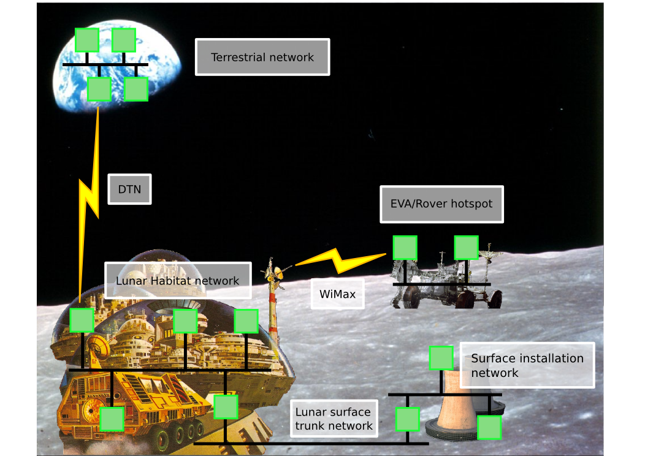
Lunar Habitat Scenario
Notes:
Disconnected network segments
Data aggregation back to Habitat,and eventually to Earth

Slide 3
Design Drivers & Deliverables
Security
Tear-away networking
Peer-to-peer architecture
  scalability
  reliability
  we use one server – for ACLs
Management of historical data
  Bionet does soft real-time
  Bionet Data Manager (BDM) manages historical record
Notes:
What does this mean for our system?

Slide 4
Security – Threat Model & Implications
Adversary has these capabilities and limitations:
  can sniff packets
  can inject packets
  can exectute their code on our machines
  cannot read others' files
  not root/superuser/Administrator
Adversary can't do more than denial of service
  cannot read unauthorized data
  cannot command actuators
  we hope
Notes:
This is the model we’ve been working from. Is this valid? Any different takes on threat model?

Slide 5
Security – Implementation
Authentication
  public key crypto
  trusted CA statically binds keys to ids where needed
Authorization
  trusted ACL (our only server)‏
  fine-grained access control
Confidentiality
  symmetric key cipher
  symmetric keys distributed using public key crypto
Integrity
  digital signatures
  message integrity codes
Notes:
Implementation, High level description of security tool usage

Slide 6
Security – additional thoughts
Security by layers
  IPsec
  WPA

Slide 7
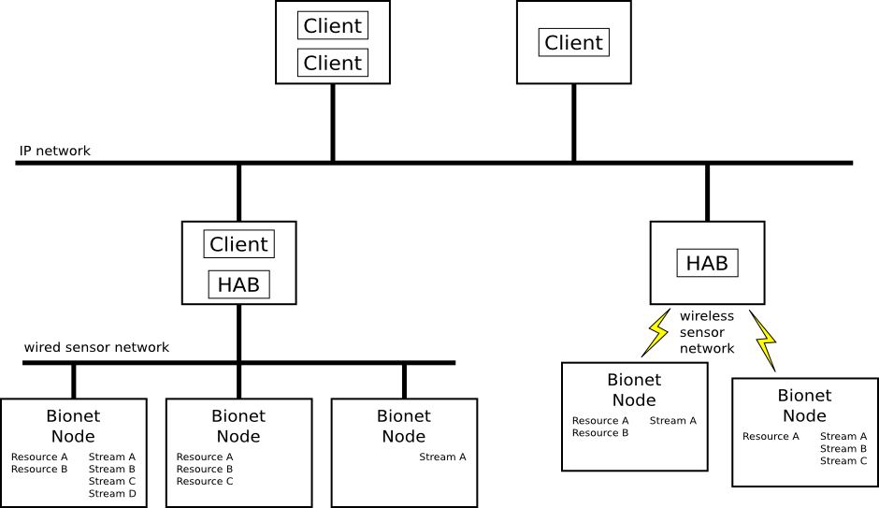
Bionet P2P architecture at a glance
Notes:
Bionet hasn’t changed much from bionet v0
ontology is still same, and has served us well
From developer point-of-view, Bionet is same. Only thing changed is how Bionet works underneath.
Tried to keep feel of HAB and client development

Slide 8
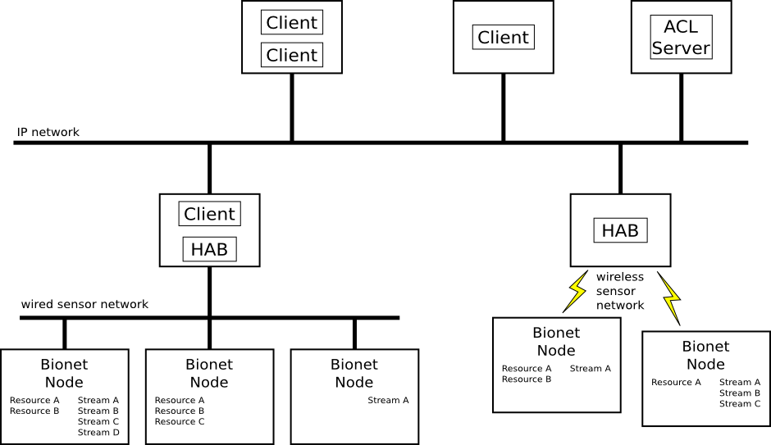
Bionet P2P architecture complete
Notes:
Two big differences are P2P and ACL server
ACLs provides us with a means to authenticate clients access to Bionet
P2P makes it more scalable and robust

Slide 9
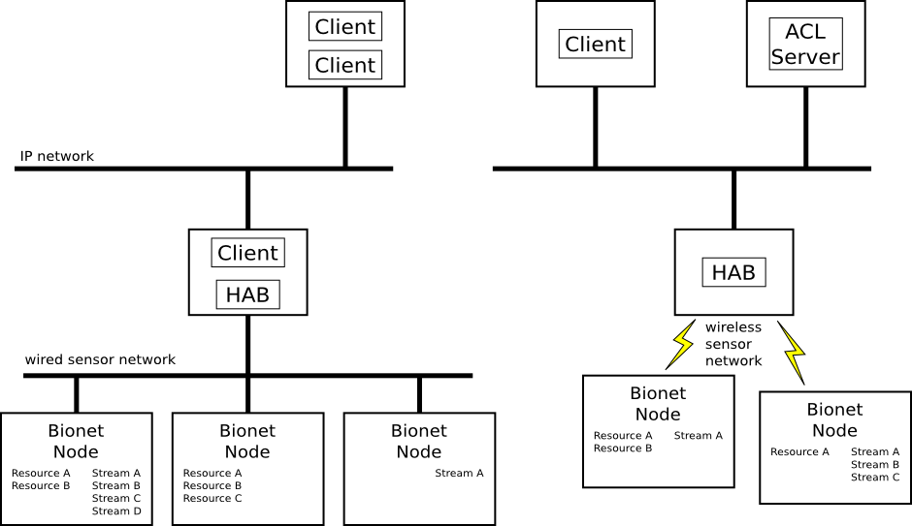
Network Tear-away
Notes:
Tear-away
network partitioned by a link-layer disconnections
entities on same side of the partition continue to communicate
entities on different sides of the partition can no longer to communicate
new connections are possible on the side with the ACL server
if a network reconnect happens, entities that are reunited reconnect

Slide 10
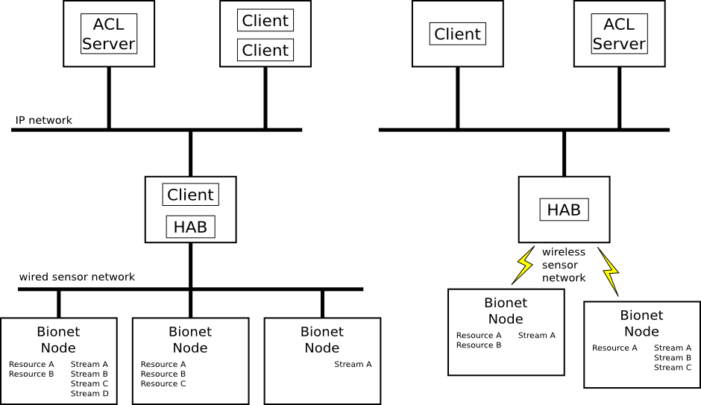
Non-broken tear-away
Notes:
So a prudent network designer should predict where network partitions are likely and position an ACL server on each segment.

Slide 11
Bionet network conversations
HAB List & peer discovery
Node List
Resource Updates
Resource Setting
Streams
  Producers
  Consumers
Notes:
These are largely unchanged from bionet v0 world
Due to P2P, need method for Clients to discover HABs, and HAB List accomplishes this
The biggest changes in theses from old Bionet is implementation of security and the availability of multicast.

Slide 12
Bionet network protocols
HAB List & peer discovery
Unicast
  higher reliability
  higher network utilization
Multicast
  lower reliability
  lower network utilization
  has race conditions
AMS?
Notes:
Like mentioned before, P2P nature necessitates peer discovery protocol
The 2 primary other conversations, (node list, resource updates) we’ve designed two complementary protocols that exist side-by-side
Allow optimization of network usage vs. reliability based differing sets of requirements
Resource Settings and Streams remain mostly unchanged - unicast only
Introduce AMS to others. Compare AMS pub/sub with Bionet, integration difficulties & possible resolution. Bionet would not use AMS's pub/sub, just its unicast comms capability. Also get peer discovery & DTN. queue Scott

Slide 13
Multicast Groups
Asset Tracking
ECLSS
Ops Console
Multicast Group A
Multicast Group B
Physical Network
Notes:
We're going to show the peer discovery protocol in some detail and walk through some examples
Who here has heard of mcast?
Who understands it?
Contrast with unicast and broadcast

Slide 14
HAB List & Peer Discovery
Asset Tracking
ECLSS
Alien-RFID
Ops Console
Physical Network

Slide 15
HAB List & Peer Discovery
Asset Tracking
ECLSS
Alien-RFID
The Alien-RFID HAB joins the Bionet HAB List multicast group.
Ops Console
HAB List Multicast
Physical Network

Slide 16
HAB List & Peer Discovery
Asset Tracking
ECLSS
Alien-RFID
The Alien-RFID HAB sends out a "HAB Joining" message.
Ops Console
HAB List Multicast
Physical Network

Slide 17
HAB List & Peer Discovery
The "HAB Joining" message contains the following information:
1) Delivery Vector
2) Timestamp
3) Identity Certificate
- Hab Name
- Public-Key
- CA-Signature
4) HAB Signature

Slide 18
HAB List & Peer Discovery
Asset Tracking
ECLSS
Alien-RFID
Because no one is listening, the "HAB-Joining" message is not registered.
Ops Console
HAB List Multicast
Physical Network

Slide 19
HAB List & Peer Discovery
Asset Tracking
ECLSS
Alien-RFID
To detect HAB failure, HABs periodically send out a "HAB Heartbeat" message.
Ops Console
HAB List Multicast
Physical Network

Slide 20
HAB List & Peer Discovery
Asset Tracking
ECLSS
Alien-RFID
When a Client starts up, it also subscribes to the HAB List multicast group.
Ops Console
BioNet-Monitor
HAB List Multicast
Physical Network

Slide 21
HAB List & Peer Discovery
Asset Tracking
ECLSS
Alien-RFID
A new Client emits a "HAB Info Request" message to the HAB List multicast group. The request contains the following:
1) Delivery Vector
2) Public Key
Ops Console
BioNet-Monitor
HAB List Multicast
Physical Network

Slide 22
HAB List & Peer Discovery
Asset Tracking
ECLSS
Alien-RFID
Each HAB now has knowledge of the Client's unicast endpoints. It sets up a unicast communication channel.
Ops Console
BioNet-Monitor
Unicast Channel
HAB List Multicast
Physical Network

Slide 23
HAB List & Peer Discovery
Asset Tracking
ECLSS
Alien-RFID
Each HAB on the HAB List multicast group sets a random timer, then emits a "HAB Info Reply" with the information in the "HAB Joining" message in the reply on the Client's unicast vector.
Ops Console
BioNet-Monitor
Unicast Channel
HAB List Multicast
Physical Network

Slide 24
HAB List & Peer Discovery
Asset Tracking
ECLSS
Alien-RFID
The Client enters knowledge of the new HABs into it's HAB List, along with the delivery vector and public key given in the "HAB Info Reply" message.
Ops Console
BioNet-Monitor
HAB List:
Alien-RFID.AssetTracking
Unicast Channel
HAB List Multicast
Physical Network

Slide 25
HAB List & Peer Discovery
Asset Tracking
ECLSS
Alien-RFID
The Client then sends an "HAB Info Ack" message back to the HAB acknowledging receipt.
Ops Console
BioNet-Monitor
HAB List:
Alien-RFID.AssetTracking
Unicast Channel
HAB List Multicast
Physical Network

Slide 26
HAB List & Peer Discovery
Asset Tracking
ECLSS
Alien-RFID
Having received the Ack, the HAB will no longer respond to further probes. The Client can transmit additional queries to verify all HABs on the local network have responded with the requested information.
Ops Console
BioNet-Monitor
HAB List:
Alien-RFID.AssetTracking
Unicast Channel
HAB List Multicast
Physical Network

Slide 27
HAB List & Peer Discovery
Asset Tracking
ECLSS
Alien-RFID
After the HAB receives the Ack, it no longer needs the unicast communication channel, so it is destroyed.
Ops Console
BioNet-Monitor
HAB List:
Alien-RFID.AssetTracking
HAB List Multicast
Physical Network

Slide 28
HAB List & Peer Discovery
Asset Tracking
ECLSS
Alien-RFID
Water-Monitor
Now a new HAB starts up.
Ops Console
BioNet-Monitor
HAB List:
Alien-RFID.AssetTracking
HAB List Multicast
Physical Network

Slide 29
HAB List & Peer Discovery
Asset Tracking
ECLSS
Alien-RFID
Water-Monitor
First it connects to the HAB List multicast group.
Ops Console
BioNet-Monitor
HAB List:
Alien-RFID.AssetTracking
HAB List Multicast
Physical Network

Slide 30
HAB List & Peer Discovery
Asset Tracking
ECLSS
Alien-RFID
Water-Monitor
Next the "HAB Joining" message. The Client sees this and registers it in its HAB List.
Ops Console
BioNet-Monitor
HAB List:
Alien-RFID.AssetTracking
Water-Monitor.ECLSS
HAB List Multicast
Physical Network

Slide 31
HAB List & Peer Discovery
Asset Tracking
ECLSS
Alien-RFID
Water-Monitor
If at any point the Client misses a "HAB Joining" message, it will eventually see a HAB Heartbeat message.
Ops Console
BioNet-Monitor
HAB List:
Alien-RFID.AssetTracking
HAB List Multicast
Physical Network

Slide 32
HAB List & Peer Discovery
Asset Tracking
ECLSS
Alien-RFID
Water-Monitor
The Client registers the HAB in its HAB List when it sees it for the first time.
Ops Console
BioNet-Monitor
HAB List:
Alien-RFID.AssetTracking
Water-Monitor.ECLSS
HAB List Multicast
Physical Network

Slide 33
HAB List & Peer Discovery
Asset Tracking
ECLSS
Water-Monitor
Heartbeats also allow dead-peer detection. Here the Alien-RFID HAB just died.
Ops Console
BioNet-Monitor
HAB List:
Alien-RFID.AssetTracking
Water-Monitor.ECLSS
HAB List Multicast
Physical Network

Slide 34
HAB List & Peer Discovery
Asset Tracking
ECLSS
Water-Monitor
After a certain number of missed heartbeats, the Client can declare the HAB dead.
Ops Console
BioNet-Monitor
HAB List:
Water-Monitor.ECLSS
HAB List Multicast
Physical Network

Slide 35
HAB List & Peer Discovery
Asset Tracking
ECLSS
Water-Monitor
Further, if a peer is supposed to be alive, and it sends a "HAB Joining" message, then the Client knows that the HAB died, and was restarted.
Ops Console
BioNet-Monitor
HAB List:
Water-Monitor.ECLSS
HAB List Multicast
Physical Network

Slide 36
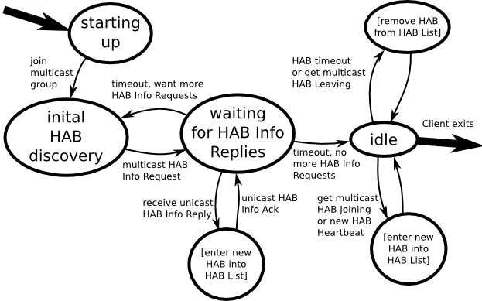
HAB List & Peer Discovery: Client State Diagram
Notes:
state diagrams are messy, sorry
this is a complicated protocol, no easy way to show it
for full details, see the Design Document
Much of the complexity comes from trying to provide reliability and performance in the face of network disruptions

Slide 37
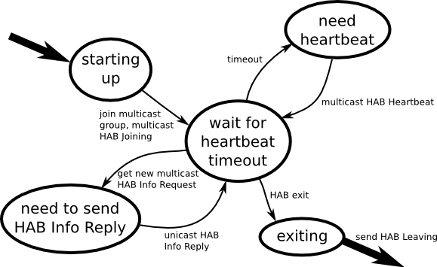
HAB List & Peer Discovery: HAB State Diagram

Slide 38
HAB List & Peer Discovery
Or just use mDNS/DNS-SD?

Slide 39
Bionet over Unicast
One connection per Client/HAB pair
All Client's subscriptions multiplexed
One symmetric key per connection
TCP or AMS
High network usage, high latency
More reliable!
Wildcards in HAB
Prepositioned subscriptions
Notes:
Bionet 2 over unicast is very much like the old bionet, with the HABs (library) taking over much of the NAG's responsibilities
addition of security

Slide 40
Bionet over Unicast: Initial Connection
Client connects to HAB
Client resents pub key & proof of identity
HAB provides a symmetric key for this connection
Notes:
HAB caches client pub key, used later for authorization

Slide 41
Bionet over Unicast: Node List Subscription
Client sends Node List Subscription Request
  Node ID pattern
HAB verifies authorization
Initial Node List by New Node messages
  New Node message fully describes the Node
  includes all Resources and Streams
Updates by New Node & Lost Node message
Client sends Node List Unsubscription Request

Slide 42
Bionet over Unicast: Resource Subscription
Client sends Resource Subscription Request
  Node ID pattern
  Resource ID pattern
HAB verifies authorization
Initial Resource Values by Resource Update messages
  Node ID
  Resource ID
  Resource Value and Timestamp
Updates by Resource Update message
Client sends Resource Unsubscription Request

Slide 43
Bionet over Unicast: Resource Setting
Client sends Resource Setting Request
  Node ID
  Resource ID
  Resource Value
HAB verifies authorization
HAB sends command to the proper end-point device

Slide 44
Bionet over Unicast: Streams
Streams come in two flavors
  Producers
  Consumers
Client sends Stream Connection Request
  Node ID
  Stream ID
HAB verifies authorization
HAB sends Stream Connection Accepted
  Delivery Vector
  Symmetric Key

Slide 45
Bionet over Multicast
One multicast group per subscription topic
One symmetric key per multicast group
UDP
Low network usage, potentially low latency
Less reliable!
No wildcards in HAB (handled by Client lib)‏
No prepositioned subscriptions

Slide 46
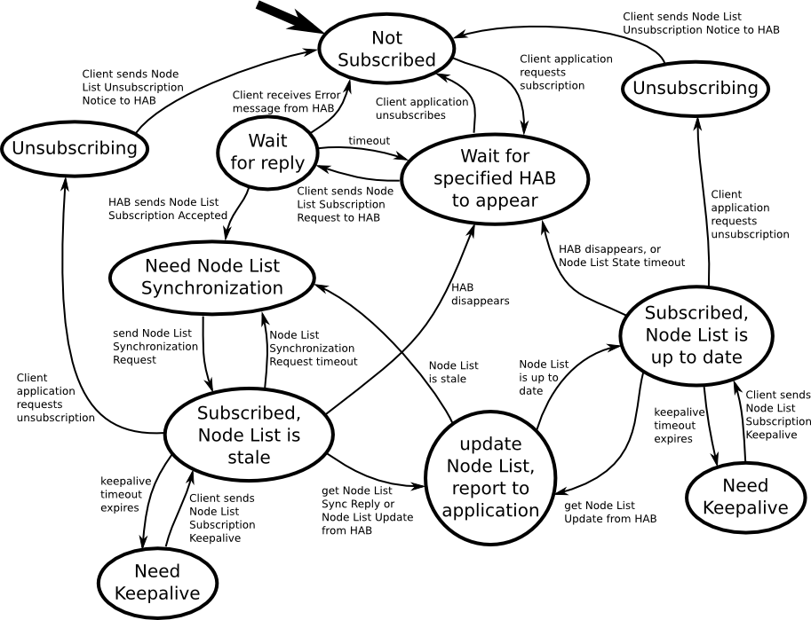
Bionet over Multicast: Node List Subscription
Client State Diagram
Notes:
worst one, promise!
complexity improves reliability
node list is important, without it clients can't access resources & streams
state sync, retransmissions, keepalives

Slide 47
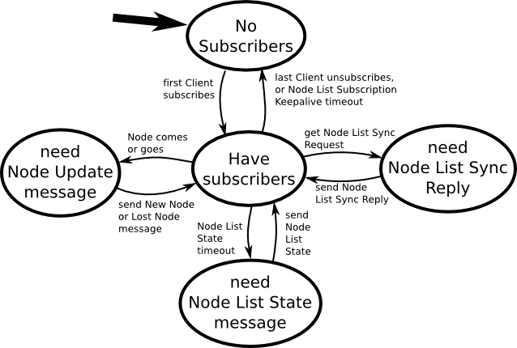
Bionet over Multicast: Node List Subscription
HAB State Diagram

Slide 48
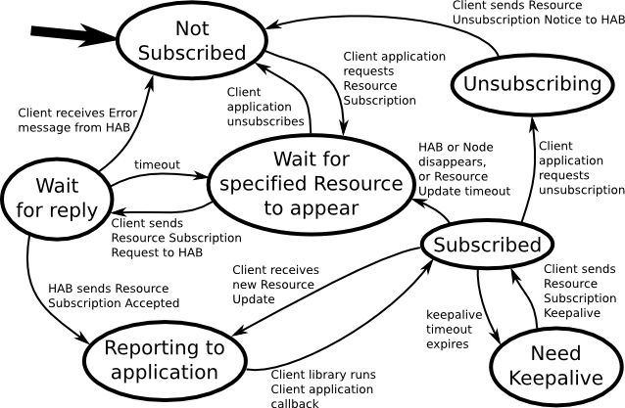
Bionet over Multicast: Resource Subscription
Client State Diagram

Slide 49
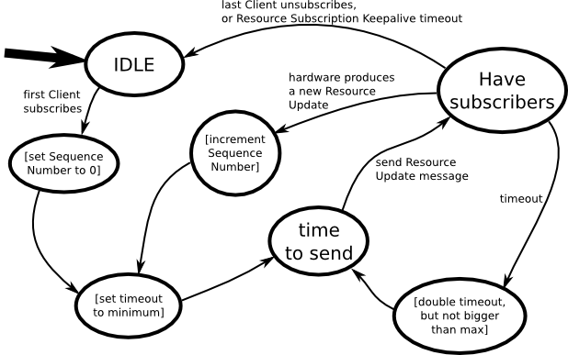
Bionet over Multicast: Resource Subscription
HAB State Diagram
Notes:
Sequence numbers prevent duplicate delivery in client

Slide 50
Bionet over Multicast: Resource Setting
Just like over Unicast
Client sends Resource Setting Request
  Node ID
  Resource ID
  Resource Value
HAB verifies authorization
HAB sends command to the proper end-point device

Slide 51
Bionet over Multicast: Streams
Just like Unicast
Streams come in two flavors
  Producers
  Consumers
Client sends Stream Connection Request
  Node ID
  Stream ID
HAB verifies authorization
HAB sends Stream Connection Accepted
  Delivery Vector
  Symmetric Key

