Slide 1
The Trap of std::map
Lenny Maiorani
http://github.com/ldm5180/map_trap

Slide 2
Current state of the map art
Java
Python
Go
Notes:
Let’s eval the maps that come to mind in different languages.
Quick overview:
VM-based compiled language
Interpreted language
New lang compiled to machine code

Slide 3
Properties of std::map
Sorted by keys
0(log n) insertion, deletion, lookup
Heap allocated value_type
Red-black tree

Slide 4
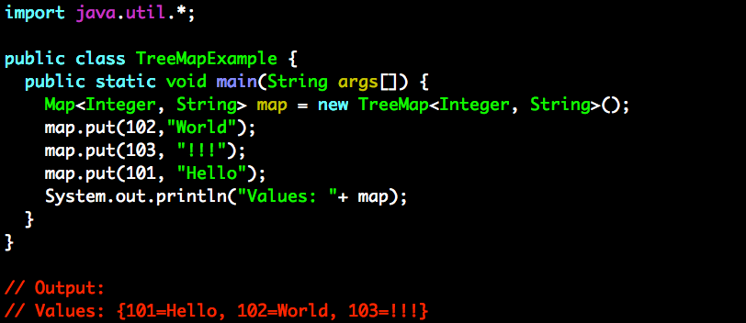
Java Maps
HashMap
TreeMap
SortedMap
LinkedHashMap
Notes:
Map is just an interface
Implementations…
Most people think of HashMap, TreeMap, SortedMap, Hashtable
HashMap is unsorted
TreeMap is r/b tree, just like C++ std::map
SortedMap (just a specialization)
LinkedHashMap (flavor of HashMap)

Slide 5
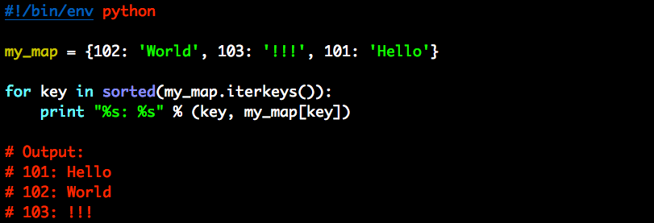
Python Maps
dict
collections.OrderedDict
Notes:
Dict is the only language type.
Collections module contains an orderedDict.
Sound promising
It is ordered by insertion, not by key

Slide 6
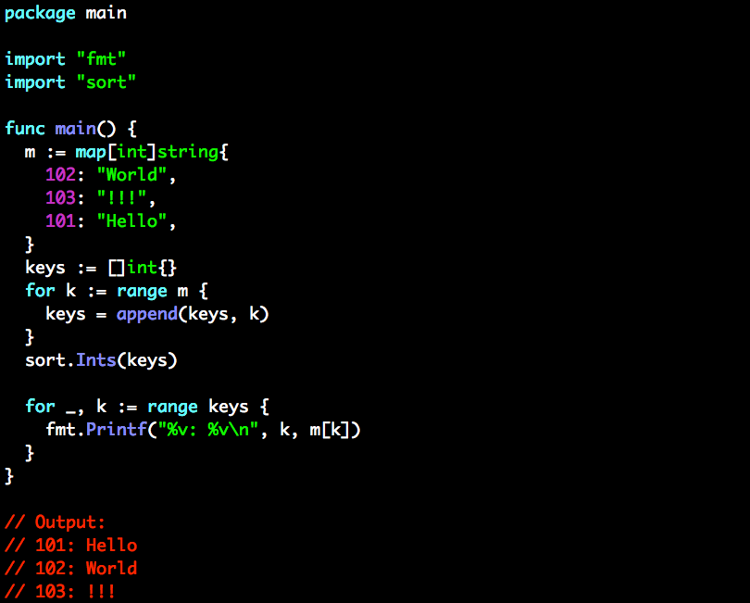
Go Maps
map
Notes:
Go has a hash-table map only.

Slide 7
Possible Language Survey Conclusions
On-demand key sorting is free?
Key-sorted maps only belong in bloated langs?
Data-driven implementations are easy?
Notes:
Since languages don’t even support it, is that because when sorting is needed it is so easy to implement that providing a generic solution is not worth the language maint cost?

Slide 8
Sorting Benchmark Hypotheses
Insert/remove into a std::map has fine perf at O(log n) complexity
Finding a mapped value in a std::map is efficient at O(log n) complexity
Sorted iteration over std::map complexity O(1) is excellent

Slide 9
Sorting Benchmarks
Notes:
Baseline map
Logarithmic

Slide 10
Sorting Benchmarks
Notes:
X-Axis is logarithmic, let’s do the same with the Y
Nice clean linear line. Goes along with O(log n) std::map insertion complexity

Slide 11
Sorting Benchmarks
Notes:
Naïve look at std::unordered_map
Insert into unordered map and the keys into a vector so that they can be sorted on-demand when the ordering is needed
Slope is different because insertion is “amortized O(1)”

Slide 12
Sorting Benchmarks
Notes:
Maybe it always needs to be sorted though. Sorting the vector on every insert, still better than std::map
Slope is worse than not sorting keys, because complexity is “amortized O(1) + O(N * (log n))” of the sort
What about a more exotic map?

Slide 13
Sorting Benchmarks
Notes:
Better for small maps, but insertions get expensive as the map grows. This makes sense since the complexity is O(log n), but the constant factor must be larger than that of std::map.
Notice the slope changes between 32k and 64k? That is the size of my CPU cache. Old Core I-7 with 256 kB cache per core. 32k * 16 bytes per value mapped = 256 kB!

Slide 14
Sorting Benchmark Hypotheses
Insert/remove into a std::map has fine perf at O(log n) complexity
Finding a mapped value in a std::map is efficient at O(log n) complexity
Sorted iteration over std::map complexity O(1) is excellent

Slide 15
Sorting Benchmarks
Notes:
Probably don’t just do insertions. You want to find things, right?
Predictions on unordered map?

Slide 16
Sorting Benchmarks
Notes:
How about predictions for flat_map?

Slide 17
Sorting Benchmarks
Notes:
Unordered map is nearly flat.
Flat_map seems to show a negative slope change from 32k to 64k.
More info?

Slide 18
Sorting Benchmarks
Notes:
Linear scale for the Y-Axis shows the same.
Digging into this, it makes sense.
Data access in unordered map is essentially random. Compute hash and then go to bucket and traverse. CPU cannot predict the bucket, so the memory pages needed get evicted.
Extending this graph, shows this bump, and slowly increasing as more and more often the bucket you want to outside the cache. Bumps happen at every additional page of memory needed
Understanding flat map requires understand the problem in std::map. Every element is individually allocated on the heap and added to a tree.
Flat_map is just a decorator on a vector. Elements are contiguous. Even memory pages are contiguous.
Lookups in std::map have O(log n) complexity in number of instructions, but causes cache thrashing. Practice does not result in O(log n).
Flat_map gets much closer because the binary search performed on the vector zooms in on a single page quickly. Provides almost the promise of O(log n)!
Extending this map right shows the much slower growth of flat_map, but Google Benchmark has a hard time determining the stddev with confidence. Takes a long time to run, so I cut it here.

Slide 19
Sorting Benchmark Hypotheses
Insert/remove into a std::map has fine perf at O(log n) complexity
Finding a mapped value in a std::map is efficient at O(log n) complexity
Sorted iteration over std::map complexity O(1) is excellent

Slide 20
Sorting Benchmarks
Notes:
Predictions for on-demand sorting of unordered_map?

Slide 21
Sorting Benchmarks
Notes:
Slope is different. Looks like at some point these cross.

Slide 22
Sorting Benchmarks
Notes:
Ok, that that is looking like it will cross sooner. Predictions for flat_map?

Slide 23
Sorting Benchmarks
Notes:
Flat map really kills it. Again, this makes sense. It is simply iterating a vector. So is the unordered_map, but that has the iteration + lookup overhead. Flat_map can avoid the lookup.
Difference is that unordered_map must be sorted on-demand or pre-sorted.

Slide 24
Sorting Benchmark Hypotheses
Insert/remove into a std::map has fine perf at O(log n) complexity
Finding a mapped value in a std::map is efficient at O(log n) complexity
Sorted iteration over std::map complexity O(1) is excellent
Notes:
Need to really determine if the insert/remove is a necessary part of the business logic. Can we design for this problem?

Slide 25
Possible Language Survey Conclusions
On-demand key sorting is free?
Key-sorted maps are not useful?
“Just use std::vector” – Chandler Carruth Efficiency with Algorithms, Performance with Data Structures
Data-driven implementations are easy?
Notes:
Review our language survey
Chandler claims just use std::vector. For example, how about open addressing built on a vector. That does not make it sorted. He says “I don’t believe there is a problem in real software std::map solves effectively.” I agree. We have just seen that we can effectively beat std::map in our microbenchmarks.
Acknowledges that associative data structures are useful, but not the ones in the STL.

Slide 26
Key-sorted Usefulness
Sorted iteration
Finding upper/lower bounds
???
Notes:
Anybody have examples of applications that need this?

Slide 27
Stock Market Order Book
Terminology:
Bids and Offers (Request to buy and sell)
“Top” is the best bid/offer
(highest/lowest respectively)
Price levels are each price that has orders

Slide 28
Stock Market Order Book
Assumptions:
Most activity is near at “Top”
Price levels are sometimes removed completely

Slide 29
Over-Simplified “Ask” Book Demo
100 price levels
50% of new asks are at the top
Random distribution of non-top updates
Updates are add volume or remove price level
Determine add/remove based on percentage argument to benchmark
Find “best” by iterating from begin() to find a non-removed level (level with non-0 quantity value)

Slide 30
Over-Simplified “Ask” Book Demo
Notes:
When 1% of updates remove the price level, “top” is near begin()
Must traverse farther on average when likelihood of “remove” increases.

Slide 31
Over-Simplified “Ask” Book Demo
Notes:
Must sort after every update. Not sure if update is new top.
Sorts all 0 quantities to the end so no post-sort traversal is needed.
Other tricks for speeding this one:
Cache the sorted data and re-sort only the updated element
Only copy to vector for sorting non-0 quantity elements
Etc…

Slide 32
Over-Simplified “Ask” Book Demo
Notes:
Flat_map’s contiguous iteration blows everything else away. Zoom in

Slide 33
Over-Simplified “Ask” Book Demo
Notes:
Demo is nice and clean within a single memory page and not blowing the cache.
Often the problem with these micro-benchmarks. Real-world situation might have more cache pollution from other activities of the application

Slide 34
Over-Simplified “Ask” Book Demo
Notes:
This is a completely unrealistic size, but does show cache problem.
Are there other options for optimization?
Remove/insert elements as they change? Bad because inserts are bad, remember?
Cache the index of the top?

Slide 35
Possible Language Survey Conclusions
On-demand key sorting is free?
Key-sorted maps are not useful?
“Just use std::vector” – Chandler Carruth Efficiency with Algorithms, Performance with Data Structures
Data-driven implementations are easy?
Notes:
Review our language survey
From this description, sorted maps look really useful.

Slide 36
Possible Language Survey Conclusions
On-demand key sorting is free?
Key-sorted maps are not useful?
“Just use std::vector” – Chandler Carruth Efficiency with Algorithms, Performance with Data Structures
Data-driven implementations are easy?
Notes:
But DD is not easy. Look at all the things we have just considered:
Algos for doing less work
Data structures for increasing CPU cache performance
Caching results in our application

Slide 37
Possible Language Survey Conclusions
On-demand key sorting is free?
Key-sorted maps are not useful?
“Just use std::vector” – Chandler Carruth Efficiency with Algorithms, Performance with Data Structures
Data-driven implementations are easy?

Slide 38
Ban std::map
[sorted] Associative containers are useful
std::map is a misleading name (std:ordered_map)
Performance is bad for known problem sets

Slide 39
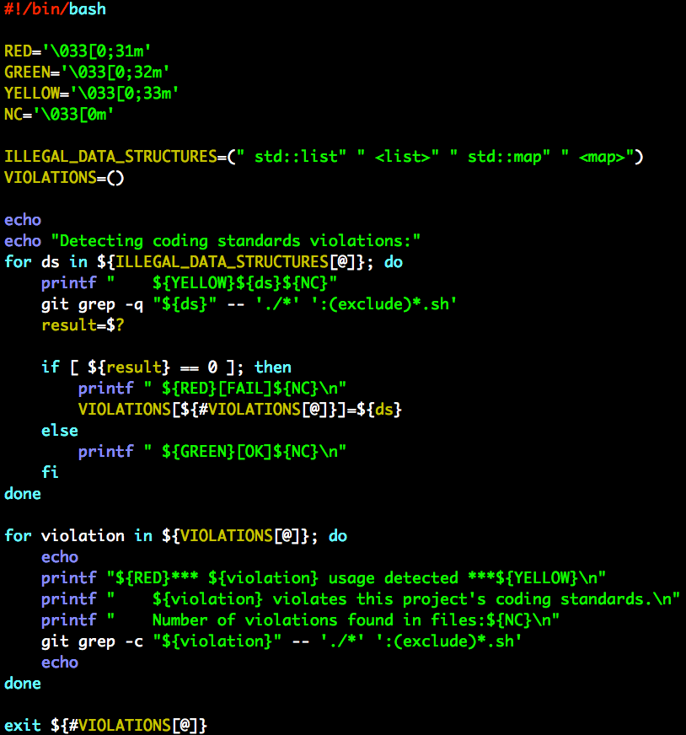
Call to Action
Notes:
I assume you already do not permit std::list. Let’s enforce that, along with std::map.
Add this script to your CI system.

