Slide 1


DATA PROJECT 1: SALE ANALYTICS WITH PYSPARK ON MICROSOFT AZURE DATABRICKS
CREATED BY: Le Duc Nguyen (Nick)

Slide 2
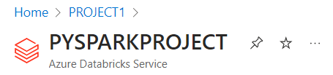

PROJECT SUMMARY
Utilize Microsoft Azure to establish Databricks environments for conducting data analytics on product sales. This project is named as PYSPARKPROJECT.

Slide 3
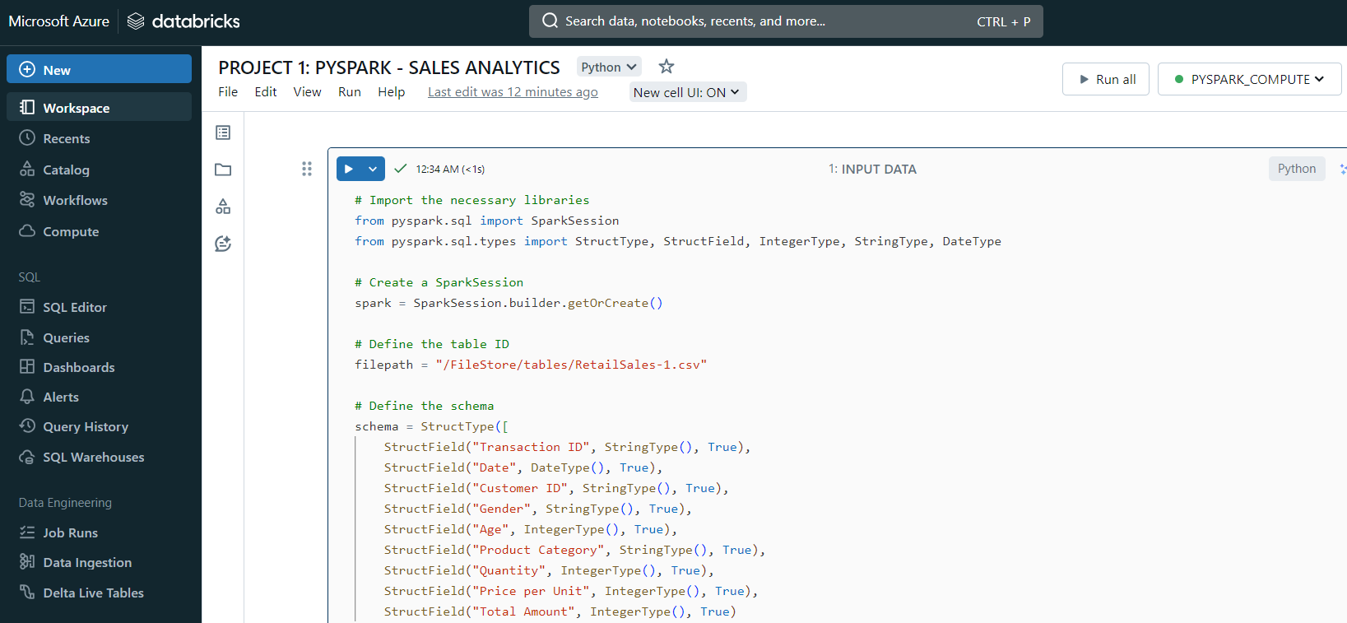
USE PYSPARK LIBRARY ON DATABRICKS

Slide 4
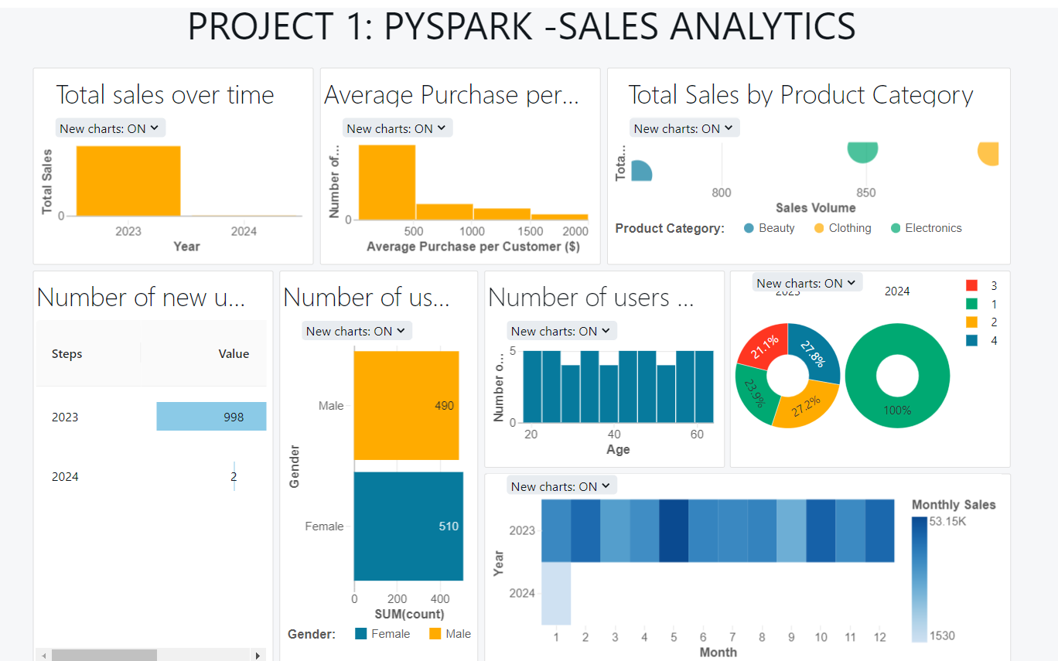
CREATE DASHBOARD

Slide 5
DATA INPUT
 | Type | Example
Transaction ID | String | 1
Date | Date | 2023-11-24
Customer ID | String | CUST001
Gender | String | Male
Age | Integer | 34
Product Category | String | Beauty
Quantity | Integer | 3
Price Per Unit | Integer | 50
Total Amount | Integer | 150
Data source:
https://app.gigasheet.com/spreadsheet/retail-sales-dataset/cc4d3a1e_496a_42f2_9fa7_af97646479d5
DERIVE
Month | Quarter | Year

Slide 6
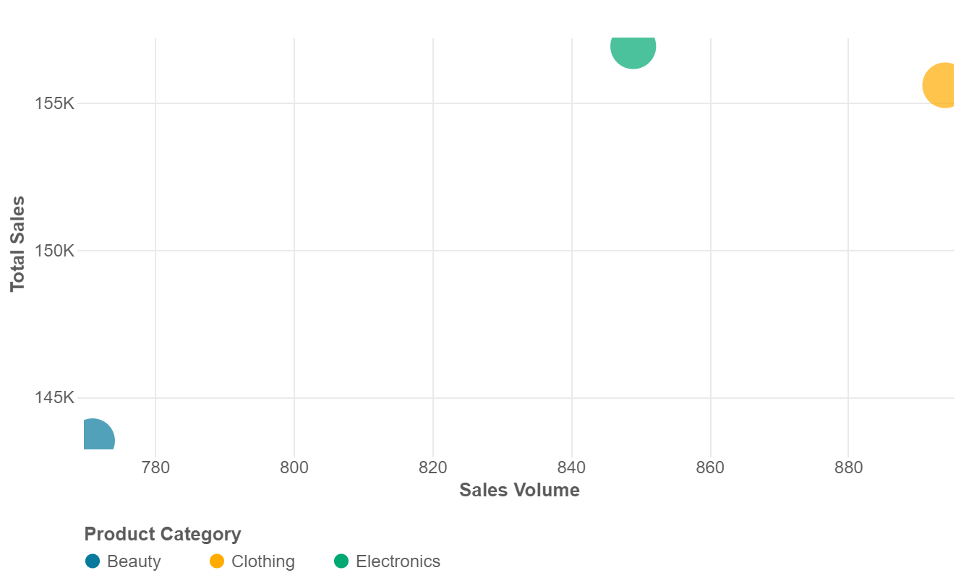
SALES KPI
 | Description
Total Sales | sum of the total amount from all sales transactions
Sales Volume | sum of the quantity of units sold
Total Sales and Sales Volume by Product Category

Slide 7
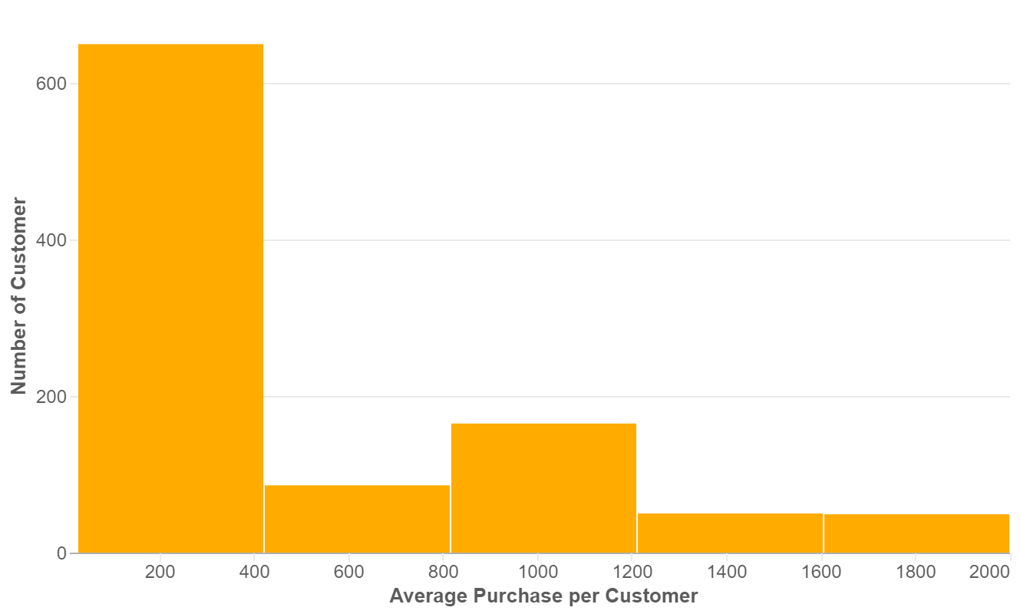
CUSTOMER KPI
Number of Customer
Average purchase per customer
Customer demographics (age, gender)
Average purchase per Customer

Slide 8
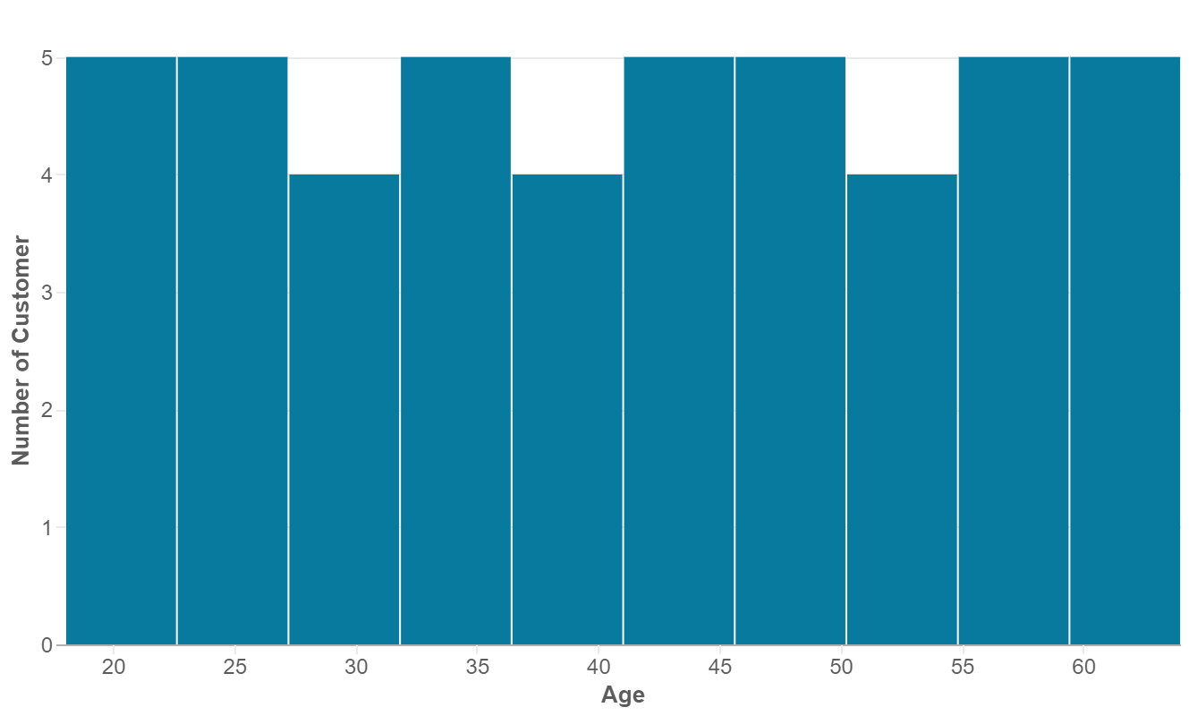
CUSTOMER KPI
Number of Customer
Average purchase per customer
Customer demographics (age, gender)
Number of customer by Age group

Slide 9
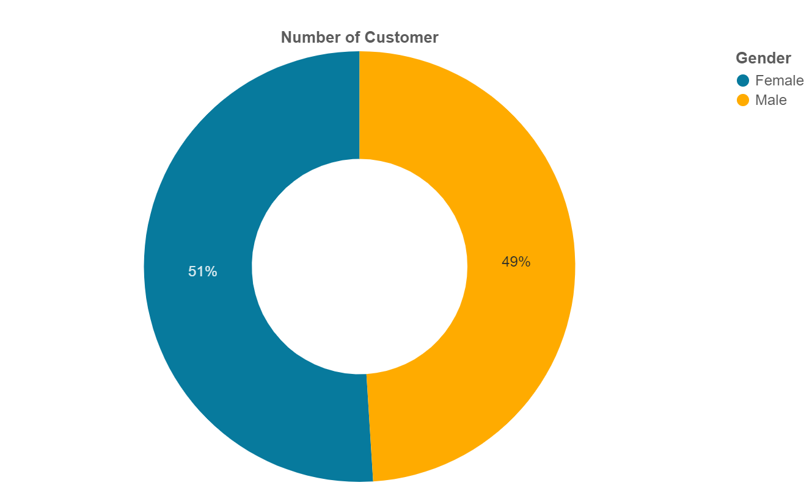
CUSTOMER KPI
Number of Customer
Average purchase per customer
Customer demographics (age, gender)
Number of customer by Gender

Slide 10
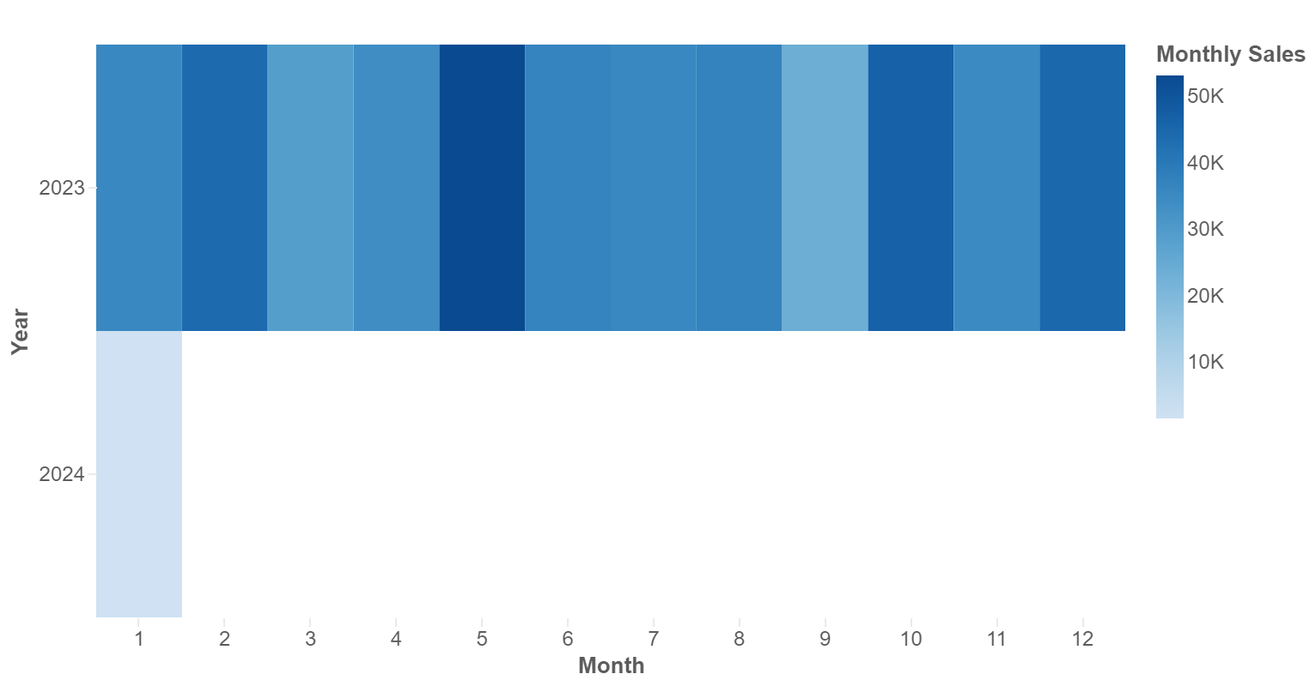
SALES BY TIME
Monthly sales
Quarterly sales
Monthly Sales over time

Slide 11
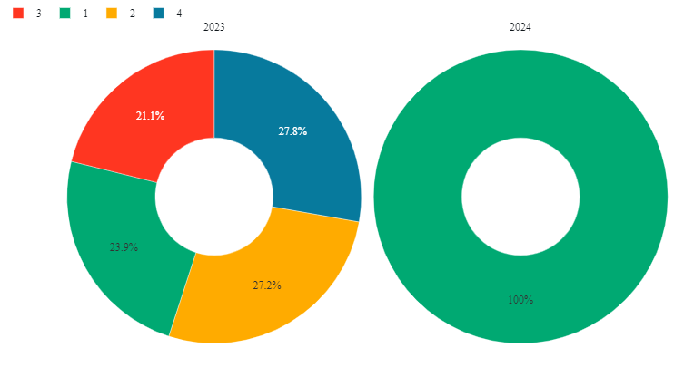
SALES BY TIME
Monthly sales
Quarterly sales
Quarterly Sales over time

Slide 12
THANK YOU FOR YOUT ATTENTION !

