Slide 1
Let your Devices talk to each other
A P2P database synchronisation example

Slide 2

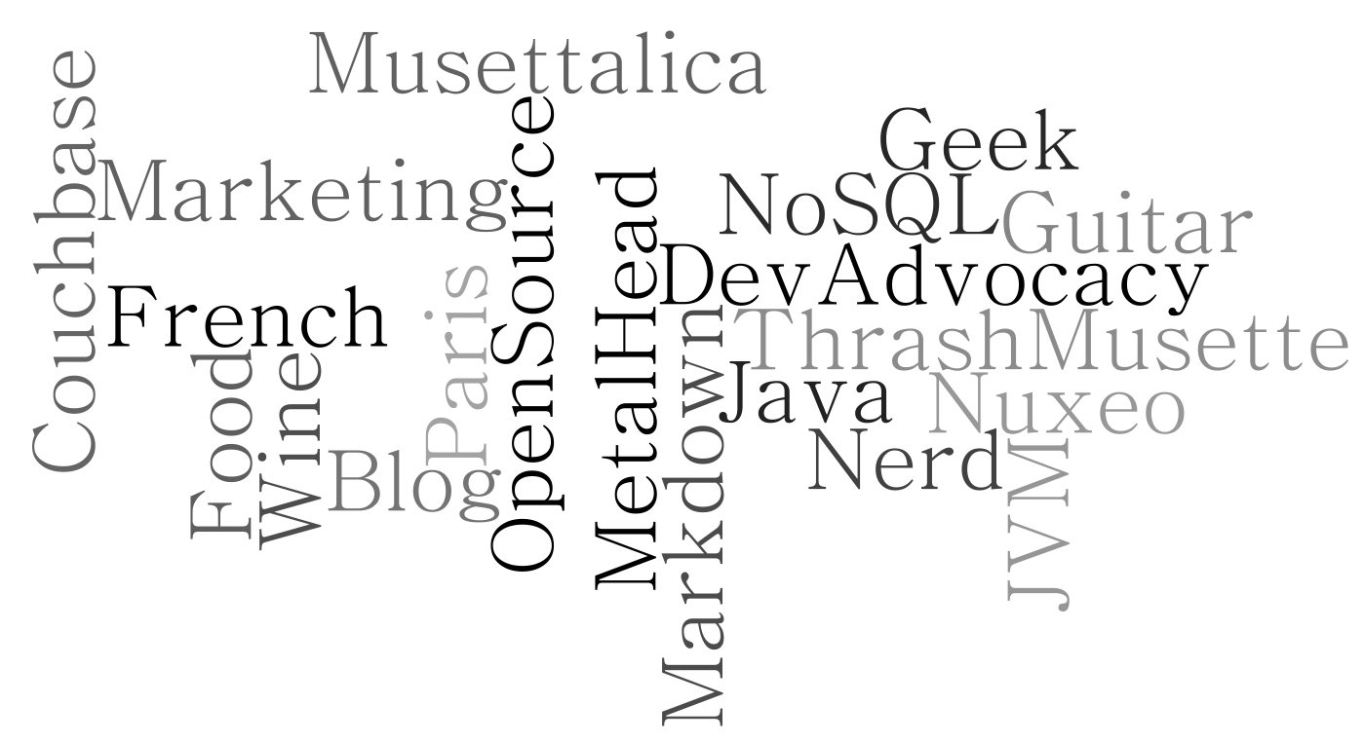
$whoami
Laurent Doguin
Couchbase Developer Advocate
@ldoguin | laurent.doguin@couchbase.com
2

Slide 3
Internet of Things
Notes:
Slide 6 - What is the business problem?

Slide 4
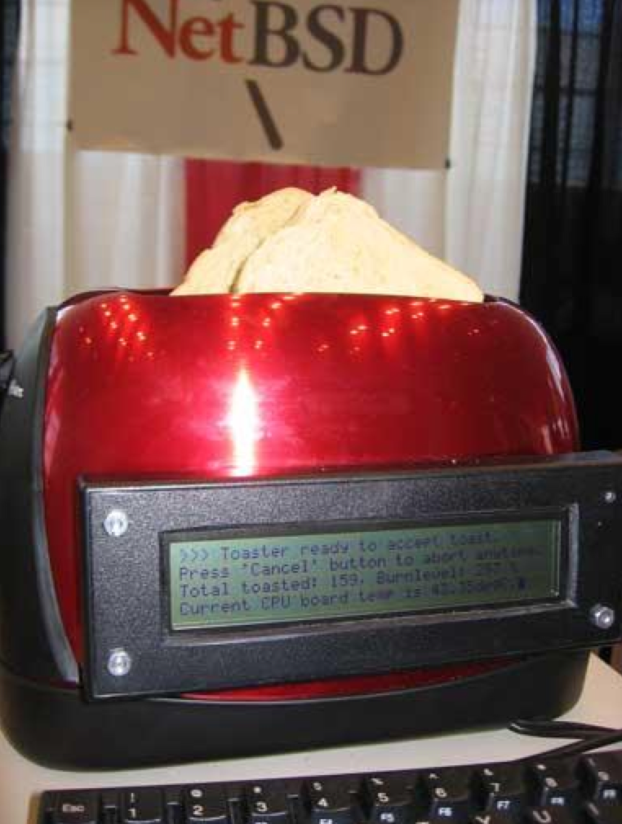
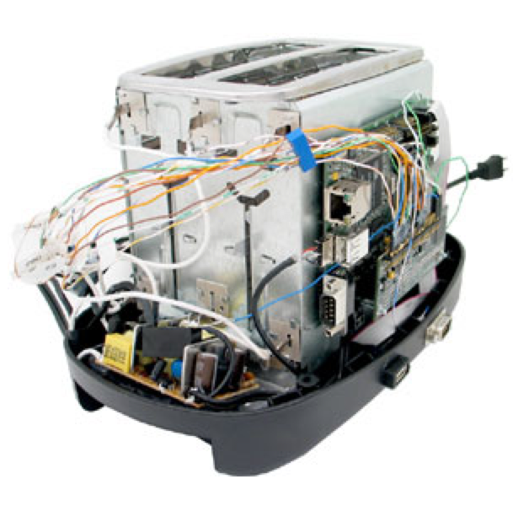
Ancestor of All the Things
https://www.embeddedarm.com/software/arm-netbsd-toaster.php
Notes:
Slide 8 - How does this affect what people think about your app?

Slide 5
http://www.internetofuselessthings.io/

Slide 6
IoT?
Usually refers to connected devices/sensors
Getting some Data from these objects
Sending them to the Cloud
-> not really your data anymore
Centralized
Notes:
Slide 12 - What does this mean for your apps?

Slide 7
Machine 2 Machine
Notes:
Slide 6 - What is the business problem?

Slide 8
M2M?
The capability of two or more machines to discuss together and take actions
Older than IoT
Decentralized by essence
Common in the industrial world
Notes:
Slide 12 - What does this mean for your apps?

Slide 9



How to connect to peers on a Network?
Enter their IP address manually
Make that automatic for instance with a QR code scan
Using Automatic Discovery
Apple Bonjour (ex RendezVous) based on ZeroConf
Android NSD
Avahi
JmDNS
Are all based on mDNS/DNS-SD
UPnP based on SSDP
Notes:
UPnP Universal Plug And Play
SSDP Simple Service Discovery Protocol

Slide 10
What’s a Couchbase Dev Advocate doing here?
Notes:
Slide 6 - What is the business problem?

Slide 11
No Bars? What would be the problem?
Notes:
Slide 6 - What is the business problem?

Slide 12
Today’s Mobile Apps
No Internet
Try again later.
please wait…
Notes:
Slide 7 - Today’s Mobile Apps

Slide 13
How does this affect what people think about your app?
How does this affect what people think about your app?
Doesn’t work a lot of the time and when it does it’s slow.
Notes:
Slide 8 - How does this affect what people think about your app?

Slide 14
How does this affect application uninstall rates?
How does this affect application uninstall rates?
Source: uSamp
Notes:
Slide 9 - How does this affect application uninstall rates?

Slide 15
Data Location is the Problem
Notes:
Slide 10 - Data Location is the Problem

Slide 16
Local Data + Sync is the Solution
Notes:
Slide 11 - Local Data + Sync is the Solution

Slide 17
What does this mean for your apps?
What does this mean for your apps?
Always work both online & offline
Always be blazing fast
Built with orders of magnitude less code
Users will absolutely love your apps
Notes:
Slide 12 - What does this mean for your apps?

Slide 18
What is Couchbase Mobile

Slide 19
Couchbase Lite
Sync Gateway
Notes:
Slide 14 - Couchbase Lite and Sync Gateway

Slide 20


Couchbase Lite
NoSQL mobile database.
Runs in-process.
Small footprint.
Notes:
Slide 15 - 4 Key Areas

Slide 21
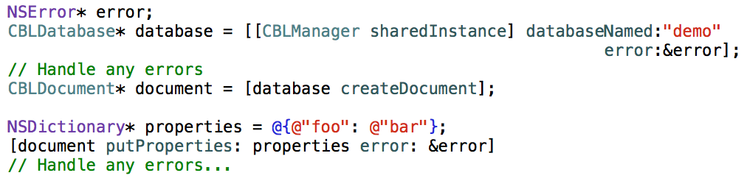
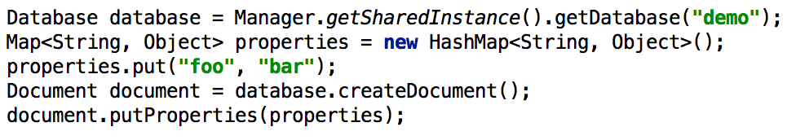
Notes:
Slide 17 - Let’s take a quick peak at some code

Slide 22
Sync Gateway
Authentication
Authorization
Data orchestration
Notes:
26. Sync Gateway

Slide 23
Notes:
27. Couchbase Mobile Stack

Slide 24
Sync Function
requireUser (username)
requireRole (rolename)
requireAccess (channels)
Notes:
28. Sync Function

Slide 25
Sync Function
channel (name)
access (username, channelname)
role (username, rolename)
Notes:
29. Sync Function

Slide 26
Couchbase Lite Listener

Slide 27
Couchbase Lite Listener
Couchbase-lite-listener
Embedded lightweight HTTP server
Optional package
Same Replication Interface as Sync Gateway
Setup Replication links
To any other running Couchbase Lite Listener
Notes:
Slide 12 - What does this mean for your apps?

Slide 28
Message App Native and Android
https://github.com/ldoguin/couchbase-messages-p2p-sample

Slide 29
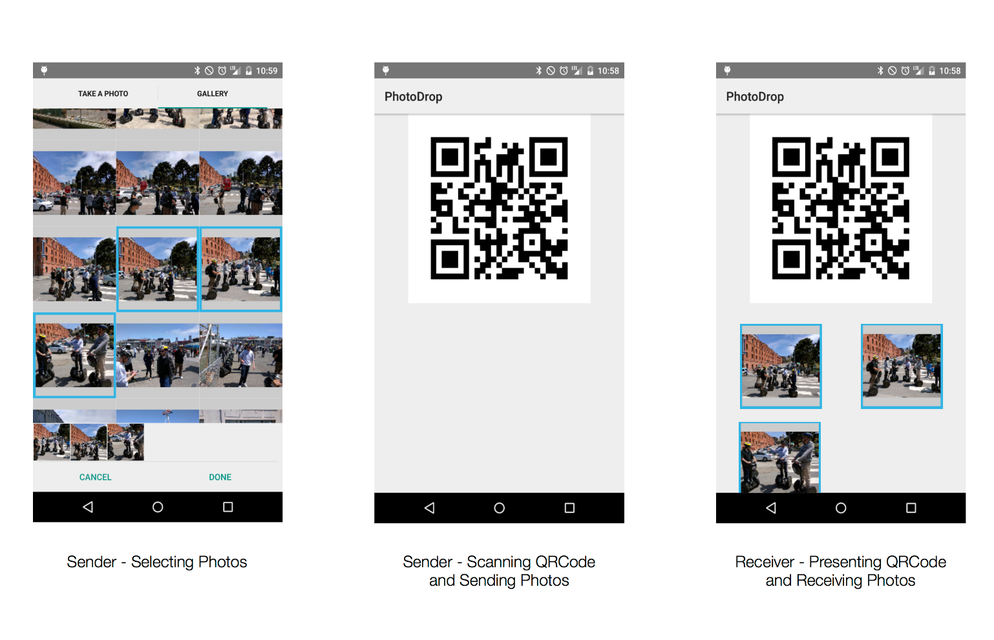
Photodrop sample app
https://github.com/couchbaselabs/photo-drop

Slide 30
Forums
http://forums.couchbase.com

Slide 31
Hack
http://bit.ly/mini-hack

Slide 32
Questions ?

Slide 33
Thank You!

